Slide 1
OMICS Journals are welcoming Submissions
OMICS International welcomes submissions that are original and technically so as to serve both the developing world and developed countries in the best possible way.
OMICS Journals are poised in excellence by publishing high quality research. OMICS International follows an Editorial Manager® System peer review process and boasts of a strong and active editorial board.
Editors and reviewers are experts in their field and provide anonymous, unbiased and detailed reviews of all submissions.
The journal gives the options of multiple language translations for all the articles and all archived articles are available in HTML, XML, PDF and audio formats. Also, all the published articles are archived in repositories and indexing services like DOAJ, CAS, Google Scholar, Scientific Commons, Index Copernicus, EBSCO, HINARI and GALE.
For more details please visit our website: http://omicsonline.org/Submitmanuscript.php

Slide 2
Imaging atherosclerosis
Dr. Christopher Lai
The Hong Kong Polytechnic University

Slide 3
My research profile
Imaging Atherosclerosis
Identification of new imaging probes
Radiation Protection
Upper limb functional imaging related to daily activities

Slide 4
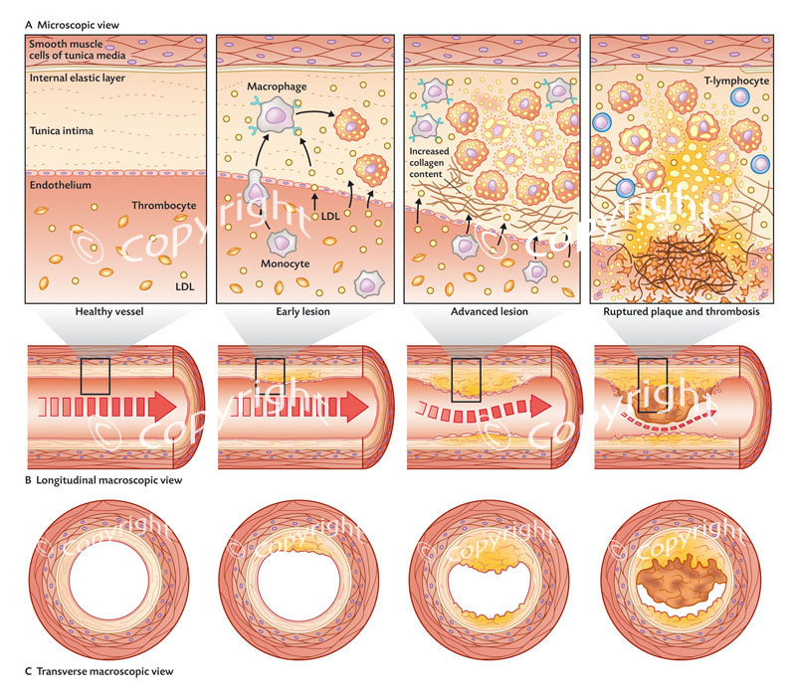
Coutesy: D.J. Maizels/Gyldendal Akademisk, 2011

Slide 5
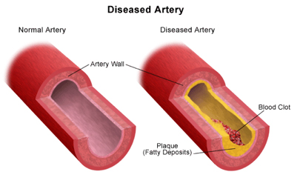
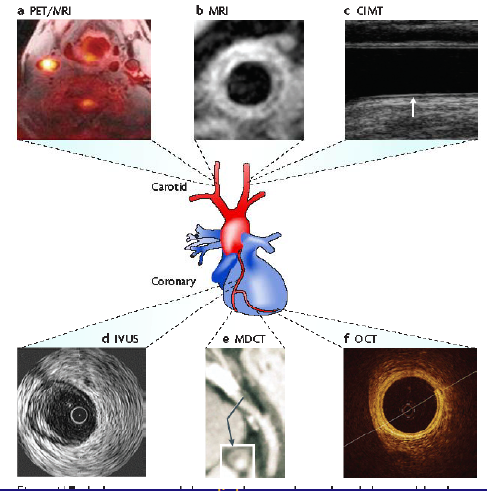
Clinical detection of plaque and stenosis
Lindsay and Choudhury, Nature Rev Drug: Disc 7: 517 2008

Slide 6
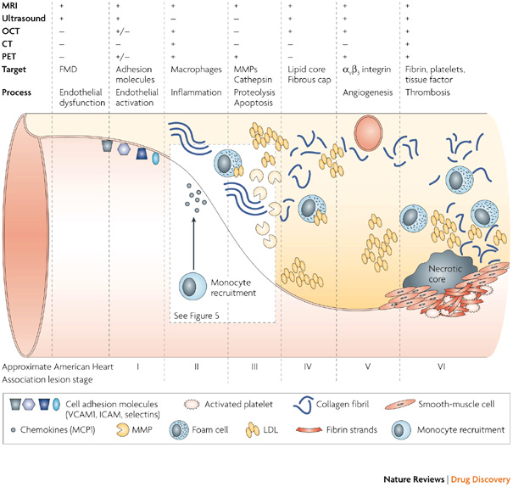
Pre-clinical and sub-clinical detection of atherosclerosis
Notes:
My focus of imaging tools is US and MRI because…..

Slide 7
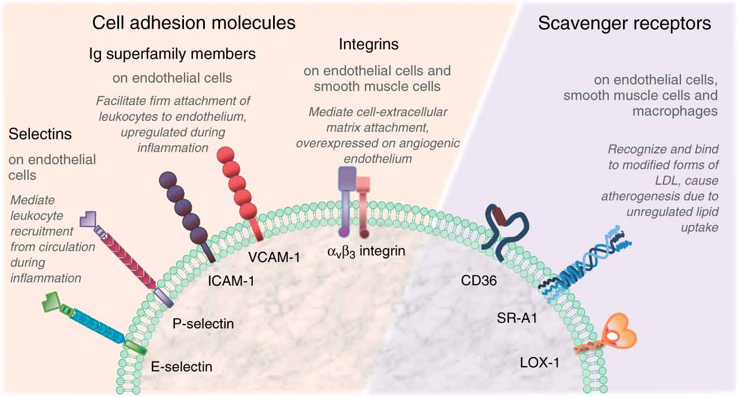
Impaired Endothelial cells encourage the secretion of various molecules
A glycoprotein involved in haemostasis
Von willebrand factor (Mannucci PM et al, 1998)
Markers of Inflammations
C-reactive protein
Cytokines
Upregulated adhesion molecules and selectin
Intracellular adhesion molecule-1 (ICAM-1)
Vascular cell adhesion molecule-1 (VCAM-1)
E- or P- Selectin
Notes:
These molecules can be detected in peripheral blood and can be used as potential markers of atherosclerosis
Von willebrand factor, a glycoprotein involved in haemostasis and produced by endothelial cells is one of the earliest surrogate markers associated with ED.
Although markers of inflammation such as C-reactive protein and cytokines and increased expression of adhesion molecules such as intracellular adhesion molecule-1 (ICAM-1), vascular cell adhesion molecule-1 (VCAM) and selectin have been found to be elevated in atherosclerosis ,
they are relatively non-specific and may be increased in inflammatory conditions other than atherosclerosis which have limited their usage as surrogate markers for ED in clinical setting
* VCAM upregulated prior to clinical manifestation.

Slide 8
Vascular endothelium
In response to various
insults (oxidative stress)
promote endothelial dysfunction
Vasomotor tone
Thrombosis
Haemostasis
Initiate step in atherosclerosis
coronary arteries
peripheral conduit arteries
ED found important
advanced atherosclerosis subjects
asymptomatic subjects
Notes:
In response to various insults such as exposure to hyperension, endothelial cells will secrete various molecules that can promote inflammation, haemostasis and atherosclerosis.
Vascular endothelium actually takes many roles in the autoregulatory processess within our body and I just highlight 3 of them here: they are………..
Vasoconstriction vasodilatation
Regulate inflammatory process such as haemostasis and thrombosis

Slide 9
Forearm blood flow (Strain-gauge plethysmography)
1990: Panza and co-workers
Resistance vessel reactivity in response to pharmacological or physiological stimuli
FBF is measured by temporarily occluding the venous return (by a cuff inflated to 40 mmHg) and measured the slight swelling of the distal portion of the limb due to pharmacological or physiological stimuli
Notes:
Strain-gauge venous occlusion plethysmography method was first described by Panza and co-workers in 1990 when it was introduced as a new technique to study resistance vessel reactivity in response to pharmacological or physiological stimuli. (Panza JA et al, 1990) This technique can detect ED with good sensitivity and specificity, but is relatively invasive and cannot examine large vessel physiology, which is more relevant to vascular disease.

Slide 10
Forearm blood flow (Strain-gauge plethysmography)
Benefits
good sensitivity and specificity
reproducible and less observer dependent
Drawback
relatively invasive
cannot examine large vessel physiology which is more relevant to vascular disease

Slide 11
Flow Mediated Dilation
Brachial flow-mediated dilation(FMD)
1989: Anderson and co-workers
a validated non-invasive measure of endothelial function
Surrogate Marker for CHD
measurement of changes up to 0.1mm in arterial diameter
Impaired FMD :
subjects with overt vascular disease
subjects with cardiovascular risk factors even in asymptomatic subjects
diabetic patients
Notes:
The Flow-mediated dilatation (FMD) method was developed as a surrogate marker for CHD.
Since Anderson and co-workers first used this technique in 1989 to measure the endothelial function non-invasively (Anderson EA et al, 1989), many advancements have been made which have allowed accurate measurement of changes up to 0.1mm in arterial diameter.
As a result, impaired FMD has been found not only in subjects with overt vascular disease, but also in subjects with cardiovascular risk factors, diabetic patients or even in asymptomatic subjects.

Slide 12
The Setup
Fatty streaks
Intimal thickening

Slide 14
Reactive Hyperemia
From Clifford et al. FASEB J. 24: 804.12, 2010.
Notes:
This diagram demonstrated that the resultant brachial blood flow in the artery is related to the duration of the forearm occlusion, the longer the occlusion duration, the larger blood flow induced in the brachial artery.

Slide 15
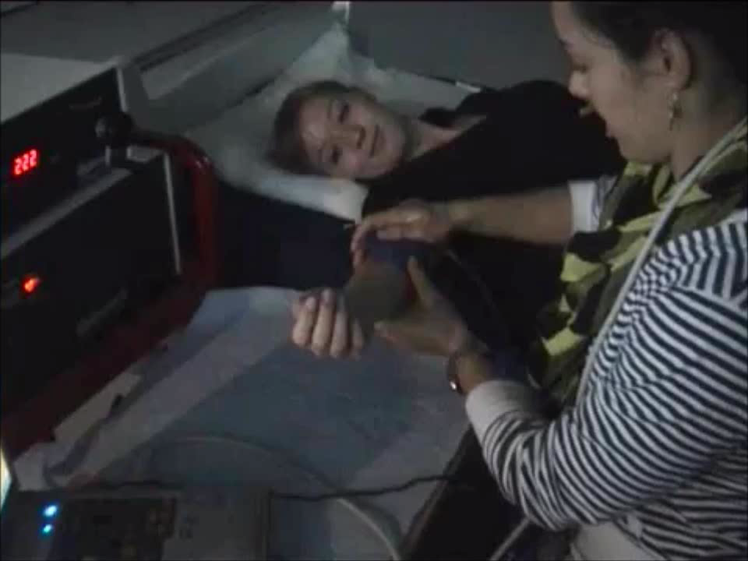
The Examination
Placement of Cuff at forearm
Locate the brachial artery by color flow and pulsed Doppler
Inflate and then deflate the cuff
Hyperemic flow generated
Monitor the lumen diameter continuously
Offline measurement with computer aids

Slide 16
Factors influence the resultant vessel dilatation
Shear Stress
Courtesy: Tousoulis D, et al, Heart 2005;91:353-358
Tousoulis, et al., Heart 2005; 91: 353-358.
Notes:
CPT = cold pressor stress test
MS=mental stress
eNOS=endothelial nitric oxide synthase
GC=guanylyl cyclase
L-NMMA= N^{G}-monomethyl-L-arginine
cGMP=cyclic guanosine-3,4-monophosphate

Slide 17
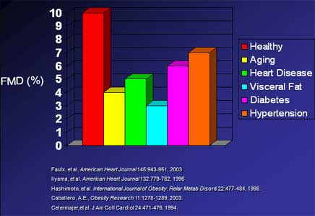
Factors induce vascular dilatation impairment
FMD was proposed as a new tests for evaluating endothelial function
Cost-effective, reproducible and standardization
Ability to predict risk and relationship to established tests of risk.
Can identify individual patients
predict a reduction in the risk of clinical events.
Useful as a screen for drug development.
Dysfunction in NO production in the endothelial cells (e.g. deficiency of NOS co-factor)
Over production of endogenous inhibitors of NOS
Reduced NO bioavailability
VSMC insensitivity to NO
Dysfunction of VSMC
Notes:
hyperaemic flow acts as a stimulus leading to synthesis of NO from L-arginine in endothelial cells by endothelial NO synthase (eNOS). NO then diffuses to VSMC and activates guanylate cyclase to synthesize cyclic guanosine-3,4-monophosphate (cGMP) causing subsequent vascular dilatation.(Vallance P and Chan N, 2001) As a result, reduced vascular dilatation may be due to dysfunction in NO production in the endothelial cells (e.g. deficiency of NOS co-factor) and/or over production of endogenous inhibitors of NOS and /or reduced NO bioavailability. In this regard, oxidative stress due to oxidized LDL can enhance NO destruction while advanced glycation endproduct (AGE) can quench NO. Apart from endothelial dysfunction, VSMC insensitivity to NO and dysfunction of VSMC can also lead to diminished vasodilatation

Slide 18
Research / clinical Application
FMD was proposed as a new tests for evaluating endothelial function (surrogate marker)
Cost-effective, reproducible and standardization
Ability to predict risk and relationship to established tests of risk.
Can identify individual patients
predict a reduction in the risk of clinical events.
Useful as a screen for drug development.

Slide 19
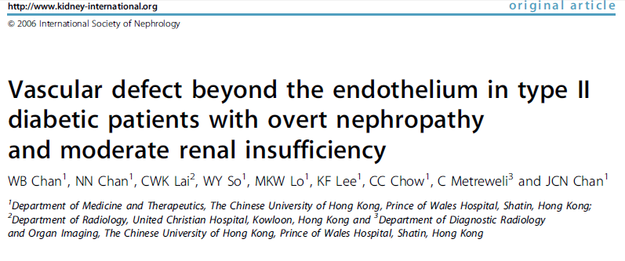
In Chinese subjects with type 2 diabetes, hyperglycaemia, hypertriglyceridemia, smoking and albuminuria were independent predictors for endothelial dysfunction
Type 2 diabetic subjects with overt nephropathy had impaired endothelium-dependent and endothelium-independent dilatation, suggesting vascular dysfunction beyond the endothelium.
In agreement with studies from Caucasians, smoking was the most important determinant for vascular dysfunction in Chinese type 2 diabetic patients with overt nephropathy.
Furthermore, FMD was predictive of new onset of cardiovascular events and related death in Chinese type 2 diabetic patients with overt nephropathy.

Slide 20
My study………………………
Recruitment
Invite those relatives of diabetes patients whom follow up at the diabetic mellitus and endocrine clinic at the Prince of Wales Hospital
at least 40 years old (middle-aged Chinese)
No previous diagnosis for diabetes
No previous diagnosis for any cardiovascular disease
Not taking any kind of long-term medications except hypertensive drugs

Slide 21
Demographic N=52
Age (y) | Male Sex | Height M) | Weight (Kg) | BMI
55y±8 | 32(62%) | 1.59±8.3 | 59.3±8.9 | 23.6±2.5
Waist Circumference (cm) | Hip Circumference (cm) | WHR | With regular exercise | Smoker
82.8±9.7 | 97.4±13.3 | 0.86±0.08 | 35 (67%) | 19 (37%)
Systolic BP (mmHg) | Diastolic BP (mmHg) | Mean BP (mmHg) | Hypertension
126 ± 21 | 83±10 | 98±13 | 6 (12%)
Total Cholesterol (mmol/L) | HDL-C (mmol/L) | LDL-C (mmol/L) | TG (mmol/L) | Glucose (mmol/L)
5.5±0.9 | 1.49±0.34 | 3.0±0.90 | 1.40±0.68 | 5.1±1.2

Slide 22
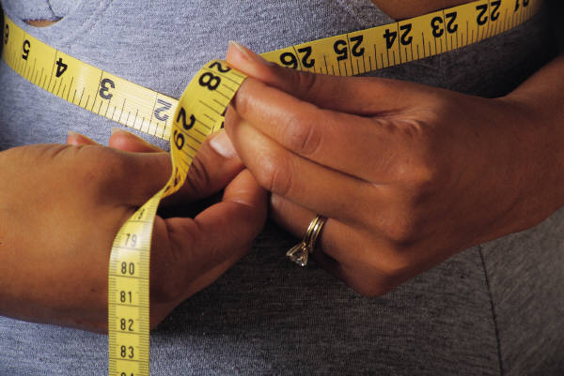
Measurement
Carotid Artery:
Intima-media Thickness (IMT)
Brachial artery:
Timed-averaged velocity (TAV)
% change in brahcial blood flow velocity
% change in brachial blood flow volume (Q)
Q=TAV(πr²)
FMD
% change in Lumen diameter

Slide 23
Results
Carotid IMT (mm) | 0.74±0.23
% change in Brachial blood flow Volume (%) | 554±195
Flow Mediated Dilation (FMD%) (endothelium dependant) | 4.54±2.26
Glycerin Tri-nitrate Induced Dilation (GTND%) (endothelium independent) | 14.3±3.77
FMD/GTND ratio | 0.32±0.15

Slide 24
Main findings
*=p<0.05, **=p<0.01
Spearman’s Correlation coefficients with FMD
Age | - 0.343*
Waist circumference | -0.363*
BMI | -0.313*
Carotid IMT | -0.349*
Systolic BP | -0.233
Diastolic BP | -0.143
Glucose | -0.290
TC | -0.290
HDL | 0.206
LDL | -0.127
TG | -0.529**
Notes:
Age and obesity is a matter
Structural changes and functional changes correlated well and quantified by US well

Slide 25
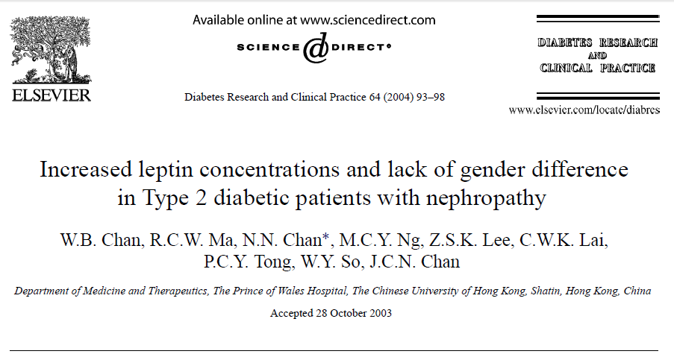
Leptin plays an important role in the regulation of body weight and energy balance
women have higher circulating leptin level than men.
However, the present study demonstrate that:
Serum leptin concentrations were higher in Type 2 diabetic patients with nephropathy than normoalbuminuric diabetic patients and controls.
Finding:
Diabetic men with nephropathy had proportionally higher serum leptin such that the gender difference in leptin observed in non-nephropathic individuals was abolished.
Notes:
Leptin (Greek leptos meaning thin) is a 16 kDa protein hormone that plays a key role in regulating energy intake and energy expenditure, including appetite and metabolism. It is one of the most important adipose derived hormones.^{[2]} The Ob(Lep) gene (Ob for obese, Lep for leptin) is located on chromosome 7 in humans.^{[3]}
Function
Leptin acts on receptors in the hypothalamus of the brain where it inhibits appetite by (1) counteracting the effects of neuropeptide Y (a potent feeding stimulant secreted by cells in the gut and in the hypothalamus); (2) counteracting the effects of anandamide (another potent feeding stimulant that binds to the same receptors as THC), and (3) promoting the synthesis of α-MSH, an appetite suppressant. This appetite inhibition is long-term, in contrast to the rapid inhibition of eating by cholecystokinin (CCK) and the slower suppression of hunger between meals mediated by PYY3-36. The absence of leptin (or its receptor) leads to uncontrolled food intake and resulting obesity. Several studies have shown that fasting or following a very-low-calorie diet (VLCD) lowers leptin levels.^{[8]} It might be that, in the short-term, leptin is an indicator of energy balance. This system is more sensitive to starvation than to overfeeding; leptin levels change more when food intake decreases than when it increases.^{[9]} It might be that the dynamics of leptin due to an acute change in energy balance are related to appetite and eventually to food intake. Although this is a new hypothesis, there are already some data that support it.^{[10][11]}
Inflammatory marker
Factors that acutely affect leptin levels are also factors that influence other markers of inflammation, e.g., testosterone, sleep, emotional stress, caloric restriction, and body fat levels. While it is well-established that leptin is involved in the regulation of the inflammatory response,^{[45][46][47]} it has been further theorized that leptin's role as an inflammatory marker is to respond specifically to adipose-derived inflammatory cytokines.
In terms of both structure and function, leptin resembles IL-6 and is a member of the cytokine superfamily.^{[1][46][48]} Circulating leptin seems to effect the HPA axis, suggesting a role for leptin in stress response.^{[49]} Elevated leptin concentrations are associated with elevated white blood cell counts in both men and women.^{[50]}
Similar to what is observed in chronic inflammation, chronically-elevated leptin levels are associated with obesity, overeating, and inflammation-related diseases including hypertension, metabolic syndrome, and cardiovascular disease. However, while leptin is associated with body fat mass, the size of individual fat cells, and the act of overeating, it is interesting that it is not affected by exercise (for comparison, IL-6 is released in response to muscular contractions). Thus, it is speculated that leptin responds specifically to adipose-derived inflammation.^{[51]} Leptin is a pro-angiogenic, pro-inflammatory and mitogenic factor, the actions of which are reinforced through crosstalk with IL-1 family cytokines in cancer. ^{[52]}
Taken as such, increases in leptin levels (in response to caloric intake) function as an acute pro-inflammatory response mechanism to prevent excessive cellular stress induced by overeating. When high caloric intake overtaxes fat cells' ability to grow larger or increase in number in step with caloric intake, the ensuing stress response leads to inflammation at the cellular level and ectopic fat storage, i.e., the unhealthy storage of body fat within internal organs, arteries, and/or muscle. The insulin increase in response to the caloric load provokes a dose-dependent rise in leptin, an effect potentiated by high cortisol levels.^{[53]} (This insulin-leptin relationship is notably similar to insulin's effect on the increase of IL-6 gene expression and secretion from preadipocytes in a time- and dose-dependent manner.)^{[54]} Furthermore, plasma leptin concentrations have been observed to gradually increase when acipimox is administered to prevent lipolysis, concurrent hypocaloric dieting and weight loss notwithstanding.^{[55]} Such findings appear to demonstrate that high caloric loads in excess of fat cells' storage rate capacities lead to stress responses that induce an increase in leptin, which then operates as an adipose-derived inflammation stopgap signaling for the cessation of food intake so as to prevent adipose-derived inflammation from reaching elevated levels. This response may then protect against the harmful process of ectopic fat storage, which perhaps explains the connection between chronically-elevated leptin levels and ectopic fat storage in obese individuals.
[edit] Obesity and leptin resistance
Although leptin is a circulating signal that reduces appetite, obese individuals generally exhibit an unusually high circulating concentration of leptin.^{[56]} These people are said to be resistant to the effects of leptin, in much the same way that people with type 2 diabetes are resistant to the effects of insulin. The high sustained concentrations of leptin from the enlarged adipose stores result in leptin desensitization. The pathway of leptin control in obese people might be flawed at some point so the body does not adequately receive the satiety feeling subsequent to eating.
Some researchers attempted to explain the failure of leptin to prevent obesity in modern humans as a metabolic disorder, possibly caused by a specific nutrient or a combination of nutrients that were not present or were not common in the prehistoric diet. Some proposed "villain" nutrients include lectins^{[57]} and fructose.^{[58]}
A signal-to-noise ratio theory has been proposed to explain the phenomenon of leptin resistance.^{[36]} In healthy individuals, baseline leptin levels are between 1-5 ng/dl in men and 7-13 ng/dl in women.^{[36]} A large intake of calories triggers a leptin response that reduces hunger, thereby preventing an overload of the inflammatory response induced by caloric intake. It has been theorized that, in obese individuals, the leptin response to caloric intake is blunted due to chronic, low-grade hyperleptinemia depressing the signal-to-noise ratio such that acute leptin responses have less of a physiological effect on the body.
Although leptin resistance is sometimes described as a metabolic disorder that contributes to obesity, similar to the way insulin resistance is sometimes described as a metabolic disorder that has the potential to progress into the type 2 diabetes, it is not certain that it is true in most cases. The mere fact that leptin resistance is extremely common in obese individuals suggests that it may simply be an adaptation to excess body weight. It has been suggested that the major physiological role of leptin is not as a “satiety signal” to prevent obesity in times of energy excess, but as a “starvation signal” to maintain adequate fat stores for survival during times of energy deficit,^{[59][60]} and that leptin resistance in overweight individuals is the standard feature of mammalian physiology, which possibly confers a survival advantage.^{[61]}
A different form of leptin resistance (in combination with insulin resistance and weight gain) easily arises in laboratory animals (such as rats), as soon as they are given unlimited (ad libitum) access to palatable, energy-dense foods,^{[62]} and it is reversed when these animals are put back on low energy-density chow.^{[63]} That, too, may have an evolutionary advantage: "the ability to efficiently store energy during periods of sporadic feast represented a survival advantage in ancestral societies subjected to periods of starvation." ^{[64]} The combination of two mechanisms (one, which temporarily suspends leptin action when presented with excess of high-quality food, and the other, which blunts the processes that could drive the body weight back to "normal"), could explain the current obesity epidemic without invoking any metabolic disorders or "villain" nutrients.

Slide 26
Further study using MRI
1
2
J.C. Carr and T.J. Carroll (eds.), Magnetic Resonance Angiography: Principles and Applications, 199 DOI 10.1007/978-1-4419-1686-0_15
1. MR imaging of lipid-rich plaques
Gadofluorine : Macrocyclic Gd chelate (diameter 5 nm)
T1W MR imaging in atherosclerotic NZW rabbits at 1.5 T
Successful targeting of lipid-rich plaques
Successful differentiation between early and advanced plaques
2. MR imaging of fibrin
EP-1873 : fibrin-binding peptide coupled to 4 Gd chelates
T1W MR imaging of plaque rupture in atherosclerotic NZW rabbits
Successful targeting of thrombus in ruptured atherosclerotic plaques

Slide 27
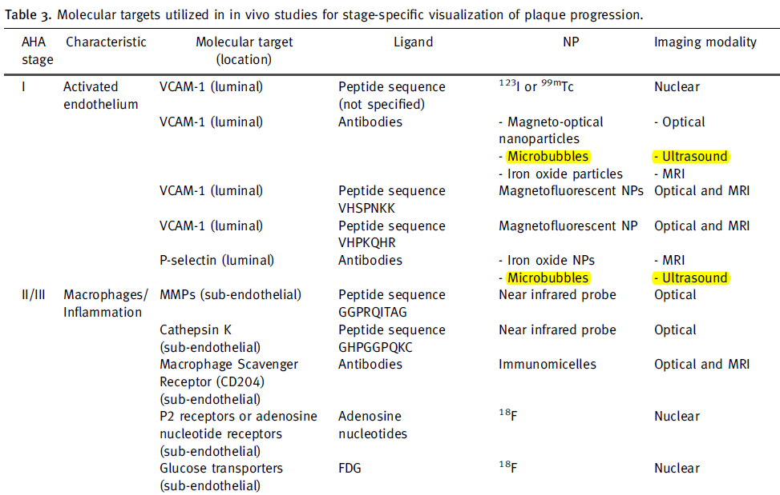
Further study using Ultrasound
1
2
Ultrasound
Notes:
Let’s look at Molecular US imaging

Slide 28
Radiology: Volume 260: Number 2—August 2011
Conclusion:
Use of a magnetic targeted microbubble system results in greater attachment to endothelial VCAM-1 in atherosclerotic aorta in conditions of high shear stress and improved detection of early inflammatory changes of atherosclerosis.
Notes:
Attachment was noted for magnetic and nonmagnetic microbubbles
but not for inactive magnetic microbubbles;
fi rm attachment at high shear stress (16–20 dyne/cm 2 ) was
achieved only with magnetic microbubbles. Fluorescence
intensity and video intensity were signifi cantly higher in
magnetic microbubbles with magnetic fi eld guidance than
in inactive magnetic microbubbles and nonmagnetic microbubbles
( P , .05). Video intensity from retained magnetic
microbubbles in APOE-defi cient mice was signifi cantly
greater than that in wild-type mice (mean video intensity
for APOE-defi cient mice: 28.25 [interquartile range, or
IQR, 26.55–29.20] with a hypercholesterolemic diet and
16.10 [IQR, 14.15–18.75] with a regular diet; mean video
intensity for wild-type mice: 9.55 [IQR, 8.85–10.5] with a
hypercholesterolemic diet and 2.90 [IQR, 1.25–3.85] with
a regular diet; P , .001).
Conclusion: Use of a magnetic targeted microbubble system results in
greater attachment to endothelial VCAM-1 in atherosclerotic
aortas in conditions of high shear stress and improved detection
of early infl ammatory changes of atherosclerosis.

Slide 29
Plaque neo-vascularisation detected by contrast-enhanced molecular ultrasound.
Common ultrasound molecular imaging probes:
microbubbles
microparticles like echogenic liposomes
acoustically active nanoparticles
Characteristic:
These particles are targeted to specific molecular structures present on the cell surface in the tissue of interest.
The concept of ultrasound molecular imaging is that, after intravenous injection,
these probes bind to disease-specific epitopes and can then be imaged noninvasively in real time.
A and B : showing microbubles with the plaque
C: immunohistological staining of the fibrous cap of the lesion imaged showing positive staining for CD31 corresponding to a large first-order neovessel (asterisk) and a smaller second-order neovessel (arrowhead)
Reproduced from Coli et al, Elsevier.
Notes:
Plaque neovascularisation detected by contrast-enhanced ultrasound. A and B showing microbubles with the plaque, immunohistological staining of the fibrous cap of the lesion imaged showing postive stainig for CD31 coresponding to a large first-order neovessel (asterisk) and a smaller second-order neovessel 9arrowhead).
Reproduced from Coli et al, Elsevier.
While the aforementioned studies demonstrate the feasibility of ultrasound molecular imaging in the evaluation of atherosclerosis, no clinical studies using this technique have been performed thus far.
For the initiation of clinical trials, several developments need to be made both for the contrast agents that are being used, as well as in the imaging technology for tracer detection.
Alternative conjugation strategies For molecular imaging of atherosclerosis, attachment of the tracer to a relatively small area like the endothelial surface of a carotid artery, as opposed to the microvasculature in a tissue, is required, and only a limited amount of tracer particles will be available for detection.

Slide 30
Plaque composition
Arterial wall biomechanics
Plaque neo-vasuclarisation
Molecular imaging of vascular phenotype changes on a sub-cellular level
Notes:
Molecular imaging of vascular phenotype changes in a subcellular level

Slide 31
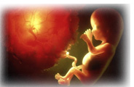
OMICS Journal of Radiology related journals
Journal of Nuclear Medicine & Radiation Therapy

Slide 32
Radiology Related Conferences
Radiology Conferences
For further details please go through the link

Slide 33
OMICS International Open Access Membership
Open Access Membership with OMICS International enables academicians, research institutions, funders and corporations to actively encourage open access in scholarly communication and the dissemination of research published by their authors.
For more details and benefits, click on the link below:
http://omicsonline.org/membership.php

