Slide 1
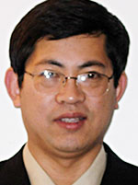
Chuanju Liu
Executive Editor
Orthopedic & Muscular System: Current Research

Slide 2
Biography
Dr. Liu was awarded his doctorate in molecular, cellular, and developmental biology from Shandong University and received his postdoctoral training in the Department of Molecular Biophysics and Biochemistry at Yale University.
Since 2002 Dr. Liu has held a dual appointment in the Departments of Orthopaedic Surgery and Cell Biology at New York University School of Medicine, since 2013 as Professor with tenure.
He is Editor-in-Chief of Open Access Rheumatology Research and Reviews and sits on the editorial boards of several journals.

Slide 3
Biography
Dr. Liu is recipient of the Harold M. Frost Award from the American Society for Bone and Mineral Research, the Dorothy W. Goldstein Award from the Arthritis Foundation, the Career Development Award from National Institute of Health, The Ethelmae Haldan Award for Innovative Science from the Arthritis National Research Foundation, the Kappa Delta Award from the American Academy of Orthopaedic Surgeons, and the Basic Research Award from the American College of Rheumatology.
His research interests include ADAMTS metalloproteinases in skeletal development and the pathogenesis of arthritis; growth factors and cytokines in autoimmune diseases, with the special focus on rheumatoid arthritis; and the biological role of interferon-inducible p200 family proteins.

Slide 4
Research Interest
cartilage biology and arthritis, skeletal development and diseases, growth factor and cytokine action, autoimmune diseases, preclinical studies on drug development , structure, function and pharmacology of ion channels.

Slide 5
Recent Publication
Guo FJ, Jiang R, Xiong Z, Xia F, Li M, et al. (2014) IRE1a constitutes a negative feedback loop with BMP2 and acts as a novel mediator in modulating osteogenic differentiation. Cell death & disease vol: 5, page: e1239.
Guo FJ, Jiang R, Li X, Zhang P, Han X, et al. (2014) Regulation of chondrocyte differentiation by IRE1alpha depends on its enzymatic activity. Cellular signalling.
Guo FJ, Xiong Z, Han X, Liu C, Liu Y, et al. (2014) XBP1S, a BMP2-inducible transcription factor, accelerates endochondral bone growth by activating GEP growth factor. Journal of cellular & molecular medicine.

Slide 6
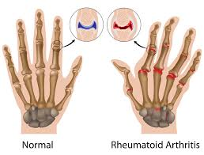
Arthritis
Arthritis (from Greek arthro-, joint + -itis, inflammation; plural: arthritides) is a form of joint disorder that involves inflammation of one or more joints. There are over 100 different forms of arthritis. The most common form, osteoarthritis (degenerative joint disease), is a result of trauma to the joint, infection of the joint, or age.

Slide 7
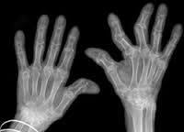
Arthritis
Other arthritis forms are rheumatoid arthritis, psoriatic arthritis, and related autoimmune diseases. Septic arthritis is caused by joint infection. The major complaint by individuals who have arthritis is joint pain. Pain is often a constant and may be localized to the joint affected.

Slide 8
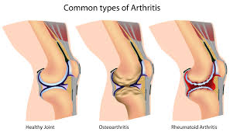
Arthritis
The pain from arthritis is due to inflammation that occurs around the joint, damage to the joint from disease, daily wear and tear of joint, muscle strains caused by forceful movements against stiff painful joints and fatigue.

Slide 9
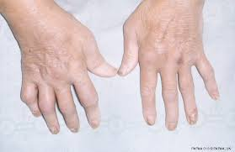
Arthritis
Regardless of the type of arthritis, the common symptoms for all arthritis disorders include varied levels of pain, swelling, joint stiffness and sometimes a constant ache around the joint(s). Arthritic disorders like lupus and rheumatoid can also affect other organs in the body with a variety of symptoms.

Slide 10
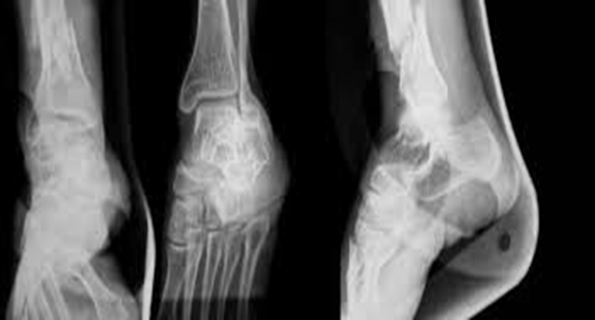
Orthopedic & Muscular System: Current Research
Physiotherapy
Sports Medicine
Doping Studies
Orthopedic surgery
musculoskeletal systems
Spine
Arthritis

