Slide 1
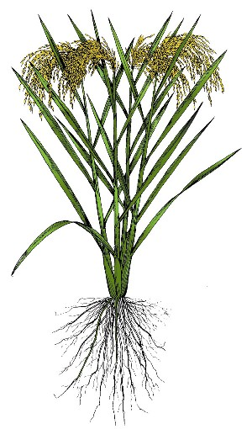
Arsenic concentrations in rice
As
corn: 0.3 ppm
Critical value in Germany,
England, the Netherlands:
1ppm
husk: 1 ppm
transfer coefficients
stem/leaves: 7 ppm
conc. in soil
root / soil
5.1
cm
ppm
36
root: 174 ppm
5
stem / soil
0.2
36
Fe: 13.600 ppm
Cr: 11 ppm
V: 23 ppm
Cu: 20 ppm
Zn: 25 ppm
Pb: 5.6 ppm
10
Factor 2 to 10
compared to wheat
husk / soil
0.03
30
15
corn / soil
0.01
28
intensive accumulation of As in the rhizosphere
restricted transport of As towards upper plant parts

Slide 2

Pathway of As intake through food-chain
Ground water
Pond Water
Traces:-0.174 mg l⁻¹
0.072-0.147 mg kg⁻¹
Agricultural produce (mg kg⁻¹ )
Rice: 0.03-1.5,
Wheat: 0.02-0.78
Potato 0.28-2.1,
Tomato 0.09-1.51
Irrigation water
0.006-0.548, mg L⁻¹
Rain water
Drinking water
0.006-0.548, mg L⁻¹
Feed: 0.41-3.69 mg kg⁻¹
Animal product (mg kg⁻¹ )
Milk: 0.001-1.189
Egg 0.007-0.287
Meat 0.009-0.562
Data source: Project survey report

Slide 3
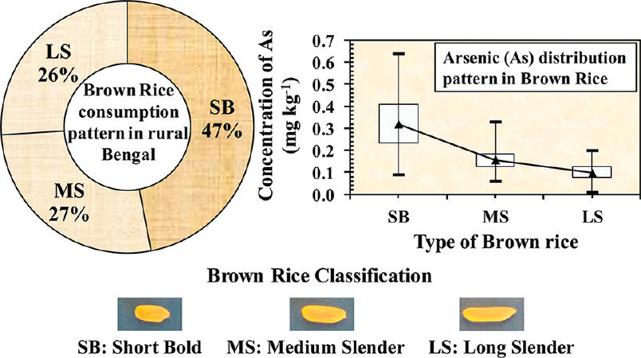
Arsenic in Rice
Halder et al., ES&T 2012

Slide 4
OMICS International
OMICS international Membership enables academic and research institutions, funders and corporations to actively encourage open access in scholarly communication and the dissemination of research published by their authors.
For more details and benefits, click on the link below:
http://omicsonline.org/membership.php

