Slide 1
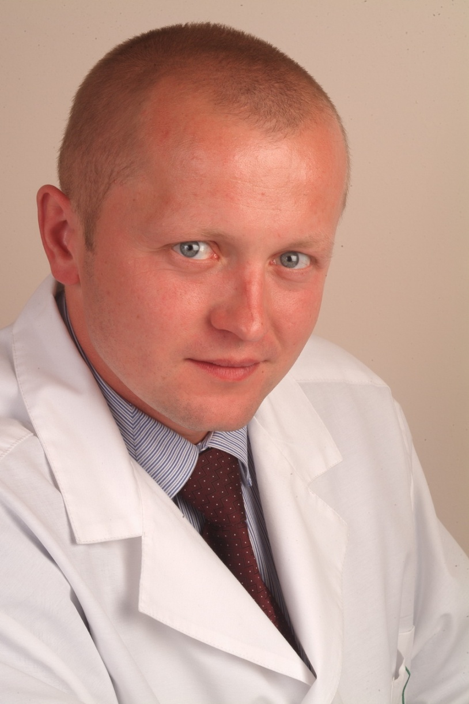
Dmitry Bulgin MD, PhD
is a principal investigator and general practitioner
ME–DENT The Center for Regenerative Medicine
Istarska 18
52210 Rovinj
Croatia
phone +385 52 842 500
fax +385 52 842 501
e–mail: info@me–dent.eu
www.me-dent.eu

Slide 2
Dr. Dmitry Bulgin
applies cell–based technologies (autologous bone marrow–derived and adipose tissue–derived mesenchymal stem cells) and other proprietary methods in the field of:
Reconstructive Dentistry
Aesthetic & Reconstructive Surgery
Traumatology & Orthopeadics
Vascular (angiology) Medicine
Wound Care
Sports Medicine.

Slide 3
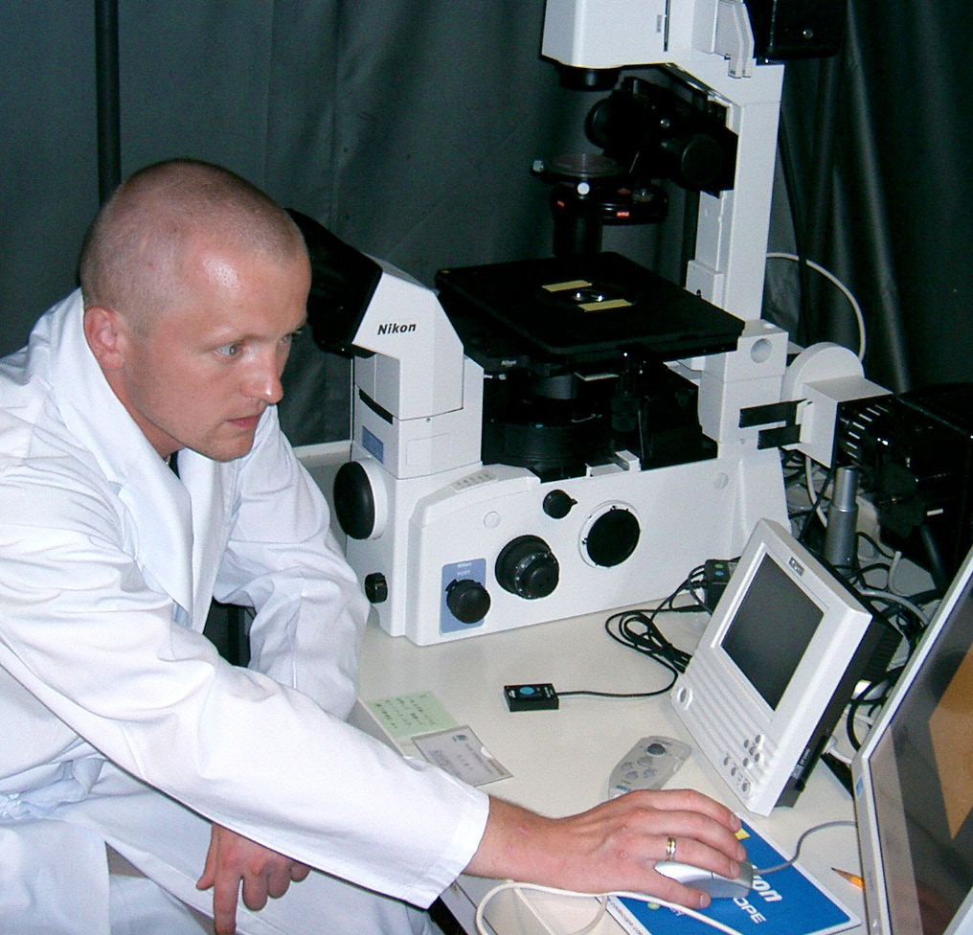
The main research interest:
The development of methods to accelerate the healing processes of tissues.
The tools and technologies for tissue and metabolic engineering to enable regenerative medicine.
Biological approaches for maintaining the human’s performance and capabilities in the face of harsh accident conditions.

Slide 4
The research results and clinical outcomes have been presented at conferences
(as a speaker):
The First Symposium of Yangming and Nagasaki Universities, Nagasaki, Japan, November 29, 2004.
The International Symposium «Young Scientists Organizing Nagasaki Symposium of International Consortium for Medical Care of Hibakusha and Radiation Life Science», Nagasaki, Japan. March 7-8, 2005.
Russian-American Conference in Hematology, Saint-Petersburg, Russia, June 21-23, 2006.
International Scientific Conference in Stem Cells Technologies, Moscow, Russia, May 30-31, 2007.
III-rd Congress of Russian Pathologist Society, Samara, Russia, May 27-30, 2009.
International Scientific Symposium: “Stem Cells, Umbilical Cord Blood and Placenta in Regenerative Medicine”, Ljubljana, Slovenia, May 27, 2011.
2012 eCM XIII Conference: Bone Fixation, Repair & Regeneration (Focus CMF, Spine, Trauma, Vet), Davos,
Switzerland, June 24 – 26, 2012.
5th Vienna Biomaterial symposium, Vienna University of Technology, Vienna, Austria, November 19 – 21, 2012.
UAE International Dental Conference & Arab Dental Exhibition AEEDC, Dubai, UAE, February 5 -7, 2013.
1st International Congress of Plastic Surgery - Fellows in Science, Ljubljana, Slovenia, September 18 – 21, 2013.
Bredent group days SKY Meeting 2014, Berlin, Germany, May 22 - 24, 2014.

Slide 5
The research results and clinical outcomes have been published:
Podtcheko A, Takakura S, Bulgin D, Namba H, Saenko V, Ohtsuru A, Yamashta S. Differ role of JNK and p38 kinase in ionizing radiation-induced thyroid cell radio-sensitization. The International Symposium «Young Scientists Organizing Nagasaki Symposium of International Consortium for Medical Care of Hibakusha and Radiation Life Science», Abstracts p.13, 2005.
Podtcheko Alexei, Bulgin Dmitry, Takakura Osamu, Namba Hiroyuki, Ohtsuru Akira, Saenko Vladimir, Yamashita Shunichi. Inhibition of c-Jun NH2-Terminal Kinase and Thyroid Cell Terminal Growth Arrest. Folia Endocrinologica Japonica, Volume 81, Number 1, 2005, p. 139.
Bulgin Dmitry, Podtcheko Alexei, Takakura Shu, Mitsutake Norisato, Namba Hiroyuki, Saenko Vladimir, Ohtsuru Akira, Rogounovitch Tatiana, Palona Iryna, and Yamashita Shunichi. Selective Pharmacologic Inhibition of c-Jun NH2-Terminal Kinase Radiosensitizes Thyroid Anaplastic Cancer Cell Lines via Induction of Terminal Growth Arrest. Thyroid: Volume 16, Number 3, 2006, p. 217-224.
Bulgin Dmitry, Hodzic Enes, Komljenovic-Blitva Danijela. Advanced and Prospective Technologies for Potential Use in Craniofacial Tissues Regeneration by Stem Cells and Growth Factors. Journal of Craniofacial Surgery: January 2011 - Volume 22 - Issue 1 – pp. 342-348.
Bulgin Dmitry, Hodzic Enes. Autologous Bone Marrow-Derived Mononuclear Cells Combined With β-Tricalcium Phosphate (β -TCP) for Maxillary Bone Augmentation in Implantation Procedures. Journal of Craniofacial Surgery: November 2012 - Volume 23- Issue 6 - pp. 1728-1732.
Bulgin Dmitry. Prospective Technologies in Dental Tissues Regeneration. Journal of Oral Hygiene & Health: June 2013 - Volume 1- Issue 2 - pp.1-2.
Bulgin Dmitry, Irha Ernst, Hodzic Enes, Nemec Boris. Autologous bone marrow derived mononuclear cells combined with β-tricalcium phosphate and absorbable atelocollagen for a treatment of aneurysmal bone cyst of the humerus in child. Journal of Biomaterials Applicatios: September 2013 - Volume 28 - Issue 3- pp. 343-353 [Epub ahead of print 2012 Jun 12].
Bulgin Dmitry, Vrabic Erik, Hodzic Enes. Autologous bone-marrow-derived-mononuclear-cells-enriched fat transplantation in breast augmentation: evaluation of clinical outcomes and aesthetic results in a 30-year-old female. Case Reports in Surgery. 2013; 2013;2013:782069. doi: 10.1155/2013/782069. Epub 2013 Aug 19.

Slide 6
Prospective Technologies
in Dental Tissues Regeneration
Interest in applications for dental tissues regeneration continues to increase as clinically relevant methods alternative to traditional treatments.
Dental tissues engineering is an opportunity that dentistry cannot afford to miss.
Recent progress in the studies of molecular basis of tooth development, adult stem cell biology, and regeneration will provide fundamental knowledge for that.
The impact of dental tissues engineering extends beyond clinical practice.
Dental tissues engineering could not have advanced to the current stage without the incorporation of interdisciplinary skill sets of stem cell biology, bioengineering, polymer chemistry, mechanical engineering, robotics, etc.
Thus, dental tissues engineering and regenerative dental medicine are integral components of regenerative medicine.
Citation: Bulgin D (2013) Prospective Technologies in Dental Tissues Regeneration.
Oral Hyg Health 1: e102. doi:10.4172/2332-0702.1000e102

Slide 7
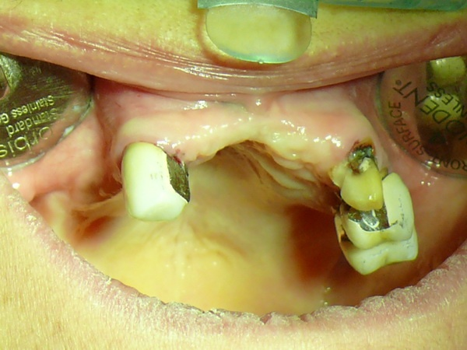
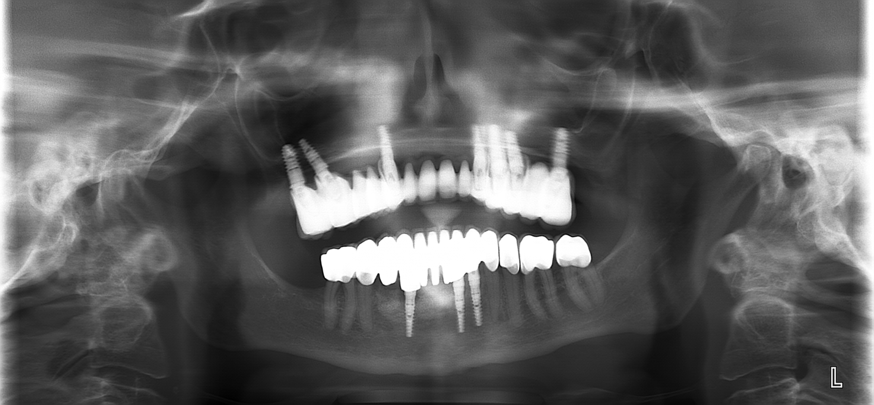
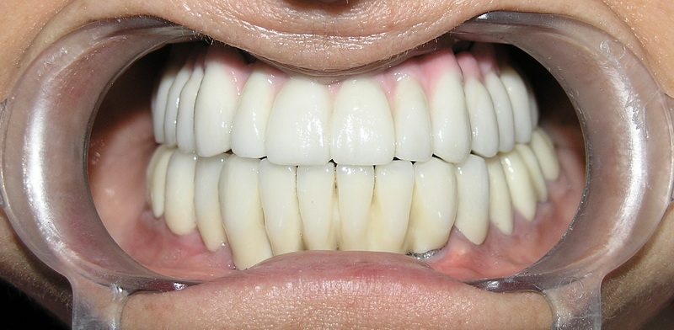
Replacing missing bone or adding mass to existing bone is often essential to the success of a dental implant.

Slide 8
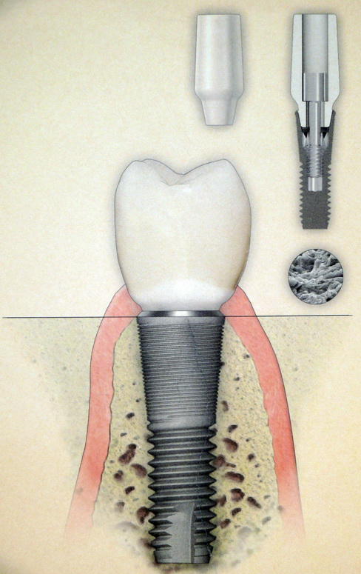
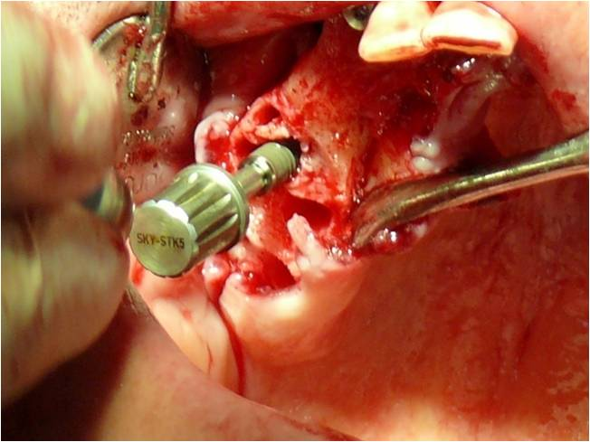
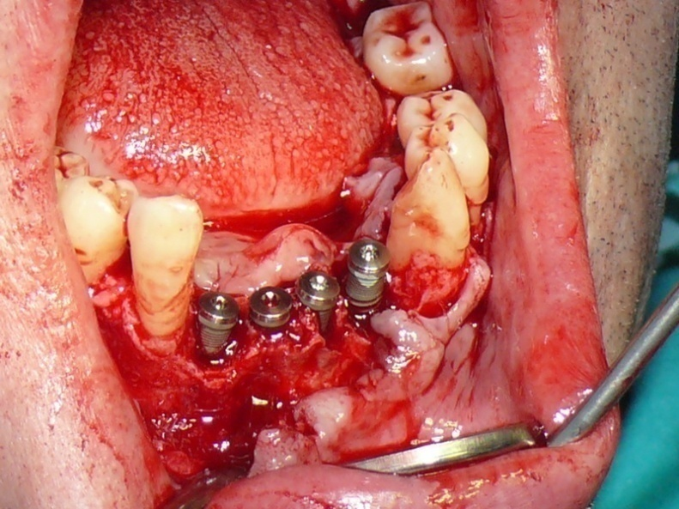
An implant needs a critical mass of bone surrounding it in order to bind to it and deliver sufficient strength and stability.

Slide 9
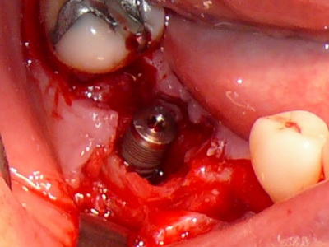
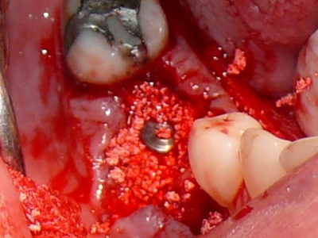
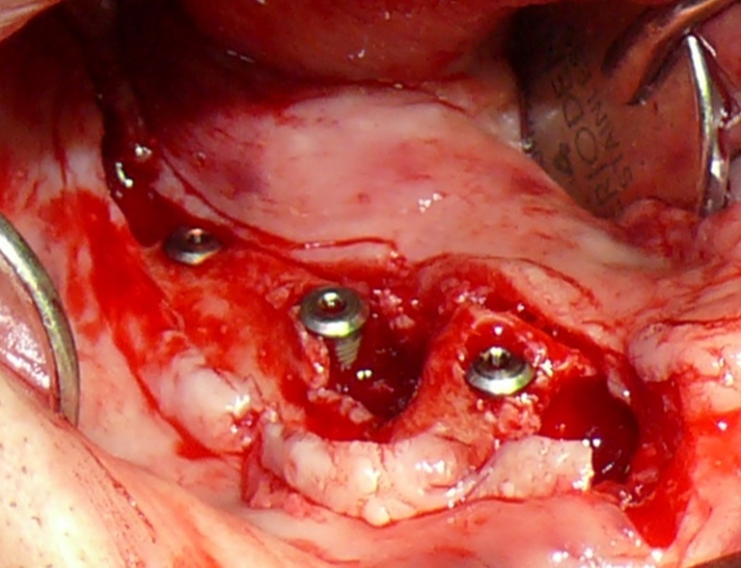
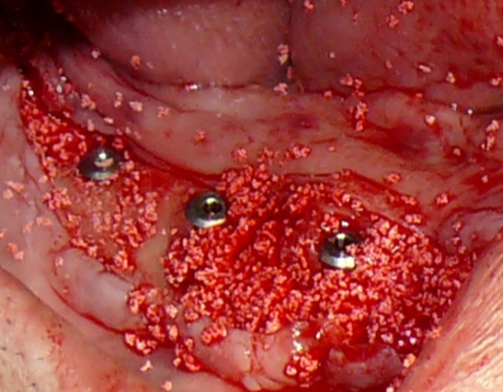
If in the location where the implants are intended there is low mass of bone (width or height) a bone graft must be applied in order to maintain this critical bone mass.
Notes:
If in the location where the implants are intended there is low mass of bone (width or height) a bone graft must be applied in order to maintain this critical bone mass.

Slide 10
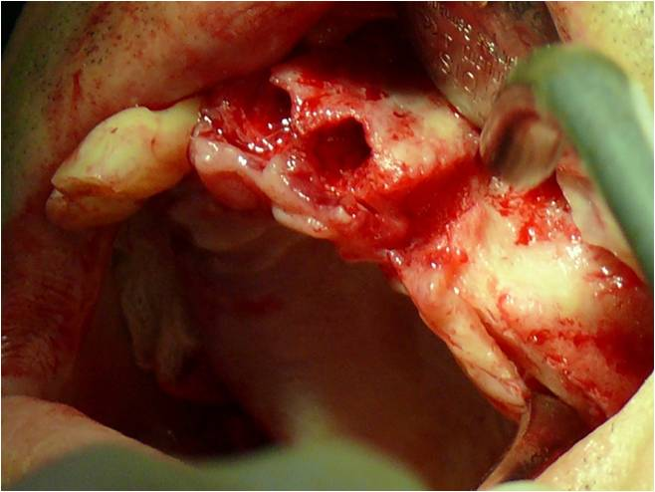
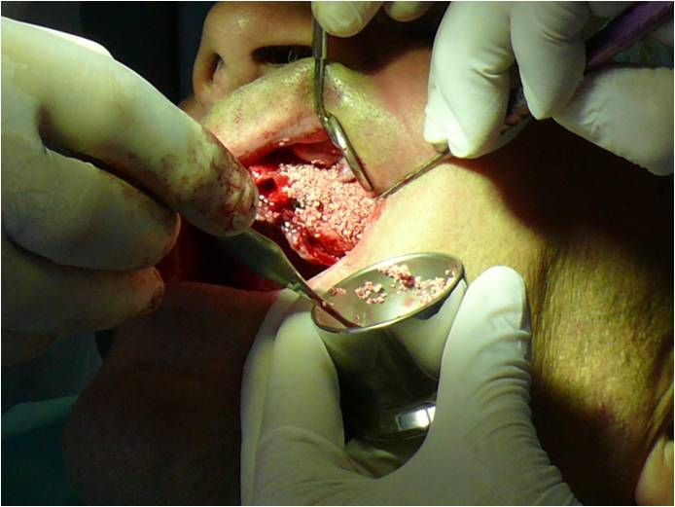
A large variety of graft materials have been used for maxillary and mandibular atrophy to fill bone defects:
AUTOGENOUS
HOMOGENOUS (allograft)
HETEROGENEOUS (xenograft)
SYNTHETIC (predominantly osteo-conductive ) substitutes.

Slide 11
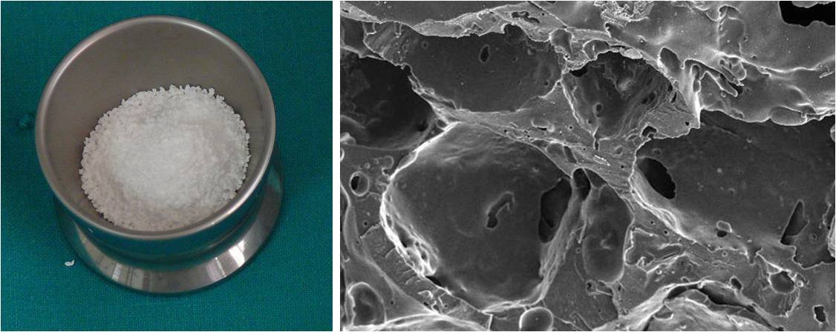
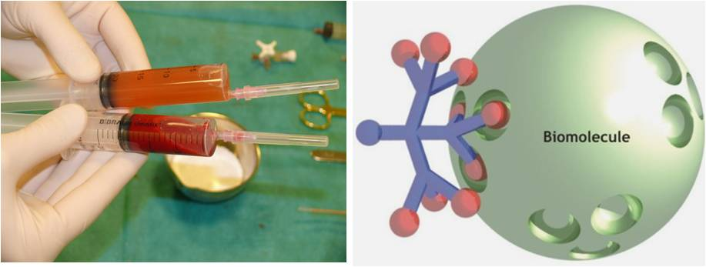
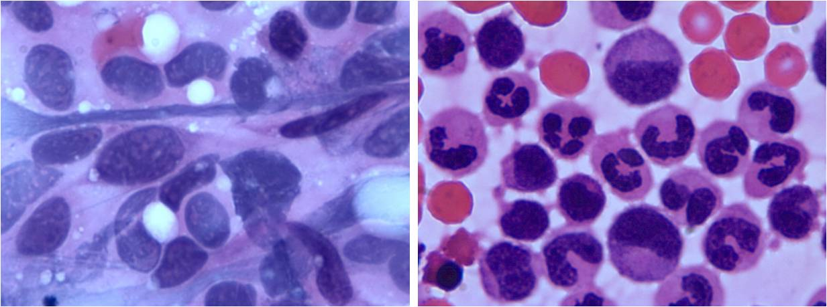
Bone-graft materials usually have one or more components:
OSTEOCONDUCTIVE MATRIX, which acts as scaffold to new bone growth
OSTEOINDUCTIVE PROTEINS, which support mitogenesis of undifferentiated cells
OSTEOGENIC CELLS, which are capable of forming bone in the appropriate environment

Slide 12
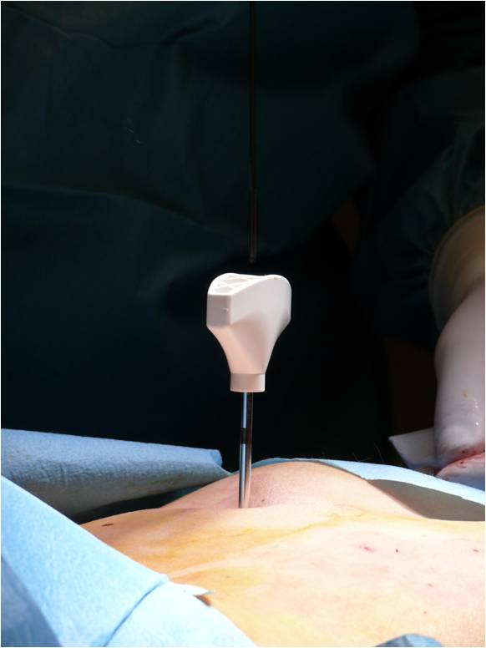
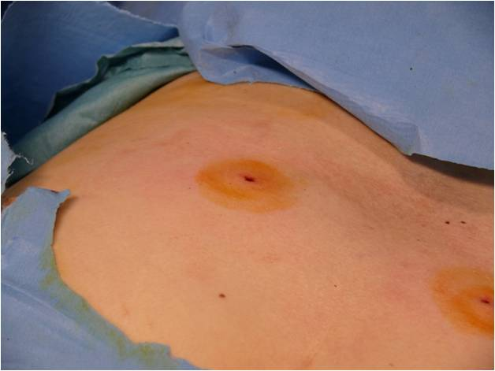
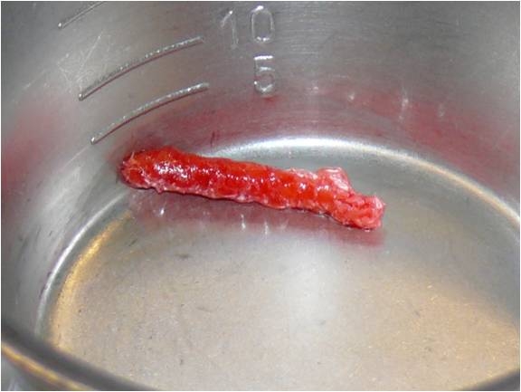
Many clinicians consider harvested autologous bone (i.e. taken from the same individual) as the “gold standard” material for the reconstruction of osseous defects.
Autologous bone grafts by their very nature are able to deliver a physiologically optimized combination of osteogenic cells and growth factors in a mineralized scaffold.
autological bone fragment from posterior iliac crest
Notes:
Many clinicians consider harvested autologous bone (i.e. taken from the same individual) as the “gold standard” material for the reconstruction of osseous defects.
Autologous bone grafts by their very nature are able to deliver a physiologically optimized combination of osteogenic cells and growth factors in a mineralized scaffold.

Slide 13
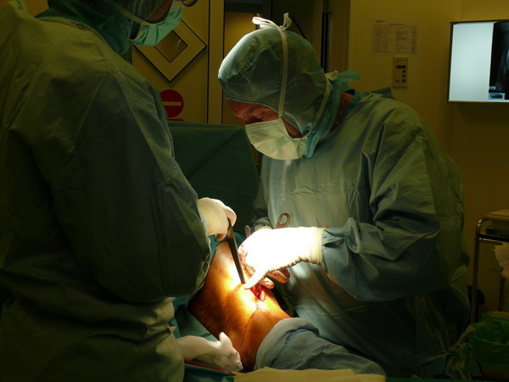
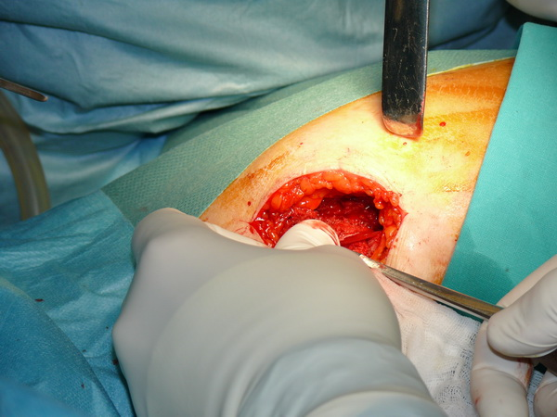
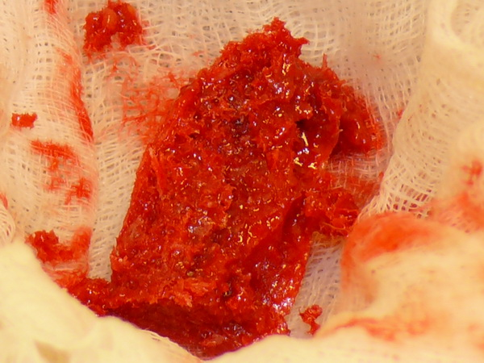
However, limited availability of donor sites, requirement for an additional surgery to obtain the graft material, and extra chair time are the limitations of this technique.
A large amount of harvested bone raises the risk of postoperative functional or cosmetic morbidities at the donor site.

Slide 14
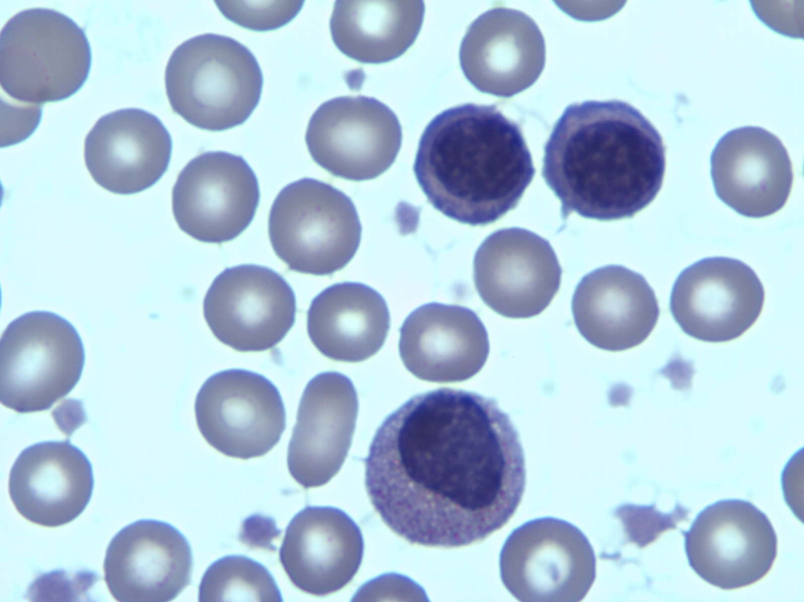
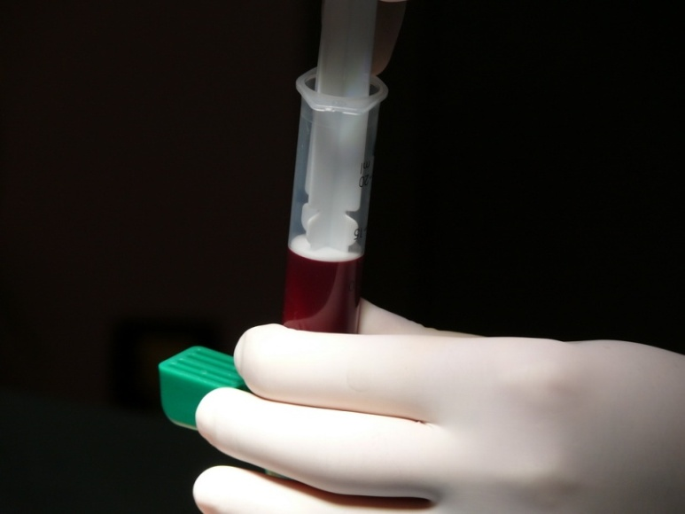
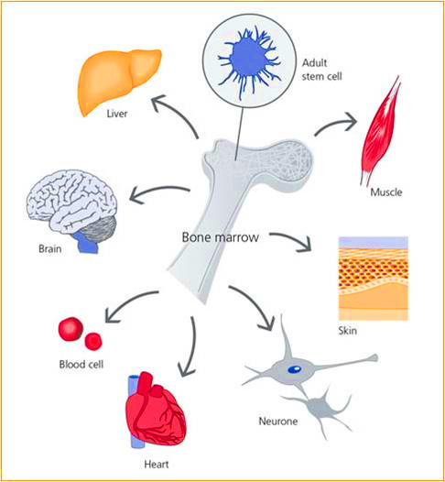
The autologous application of human bone marrow cells which are not expanded ex vivo has medico-legal advantages in clinical applications.

Slide 15
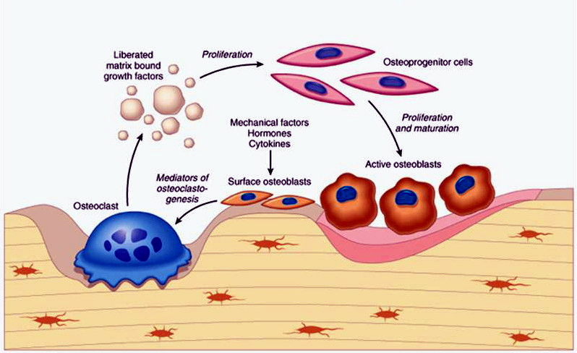
Defect repair and bone ingrowth, maturation, and modeling are cell-mediated processes.
Most clinical trials report successful bone regeneration after the application of mixed cell populations from bone marrow.

Slide 16
GROWTH FACTORS
TGF-β superfamily
BMPs
FGF
PDGF
IGF
Bone marrow derived mononuclear cells (BMMNCs) secrete many kinds of growth factors and represent a potential key component in autologous graft for bone regeneration.
Growth factors that encourage the formation of new bone have been identified and applied to heal bone defects around medical and dental implants and without implant placement.
Notes:
Bone marrow derived mononuclear cells (BMMNCs) secrete many kinds of growth factors and represent a potential key component in autologous graft for bone regeneration.
Growth factors that encourage the formation of new bone have been identified and applied to heal bone defects around medical and dental implants and without implant placement.
BMPs, which are part of the TGF-β superfamily, have osteo-and chondroinductive properties.
Other factors include the insulin-like growth factors (IGF), which have been shown to have an effect on tissue formation, especially bone, FGF, which are synthesized by skeletal cells, and PDGF, which is known for enhancing protein synthesis in bone.

Slide 17
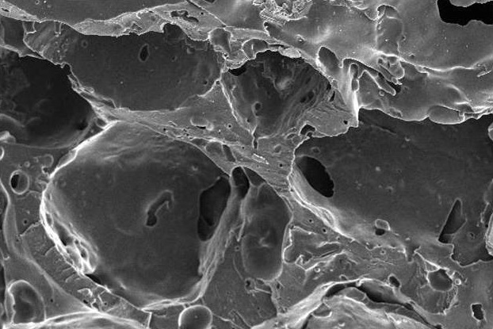
To reduce bone harvesting,
various synthetic bone void fillers with improved biocompatibility have been developed.
Notes:
To reduce bone harvesting, various synthetic bone void fillers with improved biocompatibility have been developed.

Slide 18
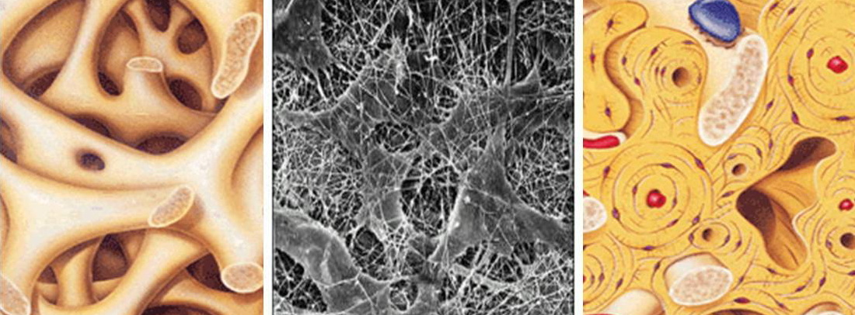
The extracellular matrix of bone has been described as a composite material composed of collagen type I fibrils mineralized with nanocrystals of hydroxyapatite.
Bernhardt A, Lode A, Boxberger S, Pompe W, Gelinsky M. J Mater Sci Mater Med 2008;19:269.

Slide 19
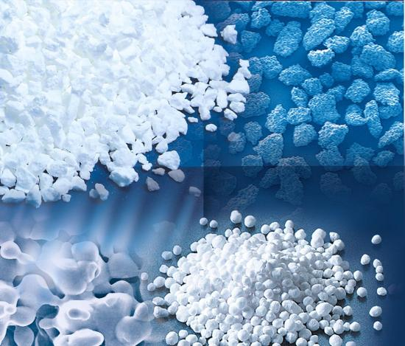
Synthetic bone replacement materials are osteoconductive scaffolds that encourage the growth of new bone by apposition from adjacent bone surfaces or from bone-forming cells.
After sufficient bone has grown throughout the defect site, the scaffold no longer plays a role in the reparative process and, ideally, is resorbed.

Slide 20
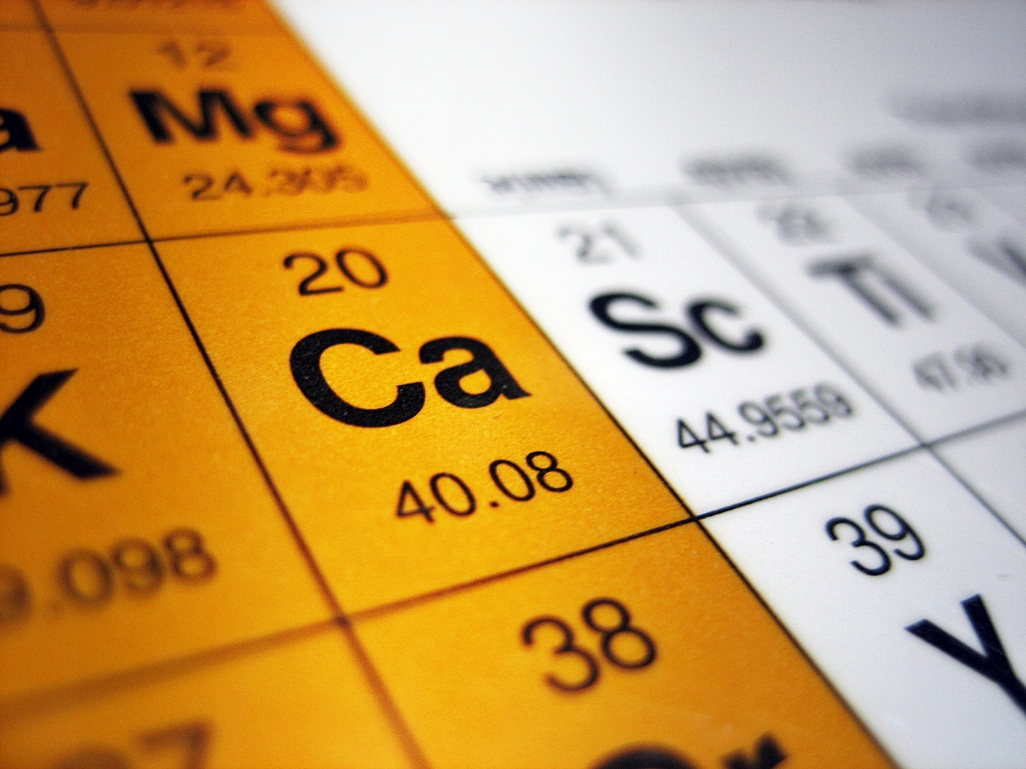
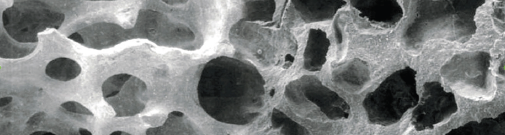
These materials are made from calcium salts:
CALCIUM SULFATE
CALCIUM CARBONATE
CALCIUM PHOSPHATE
BIOACTIVE GLASSES CONTAINING CALCIUM OXIDE
Highly biocompatible materials with retention of the natural porous trabeculation, architecture, and natural mineral content - closest components of human cancellous bone.
HUMAN BONE
CALCIUM SALT

Slide 21
The class of calcium phosphate bone replacements is composed:
porous ß-tricalcium phosphate (ß-TCP)
dense hydroxyapatite (HA)
porous HA that has retained the structure of coral (the exoskeleton of which has been chemically converted, in full or in part, from calcium carbonate into HA)
biphasic mixture of TCP and HA

Slide 22
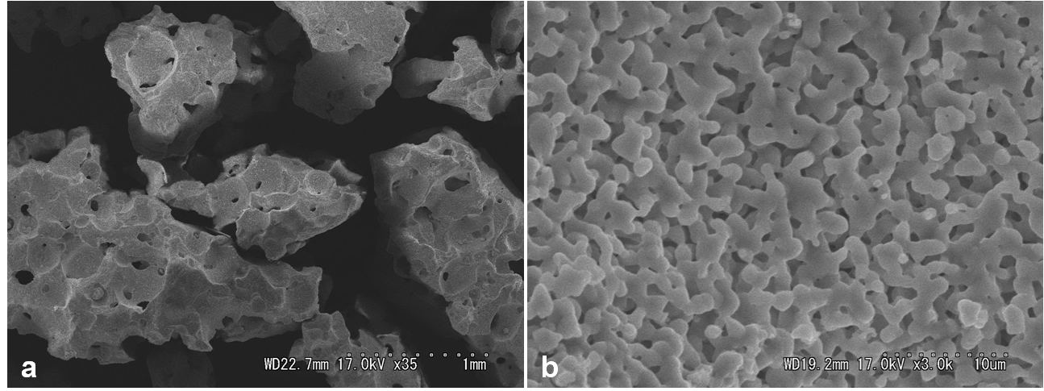
Recently highly pure porous β-tricalcium phosphate (β-TCP) represents a very interesting practical tool for bone regeneration
β-TCP is biocompatible porous material, new bone formation takes place along the surface in their micropores.
The open and interconnected porosity of β-TCP allows body fluids to circulate throughout its entire extent.
The range of pore sizes encourages tissue ingrowth.
β-TCP shows resorbable characters during bone regeneration, and can be completely substituted for the bone tissue after stimulation of bone formation.
Scanning electron micrograph of highly pure porous β-TCP:
(a) Macrostructure has a macrodiameter of 0.5－1.5 mm,
(b) micropores of 100－400 μm, various size of micropores are seen.

Slide 23
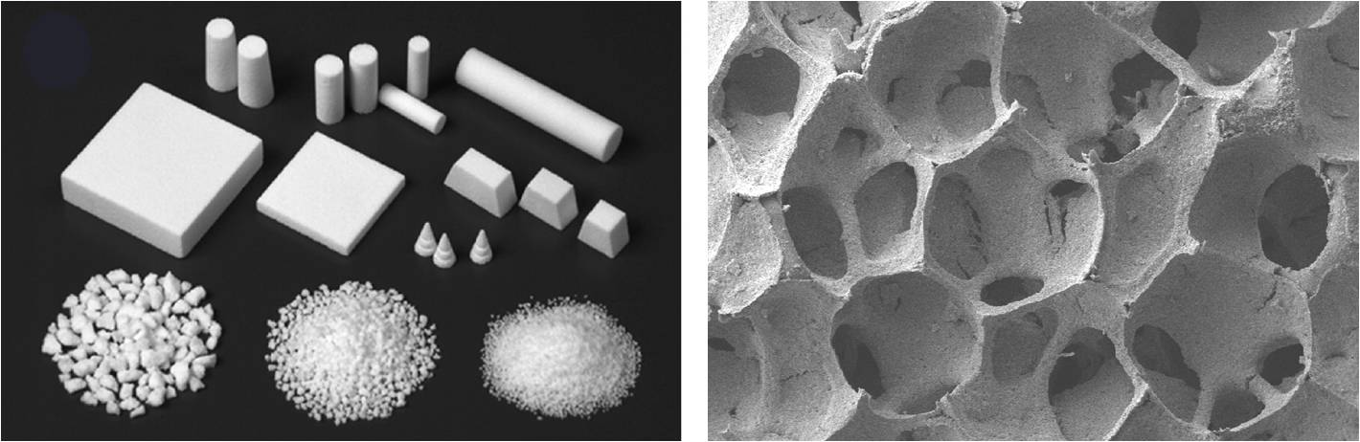
Hydroxyapatite can be produced with either a dense or macroporous morphology, and is typically sintered at temperatures above 1000 °C in granular or block forms.
The high heat of sintering produces a material that cannot be reshaped to fit into a bone defect (i.e. if in block form) and is nonresorbable.
Hydroxyapatite is a brittle material with low fracture resistance.
Hydroxyapatite is biocompatible, osteoconductive, and bioactive (i.e. it develops a direct, adherent bond with bone).

Slide 24
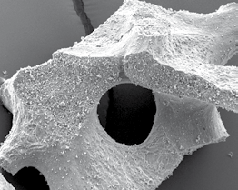
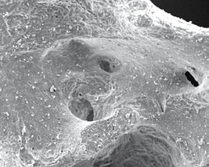
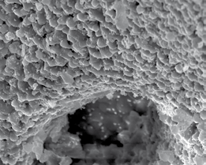
Biphasic calcium phosphate products which contain hydroxyapatite and β-TCP in various ratios are aimed at the provision of a bone grafting material which is able to degrade within a physiologically optimized time frame, while providing some measure of mechanical stability until sufficient bone in-growth has occurred.
While the ß-TCP exhibits quick osseous organization and is replaced by newly formed bone within a short period, the HA content ensures that the volume remains unchanged.

Slide 25
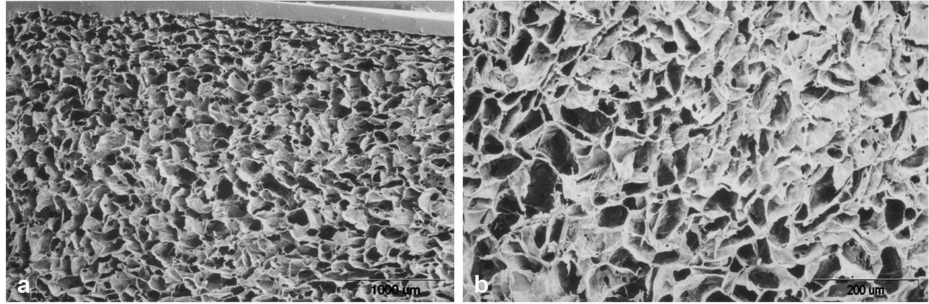
Collagen as a material for scaffold-based therapy
Scanning electron micrograph of porous atelocollagen sponge :
macrostructure
micropores of 50－500 μm, various size of micropores are seen.
The atelocollagen is a cross-linked collagen material with abundant micropores.
It has large pores that permit cellular entry and is degraded in vivo.
These characteristics suggest that this material may be a good candidate for use as scaffolding for implantation of cells.

Slide 26
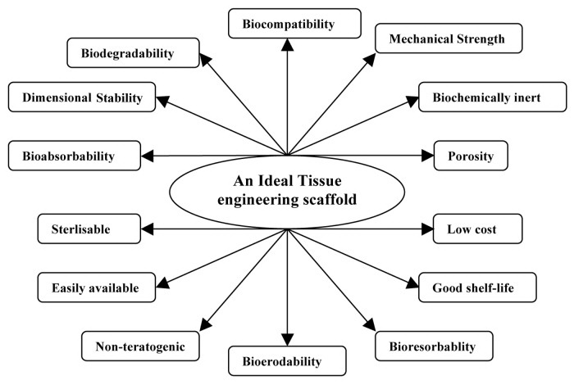

Slide 27
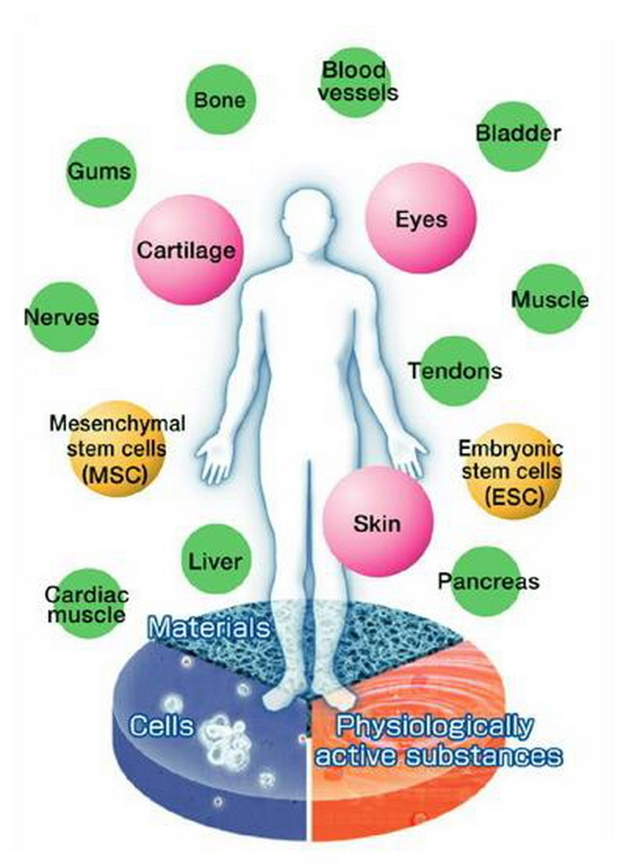
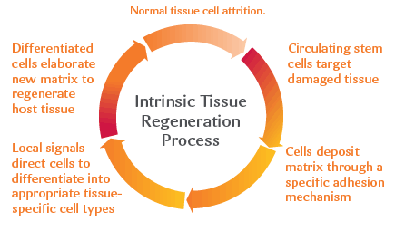
Synthetic materials require the addition of bioactive factors or cells to promote tissue regeneration.

Slide 28
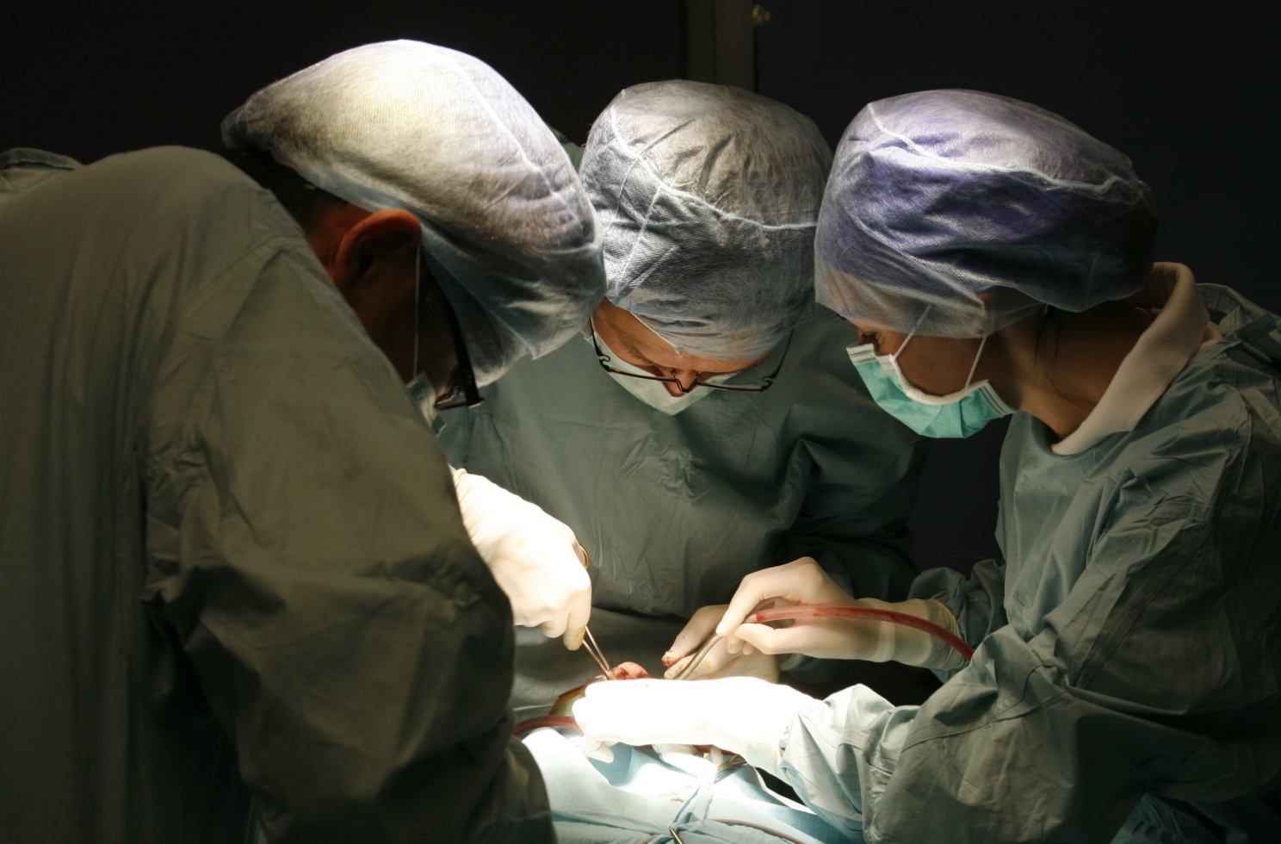
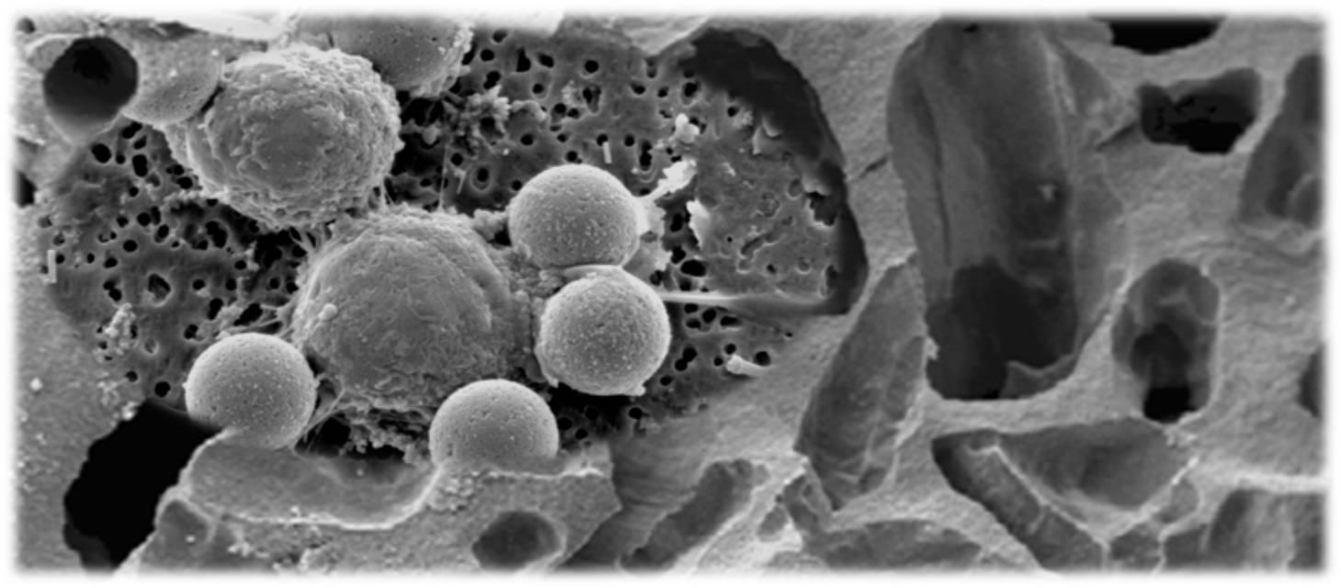
Recently, the transplantation of autogenous BMMNCs combined with synthetic grafting materials has been inaugurated and introduced as a clinical procedure in oral and maxillofacial surgery.

Slide 29
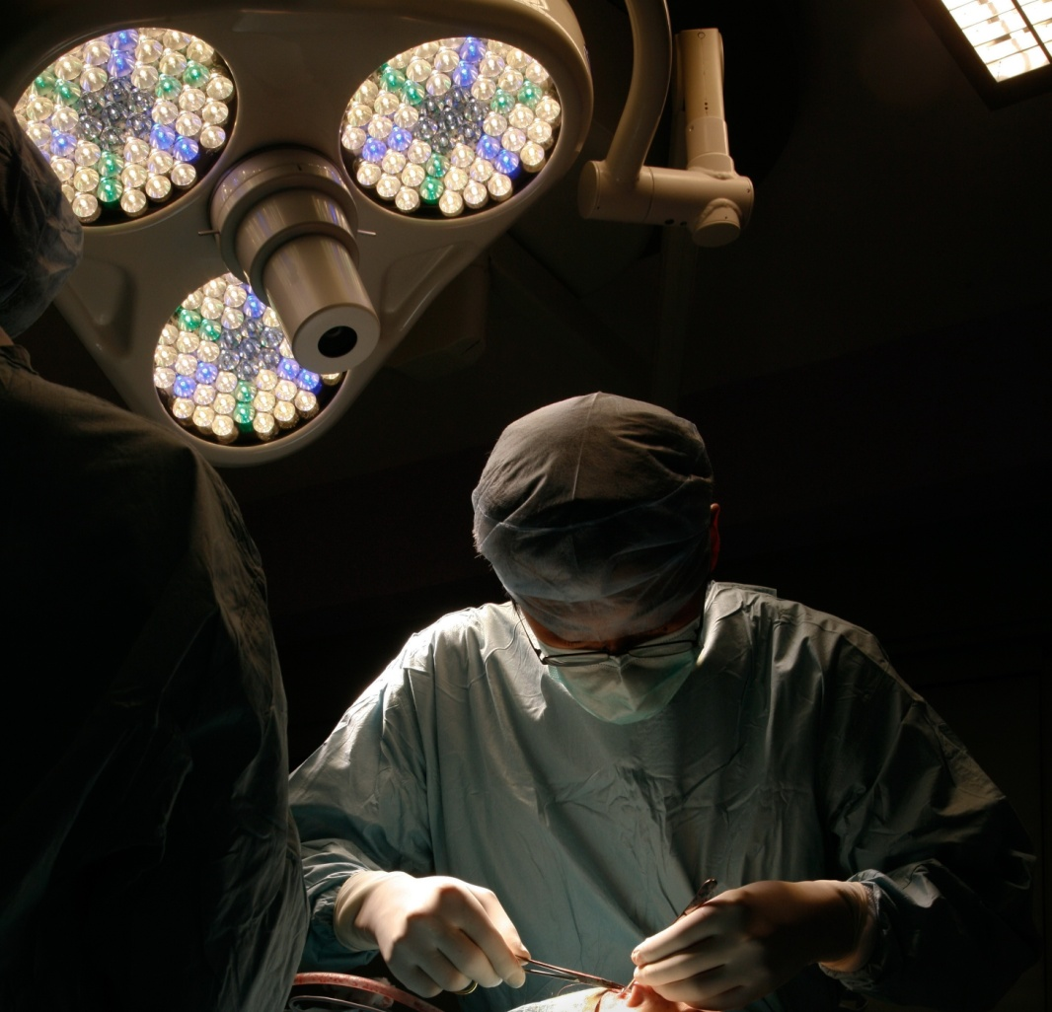
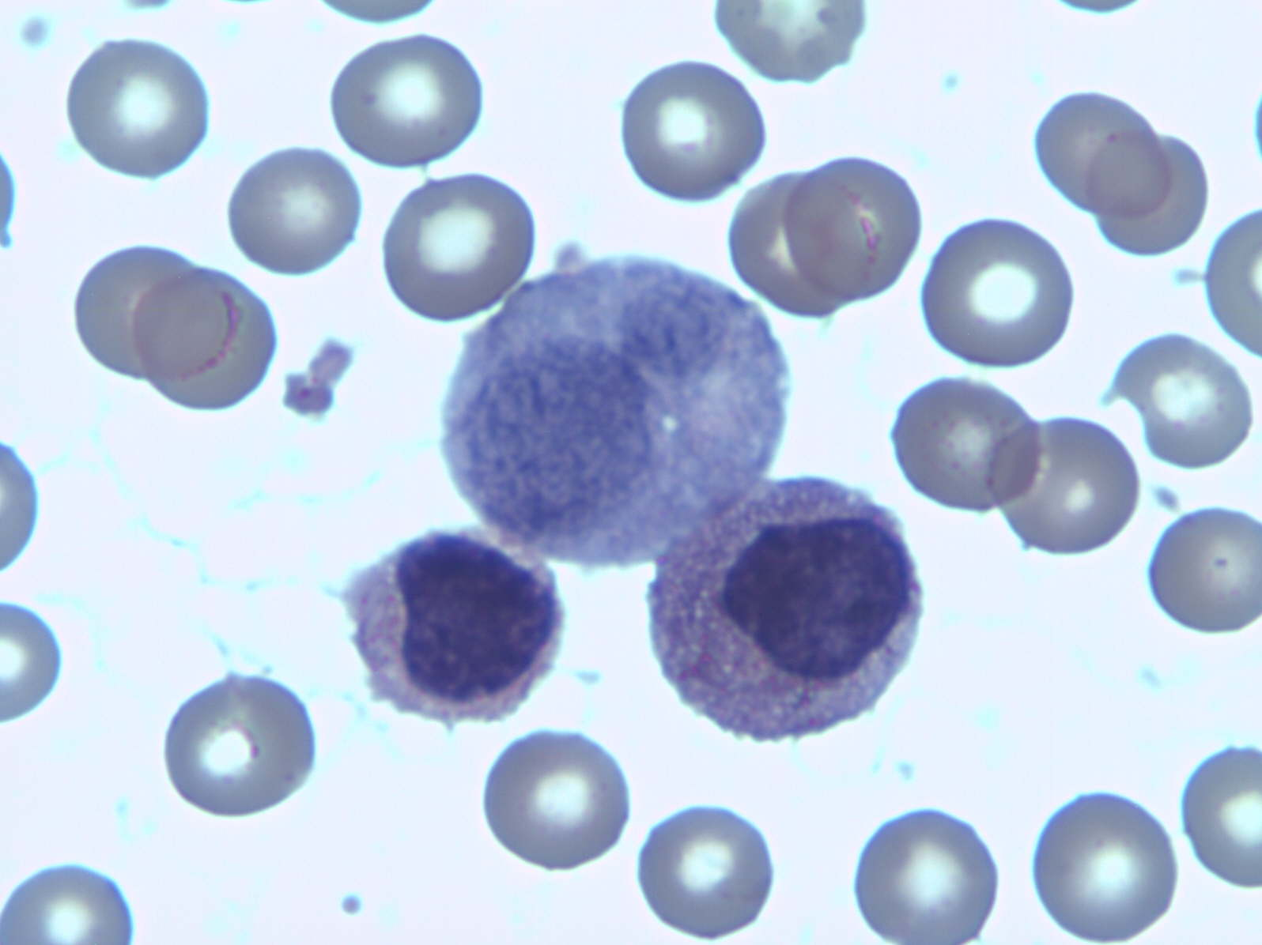
To date there has been no graft material which can be regarded as completely satisfactory.
My experience with freshly isolated autologous bone marrow derived mononuclear cells combined with synthetic biphasic calcium phosphate ceramic and absorbable atelocollagen for augmentation of the extremely atrophic maxilla and mandible is presented.
The techniques are based on stimulation of natural events continuously present in living bone, that is, the process of bone remodeling and offering both osteoinduction and osteoconductive features.

Slide 30
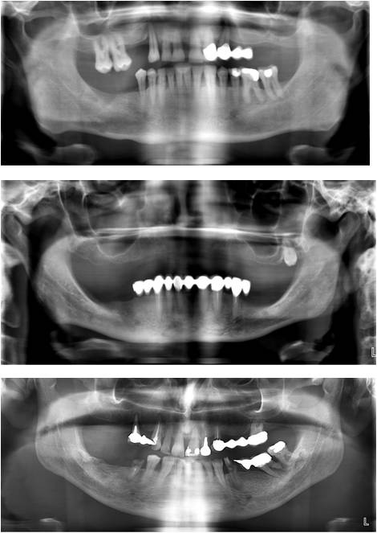
Cases breakdown
Preoperative radiological evaluation
A 57-year-old man.
Panoramic X-ray image before augmentation procedures (horizontal and vertical augmentation, left maxillary sinus lifting).
A 46-year-old woman.
Panoramic X-ray image before augmentation procedures (horizontal and vertical augmentation, left and right maxillary sinus lifting).
A 48-year-old man.
Panoramic X-ray image before augmentation procedures (horizontal and vertical augmentation).

Slide 31
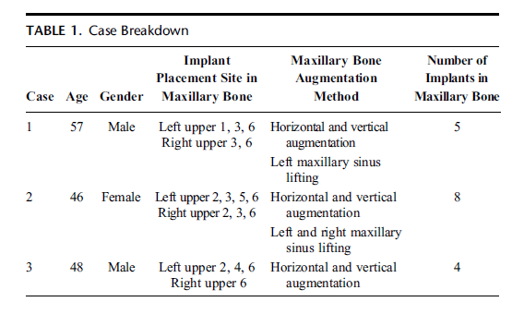
Materials and methods: Patients
Maxillary bone augmentation with the aim of embedding implants was performed under deep sedation in three healthy patients with advanced atrophy of the alveolar bone of maxilla.

Slide 32
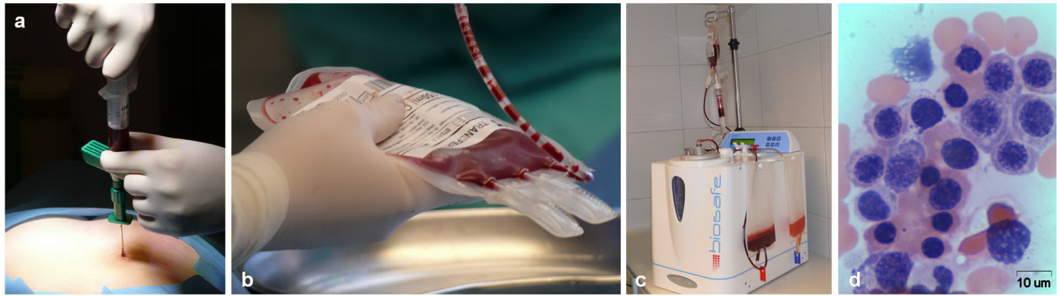
Bone marrow derived mononuclear cells preparation:
the bone marrow harvesting from posterior iliac crest
collection of bone marrow in plastic bag
the bone marrow processing by using Cell Separation System SEPAX S-100
qualitative assessment of BMMNCs population by haematoxylin and eosin cytological staining (magnification x 400).

Slide 33
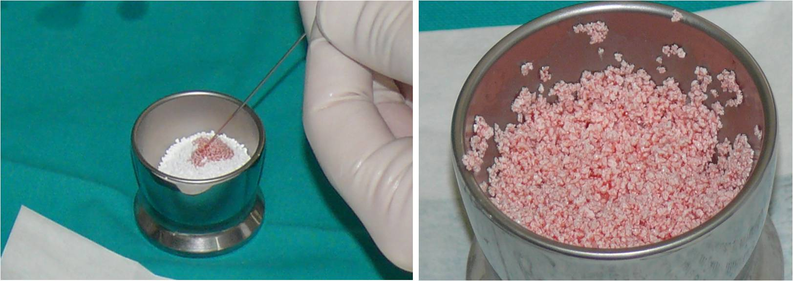
Freshly isolated autologous BMMNCs in combination with synthetic biphasic calcium phosphate ceramic
At the time of surgery, BMMNCs and synthetic biphasic calcium phosphate ceramic granules were mixed, and excess fluid volume was removed using filtration and low-grade vacuum.

Slide 34
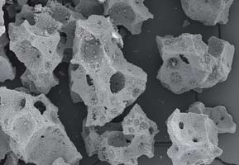

A fully synthetic, two-phase calcium phosphate ceramic consisting of
Micro- and macroporosity (magnification 25x)
nano structure (magnification 1000x)
• 60% hydroxyapatite (HA)
• 40 % ß-tricalcium phosphate (ß-TCP)

Slide 35

Surgical grafting and dental implants procedures
Maxillary bone augmentation with simultaneous implants placement.
A, Maxillary bone augmemtation site preparation.
B, Implants placement.
C, Sinus filled by synthetic biphasic calcium phosphate ceramic combined with BMMNCs.
D, Surgical sites are closing with silk non-absorbable sutures.

Slide 36

Sinus lift and bone augmentation procedures
A, Alveolar crest incision at the beginning of the bone augmentation
procedure. B, The planned maxillary bone augmentation site with advanced atrophy. C, Sinus lift procedure: window preparation and sinus membrane elevation. D, The BMMNCs and Ossceram nano® mixture grafting. The graft material isolation from the soft tissues by membrane.

Slide 37

Approximately 7 months later, dental implants were inserted into the augmented maxilla.
A, Embedding of the implantation material into the augmented maxilla
(7 months after augmentation procedure).
B, Surgical site reopening for revision of implant integration after 3 months from the date of implants placement.
C, Histological condition of graft tissue 7 months after augmentation procedure.
Hematoxylin and eosin stain method. Original magnification x200.

Slide 38


Patient S. L., 46 y. o., female (Case 2)
Advanced Maxillary Atrophy before augmentation
in 10 months after augmentation
reopening for revision of implant integration

Slide 39







Patient S. L., 46 y. o., female (Case 2)
PREOPERATIVE
24 months of follow-up
POSTOPERATIVE 1 month
24 months of follow-up
POSTOPERATIVE 12 months
24 months of follow-up
24 months of follow-up

Slide 40

Favorable bone bonding was seen in the embedded implantation material in all of the cases
A 57-year-old man.
A 46-year-old woman.
A 48-year-old man.
After a recovery period of approximately 12 months the upper structures were mounted.
Since dental implant placement, patients have maintained good
peri-implant health
(no bleeding on probing) and oral hygiene.
A, Before augmentation procedure.
B, At one month after operation.
C, At twelve months after operation.

Slide 41

Radiological evaluation of healing period
The panoramic radiographic imaging was taken at 1 and 12 months after operation to evaluate the extent of reconstruction at grafted sites by using x-ray image analysis Planmeca Romexis software (Planmeca Oy, Helsinki, Finland).
The mean increasing height of the graft site was 16.7 mm at 1 month and 15.3 mm at 12 months;
that is, the height of the graft site showed approximately 8.4% reduction from 1 to 12 months.

Slide 42






Isolation of synthetic biphasic calcium phosphate ceramic by absorbable atelocollagen membrane from the oral cavity.

Slide 43


Patient : D. M., 52 y. o., female
Diagnose: Advanced Maxillary and Mandibular Atrophy, bone resorbtion, Parodontosis, gum recession.

Slide 44



Isolation of synthetic biphasic calcium phosphate ceramic by absorbable atelocollagen membrane from the oral cavity

Slide 45



After a recovery period of approximately 12 months
the upper structures were mounted.

Slide 46

Patient : E. F., 59 y. o., female
Diagnose: Advanced Maxillary and Mandibular Atrophy, bone resorbtion, Parodontosis, gum recession.

Slide 47




Window preparation and sinus membrane elevation

Slide 48


Isolation of synthetic biphasic calcium phosphate ceramic by absorbable atelocollagen membrane from the oral cavity

Slide 49

After a recovery period of approximately 12 months
the upper structures were mounted.

Slide 50
CONCLUSIONS
Within the constraints of our clinical outcomes, freshly isolated autologous BMMNCs in combination with synthetic biphasic calcium phosphate ceramic and absorbable atelocollagen membrane (as a barrier membrane) led to significant improvements clinically as well as radiographically and, hence, can be successfully used in the treatment of extremely atrophied maxilla and mandible.

Slide 51
This method does not require cell culturing, and lacks any risk of immune reaction as the grafts are autologous in nature.
The adjunctive clinical benefit of the BMMNCs preparation can be explained on the basis of tissue engineering,
i.e., tissue engineering generally combines three key elements for regeneration:
scaffolds or matrices
signaling molecules or growth factors
cells .

Slide 52
The advantages of this method for clinical use:
the application of the cells immediately after the bone marrow is collected, consequently the surgery can be performed the same day;
the cells do not need to be expanded in vitro, they preserve their osteogenic potential to form bone and promote the proper bone defect healing.

Slide 53


Dentistry Related Journals
JBR Journal of Interdisciplinary Medicine and Dental Science
Journal of Oral Hygiene & Health
Oral Health and Dental Management

