Slide 1
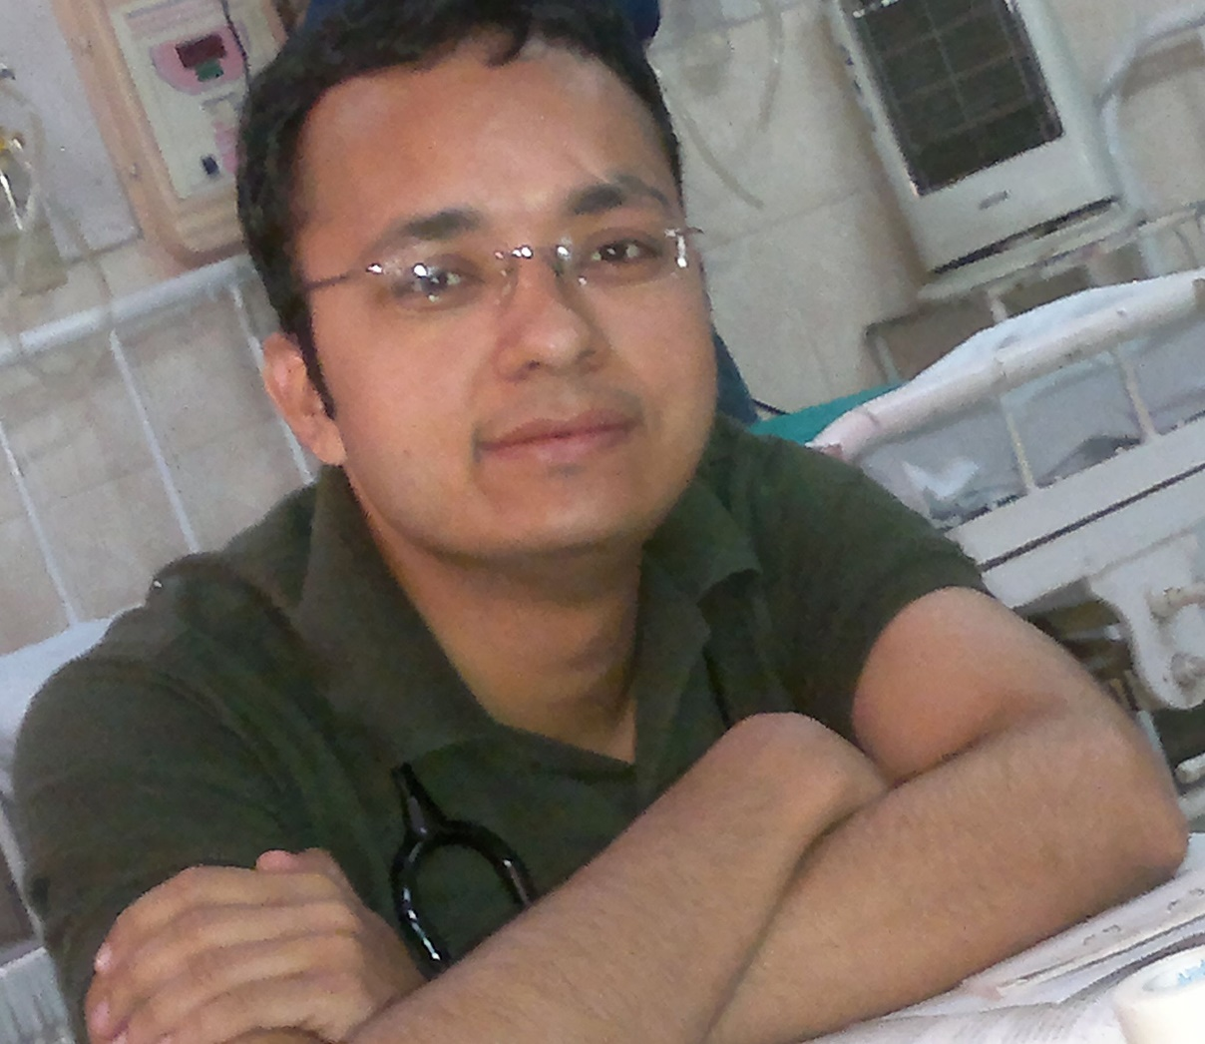
Dr Deepak Sharma, MD, DNB (Neonatology) is fellow of neonatology and researcher
Fernandez Hospital, Hyderabad, India
Phone +919462270002
Email address dr.deepak.rohtak@gmail.com

Slide 2
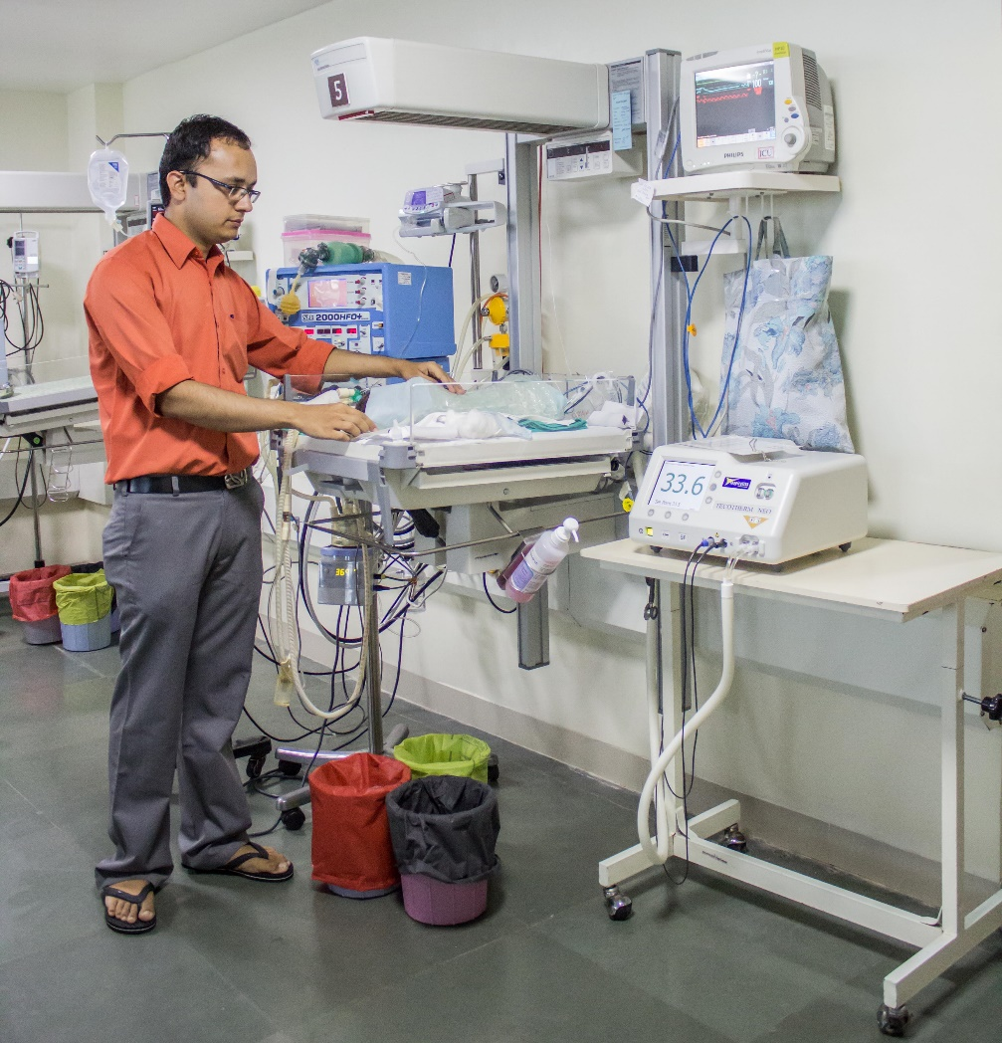
Dr Deepak Sharma applies his knowledge in field of neonatology to help neonates for better life.
His area of interest includes
Lactoferrin
Neonatal sepsis
Necrotizing enterocolitis
Neonatal jaundice

Slide 3
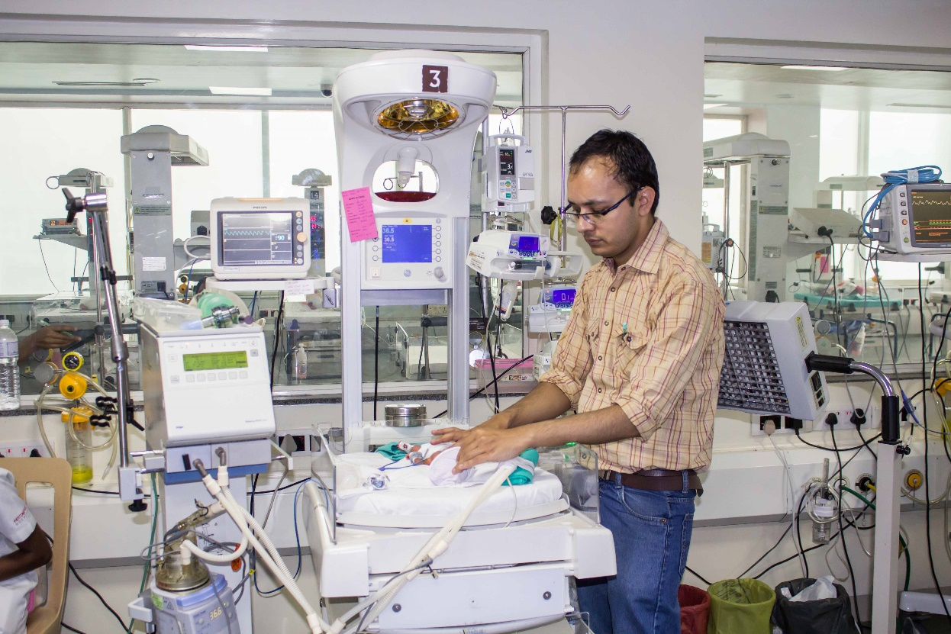
Neonatal jaundice
Kangaroo Mother Care
Hypothermia
His immense interest is to take good neonatal care with an intact survival.

Slide 4
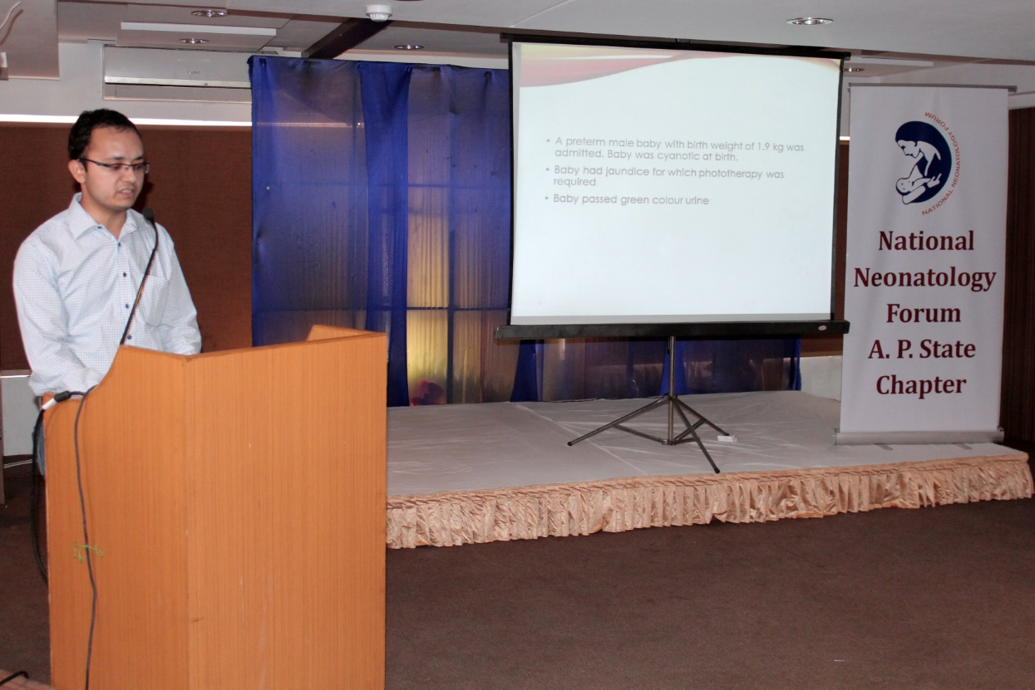
He is good speaker and has presented his hospital in many conferences

Slide 5
Dr Deepak Sharma, graduation (MBBS) from medical school in India (Sardar Patel Medical College, Bikaner, Rajasthan).
Pediatrics residency training (MD) from ( Pt B.D.Sharma Post Graduate Institute of Medical Sciences, Rohtak, Haryana)
Neonatology super-specialty (DNB Neonatology) training from Fernandez Hospital, Hyderabad , Andhra Pradesh

Slide 6
Has published multiple articles in peer reviewed journals in fields of pediatrics, neonatology and nutrition.
He is reviewer of many peer reviewed international journal and have contributed to field of neonatology by his reviews.

Slide 7
Publications: List of publication in both PubMed indexed and other journals
Deepak Sharma, Anuradha Murki, Srinivas Murki, Tejo Pratap. Use of Lactoferrin in the Newborn: where do we stand? Journal of Maternal-Fetal and Neonatal Medicine Accepted for publication: 1–21. Posted online on 23 Sep 2014.Read More: http://informahealthcare.com/toc/jmf/0/ja
Sharma D, Murki S, Pratap T. Anastomotic leak after primary repair of tracheo esophageal fistula: a dreadful condition. BMJ Case Rep. 2014 Jul 10; 2014. pii: bcr2014203982. Doi: 10.1136/bcr-2014-203982.
Sharma D, Murki A, Murki S, Pratap T. Anti-M antibodies as a cause of intrauterine fetal death and neonatal hyperbilirubinaemia. BMJ Case Rep. 2014 Apr 15; 2014. pii: bcr2014203534. Doi: 10.1136/bcr-2014-203534.
Bansal S, Gupta M, Sharma D, Bansal S. A rare case of Ibuprofen-induced eosinophilic meningitis in a 13-year-old girl. Clin Med Insights Pediatr. 2014 Feb 18; 8:3-4. Doi: 10.4137/CMPed.S13829. eCollection 2014.

Slide 8
Sharma D, Murki S, Pratap T, Vasikarla M. Cat eye syndrome. BMJ Case Rep. 2014 May 19; 2014. pii: bcr2014203923. Doi: 10.1136/bcr-2014-203923.
Murki S, Deshbhatla SK, Sharma D, Rao N, Verma S. Congenital ductus arteriosus aneurysm: an unusual cause of transient neonatal hypertension. BMJ Case Rep. 2014 May 5; 2014. pii: bcr2014203853. Doi: 10.1136/bcr-2014-203853.
Sharma D, Murki S. Congenital epulis. Arch Dis Child Fetal Neonatal Ed. 2014 Mar; 99(2):F104. doi: 10.1136/archdischild-2013-304526. Epub 2013 Jul 29.
Sharma D, Murki S, Dhanraj G. Congenital Hypothyroidism Presenting with Seizures and Pseudo-Hirschsprung's Disease in Newborn. Indian J Pediatr. 2014 Aug; 81(8):837. Doi: 10.1007/s12098-013-1274-6. Epub 2013 Nov 6.

Slide 9
Sharma D, Yadav J, Garg E. Cyclopia syndrome. BMJ Case Rep. 2014 Jun 9; 2014. pii: bcr2014203535. Doi: 10.1136/bcr-2014-203535.
Gathwala G, Sharma D, Bhakhri Bk. Effect of topical application of chlorhexidine for umbilical cord care in comparison with conventional dry cord care on the risk of neonatal sepsis: a randomized controlled trial. J Trop Pediatr. 2013 Jun; 59(3):209-13. Doi: 10.1093/tropej/fmt003. Epub 2013 Feb 13.
Sharma D, Gathwala G. Impact of chlorhexidine cleansing of the umbilical cord on cord separation time and neonatal mortality in comparison to dry cord care - a nursery-based randomized controlled trial. J Matern Fetal Neonatal Med. 2014 Aug; 27(12):1262-5. Doi: 10.3109/14767058.2013.854325. Epub 2013 Nov 7.
Singh A, Goyal M, Sharma D. Thrombocytopenia in malaria: its usefulness in a clinical setting. A study from Western Rajasthan, India. Trop Doct. 2014 Jul 31. pii: 0049475514543941. [Epub ahead of print]

Slide 10
Sharma D,Murki S,Pratap T,Madhavi V. Index of Suspicion in the Nursery. Neoreviews 2014; 15; e99. DOI: 10.1542/neo.15-3-e99
Sharma D, Murki S, Index of Suspicion in the Nursery Case 1: Persistent Respiratory Difficulty and Fever From 10 Days of Age Case. Neoreviews 2013; 14:e613-e617
Sharma D, Murki S, Pratap T. Impetigo contagiosa: an interesting and a very rare finding in a newborn. BMJ Case Rep. 2014 May 7; 2014. pii: bcr2014204639. Doi: 10.1136/bcr-2014-204639.
Murki S, Sharma D. Intrauterine Growth Retardation - A Review Article. J Neonatal Biol 2014, 3:3. http://dx.doi.org/10.4172/2167-0897.1000135
Sharma D, Murki S, Pratap T. Meconium peritonitis: an interesting entity. BMJ Case Rep. 2014 May 5; 2014. pii: bcr2014203536. Doi: 10.1136/bcr-2014-203536.
Patel A, Sharma D, Yadav J, Garg E. Split hand/foot malformation syndrome (SHFM): rare congenital orthopaedic disorder. BMJ Case Rep. 2014 Jun 27; 2014. pii: bcr2014204731. Doi: 10.1136/bcr-2014-204731.

Slide 11
Sharma D, Yadav J. Neonatal Purpura Fulminans. J Nepal Paediatr Soc 2014; 34(1):80. Doi: http://dx.doi.org/10.3126/jnps.v34i1.8975
Sharma D, Murki S, Madhavi V. Neurofibromatosis. J Nepal Paediatr Soc 2014; 34(1):81-82. doi: http://dx.doi.org/10.3126/jnps.v34i1.8535
Sharma D, Garg E. Twin-to-Twin Transfusion Syndrome. J Nepal Paediatr Soc 2013; 33(2):157. doi: http://dx.doi.org/10.3126/jnps.v33i2.8379
Sharma D, Murki S, Pratap T, Leelakumar V.Twin congenital epulis in the alveolar ridge of the maxilla and mandible in a newborn: a rare and interesting case.BMJ Case Rep. 2014 Sep 8;2014. pii: bcr2014206490. doi: 10.1136/bcr-2014-206490. No abstract available.PMID: 25199202

Slide 12
Sharma D, Murki S, Pratap T.A newborn with Omphalocele and Umbilical cord cyst: An interesting entity. Iran J Pediatr2014;24,4:449-450

Slide 13
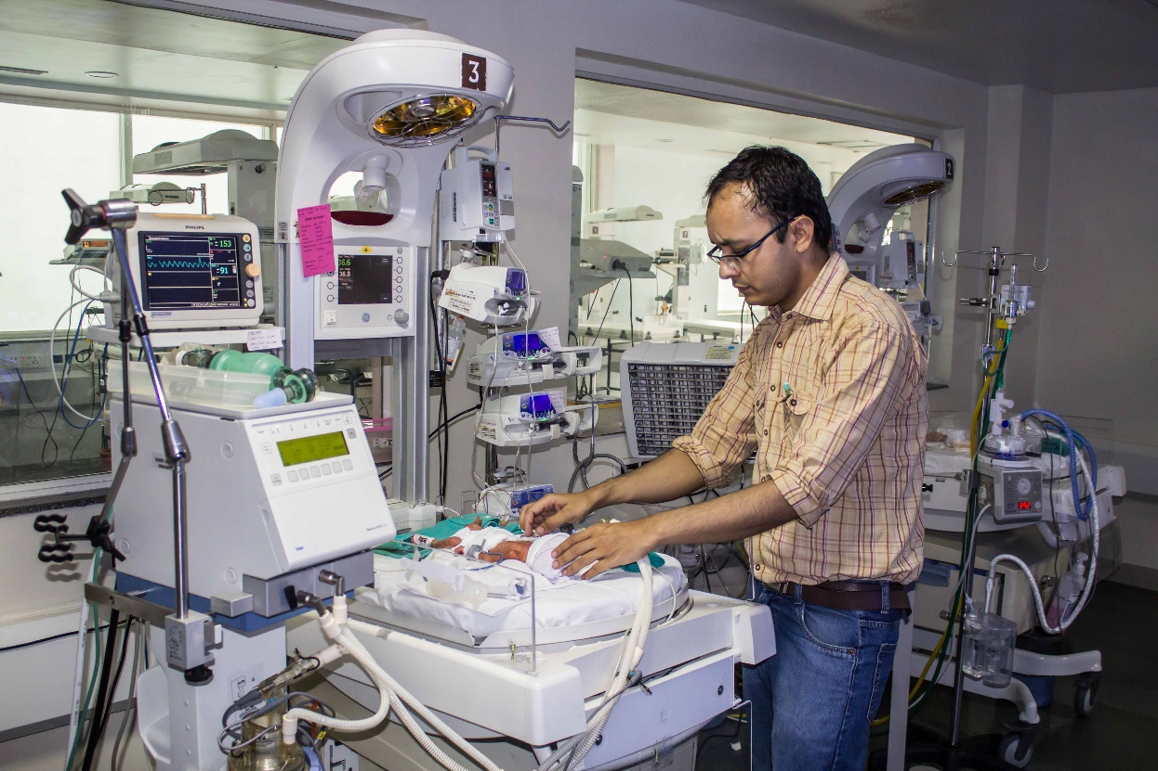
Ongoing research
Comparing early versus late Kangaroo mother care in the kangaroo ward for stable Extremely Low Birth Weight infants for improving the growth outcomes at term corrected age – Randomized Control Trial

Slide 14
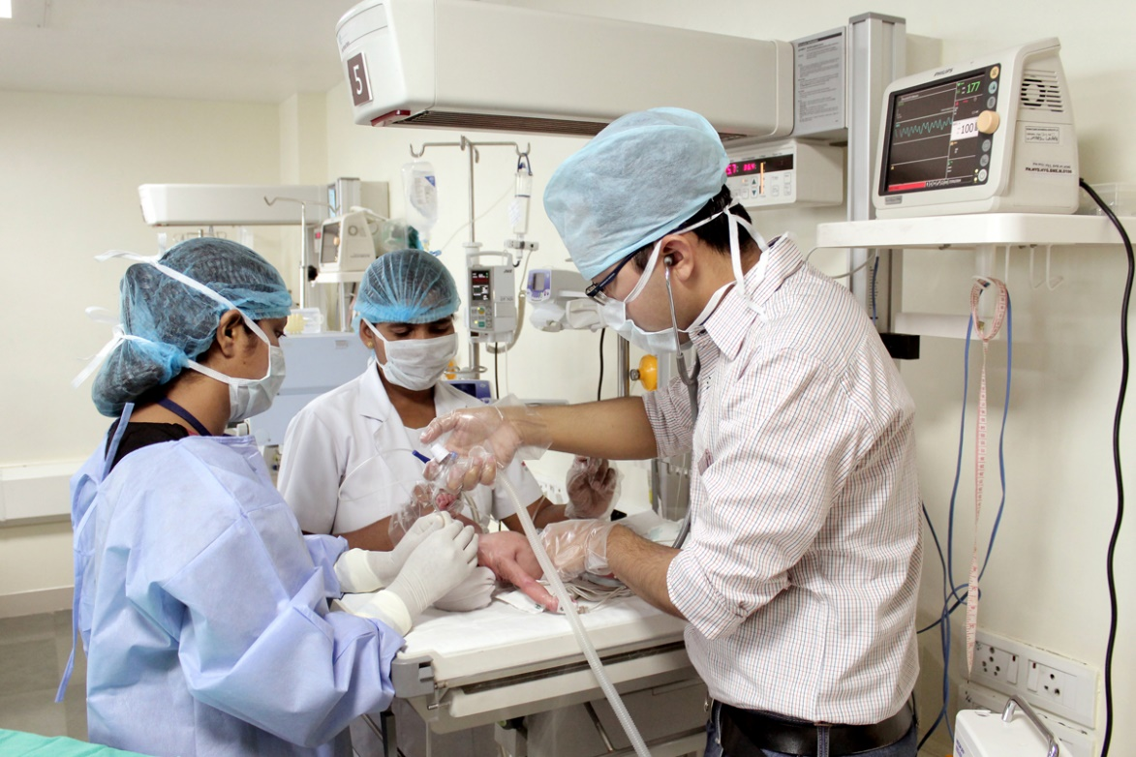

Slide 15
THANK YOU

