Slide 1
Dr. Hemonta Kr Dutta,MS,M.Ch.
Associate Professor & Head
Dept. of Pediatric Surgery
Assam Medical College & Hospital
Dibrugarh, Assam, India

Slide 2
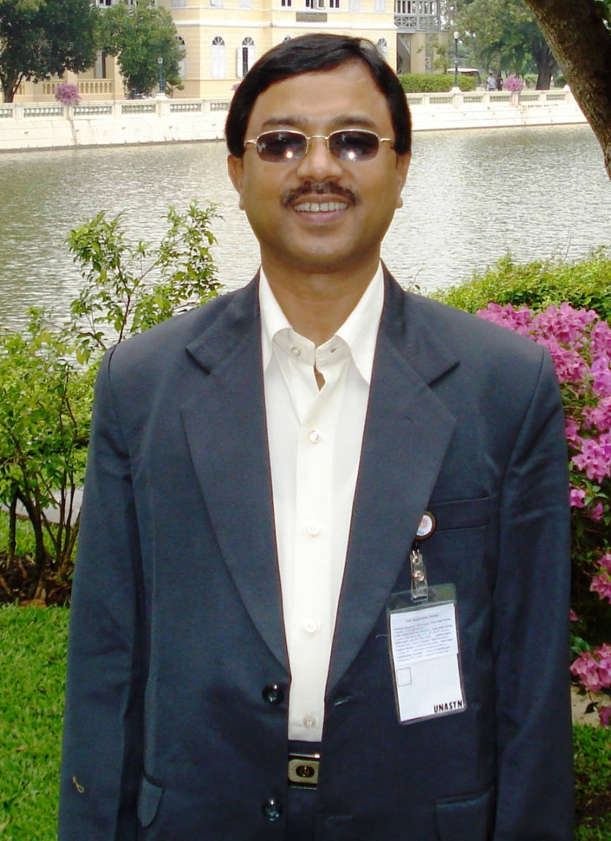
Address:
Department of Pediatric Surgery
Assam Medical College & Hospital
Dibrugarh, Assam, India
PIN-786002
E mail: hemontdut@gmail.com
Ph: +91-373-2301524(R)
+ 91-373-2300132 (O)
Mobile: +91-9435031257
Fax: +91-373-2300080

Slide 3
Education
MBBS and MS in General Surgery from Assam Medical College & Hospital, Dibrugarh.
M.Ch. in Pediatric Surgery from All India Institute of Medical Sciences , New Delhi in 1998.

Slide 4
Service
Assisstant Professor of Pediatric Surgery
( since 3.12.99 to 27.7.2011)
Associate Prof., Pediatric Surgery, AMCH since 28.07.2011.

Slide 5
Publication
Publication:
56 publications in peer reviewed journals including 22 in International Journals.
( Including 4 technical innovations)
Authored 5 chapters in books.
Scientific Presentations:
Presented 40 scientific papers including 10 in International and 31 in National and Zonal conferences.
CME Lectures:
Delivered 33 CME & Guest Lectures in National, Zonal and State level Conferences and Seminars of APSI, ASA, NE chapter of Indian Association of Pediatric Surgeons & PEDICON.
Editor of Journal of Association of Surgeons of Assam (ISSN- 2347-811X), a quarterly journal which is in the 21st years of publication since January, 2013.
Associate Editor, Journ of Progress in Paediatric Urology.

Slide 6
Research Interest
Congenital malformations
Pediatric surgical oncology
Pediatric neurosurgical reconstruction
Extrahepatic portal vein obstruction in children

Slide 7
OMICS International
www.omicsonline.org
OMICS International (and its subsidiaries), is an Open Access publisher and international conference Organizer, which owns and operates peer-reviewed Clinical, Medical, Life Sciences, and Engineering & Technology journals and hosts scholarly conferences per year in the fields of clinical, medical, pharmaceutical, life sciences, business, engineering, and technology. Our journals have more than 3 million readers and our conferences bring together internationally renowned speakers and scientists to create exciting and memorable events, filled with lively interactive sessions and world-class exhibitions and poster presentations. Join us! OMICS International is always open to constructive feedback. We pride ourselves on our commitment to serving the Open Access community and are always hard at work to become better at what we do. We invite your concerns, questions, even complaints. Contact us at contact.omics@omicsonline.org. We will get back to you in 24-48 hours. You may also call 1-800-216-6499 (USA Toll Free) or at +1-650-268-9744 and we will return your call in the same timeframe.
Contact us at: contact.omics@omicsonline.org

