Slide 1



Dr. Elisabetta Tosti Animal Physiology and Evolution laboratory Stazione Zoologica, Naples, Italy
Editorial Board Member
Journal of Marine Science: Research & Development

Slide 2

Elisabetta Tosti is senior scientist at the laboratory of Animal Physiology and Evolution of the marine biology institute “Stazione Zoologica”, Naples, Italy. She is contract Professor in the University of Naples. She is founder of the Italian Society of Embryology Reproduction and Research “ SIERR” . She served as a reviewer of 15 different peer-reviewed journals in the area of Cell Biology and Reproduction . She served as a reviewer for the “National Science Foundation” for grant assignment. She is member of the editorial board of the International Journal “ Marine Drugs” and Guest Editor of a special issue. She is member of the editorial board of the International Journal “ Journal of Cell Biology and Genetics”. She has been tutor of 7 degree thesis, 3 PhD thesis, and 5 post-doc fellowships. Invited speaker at numerous international conferences and seminars. She has organized conferences and Master Courses. She has published 55 reviewed papers, is author of 9 invited reviews, 6 book chapters, one book and is Editor of an E- book.

Slide 3

Research Interests
Her generalist expertise is in the field of Reproduction and Early Developmental Stages of marine animals and mammals. Her specialist expertise is on physiology of gametes maturation, activation and fertilization with specific emphasis on the electrical events occurring at the plasma membrane. Recently she has started to investigate the impact of marine pollution, xenobiotics and marine natural products on the reproductive processes and development of marine animals.

Slide 4

Recent publications
Gallo A, Russo GL, Tosti E. (2013) T-type Ca2+ current activity during oocyte growth and maturation in the ascidian Styela plicata. Plos One 8(1)54e604.
Gallo A. Tosti E. (2013) Adverse Effect of Antifouling Compounds on the Reproductive Mechanisms of the Ascidian Ciona intestinalis. Marine Drugs 11, 3554-3568.
Tosti E., Gallo A. Silvestre F. (2011) Ion currents involved in oocyte maturation, fertilization and early developmental stages of the ascidian Ciona intestinalis. Mol Repr Dev. 78, 854-60.
Russo GL. Bilotto S. Ciarcia G. Tosti E. (2009) Phylogenetic conservation of Cytostatic Factor related genes in the Ascidian Ciona intestinalis. Gene 429, 104-111.
Silvestre F. Cuomo A. Tosti E. (2009) Ion current activity and molecules modulating maturation and growth stages of ascidian (Ciona intestinalis) oocytes. Mol. Repr. Dev. 76, 1084-1093.

Slide 5

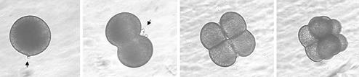
Ion currents and molecules involved in oocyte maturation, fertilization and embryo development

Slide 6
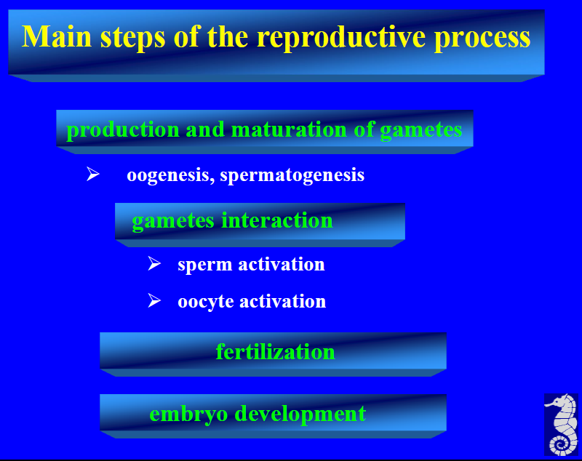

Slide 7
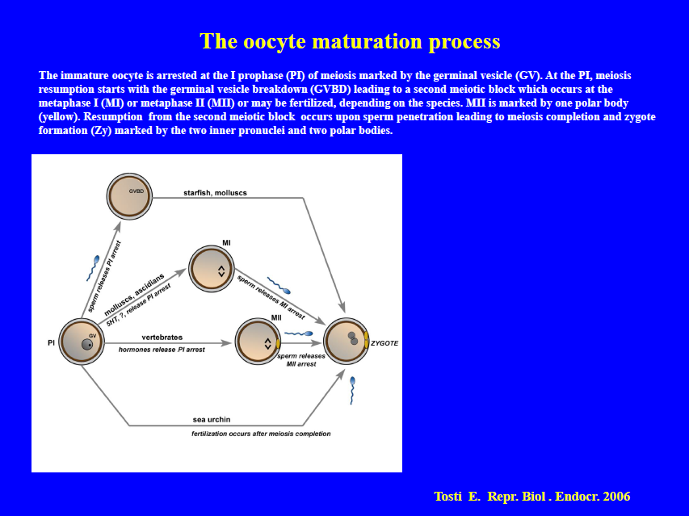

Slide 8
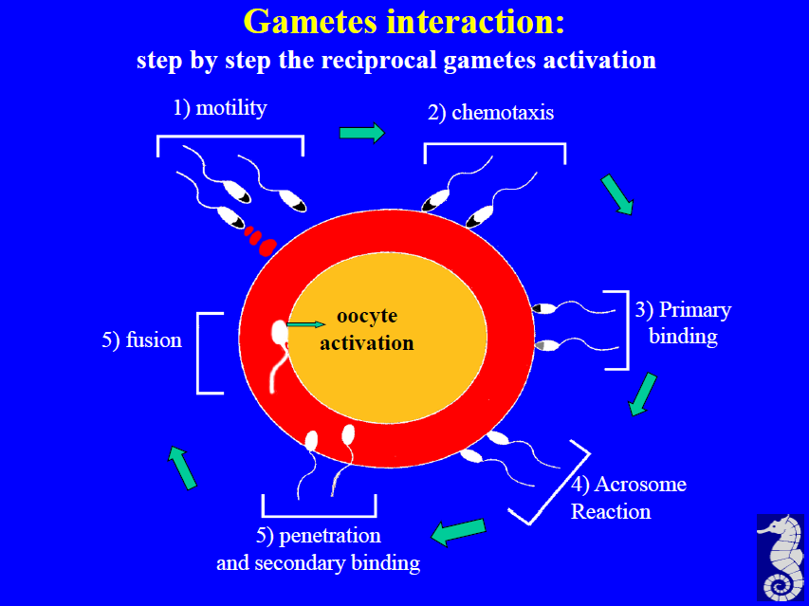

Slide 9
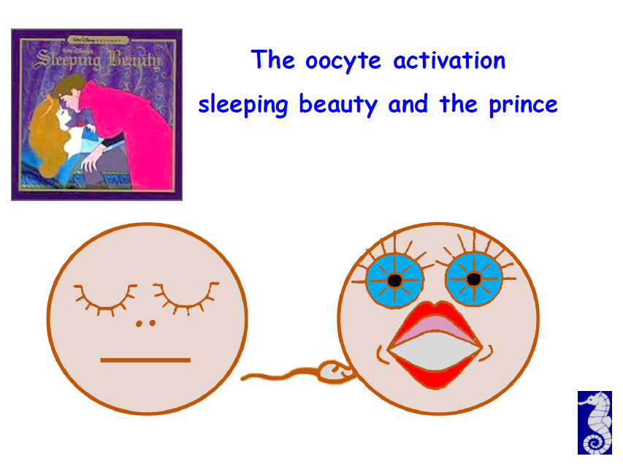

Slide 10
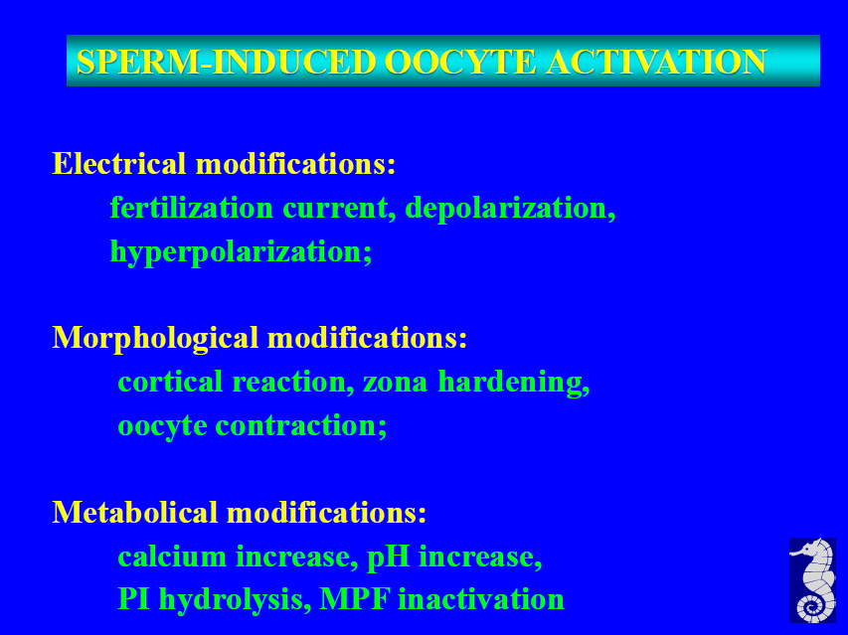

Slide 11
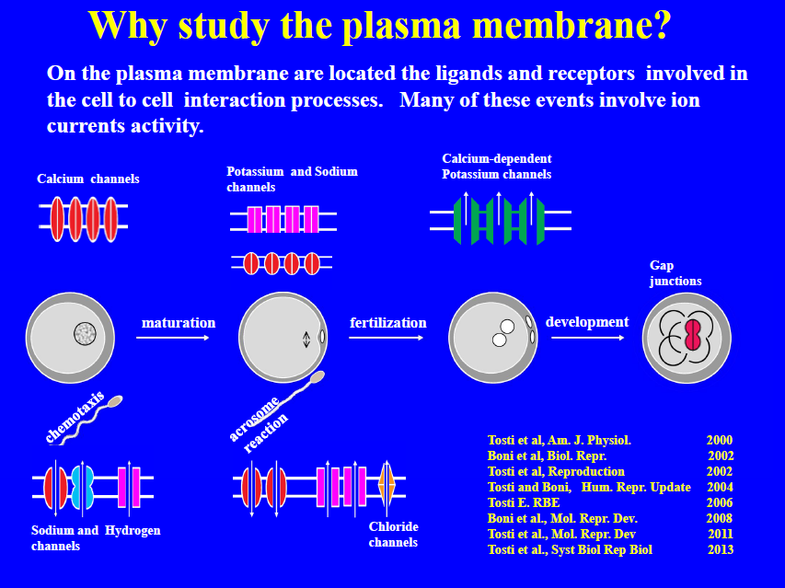

Slide 12
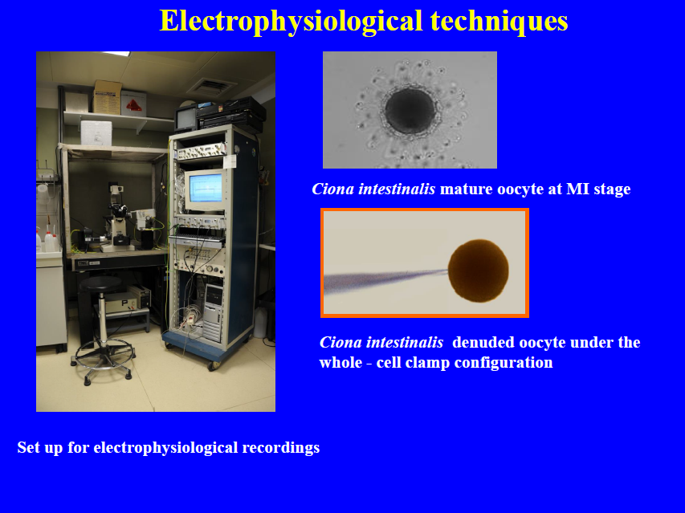

Slide 13
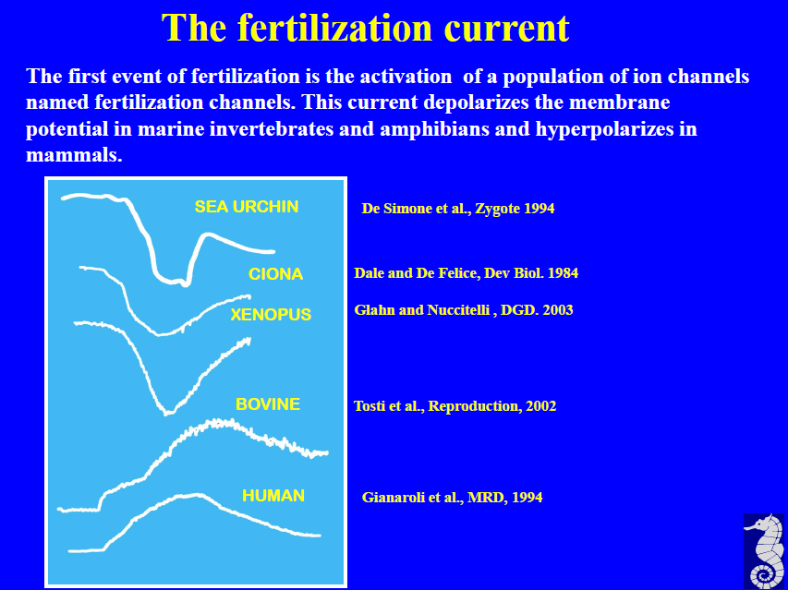

Slide 14
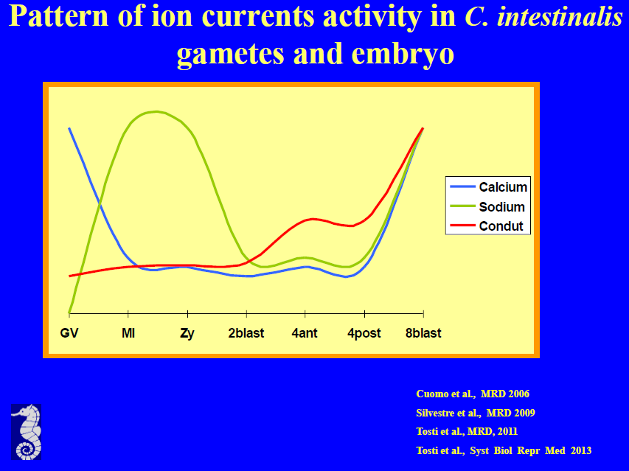

Slide 15
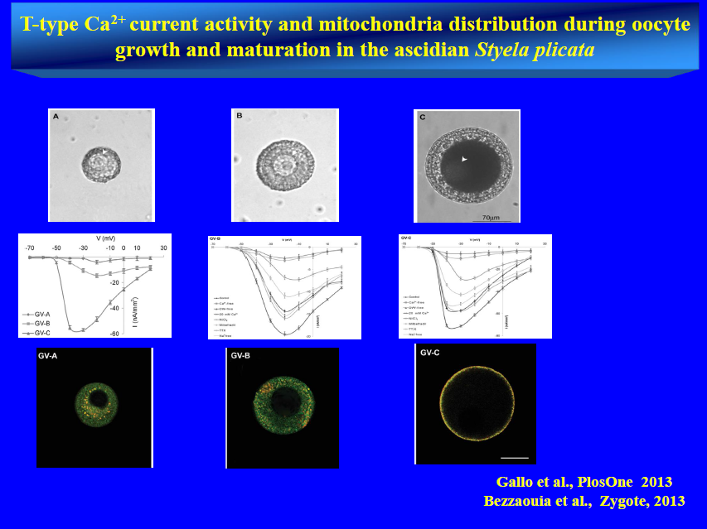

Slide 16
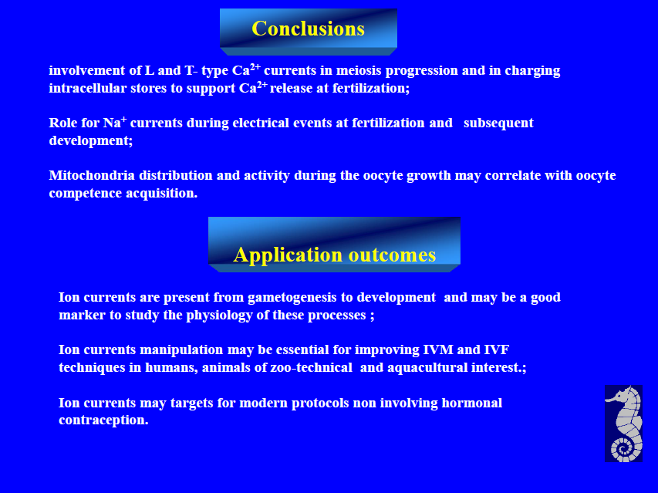

Slide 17
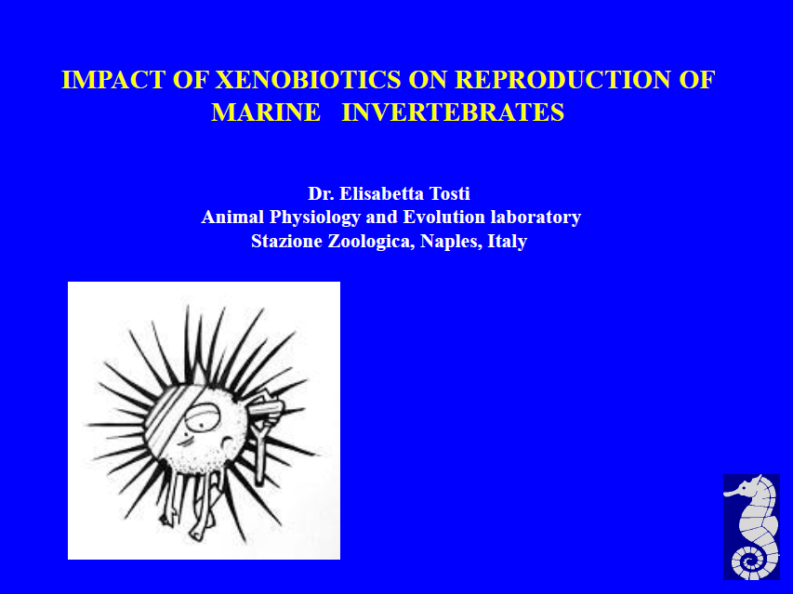

Slide 18
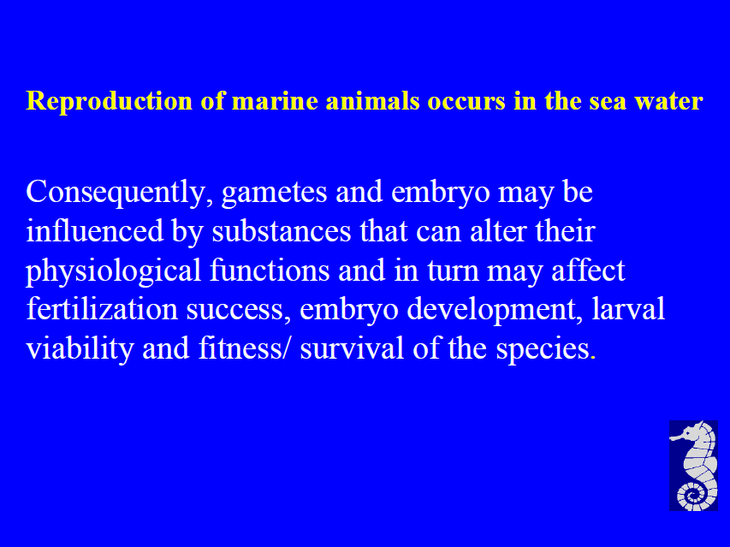

Slide 19
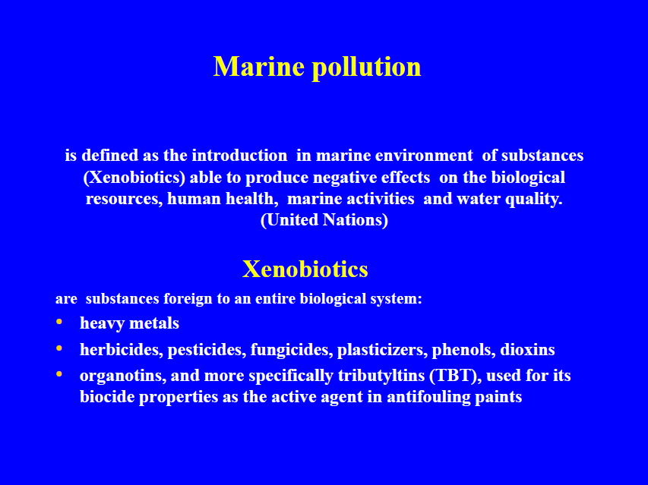

Slide 20
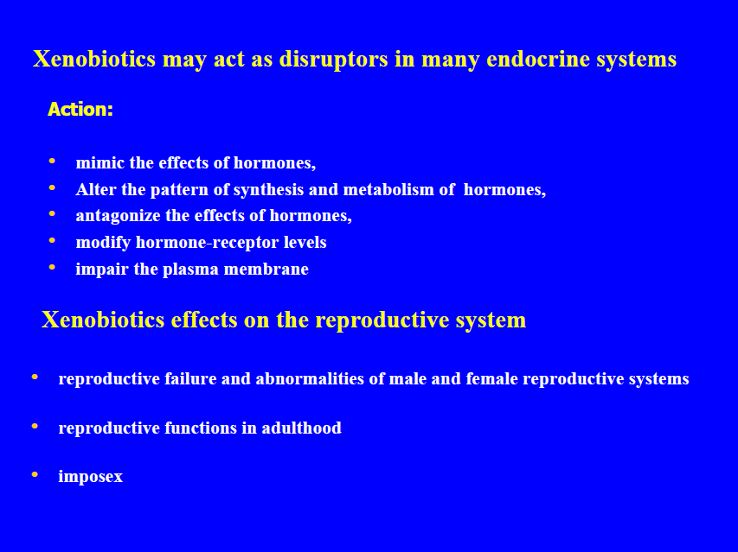

Slide 21
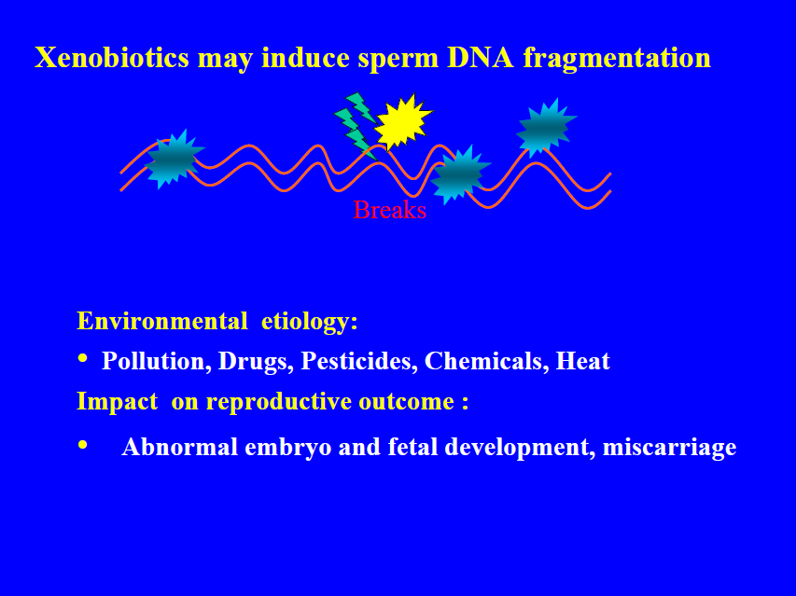

Slide 22
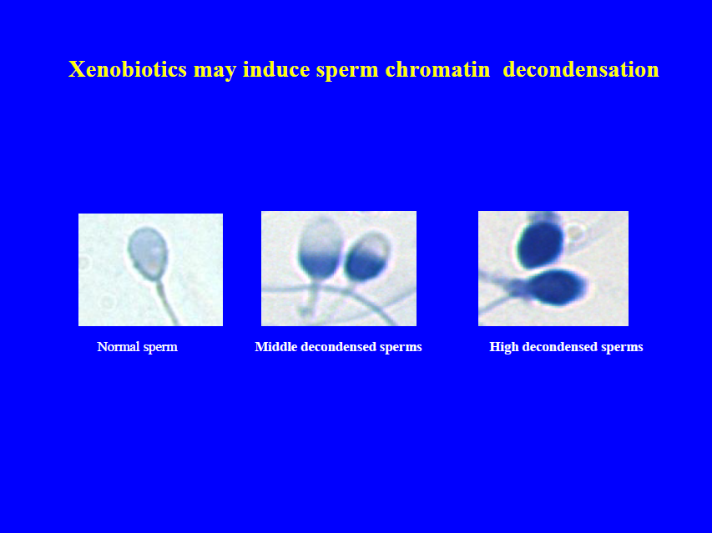

Slide 23
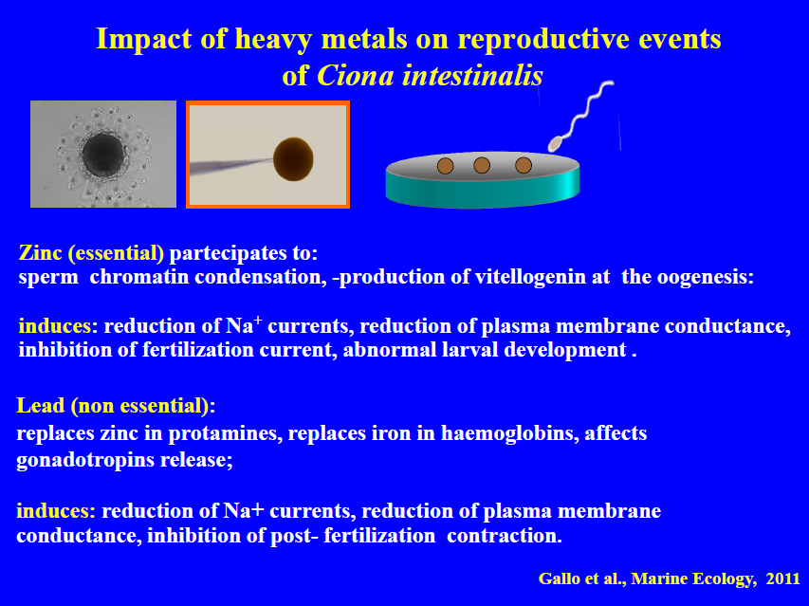

Slide 24
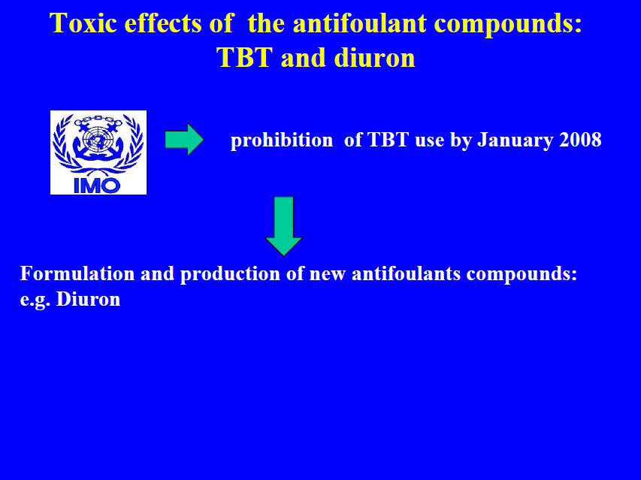

Slide 25
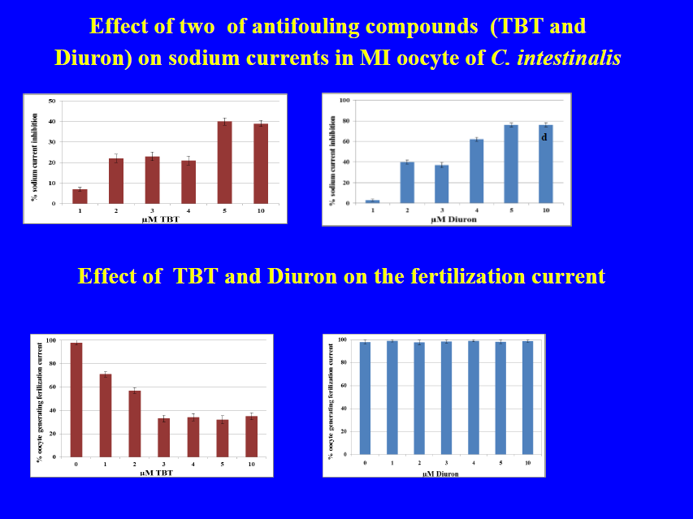

Slide 26
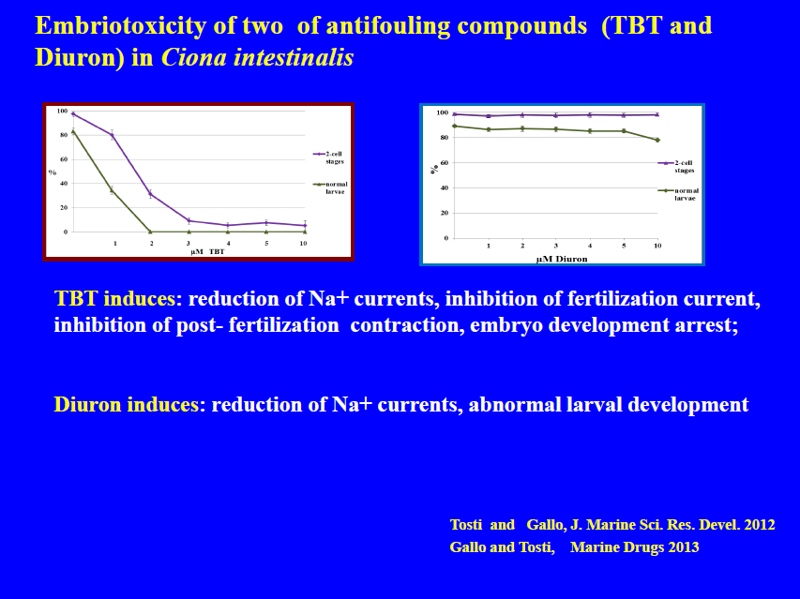

Slide 27
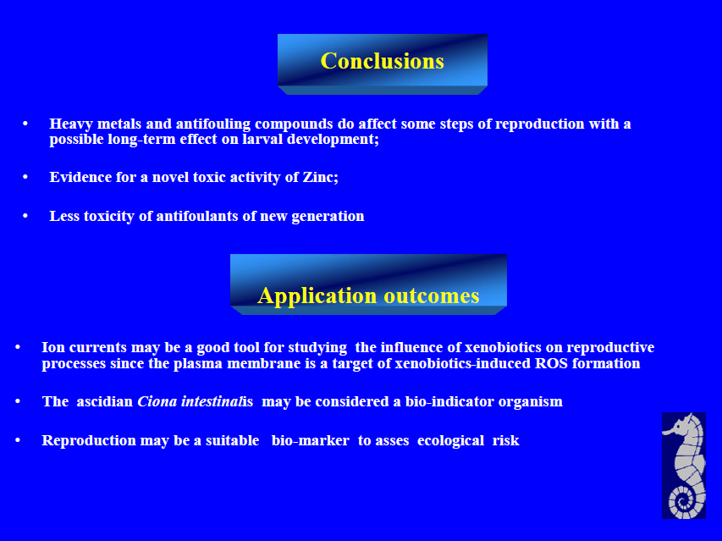

Slide 28
Approved By
E-signature:

Slide 29

OMICS Group Open Access Membership OMICS International Membership enables academic and research institutions, funders and corporations to actively encourage open access in scholarly communication and the dissemination of research published by their authors. For more details and benefits, click on the link below: http://omicsonline.org/membership.php

