Slide 1

University of Barcelona
F. Xavier Abad Morejon de Giron Campus of Universitat Autonoma de Barcelona Spain

Slide 2
BIOGARAPHY
His main research interest are persistence of animal and human viruses in the environment, with particular attention to water, fomites and foods, and the inactivation and removal procedures for assuring the viral safety of blood derivatives, cosmetics and foods, and, also, bio containment and biosafety issues in microbiological research laboratories, among others. He has written more than 30 papers in international journals and 6 book chapters. The spreading of his work has been, also, achieved through more than 50 oral or poster communications, mainly, in international congresses or symposia. In the last seven years he has became the person in charge on biosafety management in Centre de Recerca en Sanitat Animal (CReSA), managing 500 m2 BSL3 laboratory areas (in a whole Biocontainment Unit constituted of three floors of 1500 m2 each one), and from 18 months ago, he also took the management of CReSA BSL2 laboratories.

Slide 3
Biosafety, quality and viral inactivation
Xavier Abad Morejón de Girón
PhD in Biological Sciences
BSL2/BSL3 Laboratory Manager
Biosafety Officer

Slide 4
Main fields of interest
Environmental virology.
Viral inactivation procedures. Validation and standardization. Application to biosafety standard protocols.
Application of quality tools in the management of a biosafety facility.

Slide 5
Main fields of interest
Environmental virology (in stand by)
  Persistence of virus on waters
  Persistence of virus on fomites
  Environmental microbial activity with virucidal properties.
Abad, F.X., Pintó, R.M., and Bosch, A. 1994. Survival of enteric viruses on environmental fomites. Appl. Environ. Microbiol. 60;3704-3710.
Abad, F.X., Pintó, R.M., Gajardo, R., and Bosch, A. 1997. Viruses in mussels: public health implications and depuration. J. Food Protection 60;677-681.
Bosch, A., Pintó, R.M., Villena, C. and Abad, F.X. 1997. Persistence of human astrovirus in fresh and marine water. Wat. Sci. Technol. 39;243-247.
Villena, C., Morsy, W., Abad, F.X., Pintó, R.M., and Bosch, A. 2003. Group A rotavirus in sewage samples from Barcelona and Cairo: emergence of unusual genotypes. Appl. Environ. Microbiol. 69;3919-3923.
Caballero, S., Abad, F.X., Loisy, F., Le Guyader, F.S., Cohen, J., Pintó, R.M., and Bosch, A. 2004.Rotavirus virus-like particles as tracers in environmental studies. Appl. Environ. Microbiol. 70;3904-3909.

Slide 6
Main fields of interest
Viral inactivation procedures.
    On solution, desiccated on fomites (carrier), on foods…
Assay of viral inactivation procedures on demand (or due to biosafety requirements of CReSA) on a broad range of viruses, either RNA or DNA, enveloped or non-enveloped.

Slide 7
Main fields of interest
Viral inactivation procedures.
    On solution, desiccated on fomites (carrier), on foods…
Abad, F.X., Pintó, R.M., Diez, J.M., and Bosch, A. 1994. Disinfection of human enteric viruses in water by copper and silver in combination with low levels of chlorine. Applied and Environmental Microbiology 60;2377-2383.
Abad, F.X., Pintó, R.M., and Bosch, A. 1997. Disinfection of human enteric viruses on fomites. FEMS Microbiology Letters 156;107-111.
Abad, F.X., Pintó, R.M., and Bosch, A. 2000. Virus-inactivation processes: The way to ensure virus safe products. Recent Research Developments in Microbiology 4:643-655.
Abad, F.X. y Fraile, L. 2009. Teoría y práctica de la limpieza y desinfección en granjas porcinas. Suis 58; 14-22 (in Spanish)
Abad, X., Majó, N., Rosell, R., and Busquets, N. 2012. Assay of several inactivation steps on West Nile Virus and H7N1 highly pathogenic avian influenza virus suspensions. Biosafety (http://dx.doi.org/10.4172/2167-0331.1000103)

Slide 8
Main fields of interest
Viral inactivation procedures. Validation and standardization.
Data expressed, in all cases, as log10 reduction form initial viral titer. NR: No reduction after treatment; ND: Not done yet; (T): Toxicity at high dilutions, the effectiveness of the treatment could be higher that reported; (*): Carrier test performed with viral inocula desiccated on inert surfaces and submitted to H2O2 cycle strictly following manufacturer’s instructions.

Slide 9
Main fields of interest
Viral inactivation procedures. Application to disinfection biosafety standard protocols
Data expressed, in all cases, as log10 reduction form initial viral titer. NR: No reduction after treatment; ND: Not done yet; (T): Toxicity at high dilutions, the effectiveness of the treatment could be higher that reported; (*): Carrier test performed with viral inocula desiccated on inert surfaces and submitted to H2O2 cycle strictly following manufacturer’s instructions.

Slide 10
Main fields of interest
Application of quality tools in the management of a biosafety facility.
  GLP application on research groups
  ISO 17025 application in a research facility. How, on what and why?
  ISO 15793 Biological risk management on biocontainment facilities.
  Lifelong training of staff in biosafety issues

Slide 11
Main fields of interest
Application of quality tools in the management of a biosafety facility.
Abad, F.X. 2005. Principis de Bones Pràctiques de Laboratori (BPLs). Implantació en un Laboratori de Recerca. Omnis cellula 8;22-27. (in catalan).
Abad, F.X., Bosch, A., y Navarro, C. 2005. Implementation of Good Laboratory Practice in a University Research Unit. Quality Assurance Journal. 9; 304-311.
Weidmann, M., Hufert, F., Elschner, M., Silman, N., Mirazimi, A., Morejón de Girón, F., Butaye, P. 2009. Networking for BSL-3/4 laboratory scientist training. Nature Reviews Microbiology 7;756.
Abad, FX. 2013. Biosafety and Quality issues must go hand in hand. Biosafety (doi: 10.4172/2167-0331.1000e142).
Abad, X. 2014. CWA 15793: When the Biorisk Management is the Core of a Facility. Biosafety 3: 119. (doi:10.4172/2167-0331.1000119)

Slide 12
Where I work?
CReSA, research facility devoted to Animal Health. Our state-of-the-art building started in operation at 2006. More than 100 people (among technicians, researchers and platform staff).
Funding from governmental departments and agencies, from national and European competitive projects and from contracts with private companies.

Slide 13
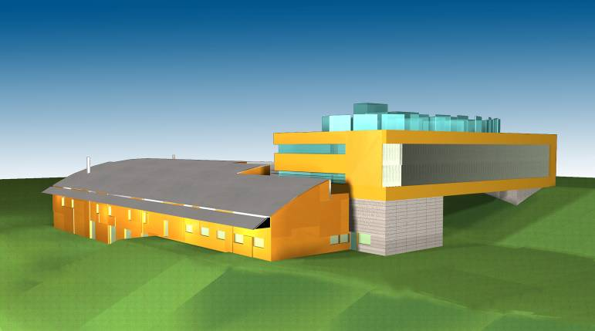

The whole building
4. BSL2 Laboratories
3. Offices, meeting rooms
2. Air treatment floor
1. BSL3 Animal boxes and laboratories
0. Liquid and solid wastes treatment floor
Air treatment
Animal Boxes
Laboratories
“Sandwich”
“Box in a Box”
Liquid /solid wastes treatment
BSL3/4 training school, May 2014
Notes:
COST ACTION B28 BSL3 Training course May 2009
13
13
The Biocontainment Unit of CReSA is constituted by three floors; two of them are technical floors giving services to the central one, where animal boxes and laboratories are allocated. The upper floor is devoted to air filtration (inhaust or supply and exhaust) and the bottom floor to treatment of liquid but also solid wastes. Besides NBS3 facility there is a conventional building with BSL2 laboratories and a floor of offices and meeting rooms.

Slide 14
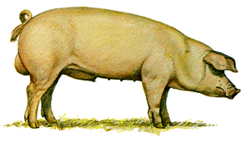

HEPA filtration
at the entry
twice HEPA filtration in the exhaust
Video camera
Shower
Air-tight door
Portable divisors
Dressing room
Dressing room
Eslat
Water
Pool for stool and orin collection
Chemical inactivation

Slide 15
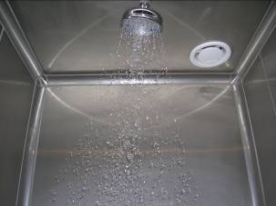
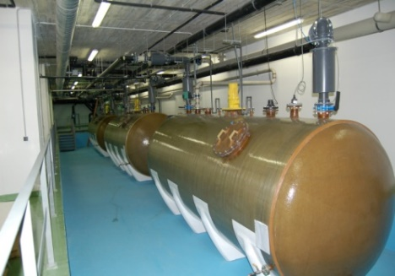
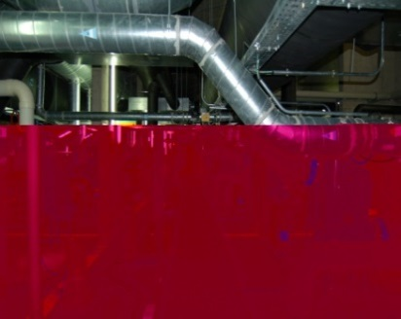
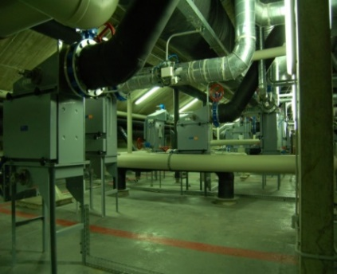
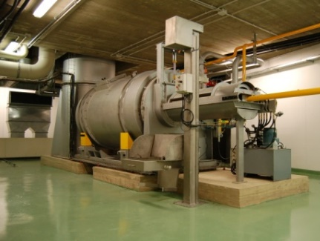
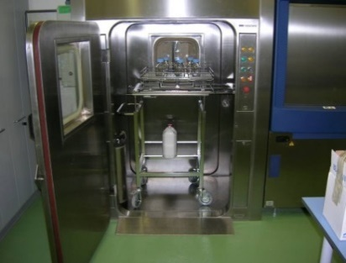
Where I work
Shower
Sterilizer
HEPA filters
Personnel
Liquids
Negative pressure
Air
Incinerator
Autoclaves
Solids

Slide 16
Biosafety, quality and viral inactivation
More than 40 international SCI papers.
Several chapters in virology books.
Contracts with private companies.
External expert for private companies in assessment of viral inactivation steps.
Expert in GLP and ISO implementation in research environments.

Slide 17

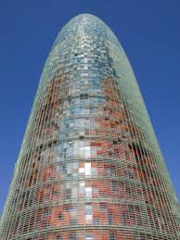
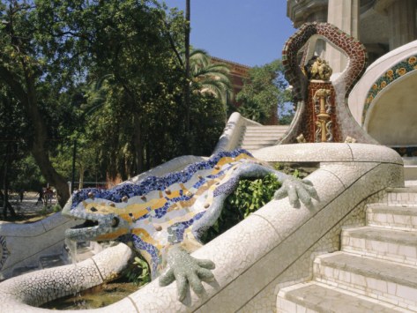
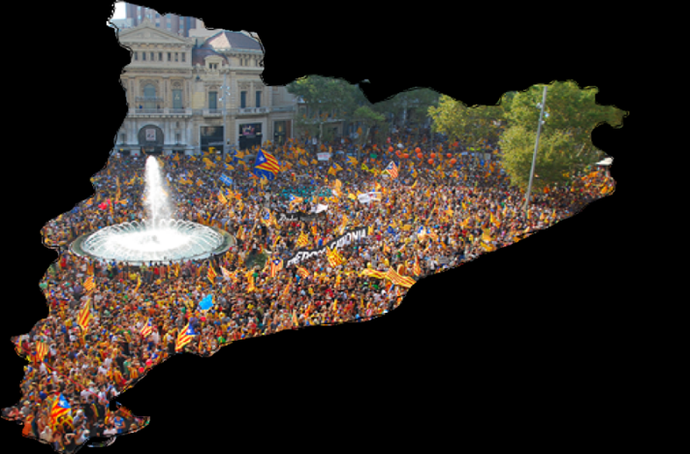

CReSA
CReSA Building
Campus Universitat Autonoma de Barcelona
08193 Bellaterra, BCN, Catalonia
xavier.abad@cresa.uab.cat

Slide 18


OMICS Group Open Access Membership
OMICS International Open Access Membership enables academic and research institutions, funders and corporations to actively encourage open access in scholarly communication and the dissemination of research published by their authors.
For more details and benefits, click on the link below:
http://omicsonline.org/membership.php

