Slide 1
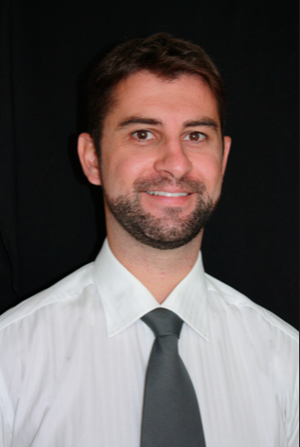

Dr. Fernando Antonini, DDS MSc
Oral and maxillofacial Surgery and Implant Dentistry
FACE – Fernando Antonini Cirurgia e Estética
Rua Antônio De Lucca, 148 – sl. 107
Criciúma, SC
Brazil
(48) 99465051 / (48) 34225775
drfernandoantonini@gmail.com

Slide 2
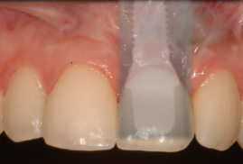
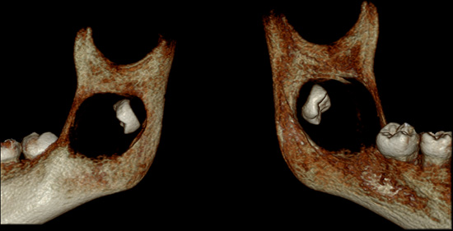
Dr. Antonini fields of practice are based on:
Minor oral surgeries
Dental implants
Alveolar and jaws reconstruction
Oral and maxillofacial Pathology
Oral and maxillofacial Trauma
Orthognathic Surgeries
TMJ Surgeries

Slide 3
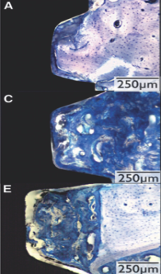
Dr. Antonini main research interests involve:
Osseointegration of dental implants
Biomaterials for alveolar reconstruction
Fixation devices in alveolar reconstruction and orthognathic surgery

Slide 4
Dr. Antonini has published a couple articles in
ABREU, M.E. ; VALIATI, R. ; HUBLER, R. ; MORAES, A.N. ; ANTONINI, F. ; OLIVEIRA, H.C. ; PAGNONCELLI, R.M. . Effect of recombinant human Growth Hormone (rhGH) on osseointegration of titanium implants: a histological and biomechanical study in rabbits. Journal of Oral Implantology , 2014, Jun 19 (Epub ahead of print)
KLÜPPEL, L.E. ; ANTONINI, F. ; SILVA, A.C. ; MORAES, M. . Emphysematous complications following third molars removal: incidence among 10779 surgeries and report of two cases. Open Journal of Stomatology, 2014, July 5 (Epub ahead of print)
ANTONINI, F. ; COELHO, FA ; KLÜPPEL, L.E. ; REBELLATO, N. L. B. . Tetanus: an unusual finding in dental office. Journal of Oral and Maxillofacial Surgery, Medicine and Pathology, 2014; v. 26, (1): 68-72.
KLÜPPEL, L.E. ; ANTONINI, F. ; OLATE, S. ; NASCIMENTO, F. F. ; ALBERGARIA-BARBOSA, J. R. ; MAZZONETTO, R. .Bone repair is influenced by different particles sizes of anorganic bovine bone matrix: a histologic and radiographic study in vivo. The Journal of Craniofacial Surgery, 2013; v. 24 (4):1074-7.
KLÜPPEL, L.E. ; STABILE, G. A. V. ; ANTONINI, F. ; NASCIMENTO, F. F. ; MORAES, M. ; MAZZONETTO, R. . Use of Resorbable Screws for Autogenous Onlay Block Graft Fixation: A Histological Analysis in Rabbits. The Journal of Oral Implantology, 2013; v. 39,(1):29-33.
CORSO, P. F. C. L.; NASCIMENTO, L. C.; KLÜPPEL, L.E.; COSTA, D. J.; ANTONINI, F.; SCARIOT, R . Sagital split osteotomy and impacted third molars: a paradigm shift. Brazilian Journal of Oral and Maxillofacial Surgery, 2013; v. 13, (4):33-38.

Slide 5
Presentations in meetings:
“Orthognathic Surgery: Diagnosing, Planning and Treating Dentofacial Deformities “
Presented as a Conference Course in II Jornada Odontológica UNESC – Criciúma, Brazil, 2013
“Use of resorbable screws for autogenous onlay block grafts fixaion: a histological analysis in rabbits”.
Presented at: 20th ICOMS – Santiago, Chile – 2011
“Influence of different particles sizes of anorganic bovine bone matrix on bone repair: histologic and radiographic analysis in surgically created defects in rabbit calvaria”.
Presented at: 20th ICOMS – Santiago, Chile – 2011
“Maxillofacial Trauma and Reconstruction”.
Presented as a pre-conference course (2 hours course). Paraná Federal University – Curitiba, Brazil - 2011
“Occlusal plane manipulation for facial esthetics improvement in bimaxillary orthognathic surgeries”.
Presented at: XXXI SAOJEM – Curitiba, Brazil - 2011
“Virtual planning in orthognathic surgery: tridimensional diagnosis and planning”.
Presented at: XXXI SAOJEM – Curitiba, Brazil - 2011
“Coronal Approach for Panfacial Fractures”
Presented at: XXXI SAOJEM – Curitiba, Brazil - 2011

Slide 6
Honors and Awards:
2013 – Best poster presented in XXII Brazilian OMFS Meeting – Rio de janeiro, Brazil
Title: Cartilaginous graft in lower eye lid for ectropion correction.
2012 – Second Best Oral Presentation in XXXII SAOJEM – Curitiba, Brazil
Title: Bone Pathology associated to impacted tooth in mandible: diagnostic hypothesis and report of a case.
2007 - Best Oral and Maxillofacial Surgery Student of Santa Catarina Federal University
Awarded by: Brazilian Association of Oral and Maxillofacial Surgeons

Slide 7
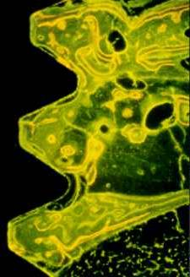
Osseointegration of dental implants
A major goal of biomedical engineering is to produce replacement parts for diseased or damaged tissues, and bone implants are considered to be one of the most successful prosthetic devices. Most orthopedic and dental implants are now engineered in such a way as to have sufficient strength and biocompatibility, so the key challenge has become to devise ways to accelerate the integration of an implant into bone.

Slide 8
Osseointegration of dental implants
Several factors including surface treatment, implant macro and microdesign, surgical technique among others play a role on implant osseointegration and many researches are performed every day aiming to accelerate this healing process.
Some studies have sought to act in bone physiology through the use of growth factors (GFs), which are endogenous proteins capable of activating receptors on cell surfaces directly involved in the bone tissue regeneration. GFs include growth hormone (GH), insulin-like growth factor (IGF-1 and -2), fibroblast growth factor (FGF-2), melatonin, parathyroid hormone (PTH), calcitonin, and morphogenetic and osteogenic proteins. In oral implantology, GFs seem to be particularly suitable to accelerate bone repair and to enhance bone implant osseointegration and/or bone graft incorporation in poor bone quality situations.

Slide 9
Osseointegration of dental implants
GH affects the function of most body cells, directly increasing intracellular metabolism and thus promoting whole-body growth. GH acts on protein synthesis, cell multiplication and differentiation of certain specific cell types, such as bone-forming cells and immature muscle cells. In bone tissue, GH promotes increased protein deposition by chondrocytes and osteoblasts, increased rate of mitosis and conversion of chondrocytes into osteoblasts. In this context, GH has been used experimentally to stimulate bone healing, either by topical application in bone defects, aiming to obtain osteoinductive paracrine and/or autocrine effects, or by parenteral administration, aiming at endocrine actions. However, few studies have investigated the effects of GH on the healing of bone fractures and on the osseointegration process of titanium implants.

Slide 10
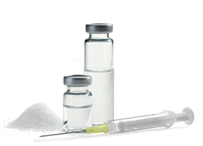
Osseointegration of dental implants
Growth hormone(GH)
    Stimulates cell growth and reproduction
    Used in growth disturbance pathologies
rhGH:
    Stimulates osteoblast proliferation and differentiation
    Stimulates osteoclastic activity (bone resorption)
    Promotes bone turnover acceleration

Slide 11
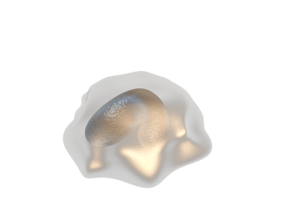
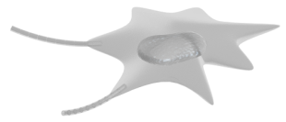
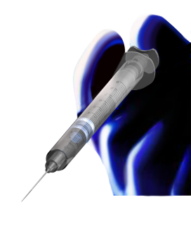
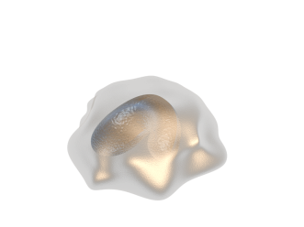
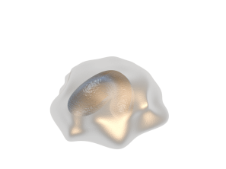

rhGH – effect in bone metabolism
Notes:
Solventes organicos sao utilizados na preparacao do PLGA
Além desta instabilidade física e química do rhGH em meio aquoso, tal subtsância pode ainda sofrer desnaturação física quando exposto a solventes orgânicos¹¹⁸. A exposição a solventes orgânicos é necessária para a confecção da matriz de PLGA, já que o PLGA não é solúvel em solventes aquosos

Slide 12
rhGH – effect in bone metabolism
OSTEBLASTS
Cell proliferation and differentiation on osteoblastics cell lines
Production of type I collagen
Alkaline phosphatase and osteocalcin production
IL-6 (bone resorption molecule)
OSTEOCLASTS
Osteoclastic activuty stimulation
Direct stimulation of rhGH on osteoblasts, promoting bone formation
Direct and indirect stimulation of rhGH on osteoclasts, promoting bone resorption

Slide 13
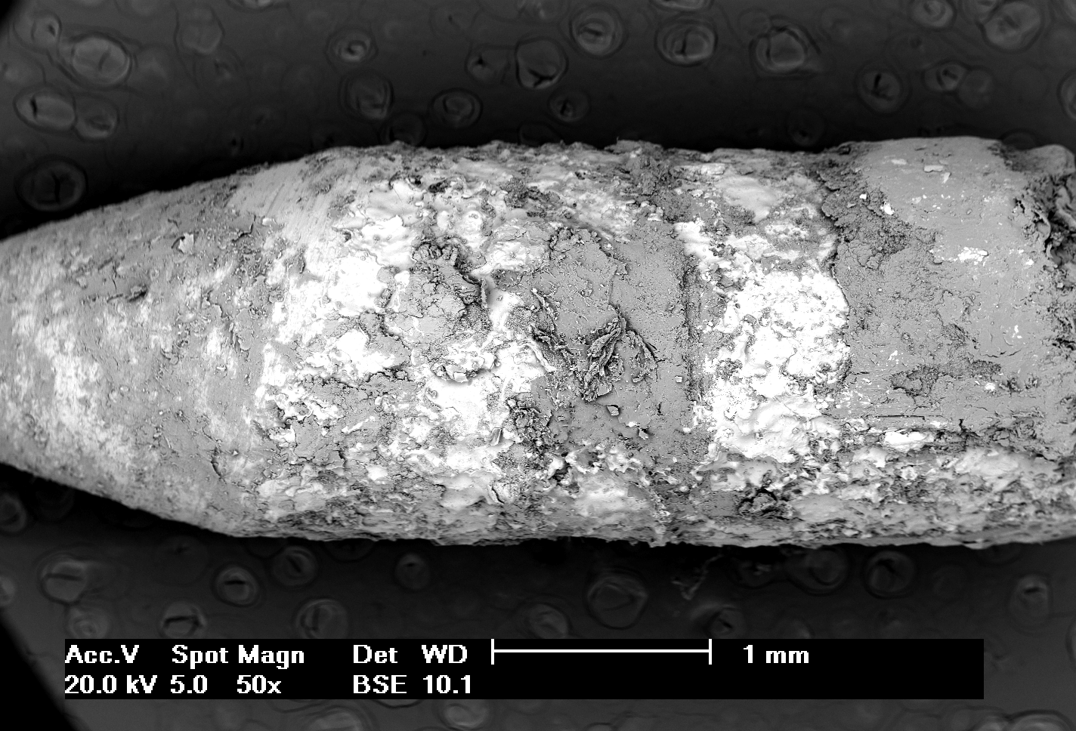
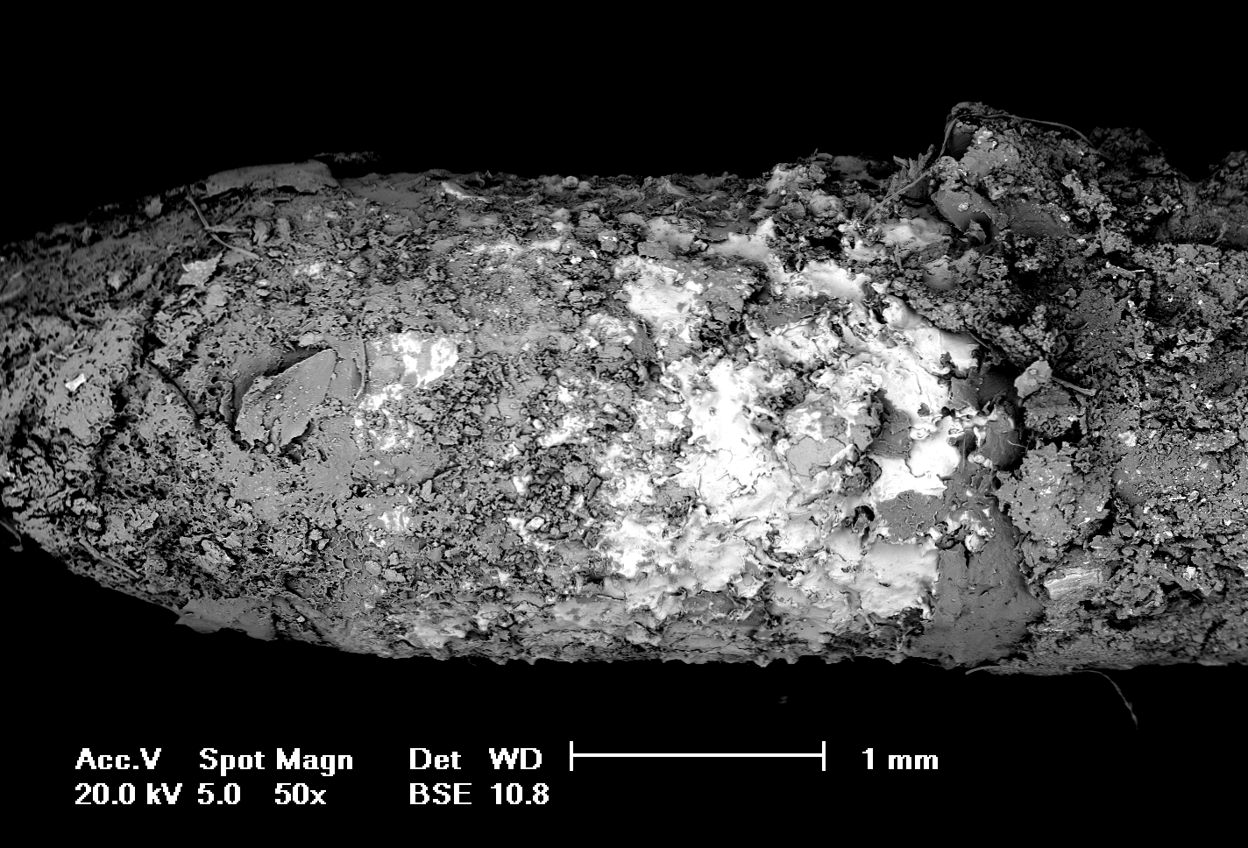
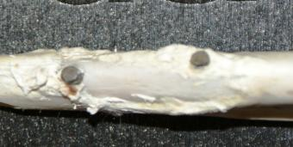
Osseointegration of dental implants
Our research focus on the use of rhGH in implant sites aiming to accelerate osseointegration.
Rabbit tibia containing dental implants
SEM analysis of the implants 14 days after implant insertion
SEM analysis of the implants 14 days after implant + rhGH insertion

Slide 14
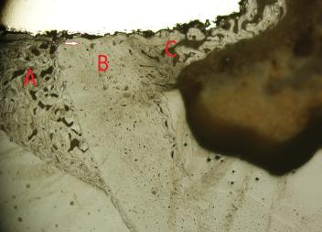
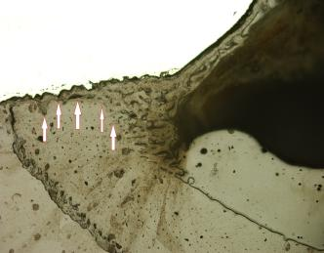
Osseointegration of dental implants
Reflection light microscopy of peri-implant bone area 14 days after implant insertion
Implant + rhGH
Implant only
Brigthfield illumination, where (A) corresponds to cortical reaction, (B) to newly formed lamellar bone, (C) to bone marrow and the arrow indicates Haversian canal
Brigthfield illumination, the arrows indicate the boundary between immature newly formed bone in contact with the implant and lamellar bone

Slide 15
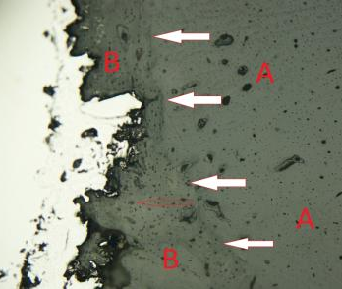
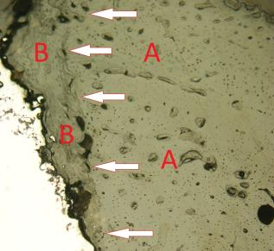
Osseointegration of dental implants
Light microscopy of peri-implant bone area 42 days after implant insertion
(A) corresponds to original bone, (B) to newly formed bone, filled arrows indicate the boundary between original and newly formed bone, and hollow arrows indicate the Haversian system )
Implant + rhGH sites. Peri-implant area showing newly formed bone with lamellar features
Implant only sites. Peri-implant area showing maturing newly formed bone

Slide 16
Osseointegration of dental implants
Intraoperative topical use of rhGH induces peri-implant new bone formation without change the bone microstructure. Administration of rhGH accelerates and increases new bone formation in the early stages of bone healing. However, it remains unclear whether rhGH could maintain its osteoinductive effects or would be ineffective in later stages of bone healing

Slide 17
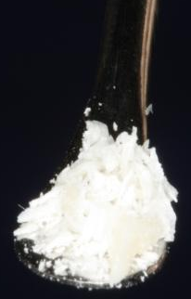
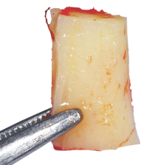
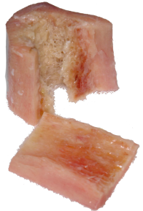
Biomaterials
Bone augmentation procedures for dental implant site preparation is a common surgical technique and widely performed to stimulate, or at least facilitate, bone growth in a certain site which is designated to receive a dental implant in its optimal tridimensional position in the jaw, and to attain predictable long-term functioning of the prosthetic rehabilitation. This outcome can be achieved with autogenous, allogeneic and xenogeneic bone grafts, biomaterials or association of them.
Autogenous bone
Allogenic bone
Xenogenous bone

Slide 18
Biomaterials
Anorganic bovine bone matrix (ABBM) has been a bone graft option for more than two decades and many studies proved it to be a biocompatible and osteoconductive material. Although its use as block grafts have been recently reported, its mainly employed in dentistry as particulate grafts. Its porous nature greatly increases the surface area of the material thus providing a substratum for increased angiogenesis and a scaffold for new bone formation and histological findings provide proof-of-principle that ABBM particles can undergo incorporation with bone formation and remodeling. Inumerous of these biomaterials are nowadays available for use in clinical practice and it has been reported in literature that such grafted particles may play a role in osteogenesis and bone repair.
Biomaterials

Slide 19
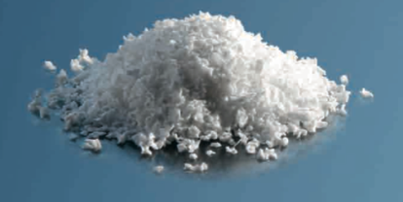
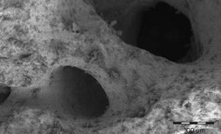
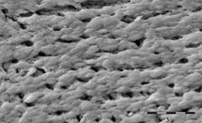
Biomaterials
Diiferent properties of these biomaterials may play a role in remodeling rate and hence in bone formation, such as nature of the material, structure and topography, lyophilization process, porosity, hydrophilicity, particle size among others.

Slide 20
Biomaterials
Once there are different particle sizes available for use in clinical practice and it has been reported in literature that the size of the grafted particles may play a role in osteogenesis and bone repair, researches aiming to evaluate the influence of ABBM particle sizes on bone repair process shold be perfomed.
Rabbiy calvaria defects filled with particulate autogenous bone, small, medium and large ABBM particles.
60 days radiographic image of defects filled with particulate autogenous bone, small, medium and large ABBM particles.

Slide 21
Biomaterials
Research in New Zealand rabbits
Histological analysis showing bone repair after 60 days of small size particles (<450µm) ABBM implantation.
Histological analysis showing bone repair after 60 days of medium size particles (450 to 749 μm) ABBM implantation.
Histological analysis showing bone repair after 60 days of large particles (750 to 1000μm) ABBM implantation.
Histological analysis showing bone repair after 60 days of autogenous bone particles implantation (control group).

Slide 22
Biomaterials
Particle size of anorganic bovine bone matrix influences bone repair process: smaller particles tend to resorb faster and promote more bone neoformation than larger particles.
It is not possible to use radiographs to evaluate qualitative or quantitative patterns of bone repair when anorganic bovine bone matrix is used as an osteoconductor.

Slide 23
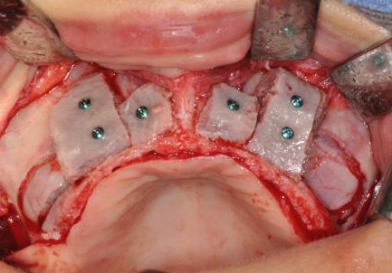
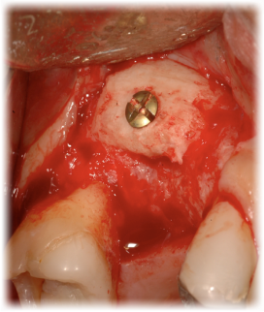
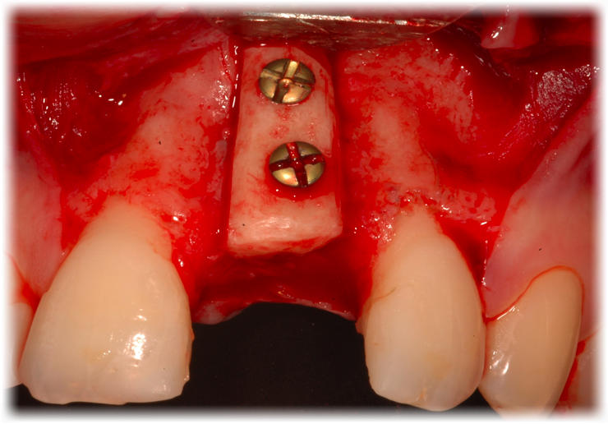
Fixation devices
Surgical procedures for reconstruction of alveolar ridges have become particularly common in the 90's due to the large use of dental implants to replaced missed teeth. By restoring the natural form and volume of alveolar ridge, the surgeon is able to place dental implants in an ideal esthetic and functional tridimensional position. Other advantages of this procedure include the installation of a larger number of implants, implant placement with larger diameter and height and better distribution of implants in the arches.

Slide 24
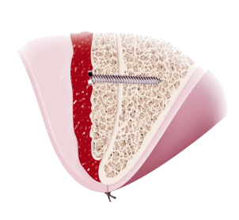

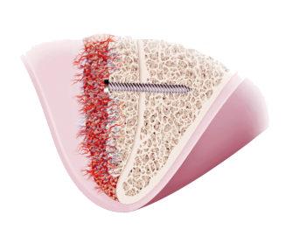
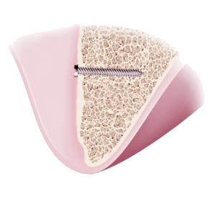
Fixation devices
Once onlay grafting has been chosen as the modality for ridge augmentation, it is imperative that they are properly adapted to the recipient site and remain firmly attached until its incorporation.
Traditionally, metallic screws have been used to achieve rigid fixation for onlay grafting. Titanium is widely accepted as the metal with the best biocompatibility and excellent mechanical properties and therefore has been successfully used to provide rigid fixation, although it does have some limitations.

Slide 25
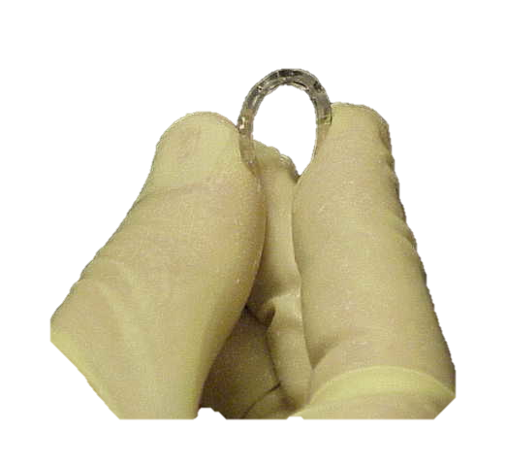
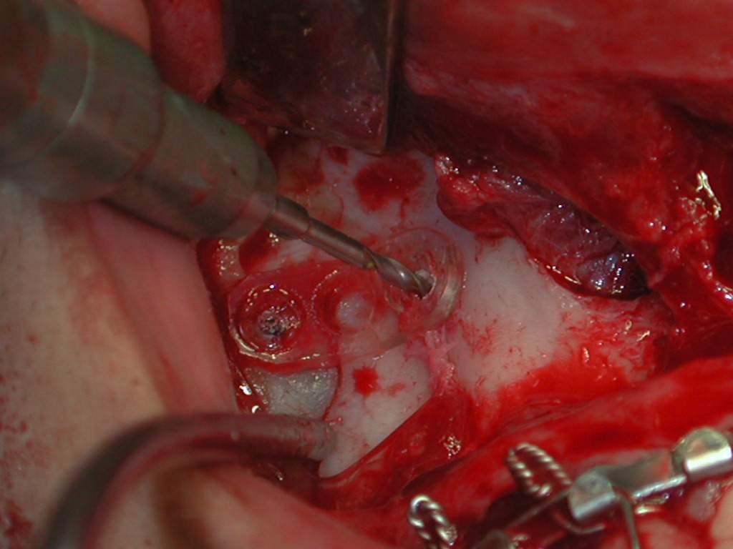
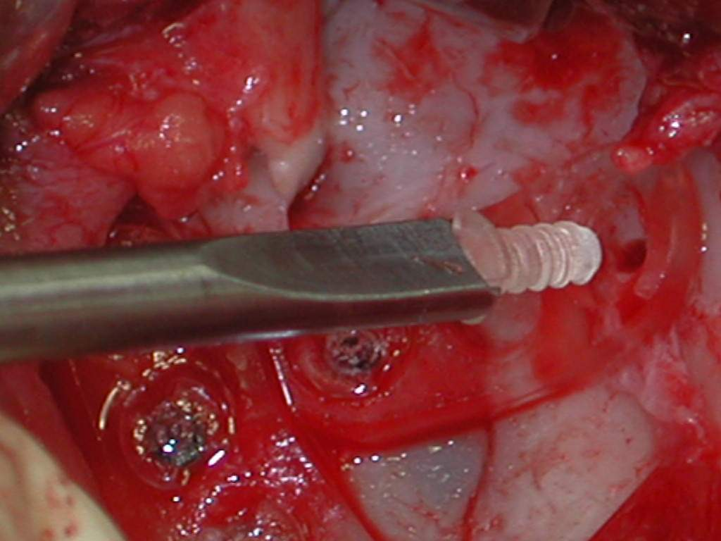

Fixation devices
The use of resorbable fixation devices in oral and maxillofacial surgery has been studied. Various investigators have demonstrated favorable results using resorbable fixation

Slide 26
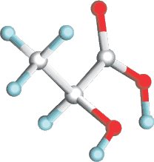
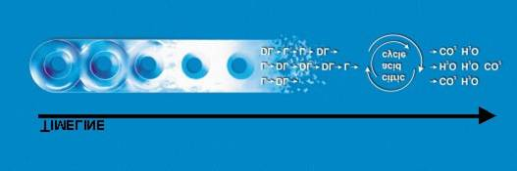
Fixation devices
The fixation devices consist of a combination of different bioresorbable polymers including polylactide, polyglycolide and their co-polymers, so as to achieve a balance between mechanical strength, flexibility, inflammatory response and resorption time. Currently, most devices are manufactured by combining two polymers, mainly poly-D-lactide or polyglycolide with poly-L-lactide.

Slide 27
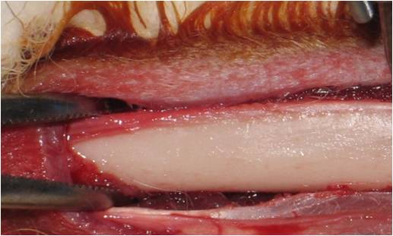
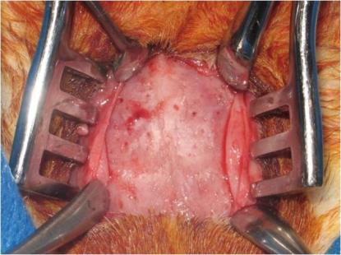
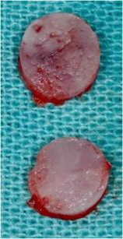
Fixation devices
In order to overcome some drawbacks of the metallic devices, alternatives to this material were completely investigated and therefore the number of resorbable fixation systems increased surprisingly. Despite the increasing number of publications referring to the use of the resorbable polymers as fixation device, the lack of studies using them in bone reconstruction surgery for the placement of endosseous implants is evident.
Rabbit’s tibia plateau (recipient site)
Rabbit’s calvaria (donor site)
Cylindrical block grafts harvested from calvaria

Slide 28
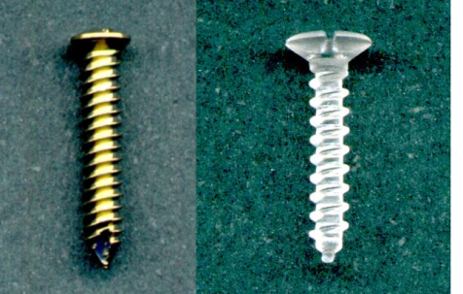
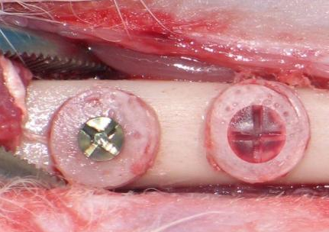
Fixation devices
Differences between titanium and resorbable screw fixation in graft incorporation have been research by our group

Slide 29
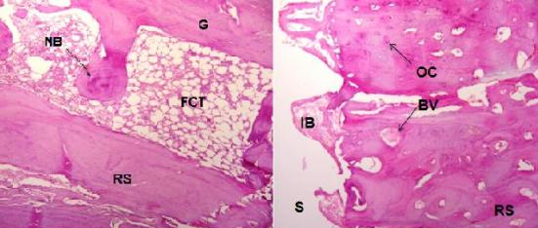
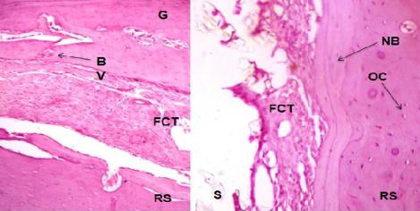
Fixation devices
3 weeks titanium screws
3 weeks resorbablescrews
Fibrous connective tissue at the interface between the bone graft and the recipient bone, although immature bone could be seen forming towards the recipient site
Chambers of the screws predominantly filled with very immature newly formed bone with large vascular channels
Fibrous tissue between the bone fragments. Moreover, in all animals there is necrosis and more intense neutrophil infiltration when compared to the control group
In the screws chambers and the recipient bone there is also an amount of immature bone formation, but at this time frame this woven bone is not in contact with the screws threads as observed in the control group
G= graft; FCT=fibrous connective tissue; RS=recipient bone; NB=new bone; BV= blood vessel; IB=immature bone; OC=osteocyte

Slide 30
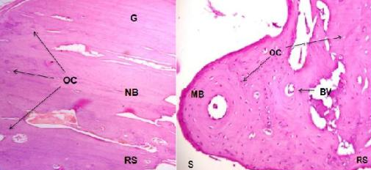
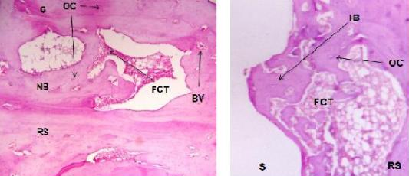
Fixation devices
8 weeks titanium screws
8 weeks resorbablescrews
Siimilar pattern of graft integration as metallic screws - graft shows good incorporation process into the recipient site. Both tissues are bridged together by newly formed mature bone and very small amount of fibrous connective tissue
Narrow band of newly formed bone in the perimeter of the screws including the chambers between the threads
Maturebone bridging the graft and recipient site, demonstrating the incorporation process of the graft. This newly formed bone is already characterized with the presence of large channels and osteocytes
The chambers between the threads of the metallic screws are filled with fibrous connective tissue and, in turn, newly formed mature bone
G= graft; FCT=fibrous connective tissue; RS=recipient bone; NB=new bone; BV= blood vessel; IB=immature bone; MB=mature bone; OC=osteocyte

Slide 31
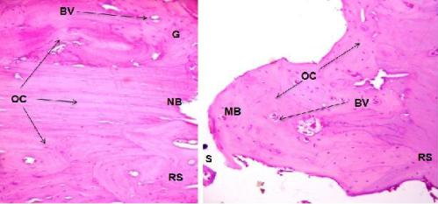
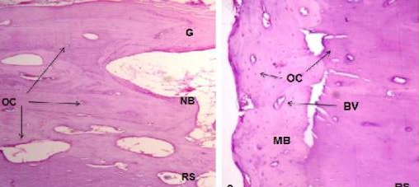
Fixation devices
16 weeks titanium screws
16 weeks resorbablescrews
Small rupture line between the native and formed bone at the interface graft-recipient site. Some refractile fragments were still involved by adipocytes in bone marrow
Disordered arrangement of bone tissue in the valleys regions. In general there is a thin band of bone oriented parallel to the medullary canal at the perimeter of the screw, sometimes occurring Haversian systems
Thick band of lamellar bone between the grafted bone and the recipient site. This bone is characterized by well organized bone features as medullary spaces filled with blood vessels, osteocytes and Haversian system
Newly formed bone can also be appreciated in the chambers between the threads of the titanium screws
G= graft; FCT=fibrous connective tissue; RS=recipient bone; NB=new bone; BV= blood vessel; IB=immature bone; MB=mature bone; OC=osteocyte

Slide 32
Biomaterials
The use of metallic devices for this purpose offers some disadvantages and potential drawbacks. The titanium fixation screws require secondary removal from the bone graft before placement of the dental implants. The procedure for removal of osteosynthesis material is made usually at the time of installation of dental implants. In the case of smaller grafts, this removal is relatively easy through a small incision. On the other hand, when the most extensive bone reconstruction is performed, the removal of the screws requires more extensive surgical approaches with larger incisions and additional extensive soft tissue stripping, which increases both the duration and morbidity of surgery. Moreover, other complications are related to the use of metallic devices, such as risk of screw fracture during removal, radiographic artifacts during imaging exams, patient discomfort due to palpability through the oral mucosa if resorption occurs, bone atrophy or osteopenia caused by stress shielding and corrosion, allergic reactions; and the possibility of causing growth restriction of the craniofacial skeleton in pediatric patients.

Slide 33
Biomaterials
It is well documented in the literature that resorbable fixation materials offer many advantages for osteosynthesis over their metallic counterparts. No removal of the material is needed, thus problems that can arise from the need to remove screws, such as the risk of damage to the underlying bone, are avoided. The elasticity of these materials is close to that of bone, thus enhancing the stress protection. During bone healing, the resorbable material will gradually degrade, allowing physiologic stress to be transferred back to the healing bone. As a result, stress shielding is avoided.

Slide 34
Biomaterials
Resorbable screws induced a stronger inflammatory response compared to titanium screws. This was most evident in histological analysis of 3 and 8 weeks. Most likely this inflammatory reaction explains the slight delay in the process of incorporation of bone grafts fixed with absorbable screws. Nevertheless, the results after 16 weeks was similar for both groups. This difference in inflammatory reaction did not compromise the incorporation of bone grafts and the low inflammatory response associated with both groups and its reduction throughout the study indicated that the biologic response to the procedure was favorable for graft consolidation.

Slide 35
Biomaterials
The present study demonstrated that the resorbable screw is able to provide enough mechanical stability to provide incorporation of bone grafts. In addition, besides satisfactory mechanical strength, the absorbable device used showed the desirable properties for a resorbable fixation systems such as degradation in a predictable fashion while promoting smooth and gradual transfer of mechanical loads to the bone following the repair process, did not promote tissue response so that its removal was required, did not cause toxic reactions and was simple to use.

Slide 36
Biomaterials
Conclusions
The resorbable fixation system tested was effective in promoting the incorporation of bone grafts;
The resorbable polymer induce a more intense inflammatory response when compared to titanium system;
There was a slight delay in the incorporation of bone grafts fixed with resorbable screws;
Both materials proved to be biocompatible and lacked histological evidence of foreign body reaction.

Slide 37
Affiliations
Dr. Fernando Antonini, DDS MSc
Oral and maxillofacial Surgery and Implant Dentistry
Member of International Association of Oral and Maxillofacial Surgeons
Member of AO (Academy of Osseointegration)
Member of Brazilian Association of Oral and Maxillofacial Surgery

