Slide 1
Situational Crime Prevention Strategies
Prof (Dr) G S Bajpai
Chairperson,
Centre for Criminal Justice Administration
National Law Institute University
Bhopal

Slide 2
Crime Prevention
Intervening in the causal chain to prevent crime from occurring at all
Notes:
Source: Clarke, R.V. (2004). 25 Techniques of Situational Crime Prevention. Presented at the Problem-Oriented Policing Conference,
Charlotte, NC.
Alternative definition: Crime prevention entails any action designed to reduce the actual level of crime or perceived fear of crime.
Lab, S. (2004). Crime Prevention: Approaches, Practices and Evaluations. Anderson Publishing.

Slide 3
Types of Crime Prevention
Primary prevention
Effecting conditions of the physical and social environment that provide opportunities for or precipitate criminal acts.
Secondary prevention
Engages in early identification of potential offenders and seeks to intervene before the commission of illegal activity
Tertiary prevention
Dealing with actual offenders and intervention
Notes:
Source Lab, S. (2004). Crime Prevention: Approaches, Practices and Evaluations. Anderson Publishing.

Slide 4
Two ways to prevent crime
Change people’s criminal motivations
Reduce opportunities for crime
Notes:
Source: Clarke, R.V. (2004). 25 Techniques of Situational Crime Prevention. Presented at the Problem-Oriented Policing Conference,
Charlotte, NC.

Slide 5
Situational crime prevention
(SCP)
Primary crime prevention.
The art and science of reducing opportunities for crime
Based on new crime theories:
  Rational choice
  Routine activity
Notes:
Source: Clarke, R.V. (2004). 25 Techniques of Situational Crime Prevention. Presented at the Problem-Oriented Policing Conference,
Charlotte, NC.

Slide 6
SCP seeks to influence the offender’s decision or ability to commit crimes at particular
Places and times by way of particularly designed measures.

Slide 7
Focus of New Crime Theories
Crime, not criminality
Events, not dispositions
Near, not distant causes of crime
How crime occurs, not why it happens
Situational and opportunity factors
Notes:
Source: Clarke, R.V. (2004). 25 Techniques of Situational Crime Prevention. Presented at the Problem-Oriented Policing Conference,
Charlotte, NC.

Slide 8
5 Ways to Modify a Situation
Increasing the effort the offender must make to carry out the crime.
Increasing the risks the offender must face in completing the crime.
Reducing the rewards or benefits the offender expects to obtain from the crime.
Reducing or avoiding provocations that may tempt or incite offenders into criminal acts
Removing excuses that offenders may use to “rationalize” or justify their actions.
Notes:
While the Problem Analysis Triangle helps to analyze problems, situational crime prevention provides a framework for intervention. By assessing the opportunities that specific situations offer for crime, situational crime prevention has identified five main ways in which situations can be modified. These are:
Increasing the effort the offender must make to carry out the crime.
Increasing the risks the offender must face in completing the crime.
Reducing the rewards or benefits the offender expects to obtain from the crime.
Reducing or avoiding provocations that may tempt or incite offenders into criminal acts.
Removing excuses that offenders may use to “rationalize” or justify their actions.
These five approaches to reducing opportunity were expanded to 25 techniques of situational crime prevention.
Source: Center for Problem-Oriented Policing, http://www.popcenter.org/about-situational.htm

Slide 9
Reducing Opportunity
Criminal opportunity is reduced by:
Increasing the effort involved in crime by making the targets harder to get at or hindering the commission of crime (e.g., target hardening, access control, exit and entrance screening)
Increasing the risks, whether real or perceived, of detection and apprehension (e.g., surveillance, screening, profiling)
Reducing the rewards of crime, (e.g., target removal, property marking, merchandise ink-tags)

Slide 10
Reducing Opportunity
Reducing or avoiding provocations that may tempt or incite offenders into criminal acts
Removing excuses that offenders may use to “rationalize” or justify their actions.

Slide 11
Reducing Opportunity
Opportunity for crime can be reduced directly & indirectly:
Directly: “organizing” the immediate physical environment (e.g., target hardening, access control, target removal)
Indirectly: “organizing” people to foster or reinforce their individual and collective behaviour to minimize their vulnerability to crime (e.g., Neighbourhood Watch)

Slide 12
SCP involves the management, design, or manipulation of the immediate physical environment
Primary objective: reduce the opportunity for criminal activity
Opportunity for reducing crime can be pursued by: (i) “organizing” the immediate physical environment or (ii) organizing individuals (e.g., Neighbourhood Watch)

Slide 13

Triangle
when a crime occurs, three things happen at the same time and in the same space:
a suitable target is available.
there is the lack of a suitable guardian to prevent the crime from happening.
a motivated offender is present.

Slide 14
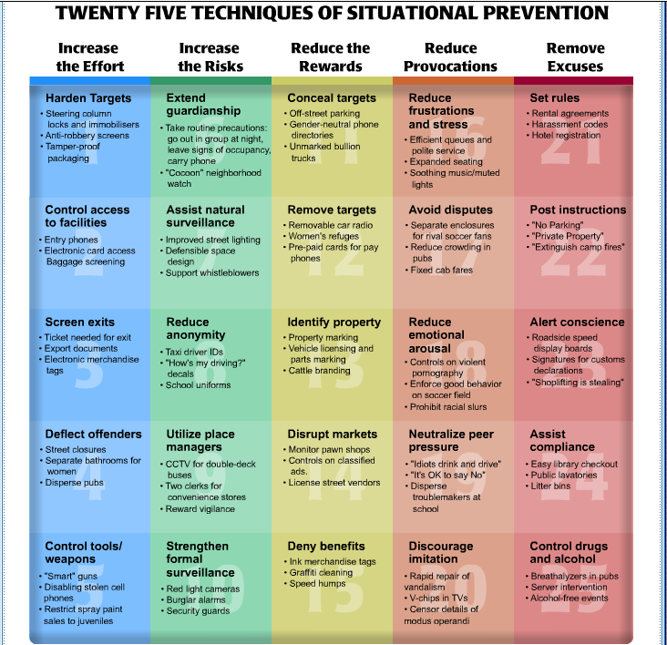
Notes:
Source: Center for Problem-Oriented Policing, http://www.popcenter.org/25techniques.htm

Slide 15
Increase the Effort
Harden Targets
Control Access
Screen Exits
Deflect Offenders
Control Tools/Weapons
Notes:
Harden targets
Steering column locks and immobilizers
Anti-robbery screens
Tamper-proof packaging
Control access to facilities
Entry phones
Electronic card access
Baggage screening
Screen exits
Ticket needed for exit
Export documents
Electronic merchandise tags
Deflect offenders
Street closures
Separate bathrooms for women
Disperse pubs
Control tools/weapons
“Smart” guns
Disabling stolen cell phones
Restrict spray paint sales to juveniles
Source: Center for Problem-Oriented Policing, http://www.popcenter.org/25techniques.htm

Slide 16
Increase the Risks
Extend guardianship
Assist natural surveillance
Reduce Anonymity
Utilize place managers
Strengthen formal surveillance
Notes:
According to interviews with offenders, they worry more about the risks of being apprehended than about the consequences if they are caught. This makes sense from their point of view since there is very little they can do to avoid punishment if caught, but they can do a lot to reduce the risks of being captured by being careful. This is why situational crime prevention seeks to increase the risks of being caught and makes no attempt to manipulate punishment.
Extend guardianship
Take routine precautions: going out in a group a night, leave signs of occupancy, carry phone
“Cocoon” neighborhood watch
Assist natural surveillance
Improved street lighting
Defensible space design
Support whistleblowers
Reduce anonymity
Taxi driver IDs
“How’s my driving?” decals
School uniforms
Utilize place managers
CCTV for double-deck buses
Two clerks for convenience stores
Reward vigilance
Strengthen formal surveillance
Red light cameras
Burglar alarms
Security guards
Source: Center for Problem-Oriented Policing, http://www.popcenter.org/25techniques.htm

Slide 17
Reduce the Rewards
Conceal targets
Remove targets
Identify property
Disrupt markets
Deny benefits
Notes:
Offenders are always seeking to benefit from their crimes. The benefits may not simply be material as in theft because there are many other rewards of crime, including sexual release, intoxication, excitement, revenge, respect from peers and so forth. An important strand of situational crime prevention is therefore to understand the rewards of any particular category of offending and to find ways of reducing or removing them.
Conceal targets
Off-street parking
Gender-neutral phone directories
Unmarked bullion trucks
Remove targets
Removable car radio
Women’s refuges
Pre-paid cards for pay phones
Identify property
Property marking
Vehicle license and parts marking
Cattle branding
Disrupt markets
Monitor pawn shops
Controls on classified ads
License street vendors
Deny benefits
Ink merchandise tags
Graffiti cleaning
Speed humps
Source: Center for Problem-Oriented Policing, http://www.popcenter.org/25techniques.htm

Slide 18
Reduce the Provocations
Reduce frustrations and stress
Avoid disputes
Reduce emotional arousal
Neutralize peer pressure
Discourage imitation
Notes:
Studies of prisons and pubs have found that crowding, discomfort and rude treatment provoked violence in both settings. Therefore, an important category of situational prevention is to reduce provocations to crime.
Reduce frustrations and stress
Efficient queues and polite service
Expanding seating
Soothing music/muted lights
Avoid disputes
Separate enclosures for rival soccer fans
Reducing crowding in pubs
Fixed cab fares
Reduce emotional arousal
Controls on violent pornography
Enforce good behavior on soccer field
Prohibit racial slurs
Neutralize peer pressure
“Idiots drink and drive”
“It’s OK to say No”
Disperse troublemakers at school
Discourage imitation
Rapid repair of vandalism
V-chips in TVs
Censor details of modus operandi
Source: Center for Problem-Oriented Policing, http://www.popcenter.org/25techniques.htm

Slide 19
Remove the Excuses
Set Rules
Post instructions
Alert conscience
Assist compliance
Control drugs and alcohol
Notes:
The fifth category of situational techniques recognizes that offenders often rationalize their conduct to “neutralize” what would otherwise be incapacitating feelings of guilt or shame. They make such excuses as: “He deserved it,” “I was just borrowing it,” and “I only slapped her.” These excuses may be especially important for ordinary people responding to everyday temptations to evade taxes, drive when drunk, sexually harass junior employees and steal employers’ property.
Set rules
Rental agreements
Harassment codes
Hotel registration
Post instructions
“No Parking”
“Private Property”
“Extinguish camp fires”
Alert conscience
Roadside speed display boards
Signatures for customer declarations
“Shoplifting is stealing”
Assist compliance
Easy library checkout
Public lavatories
Litter bins
Control drugs and alcohol
Breathalyzers in pubs
Server intervention
Alcohol-free events
Source:
Center for Problem-Oriented Policing, http://www.popcenter.org/25techniques.htm

Slide 20
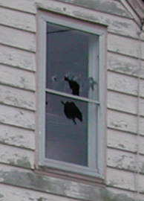
Broken Windows Theory
Minor incivilities, if unchecked and uncontrolled, will promote more serious crimes
‘Incivilities’ act as the catalyst: they represent signs of disorder and signify that 'no one cares', that the environment is ‘uncontrolled and uncontrollable’
Solution: stop and reverse the cycle of decline in its earliest stages by a focus on ‘order maintenance’ and aggressive policing of incivilities and other signs of crime.

Slide 21
Problem oriented policing (POP) http://www.popcenter.org

Slide 22
Online Exercise
Complete the 25 Techniques Module
at
http://www.popcenter.org/25techniques.htm

Slide 23
POP and SCP - SIMILARITIES
Both are preventive approaches; one is defined within policing while the other is not
Both originated in the 1970’s, SCP in the UK and POP in the USA
Both focus on highly specific problems
Both use action research models
Notes:
Source: Clarke, R.V. (2004). 25 Techniques of Situational Crime Prevention. Presented at the Problem-Oriented Policing Conference,
Charlotte, NC.

Slide 24
Action research
POP
Scanning
Analysis
Response
Assessment
SCP
Data collection
Analysis of problem
Choice of solution
Implementation
Evaluation
Notes:
Source: Clarke, R.V. (2004). 25 Techniques of Situational Crime Prevention. Presented at the Problem-Oriented Policing Conference,
Charlotte, NC.

Slide 25
POP vs. SCP - DIFFERENCES
SCP | POP
Origins: Crime theory | Origins: Police management theory
Focus: Crime and disorder problems | Focus: Police and community problems
Implemented by an agency with a crime or disorder problem | Implemented by police
Well-evaluated | Widely implemented
Notes:
Source: Clarke, R.V. (2004). 25 Techniques of Situational Crime Prevention. Presented at the Problem-Oriented Policing Conference,
Charlotte, NC.

Slide 26
Importance of the
25 Techniques
Help to systematize our knowledge
Provides a stimulus for research
The techniques may overlap - Increasing efforts can also increase risks
Some preventive measures can serve more than one purpose
Best used to help further thinking at the Response phase of the SARA process
Notes:
Source: Clarke, R.V. (2004). 25 Techniques of Situational Crime Prevention. Presented at the Problem-Oriented Policing Conference,
Charlotte, NC.

Slide 27
Limitations
Not all techniques are equally suitable for all types of crimes. For example:
  Removing excuses may be most effective for dealing with “everyday” crimes
  Reducing provocations may be most effective in closed environments
Notes:
Source: Clarke, R.V. (2004). 25 Techniques of Situational Crime Prevention. Presented at the Problem-Oriented Policing Conference,
Charlotte, NC.

Slide 28
Exercise 1
Take a walk on campus (or throughout your city) and identify some places/areas that might benefit from situational crime prevention.
Using the 25 techniques of SCP, write up a summary of recommendations for improving those areas and reducing the likelihood of criminal activity.

Slide 29
Exercise 2
Identify/devise some low-cost situational crime prevention methods that would make a college dormitory more secure.

Slide 30
Exercise 3
In an effort to maximize effectiveness, try to match each of the 25 techniques to a specific crime or disorder problem.
Explain your rationale.

Slide 31
Online/Group Exercise
Using the 25 Techniques, break into groups and develop two crime prevention techniques from each of the five categories (a total of 10) for one of the following crime problems:
  Drunk driving
  Assaults at public place
  Robbery
  Delinquency
  Shoplifting
  Disorderly youth at public place
  Theft of vehicles
  Street prostitution
Notes:
Students should list the category (e.g., increase risk, increase effort, reduce rewards, reduce provocations, remove excuses), the technique’s name (e.g., screen exits, deny benefits), and a description of the specific technique. Note: if one specific technique falls into two categories list it in both and it will count twice (e.g., fixing cab fares is both avoiding disputes and setting rules).
For example:
Topic: Sexual Assault at Bars
Increase effort, extend guardianship: women do not go to the bathroom or to their cars without a friend.

