Slide 1
On Lentiviral Vector Cloning, Titration, and Expression in Mammalian Cells
Gang Zhang, Ph. D
Research Technician II
Centre for Research in Neurodegenerative Diseases
Department of Medicine
University of Toronto, Canada

Slide 2
This talk based on the following publications:
Gang Zhang* & Anurag Tandon. Quantitative assessment on the cloning efficiencies of lentiviral transfer vectors with a unique clone site. Scientific Reports, 2012, 2: 415
Gang Zhang* & Anurag Tandon. Quantitative models for efficient cloning of different vectors with various clone sites. American Journal of Biomedical Research, 2013, 1(4): 112-119
Gang Zhang*. A new overview on the old topic: the theoretical analysis of “Combinatorial Strategy” for DNA recombination. American Journal of Biomedical Research, 3013, 1(4):108-111
Gang Zhang*, Anurag Tandon. Efficient lentiviral transduction of different mammalian cells. In preparation.

Slide 3
Main topics
Theoretical design of combinatorial strategy
2. Special examples with BamH I clone site
3. General examples with various clone sites
4. The titration of lentiviral vectors and expression in mammalian cells

Slide 4
Part I: Theoretical design of combinatorial strategy
To explore the quantitative law of recombinant DNA

Slide 5
The birth of recombinant DNA technology
In 1972, Jackson et al. reported the first recombinant DNA, SV40-λdvgal DNA was created. This work won Nobel Prize in Chemistry in 1980 (Jackson, et al. PNAS, 1972, 69: 2904-9).
In 1973, Cohen, et al. found, for the first time, that the recombinant DNA could be transformed into E. Coli and biologically functional in the host. Stanford University applied for the first US patent on recombinant DNA in 1974. This patent was awarded in 1980 (Cohen, et al. PNAS, 1973, 70: 3240-4).
This technology revolutionarily changed the bio-medical research during the past decades.

Slide 6
Achievements in DNA recombination:
Many different vector systems available:
1. Regular vectors: pET, pcDNA, etc.
2. Viral vectors: Adenoviral vectors, retroviral vectors, lentiviral vectors, etc.
3. Bacterium expression vectors, insect expression vectors, mammalian
expression vectors, etc.
4. Continual expression vectors, inducible expression vectors, etc.
5. Ubiquitous expression vectors, tissue-specific expression vectors, and so on.
At genome era, more and more gene sequences available
Therefore, in theory, we could very easily put any genes of interest into any vectors, and transfer them into any organisms and tissues, to investigate their functions according to our purposes.

Slide 7
Puzzles in molecular cloning:
Some times, if we are lucky, we could clone a vector easily with 5 to
10 minipreps in 3 days, in other times, if we are not lucky, we might
need to make hundreds of minipreps, and waste months for a vector, why?
Possible reasons:
The sizes of the vectors and inserts;
The preparation methods of the inserts;
The ligation efficiencies of the clone sites;
The transformation efficiencies of the host cells, etc.
Now I want to ask “Could we find a way to clone vectors efficiently, and quantitatively?” The answer is YES!!!

Slide 8
Typical reaction system of ligation
ddH2O | Insert | Vector | 10 X ligase buffer | T4 DNA ligase
Add up to 20µl | ~100ng | ~200ng | 2µl | 1µl
A Mole= ~6.02 X 10²³ molecules; Average Molar Weight of A, G, C, T= ~660 g
1 g=1 X 10⁹ ng; 1 mole=1 X 10¹² pmoles
Suppose the insert: 1.5kb, the vector: 5kb, then
100ng insert=100ng/(660 X 1500 X 2 X 1,000,000,000)ng=0.05pmole X 6.02 X 10²³/10¹² =3.01 X 10¹⁰ insert molecules
200ng vector=200ng/(660 X 5,000 X 2 X 1,000,000,000)ng=0.03pmole X 6.02 X 10²³/10¹²=1.8 X 10¹⁰ vector molecules
So what will happen in this tiny 20µl ligation tube?

Slide 9
Main procedure of recombinant DNA
1. Choose or create compatible clone sites between
the vectors and inserts
High efficient clone sites, such as EcoR I, BamH I, EcoR V etc.
2. Digest and purify the vectors and inserts
The purities A260/280≥1.80
3. Ligation, high concentration T4 DNA ligase
4. Transformation, high efficient competent cells, such as DH5α, Top10
5. Identification by digestion and sequencing

Slide 10
Approaches to create compatible clone sites
Design PCR primers contained proper clone sites for the inserts
Make blunt ends by Klenow fragment and T4 DNA polymerase
Insert clone sites by site-directed mutagenesis

Slide 11
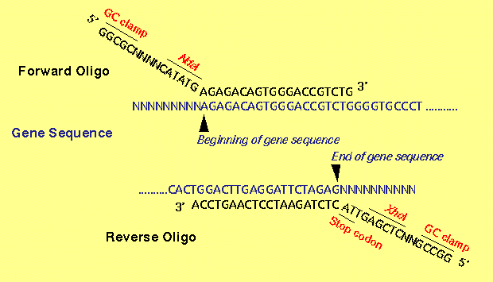
Design PCR primers contained proper clone sites for the inserts
Advantages: easy and simple, suitable for small size regular cloning
Disadvantages: not guarantee 100% correct-cutting ends, not suitable
for large size cloning
From online

Slide 12
Making blunt ends for the inserts or/and vectors with Klenow
fragment or T4 DNA polymerase
Functions of Klenow fragment and T4 DNA polymerase:
Fill-in of 5’-overhangs to form blunt ends
Removal of 3’-overhangs to form blunt ends
Result in recessed ends due to the 3’ to 5’ exonuclease activity of the enzymes.
Advantages:
Easy and simple, only a short time reaction, such as 5 to 15 minutes, suitable for easy
cloning
Disadvantages:
Not guarantee 100% with the correct blunt ends, not suitable for low efficient cloning
New England BioLabs

Slide 13
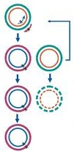
Inserting clone sites by site-directed mutagenesis (SDM)
1. Mutant strand synthesis
Perform thermal cycling to
A. Denature DNA template
B. anneal mutagenic primers
containing desired mutantion
C. extend and incorporate primers with PfuUltra DNA polymerase
2. Dpn I digestion of template
Digest parental methylated and
hemimethylated DNA with Dpn I
3. Transformation
Transform mutated molecules into competent cells for nick repair
Stratagene SDM Kit

Slide 14
Advantages of inserting clone sites by SDM
The mutated products are circular double-stranded plasmid DNA
The linearized inserts are theoretically 100% with correct-cutting ends
Maximal ligation could achieve with the vectors
Suitable for low efficient vector cloning, such as lentiviral vectors.

Slide 15
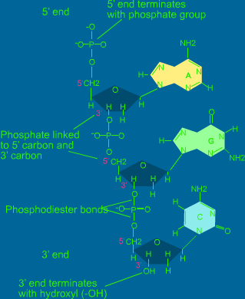
The function of T4 DNA ligase
1. To catalyze the formation of 3’, 5’-Phosphodiester Bond between juxtaposed 5’-phosphate groups and 3’-hydroxyl groups.
2. Ligation could take place when there are mismatches at or close to the ligation junctions. That is to say, T4 DNA ligase could catalyze the ligation between different
clone sites (Haarada & Orgel, Nucl. Acids Res., 1993, 21: 2287-91).

Slide 16
Procedure of regular ligation
1. Inter-molecular reaction to form
non-covalently bonded, linear
vector-insert Hybrids.
This reaction requires high
DNA concentrations
2. Intra-molecular reaction to form
non-covalently bonded, circular
molecules.
This reaction works efficiently
with low DNA concentrations.
3. Annealing between the inter and intra molecules brings the 5’-phosphate and 3’-hydroxyl residues of the vectors and inserts into close alignment, which allows T4 DNA ligase to catalyze the formation of
3’, 5’-phosphodiester bonds.
Molecular cloning,
3rd Edition

Slide 17
Transformation and selection after DNA ligation
Vector
Insert
5’
3’
+
5’
3’
3’
5’
3’
5’
Clone site B
Clone site A
Clone site A
Clone site B
ligation
vector
Vector and insert
insert
Transformation and antibiotic selection
Transformants can
not survive
Transformants survive
Transformants survive
Note: clone sites A and B could be blunt ends, over-hang ends, the same or different

Slide 18
The function of calf intestinal phosphatase (CIP)
Vector
5’-P
3’-OH
3’-OH
5’-P
CIP Treatment
3’-OH
3’-OH
Ligation
3’-OH
3’-OH
Can not be self-circularized
Transformation
Because the transformation efficiencies of linear DNA are very low,
the backgrounds with empty-vectors are decreased radically.
Molecular cloning, 3rd edition

Slide 19
Choosing proper competent cells for transformation
Subcloning efficiency DH5α chemical competent E. Coli:
1 X 10⁶ CFU/µg supercoiled DNA
One shot Stbl3 chemical competent E. Coli:
1 X 10⁸ CFU/µg supercoiled DNA
One shot Top10 chemical competent E. Coli:
1 X 10⁹ CFU/µg supercoiled DNA
Invitrogen (Life Technologies)

Slide 20
Theoretical design of combinatorial strategy
Inserts from circular vector
with matching clone sites or
Inserted by SDM
Regular or
lentiviral vector
Enzyme digest and CIP
Enzyme digest
3’-OH
+
5’-P
3’-OH
3’-OH
3’-OH
5’-P
100% correct cutting, not self-ligated
100% correct cutting ends
Ligation
3’-OH
3’-OH
Vector +
insert
insert
Can not circularized
Transformation
Top10 to increase transformation
Linerized vector
very few
Survive, 100% positive, if different clone sites
50% positive if the same and blunt clone sites
Not survive

Slide 21
Suggestions and predictions for molecular cloning with
CIP-treated vectors
Clone sites | Sizes (kb) | Methods for clone sites | Transformation host | No. of colonies | Positive clones
Blunt sites | Small (vector<5, insert<1.5) | Existed/Klenow or T4 DNA Polymerase | Top10 | Dozens#/a few | About 50%
 | large (vector>5, insert>1.5) | Existed | Top10 | A few to dozens | About 50%
Different over-hang sites | Small (vector<5, insert<1.5) | PCR*/SDM | Top10/DH5α | Dozens/hundreds or more# A few/dozens | Nearly 100%
 | Large (vector>5, insert>1.5 ) | SDM | Top10 | Dozens to hundreds | Nearly 100%
One over-hang site | Small (vector<5, insert<1.5) | PCR*/SDM | Top10/DH5α | Dozens/hundreds or more# A few/dozens | About 50%
 | Large (vector>5, insert>1.5 ) | SDM | Top10 | Dozens to hundreds | About 50%
Notes: # Data in boldfaces are obtained from existed clone
sites and Top10 cell transformations.
Gang Zhang, American Journal of Biomedical Research, 2013

Slide 22
Part II: Demonstration of combinatorial strategy
with a unique BamH I clone site for lentiviral
vector cloning

Slide 23
Scheme of clone pWPI/hPlk2/Neo and pWPI/EGFP/Neo with BamH I site

Slide 24
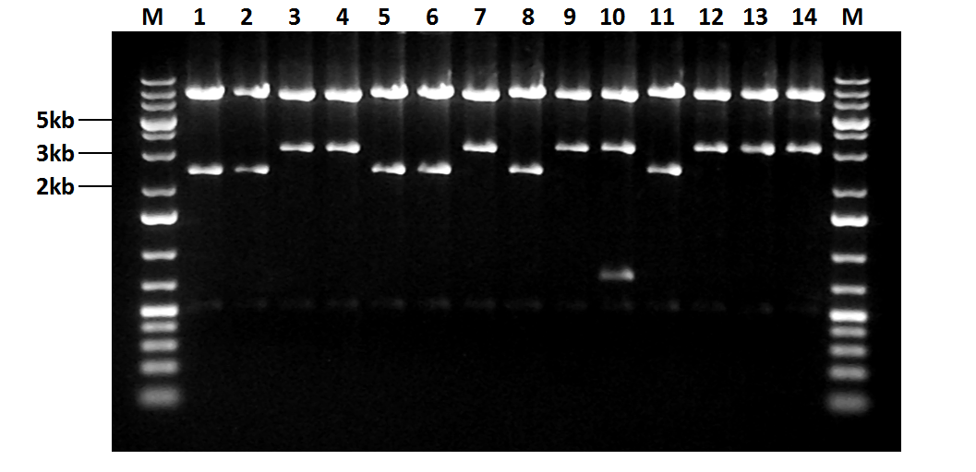
Identification of pWPI/EGFP/Neo digested by Not I (n=1)
Positive clones: 3, 4, 7, 9, 12, 13, 14; Negative clones: 1, 2, 5, 6, 8, 11; Clone 10 with 2 copies of insert

Slide 25
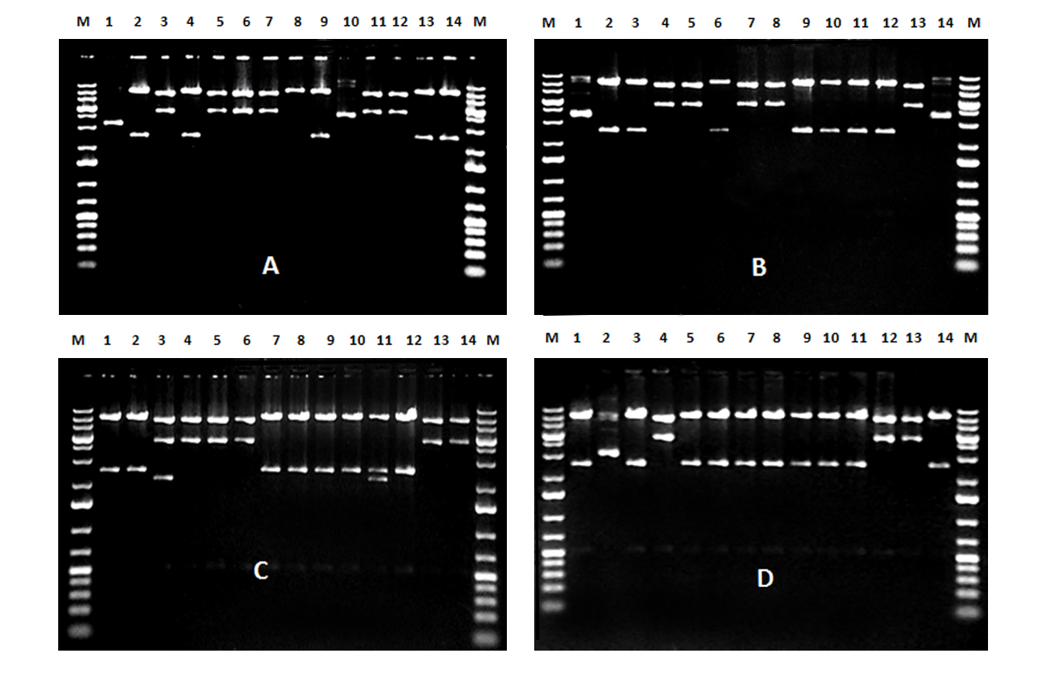
Identification of pWPI/hPlk2/Neo digested by Not I (n=1)
A: WT, 2, 4, 9, 13, 14 were positive; B: K111M, 2, 3, 6, 9,
10, 11, 12, were Positive; C: T239D, 1, 2, 7, 8, 9, 10, 12, were
positive; D: T239V, 1, 3, 5, 6, 7, 8, 9, 10, 11, 14, were positive.

Slide 26
Identification of pWPI/hPlk2 WT and mutants and pWPI/EGFP (n=3)
A, B: EGFP; B, C: hPlk2WT;
D, E: K111M; E, F: T239D;
G, H: T239V.

Slide 27
Statistical analysis of Cloning efficiencies of LVs with CIP-treated vectors (n=4)
Vector | Hosts of transformation | Total No. of transformed clones | Total No. of identified clones | Percentage of inserted vectors (Mean±SD) | Percentage of Correct-oriented inserts (Mean±SD)
EGFP | Top10 | 149±100 (n=4) | 41 (n=4) | 97%±5.5%ª(40) | 37%±12.4% (16)
hPlk2 WT | Top10 | 123±108 (n=4) | 41 (n=4) | 95%±10.5% (38) | 43%±16.6% (17)
K111M | Top10 | 123±88 (n=4) | 41 (n=4) | 91%±10.9% (37) | 52%±21.2% (21)
T239D | Top10 | 126±78 (n=4) | 41 (n=4) | 95%±6.4%ª(39) | 54%±9.8%ª (22)
T239V | Top10 | 98±60 (n=4) | 41 (n=4) | 93%±5.2% (38) | 54%±12.8% (23)

Slide 28
Cloning efficiencies of LVs with non-CIP-treated
vectors (n=5)
Vector | Hosts of transformation | Total No. of identified colonies | Percentage of inserted vectors | Percentage of Corrected-oriented inserts
EGFP | Top10 | 10 | 0% (0/10) | 0% (0/10)
hPlk2 WT | Top10 | 10 | 10% (1/10) | 0% (0/10)
K111M | Top10 | 10 | 10% (1/10) | 0% (0/10)
T239D | Top10 | 10 | 0% (0/10) | 0% (0/10)
T239V | Top10 | 10 | 30% (3/10) | 10% (1/10)
Total
10% 2%

Slide 29
Cloning efficiencies of LVs with CIP-treated
and un-CIP-treated vectors with BamH I site

Slide 30
Transient expression of hPlk2 Wt and mutants and EGFP
in 293T cells
Vector sizes: ~13kb
1, 6: 293T cells;
2, 3, 4, 5: hPlk2Wt;
7, 8: K111M;
9, 10: T239D;
11, 12: T239V;
c, e: EGFP
Zhang & Tandon, Sci. Rep., 2012, 2: 415

Slide 31
Gang Zhang* & Anurag Tandon. Quantitative assessment on the cloning efficiencies of lentiviral transfer vectors with a unique clone site. Scientific Reports, 2012, 2: 415
This paper is ranked #1 published on the same topic since the publication by Isabelle Cooper-BioMedUpdater
(http://wipimd.com/?&sttflpg=23c42b52a62e87fabdf578517544b43ca5d50aa8f00f8029)
Ranked #1 in Concept-“Clone” by Scicombinator (http://www.scicombinator.com/concepts/clone/articles‎)
Ranked #1 in Concept–“viral vector” by Scicombinator (http://www.scicombinator.com/concepts/viral-vector/articles)

Slide 32
Part III: General examples for different vector
cloning with various clone sites

Slide 33
Scheme of cloning LVs with blunt clone sites (Swa I, EcoR V, Pme I)

Slide 34
Scheme of cloning pLVCT LVs with one blunt site and another overhang Pst I site

Slide 35
Scheme of cloning different vectors with two different overhang sites and one Xba I site
Two different clone sites
One unique clone site

Slide 36
Cloning efficiencies of different vectors with various
clone sites
Vector & clone sites | Inserts & clone sites | Transformed colonies | Inserted colonies | Positive colonies
pWPI (Swa I) | α-Syn-WT (Pme I) | 13 (n=1) | 3 (75%) | 1 (25%)
pWPI (Swa I) | α-Syn-A30P (Pme I) | 7 (n=1) | 4 (100%) | 3 (75%)
pWPI (Swa I) | α-Syn-A53T (Pme I) | 10 (n=1) | 1 (25%) | 1 (25%)
pWPI (Swa I) | Rab-WT (Pme I) | 2 (n=1) | 2 (100%) | 2 (100%)
pWPI (Swa I) | Rab-T36N (Pme I) | 14 (n=1) | 8 (80%) | 2 (20%)
pWPI (Swa I) | Rab-Q (Pme I) | 11 (n=1) | 4 (100%) | 3 (75%)
pWPI (Swa I) | GDI-WT (Pme I) | 13 (n=1) | 4 (66.7%) | 3 (50%)
pWPI (Swa I) | GDI-R218E (Pme I) | 7 (n=1) | 2 (40%) | 1 (20%)
pWPI (Swa I) | GDI-R (Pme I) | 10 (n=1) | 4 (100%) | 1 (25%)
pWPI (Swa I) | β5-WT (EcoR V, Pme I) | 20 (n=1) | 2 (100%) | 2 (100%)
pWPI (Swa I) | β5-T (EcoR V, Pme I) | 2 (n=1) | 1 (50%) | 1 (50%)
pLenti (EcoR V) | β5-WT (EcoR V, Pme I) | 12 (n=1) | 6 (75%) | 3 (37.5%)
pLenti (EcoR V) | β5-T (EcoR V, Pme I) | 13 (n=1) | 7 (87.5%) | 1 (12.5%)
pLVCT (Pme I, Pst I) | β5-WT (EcoR V, Pst I) | ~300 (n=1) | 4 (80%) | 4 (80%)
pLVCT (Pme I, Pst I) | β5-T (EcoR V, Pst I) | ~100 (n=1) | 5 (100%) | 5 (100%)
pcDNA4 (Not I, Xho I) | β5-WT (Not I, Xho I) | ~500 (n=1) | 8 (100%) | 8 (100%)
pTet (Xba I) | β5-WT (Xba I) | ~1000 (n=1) | 14 (100%) | 4 (28.6%)
pTet (Xba I) | β5-T1A (Xba I) | ~1000 (n=1) | 14 (100%) | 6 (42.9%)

Slide 37
Statistical analysis of cloning efficiencies of different vectors with various clone sites
Zhang & Tandon, American Journal of Biomedical Research, 2013

Slide 38
Conclusions
Clone sites | Positive clones
Two different clone sites | Nearly 100%
The same clone site/blunt sites | About 50%
Therefore, with our “Combinatorial strategy”, almost all the
plasmid vectors could be successfully cloned by “One ligation,
One transformation, and 2 to 3 minipreps”.
This is the quantitative law of recombinant DNA
with our method.

Slide 39
Part IV: Lentiviral titration, and expression in mammalian cells

Slide 40
Scheme of The third generation lentiviral vector system
Transfer vector with
genes of interest
No expression
5’LTR
RRE
cPPT
CMV
GFP
WPRE
3’LTR
pMDL
pRev
pVSVG
CMV
Gag-Pol
pA
Packaging vectors
RSV
Rev
pA
CMV
VSVG
pA
Gag-Pol precursor protein is for integrase, reverse transcriptase and structural proteins. Integrase and reverse transcriptase are involved in infection. Rev interacts with a cis-acting element which enhances export of genomic transcripts. VSVG is for envelope membrane, and lets the viral particles to transduce a broad range of cell types. Deletion of the promoter-enhancer region in the 3’LTR (long terminal repeats) is an important safety feature, because during reverse transcription the proviral 5’LTR is copied from the 3’LTR, thus transferring the deletion to the 5’LTR. The deleted 5’LTR is transcriptionally inactive, preventing subsequent viral replication and mobilization in the transduced cells. Tiscornia et al., Nature Protocols, 2006

Slide 41
The advantages of the third generation lentiviral vectors
LVs can transduce slowly dividing cells, and non-dividing terminally differentiated cells;
Transgenes delivered by LVs are more resistant to transcriptional silencing;
Suitable for various ubiquitous or tissue-specific promoters;
Appropriate safety by self-inactivation;
Transgene expression in the targeted cells is driven solely by internal promoters;
Usable viral titers for many lentiviral systems.
Naldini et al., Science, 1996; Cui et al., Blood, 2002; Lois et al, Science, 2002

Slide 42
The disadvantages of the third generation lentiviral vectors
Lentiviral vectors are self-inactivated by the deleting of 3’-LTR region, therefore, they can not be replicated in host cells. For each lentiviral vector, the titer is solely dependent on the transfection step;
Only the host cells co-transfected with all the four vectors, can produce lentiviral particles for infection;
To make efficient lentiviral transduction, good tissue culture and transfection techniques are very important, such as lipofectamine transfection.

Slide 43
Lentiviral vector system in our research
Transfer vectors:
pWPI-Neo
pLenti-CMV/TO-Puro-DEST
Packaging vectors:
EF1-α
Gene
IRES
Neomycin
About 11.4kb
About 1.7 kb, this is for GateWay cloning, we
Cut off this sequence in our cloning
attR1-CmR-ccdB-attR2
CMV/TO
Gene
PGK
Puromycin
About 7.8kb
CMV
Gag/Pol
Tat/Rev
pPAX2
CMV
VSV-G
pMD2.G
In order to get sufficient titers, we used the third generation of transfer vectors
and the second generation of packaging vectors to produce lentiviruses.
Campeau et al., PLoS One, 2009

Slide 44
Working procedure of lentiviral transduction:
293T cells in DMEM + 10% FBS
Co-transfected with lentiviral transfer vectors, pM2D and pPAX2 packaging vectors by Lipofectamine
Transfection
Collect supernatants
with lentiviruses, 48-72 hours later
Infection of
targeting cells
Stable cell lines with transgenes
Selection
2 weeks
293, SHSY5Y, NSC, BV-2, etc.

Slide 45
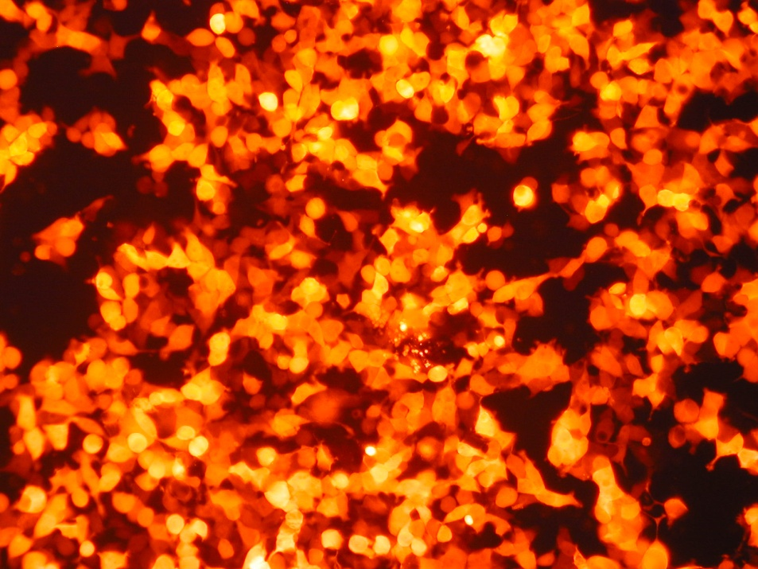
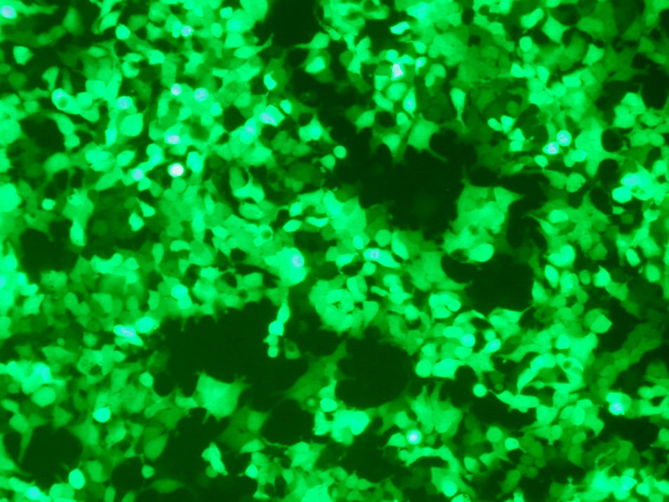
A
B
A: Lipo-transfection of 293 cells with CMV-DsRed plasmid;
B: Lipo-transfection of 293 cells with EF1α-EGFP plasmid.

Slide 46
The mechanism of tetracycline-regulated expression system
pLenti/TR
PCMV
TetR
Blasticidin
1. Express Tet repressor protein in mammalian cells, TetON cell lines
TetR protein
2. To form TetR
homodimers
pLenti/CMV/TO
Expression repressed
X
3. TetR dimers bind with TetO sequence to repress the expression
PCMV
TetO
TetO
GENE
Puromycin

Slide 47
4. added Tet binds to TetR homodimers
PCMV
TetO
TetO
GENE
Puromycin
5. The binding of Tet and TeR dimers causes a conformational change in TetR, release from the Tet operator sequences, and induction of gene of interest.
Expression derepressed
PCMV
TetO
TetO
GENE
Puromycin
Modified from Invitrogen

Slide 48
My lentiviral transductin and expression work contributed to the following papers:
N. Visanji, S. Wislet-Gendebien, L. Oschipok, G. Zhang, I. Aubert, P. Fraser, A. Tandon. The effect of S129 phosphorylation on the interaction of alpha-synuclein with synaptic and cellular membranes. The Journal of Biological Chemistry, 2011, 286: 35863-35873.
Robert HC Chen, Sabine Wislet-Gendebien, Filsy Samuel, Naomi P Visanji, Gang Zhang, Marsilio D, Tanmmy Langman, Paul E Fraser, and Anurag Tandon. Alpha-synuclein membrane association is regulated by the Rab3a recycling machinery and presynaptic activity. The Journal of Biological Chemistry, 2013, (Selected as the Journal of Biological Chemistry "Paper of the Week“.
3. Cheryl A D’Souza, Melanie Dyllick-Brenzinger, Gang Zhang, Peter-Michael Kloetzel, Anurag Tandon. A genetic model of proteasome inhibition by conditional expression of a catalytically inactive Beta5 subunit. (In preparation).

Slide 49
My PH.D thesis work on mouse cloning and oocyte maturation work and publications (microinjection, confocal microscopy, tissue and embryo culture, surgeris):
Gang Zhang, Qingyuan Sun, Dayuan Chen. In vitro development of mouse somatic nuclear transfer embryos: Effects of donor cell passages and electrofusion. Zygote, 2008, 16: 223~7
Gang Zhang, Qingyuan Sun, Dayuan Chen. Effects of sucrose treatment on the development of mouse nuclear transfer embryos with morula blastomeres as donors. Zygote, 2008, 16: 15~9
Kong FY*, Zhang G*, et al. Transplantation of male pronucleus derived from in vitro fertilization of enucleated oocyte into parthenogenetically activated oocyte results in live offspring in mouse. Zygote, 2005, 13: 35~8 (* Co-first author)

Slide 50
Acknowledgement
The Parkinson Society of Canada grant (The Margaret Galloway
Basic Research Fellowship) to Gang Zhang (2005-2007), University of Toronto;
The Stem Cell Network of Canada grant to Dr. Vincent Tropepe
(2005-2007), Department of Cellular & Systems Biology, University of Toronto;
The Canadian Institutes of Health Research (CIHR) grant
MOP84501 and the Parkinson Society of Canada grant to
Dr. Anurag Tandon, Centre in Research for Neurodegenerative
Diseases (CRND), University of Toronto.

Slide 51
Journal of Genetic Syndromes & Gene Therapy Related Conferences
http://www.conferenceseries.com/

Slide 52
OMICS Group Open Access Membership
OMICS publishing Group Open Access Membership enables academic and research institutions, funders and corporations to actively encourage open access in scholarly communication and the dissemination of research published by their authors.
For more details and benefits, click on the link below:
http://omicsonline.org/membership.php

