Slide 1
Dr.GEORGE PERRY
Executive Editor
Journal of Oceanography
PhD in Marine Biology
Postdoctoral Fellowship in the Department of Cell Biology
Notes:
Dr.George Perry

Slide 2
BIOGRAPHY
George Perry is Dean of the College of Sciences and professor of biology at The University of Texas at San Antonio. Perry is recognized in the field of Alzheimers disease research particularly for his work on oxidative stress. Perry received his bachelors of arts degree in zoology with high honors from University of California, Santa Barbara. After graduation, he headed to Scripps Institution of Oceanography and obtained his Ph.D. in marine biology under David Epel in 1979. He then received a postdoctoral fellowship in the Department of Cell Biology in the laboratories of Drs. Bill Brinkley and Joseph Bryan at Baylor College of Medicine where he laid the foundation for his observations of abnormalities in cell structures. In 1982, Perry joined the faculty of Case Western Reserve University, where he currently holds an adjunct appointment. He is distinguished as one of the top Alzheimer’s disease researchers with over 900 publications, one of the top 100 most-cited scientists in neuroscience and behavior and one of the top 25 scientists in free radical research.
Perry has been cited over 42,500 times (H=103) and is recognized as an ISI highly cited researcher. Perry is editor for numerous journals and is editor-in-chief for the Journal of Alzheimer's Disease. He is a fellow of the American Association for the Advancement of Sciences and past-president of the American Association of Neuropathologists. He received the Distinguished Professional Mentor Award from the Society for the Advancement of Chicanos and Native American Scientists. Most recently he has been named a Foreign Correspondent Member of the Spanish Royal Academy of Sciences. Perry's research is primarily focused on how Alzheimer disease develops and the physiological consequences of the disease at a cellular level. He is currently working to determine the sequence of events leading to damage caused by and the source of increased oxygen radicals.

Slide 3
Research Interests
Cytopathology of Alzheimer's Disease
The mechanism for RNA-based redox metal binding
The consequences of RNA oxidation on protein synthesis rate and fidelity
The role of redox active metals in mediating prooxidant and antioxidant properties
The signal transduction pathways altered in Alzheimer disease that allow neurons to evade apoptosis
The mechanism of phosphorylation control of oxidative damage to neurofilament proteins

Slide 4
Recent Publications
Perry EA, Castellani RJ, Moreira PI, Nunomura A, Liu Q, Harris PL, Sayre LM, Szweda PA, Szweda LI, Zhu X, Smith MA, Perry G. Neurofilaments are the major neuronal target of hydroxynonenal mediated protein crosslinks. Free Radic Res 47:507-510, 2013.
Schrag M, Mueller C, Zabel M, Crofton A, Kirsch WM, Chribi O, Squitti R, Perry G. Oxidative stress in blood in Alzheimer’s disease and mild cognitive impairment: a meta-analysis. Neurobiol Dis 59:100-110, 2013.
Paley EL, Perry G. Sokolova O. Tryptamine induces axonopathy and mitochondriopathy mimicking neurodegenerative diseases via tryptophanyl-tRNA deficiency. Curr Alzheimer Res 10:987-1004, 2013.
Fujioka H, Phelix CR, Friedland R, Zhu X, Perry EA, Castellani RJ, Perry G. Apolipoprotein E4 prevents growth of Plasmodium falciparum at the intraerythrocyte stage: implications for differences in racial susceptibility to Alzheimer disease. J Health Care for the Poor and Underserved 24:70-78, 2013.
Williams WM, Richardson S, Siedlak SL, Castellani RJ, Perry G, Smith MA, Zhu X. Antimicrobial Peptide beta-defensin-1 expression is upregulated in Alzheimer’s brain. J Neuroinflammation 10, http://www.jneuroinflammation.com/content/10/1/127, 2013.
Castellani RJ, Nugent SL, Morrison AL, Zhu X, Lee H-g, Harris PLR, Bajić V, Sharma HS, Chen SG, Oettgen P, Perry G, Smith MA. CD3 in Lewy pathology: does the abnormal recall of neurodevelopmental processes underlie Parkinson’s disease. J Neural Transm 118:23-26, 2011.
Phelix CF, LeBaron RG, Roberson DJ, Villanueva RE, Villareal G, Rahimi OB, Siedlak S, Zhu X, Perry G. Transcription-to-metabalome biosimulation reveals human hippocampal hypometabolism with age and Alzheimer’s disease. Intern J Knowledge Discovery Bioinformatics 2:1-18, 2011.

Slide 5
Introduction
Oceanography
Oceanography is the science of oceans and seas including marine environment, coastal zone management, fishery economics, and marine pollution.
Oceanography increases the scope of marine pollution impact and possible effects of the exploitation of marine resources, together with the role of the ocean in possible global warming and climate change.
Oceanographic fields and processes possess certain features that are not commonly encountered in some other areas of science and engineering.

Slide 6
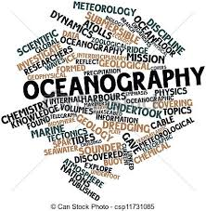

Slide 7
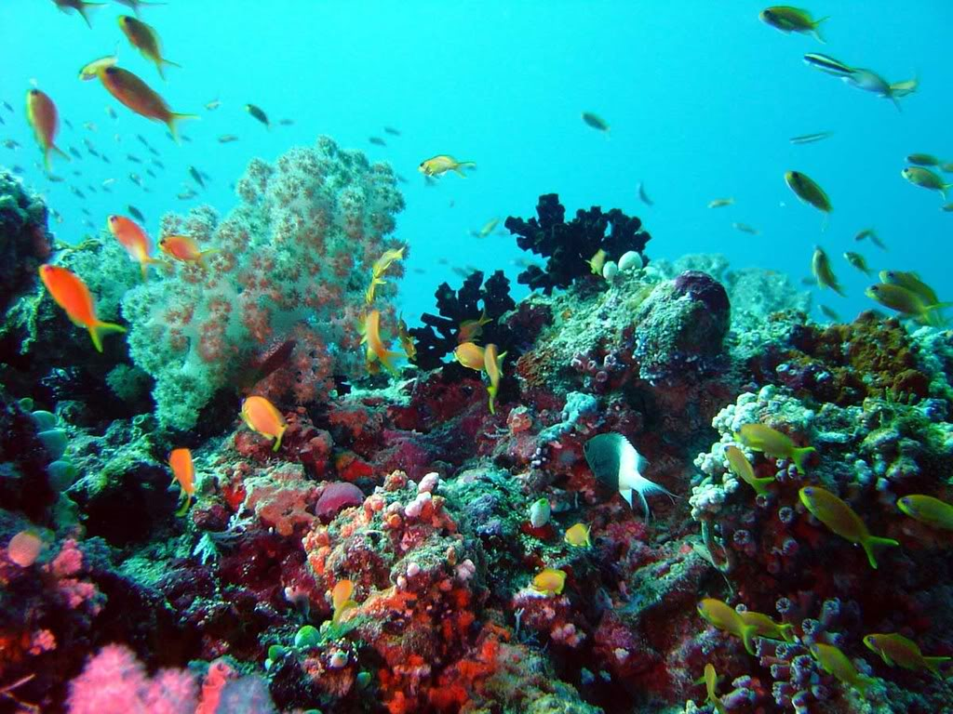

Slide 8
Aims & Scope
The Applied oceanography is devoted to the rapid publication of fundamental research papers on all phases of oceanography. Topics include:
Biological oceanography, study of the plants, animals and microbes of the oceans and their ecological interaction with the ocean;
Chemical oceanography, study of the chemistry of the ocean and its chemical interaction with the atmosphere;
Geological oceanography, study of the geology of the ocean floor including plate tectonics and paleoceanography;
Physical oceanography, studies the ocean's physical attributes including temperature-salinity structure, mixing, waves, internal waves, surface tides, internal tides, and currents.
All contributions shall be rigorously refereed and selecting on the basis of quality and originality of the work as well as the breadth of interest to readers.
Notes:
Aims & Scope

Slide 9
Oceanographic fields and processes possess certain features that are not commonly encountered in some other areas of science and engineering.
Oceanographic processes include coupling across a large range of scales and linkage between a numbers of factors of different nature. In recent times that nations have begun to recognize the size, diversity and complexity of the ocean industries and their importance to all.
Too many people marine equals shipping, which is indeed an important industry as the world fleet carries over 90% of the world trade by tonnage and shipbuilding is a business worth over U.S. $32 billion per annum.
Offshore oil & gas is the world's biggest marine industry where off production alone can have a value of more than $300 billion per annum. Submarine cables are now a huge business that provides the "worldwide" part of the world wide web and enables the very existence of the internet.

Slide 10
Oceanography: Its Scope, Problems, and Economic Importance
IT is barely sixty years since H.M.S. Challenger, by her exploratory voyages round the world, built the foundations upon which the modern science of oceanography has grown up.
For centuries man had roamed the seas and charted their boundaries, looking for new land or trade routes rather than for a knowledge of the sea itself.
Exploration showed that less than one-third of the earth’s surface is dry land; now that most of this has been mapped, attention is being turned more and more to the remaining two-thirds, which forms a world of its own, and by the very reason of its vastness holds the key to many of the secrets of land phenomena.

Slide 11
Careers in Oceanography
Marine Biologists
Marine Geologists
Geophysicists
Marine Chemists
Physical Oceanographers
Atmospheric Scientists and Climate Researchers
Biological Oceanographers
Marine Physicists

Slide 12
OMICS International Open Access Membership
OMICS International Open Access Membership enables academic and research institutions, funders and corporations to actively encourage open access in scholarly communication and the dissemination of research published by their authors.
For more details and benefits, click on the link below:
http://omicsonline.org/membership.php

