Slide 1





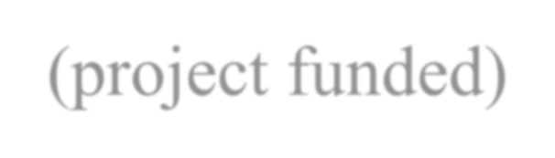






























Georgios Xydis
Senior Researcher (project funded) Inst. for Research &Technology, Thessaly
Centre for Research &Technology
Open University of Cyprus, Adjunct Tutor
Hellenic Open University, Adjunct Tutor

Slide 2


Biography
George (Georgios) Xydis worked on various projects mainly in Greece that range from a single 10-kW turbine to a 486 MW offshore wind farm. He did work in the wind sector together with developers, utilities, universities, and research institutes. He holds a PhD in Engineering from National Technical University of Athens (NTUA), and a degree in Mechanical Engineering from Aristotle University of Thessaloniki. He used to work as a Wind Projects Development Coordinator at Rokas Renewables – Iberdrola Renewables, as a Wind Project Developer (Wind Resource & Siting Engineer) at Vector Hellenic Windfarms S.A., and as a Researcher (eq. Assistant Professor level) in the Center for Electric Power and Energy (CEE), Department of Electrical Engineering at Technical University of Denmark. He now runs his Energy Research and Applications company (www.xydis.gr/gr) and collaborates with Hellenic Open University and the Open University of Cyprus as an adjuct tutor, with the Centre for Research and Technology Hellas as a Senior Researcher (project funded), with the Technological Education Institute of Piraeus, and with various SMEs in the fields of Wind Resource Assessment, Energy Resources Optimization and Spatial Planning, Demand Side Management Strategies, Smart Cities, and Exergy Analysis.

Slide 3


Research Interests
Wind Resource Analysis; Energy Analysis; Energy Resources and Spatial Planning; Demand Side Management Strategies; Resource Use Efficiency and Sectorial Analysis; Urban Planning and Built Environment.

Slide 4






RECENT PUBLICATIONS
EA Nanaki, CJ Koroneos, GA Xydis, D Rovas (2014) Comparative environmental assessment of Athens urban buses—Diesel, CNG and biofuel powered.
G. Xydis, E.A. Nanaki, C.J. Koroneos (2014) Comparative wind farm planning
on a high plateau: Dust dispersion as a sitting constraint.
G Xydis (2013) Comparison study between a Renewable Energy Supply System and a super grid for achieving 100% from renewable energy sources in Islands.
C. Koroneos, G. Xydis, A. Polyzakis (2013) The Optimal use of Renewable
Energy Sources—The Case of Lemnos Island.
G Xydis, E Nanaki, C Koroneos (2013) Energy analysis of biogas production from a municipal solid waste landfill.
G Xydis (2013 Wind energy to thermal and cold storage—A systems approach.

Slide 5






G. Xydis (2013) The wind chill temperature effect on a large-scale PV plant—an energy approach.
George Xydis (2013) A techno-economic and spatial analysis for the optimal planning of wind energy in Kythira island, Greece.
George A Xydis, Evanthia A Nanaki, Christopher J Koroneos (2013) Low- enthalpy geothermal resources for electricity production: A demand-side management study for intelligent communities.
G Xydis (2012) Development of an integrated methodology for the energy
needs of a major urban city: The case study of Athens, Greece.
G Xydis (2012) Wind-direction analysis in coastal mountainous sites: An experimental study within the Gulf of Corinth, Greece.
Christopher J Koroneos, Evanthia A Nanaki, George A Xydis (2012) Sustainability Indicators for the Use of Resources—The Energy Approach.

Slide 6
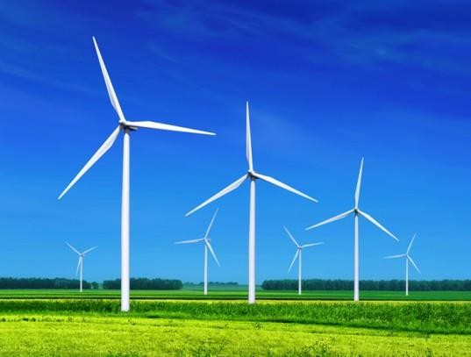


Slide 7

What do wind energy systems provide?
Electricity for
  Central-grids
  Isolated-grids
  Remote power supplies
  Water pumping
…but also…
Support for weak grids
Reduced exposure to
energy price volatility
Reduced transmission and distribution losses

Slide 8


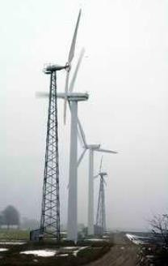
Wind Resource
High average wind speeds are essential
  4 m/s annual average is minimum
  People tend to overestimate the wind
  Wind speed tends to increase with height
Good resource
  Coastal areas
  Crests of long slopes
  Passes
  Open terrain
  Valleys that channel winds
Typically windier in
  Winter than summer
  Day than night

Slide 9

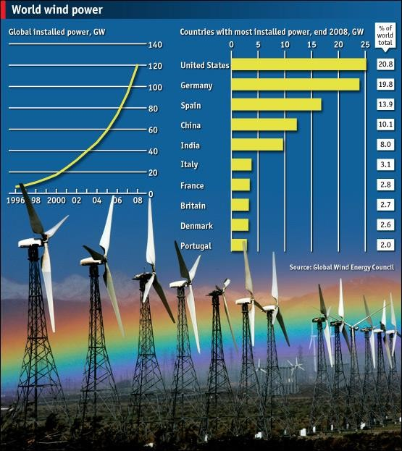
Advantages of Wind Power
Environmental
Economic Development
Fuel Diversity &
Conservation
Cost Stability

Slide 10
Technology

Slide 11

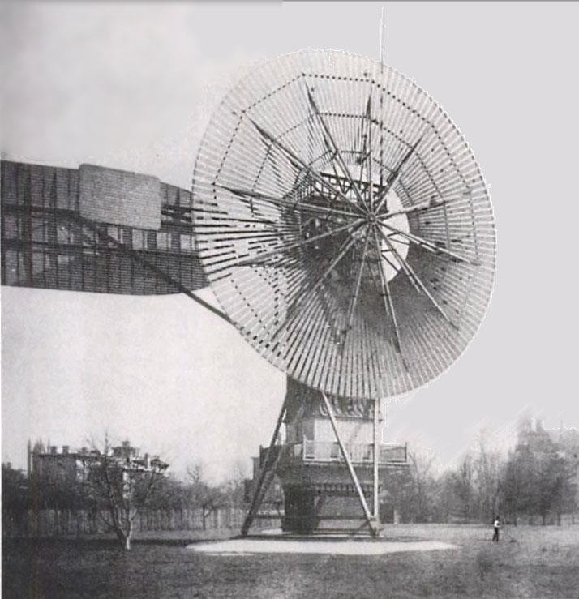
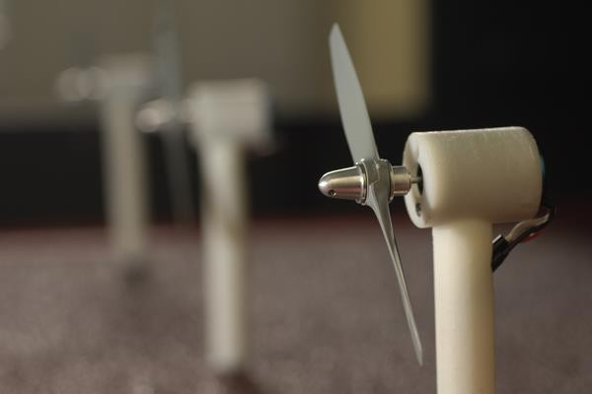
Turbine Evolution
Used for
Pumping water
Grinding grain
Mainly used for
Generating Electricity

Slide 12
Types of turbines
VAWT
Drag is the main force
Nacelle is placed at the bottom
Yaw mechanism is not required
Lower starting torque
Difficulty in mounting the turbine
Unwanted fluctuations in the power output

Slide 13
HAWT
Lift is the main force
Much lower cyclic stresses
95% of the existing turbines are HAWTs
Nacelle is placed at the top of the tower
Yaw mechanism is required

Slide 14
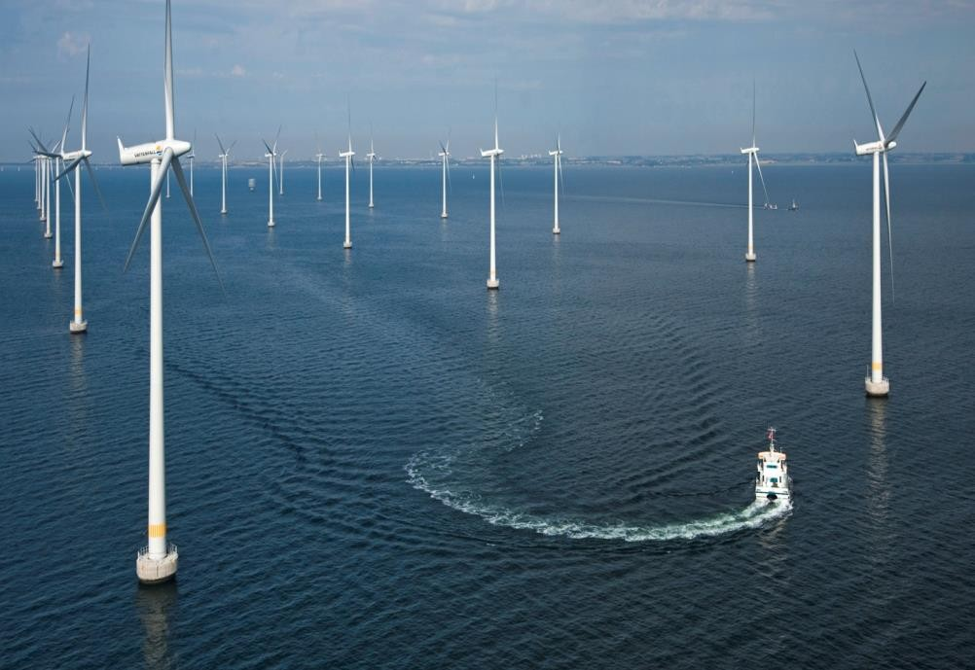
Offshore Turbines
More wind speeds
Less noise pollution
Less visual impact
Difficult to install and maintain
Energy losses due long
distance transport

Slide 15
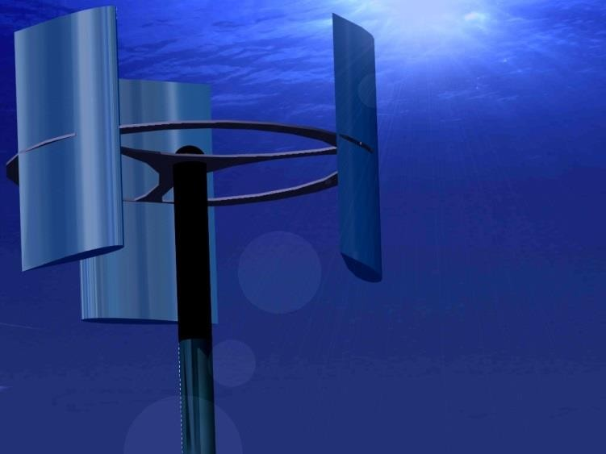
Future Wind Turbines
Wind Amplified Rotor
Platform

Slide 16
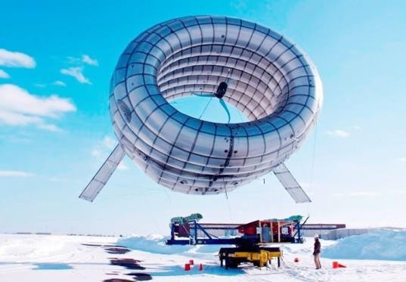
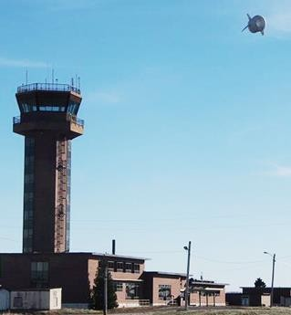
World’s First Airborne Wind Turbine To
Bring Renewable Energy and WiFi

Slide 17
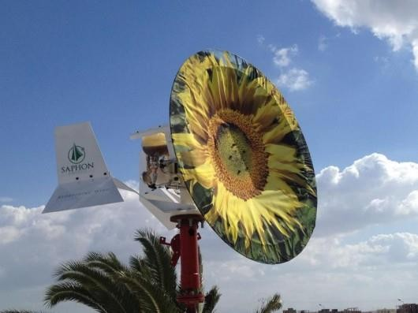
Disc type wind turbine
Much more efficient than HAWT
Requires less height
Low noise
Works in any wind
direction

Slide 18



E-signature
==========
George Xydis, PhD
Senior Researcher (project funded)
Institute for Research & Technology-Thessaly(I.RE.TE.TH.)/ Centre for Research & Technology Hellas (CE.R.T.H.) Technology Park of Thessaly, 1st Industrial Region,
P.O. Box 15, 38500 Volos, Greece
e-mail: gxydis@mail.ireteth.certh.gr, gxydis@gmail.com
==============================================

Slide 19








OMICS International Open Access Membership enables academic and research institutions, funders and corporations to actively encourage open access in scholarly communication and the dissemination of research published by their authors. For more details and benefits, click on the link below: http://omicsonline.org/membership.php
OMICS GROUP OPEN ACCESS MEMBERSHIP

