Slide 1
Journal of Astrobiology and Outreach
Dr. Hans J. Haubold
Editorial Board member
Professor
Department of Theoretical Astrophysics
Vienna International Centre
Vienna
Austria

Slide 2
Biography
Dr. Hans J. Haubold
Hans J. Haubold studied physics at the Technical University, Chemnitz, Germany, and received the PhD in 1980 and DSc 1984, both on topics of stellar astrophysics.
From 1974 to 1990, he worked at the Institute for Astrophysics, Potsdam, Germany.
In 1990, he accepted a post at the United Nations Programme on Space Applications, Office for Outer Space Affairs, United Nations, New York, USA (relocated to the United Nations Office at Vienna, Austria, in 1993) where he still works.
Research interest in astrophysics, physics, mathematics, history of physics, and space education. Since 1983 he is also a Professor at the Centre for Mathematical Sciences, Pala, Kerala, India.
He edited more than 10 volumes of workshop proceedings, is co-author of more than 10 books and 250 papers.

Slide 3
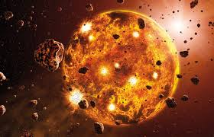
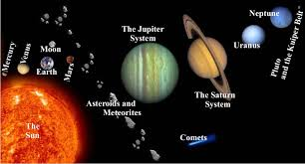
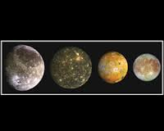
Research Interests
Astrophysics,
Planetary Science,
Cosmology,
Astronomy,
Space Science

Slide 4
Recent Publications
Mittag-Leffler functions and their applicationsHJ Haubold, AM Mathai, RK Saxena, Journal of Applied Mathematics 2011
Further solutions of fractional reaction–diffusion equations in terms of the h-function, HJ Haubold, AM Mathai, RK Saxena, Journal of Computational and applied Mathematics 235 (5), 1311-1316
Solutions of certain fractional kinetic equations and a fractional diffusion equation, RK Saxena, AM Mathai, HJ Haubold, Journal of Mathematical physics 51 (10), 103506
The H-function, AM Mathai, RK Saxena, HJ Haubold,Springer
Special functions for applied scientists, AM Mathai, HJ Haubold, Springer Science+ Business Media
Notes:
Further solutions of fractional reaction–diffusion equations in terms of the h-functionHJ Haubold, AM Mathai, RK Saxena
Journal of Computational and applied Mathematics 235 (5), 1311-1316
Further solutions of fractional reaction–diffusion equations in terms of the h-functionHJ Haubold, AM Mathai, RK Saxena
Journal of Computational and applied Mathematics 235 (5), 1311-1316
Further solutions of fractional reaction–diffusion equations in terms of the h-functionHJ Haubold, AM Mathai, RK Saxena
Journal of Computational and applied Mathematics 235 (5), 1311-1316

Slide 5
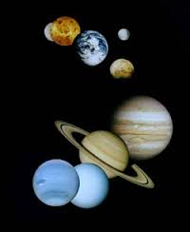

Slide 6
The Planets
There are 8 planets (Mercury, Venus, Earth, Mars, Jupiter, Saturn, Uranus, Neptune (mercury nearest and Pluto farthest from the Sun) that revolve around Sun in their specific orbits, which lie more or less in the Sun’s equatorial plane.
There are moons or natural satellites, which revolve around planets.
It is natural to think that planetary bodies have evolved from the Sun and the moons from their central bodies. However earth’s moon has been found to be older than earth and has its own history of evolution.
The biggest planet Jupiter is more akin to Sun than to other planets. In fact Mercury, Venus and Mars show surface features similar to our moon.
The planets can be divided into two categories.
The inner planets: Mercury, Venus, Earth, Mars which have densities of the order of 5 or more and sizes comparable to that of earth.

Slide 7
The outer planets (Jupiter, Saturn, Uranus, Neptune) quite large in size and have low densities ≈ 1.5 (Jupiter like hence called Jovian planets).
In our planetary system there are bodies which have little or no atmosphere and magnetic field (Moon, Mercury)
bodies which have substantial atmospheres but very little or no magnetic field (Venus and Mars) and bodies having both atmosphere and intrinsic magnetic field (Earth, Jupiter)
The solar flux expected at the orbit of planet outside its atmosphere, its albedo (measure of the reflectance of the surface) and effective computed temperature T_{eff} are listed in Table 3.
Actual temperature would depend on the presence or absence of atmosphere, sunlit or dark condition etc. For earth the actual temperature 288 K is warmer than the effective temperature.

Slide 8
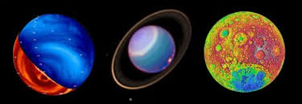

Slide 9
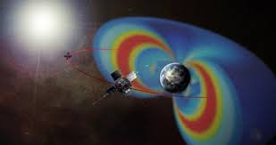

Slide 12
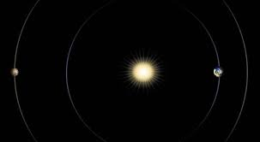

Slide 13
According to Professor Haubold’s research interest
An overview on statistical techniques for the analytic evaluation of integrals for non-resonant, non-resonant depleted, non-resonant cut-off, non-resonant sccreened, and resonant thermonuclear reaction rates.
The techniques are based on statistical distribution theory and the theory of Meijer's G-function and Fox's H-function.
He presented a computable solution of a fractional partial differential equation associated with a Riemann-Liouville derivative of fractional order as the time-derivative and Riesz-Feller fractional derivative as the space derivative.
The method followed in deriving the solution is that of joint Laplace and Fourier transforms. The solution is derived in a closed and computable form in terms of the Hfunction.
It provides an elegant extension of the results given earlier by Debnath, Chen et al., Haubold et al., Mainardi et al., Saxena et al., and Pagnini et al.

Slide 14
The results obtained are presented in the form of four theorems. Some results associated with fractional Schr¨odinger equation and fractional diffusion-wave equation are also derived as special cases of the findings.
The results are of interest to the physics of complex systems goverend by non-Gaussian, Non-Markovian, and non-Fickian phenomena.
Stars are gravitationally stabilized fusion reactors changing their chemical composition while transforming light atomic nuclei into heavy ones.
The atomic nuclei are supposed to be in thermal equilibrium with the ambient plasma. The majority of reactions among nuclei leading to a nuclear transformation are inhibited by the necessity for the charged participants to tunnel through their mutual Coulomb barrier.

Slide 15
Approved by
E-signature:

Slide 16
OMICS International Open Access Membership
OMICS International Open Access Membership enables academic and research institutions, funders and corporations to actively encourage open access in scholarly communication and the dissemination of research published by their authors.
For more details and benefits, click on the link below:
http://omicsonline.org/membership.php

