Slide 1
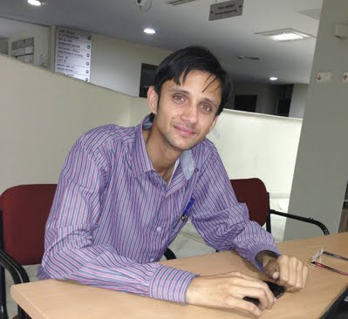
Harish Garg
Assistant Professor,
School of Mathematics & Computer Applications,
Thapar University Patiala, Punjab, India.
Email: harishg58iitr@gmail.com
URL: https://sites.google.com/site/harishg58iitr/
Tel: +91 8699031147

Slide 2
Research Interest
Optimization Technique
Statistics Methods & Algorithms
Numerical Methods
Computational Algorithm in Optimization
Engineering Mathematics
Artificial Intelligence
Differential Equations
Fuzzy Optimization
Reliability Analysis
Fuzzy set theory
Soft computing Technique (GA, PSO, ABC, ANN etc.)
Evolutionary Algorithms
Maintenance analysis
Fuzzy optimization
Statistical Analysis

Slide 3
Professional Experience:
June 17, 2014 – till date
Assistant Professor
Institute: School of Mathematics and Computer Applications, Thapar University, Patiala, Punjab, India
Duties: Teaching Undergraduate and Post Graduate students and responsible for carrying out innovative and insightful research in the area of reliability theory using Evolutionary algorithm and fuzzy set theory with their application in numerous industrial engineering areas.
July 19, 2013 – June 16, 2014
Lecturer
Institute: School of Mathematics and Computer Applications, Thapar University, Patiala, Punjab, India
Duties: Teaching Undergraduate and Post Graduate students and responsible for carrying out innovative and insightful research in the area of reliability

Slide 4
Awards, Achievement and Memberships:
Won 2nd prize and certificate in Scopus, Science direct Quiz held in Mahatma Gandhi Central Library, IIT Roorkee
DST Travel Grant for attending and presenting a research paper in Guanghou, China during November 18 – 20, 2011.
Qualified CSIR – UGC – JRF in June 2010.
Qualified CSIR – NET in December 2008.
Qualified GATE 2009 with MATHEMATICS securing 88.70 % percentile score.
Qualified GATE 2008 with MATHEMATICS securing 92.76 % percentile score.
National Mathematics Olympiad Certificate.

Slide 5
Memberships
Life Member of International Association of Engineering (IAENG) whose membership No is 113861.
Life Member of International Association of Computer Science and Information Technology (IACSIT) whose membership No. is 80341908
Associate Member of UACEE whose membership No. is AM1002445
Student Member of Bernoulli Society membership number is 15598
Member of Science and Engineering Institute (SCIEI) whose membership number is 20130206001

Slide 6
Achievements
Listed in MARQUIS Who’s Who in the World, USA, 31th Ed., 2014; International Directory of Distinguished Leadership, ABI Inc., USA.
One of my articles with entitles “Multi-Objective reliability redundancy allocation problem using particle swarm optimization”, published in Computer & Industrial Engineering; Elsevier is appeared on first position in the listing for most downloaded articles.
One of my paper published in MAPAN-Journal of Metrology Society of India with entitle “Reliability, Availability and Maintainability analysis of Industrial systems using PSO and fuzzy methodology” has appeared in the Popular content in this Publication.
One of my paper with entitles, “A Two-phase approach for reliability and maintainability analysis of an industrial system”, published in International Journal of Reliability, Quality and System Safety, WorldScientific is appeared in the listing of most read article.

Slide 7
Professional Activities
Guiding MSc Students (Completed: 01)
ANSHA, Generalized Parabolic fuzzy numbers and its applications, 2014

Slide 8
Journals (Under review: --, Accepted: 06 Published: 30)
1. Harish Garg, A novel approach for analyzing the behavior of industrial systems using weakest t-norm and intuitionistic fuzzy set theory, ISA Transaction, Elsevier (Impact Factor: 1.626).
2. Harish Garg, Monica Rani and S.P. Sharma, Performance analysis of industrial systems using artificial bee colony and fuzzy methodology, International Journal of Artificial Intelligence and tools, World Scientific (Impact Factor: 0.25).
3. Harish Garg, Predicting uncertain behavior in critical engineering systems under vague environment, Journal of Multiple-Valued Logic and Soft Computing, Old City Publishers (Impact Factor: 1.047).
4. Harish Garg, Analyzing the behavior of an industrial system using fuzzy confidence interval based methodology, National Academy Science Letters, Springer (Impact Factor: 0.067).

