Slide 1

OMICS Journals are welcoming Submissions
OMICS International welcomes submissions that are original and technically so as to serve both the developing world and developed countries in the best possible way.
OMICS Journals are poised in excellence by publishing high quality research. OMICS International follows an Editorial Manager® System peer review process and boasts of a strong and active editorial board.
Editors and reviewers are experts in their field and provide anonymous, unbiased and detailed reviews of all submissions.
The journal gives the options of multiple language translations for all the articles and all archived articles are available in HTML, XML, PDF and audio formats. Also, all the published articles are archived in repositories and indexing services like DOAJ, CAS, Google Scholar, Scientific Commons, Index Copernicus, EBSCO, HINARI and GALE.
For more details please visit our website: http://omicsonline.org/Submitmanuscript.php

Slide 2
Characterization of the pharmacological effects of cardiac glycosides on lung epithelial cells
PhD dissertation defense by
Hosam A. Elbaz
Pharmaceutical and Pharmacological Sciences
West Virginia University
Advisors: Prof. C. Z. Dinu / Prof. Y. Rojanasakul

Slide 3
Introduction
Lung cancer alone accounts for 15% of cancer incidences and 30% of cancer related mortality.
Lung cancer has poor prognosis due to an intrinsic wide signaling array, and limited therapeutic approaches.
Developing new therapeutic alternatives for lung cancer is of critical need.
Cardiac glycosides are potential candidates.

Slide 4
General outline
Digitoxin, a cardiac glycoside with the potential to provide a new hope for cancer therapy.
Digitoxin and a synthetic monosaccharide analog inhibit cell viability in lung cancer cells.

Slide 5
Digitoxin, a cardiac glycoside with the potential to provide a new hope for cancer therapy
Outline
  What are CGs?
  Evidence for anticancer effect.
  Potential CGs candidates.
  Differential effects on Na+/K+ATPase.
  Structural manipulation enhanced digitoxin’s cytotoxic activity.
  Potential mechanism for CG’s selective cytotoxicity
  Conclusions and future directions

Slide 6
What are cardiac glycosides?
A large family of chemical compounds found in several plants and animal species.
Known for more than 1500 years for several medical conditions as diuretics, emetics, abortifacients, antineoplastics, and heart tonics .
Patients with congestive heart failure, “dropsy””, improved after administering foxglove extract (Digitalis purpurea L.)

Slide 7
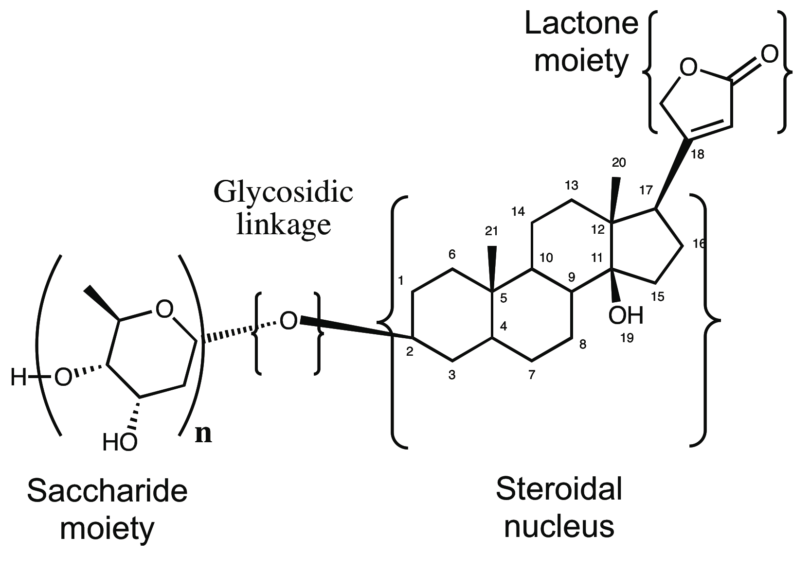
Cardiac glycosides share a common structural motif
C17
C
D
A
B
C2

Slide 8
Evidence for anticancer effect for cardiac glycosides
Historical records indicated CGs extracts for treating malignant conditions.
Shiratori et al., (1967) found anticancer potential for CGs on rodent cancer models.
Stenkvist et al. (1979-2001), and Goldin et al., (1984) showed that women on digitalis therapy
  developed more benign forms of breast tumors, and
  9.6-times lower cancer recurrence rate when compared to control patients.
CGs mediate a significant anticancer effect.

Slide 9
What are potential candidates from cardiac glycosides?
Digitoxin is an ideal candidate as an anticancer drug because:
  Anticancer effect at therapeutic concentrations
  Long half life (7days)
    97% bound to plasma proteins
    Large V_{d}
  Complete clinical profile

Slide 10
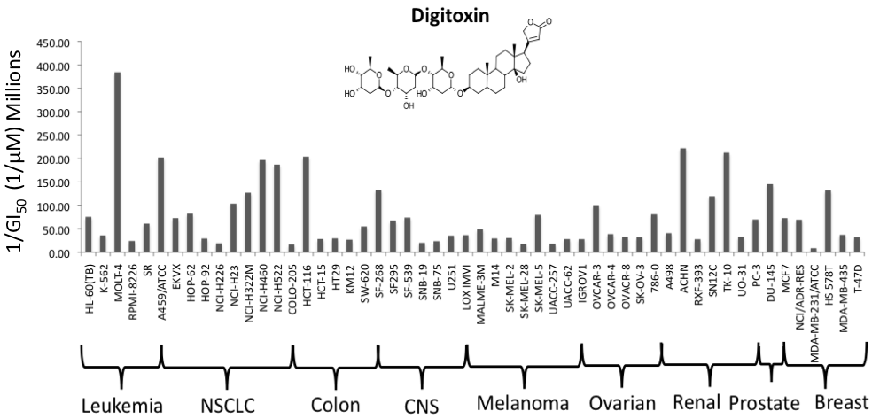
What are potential candidates from cardiac glycosides?
Iyer et al., 2010, Wang et al., 2010

Slide 11
Manipulation of the glycosidic linkage and saccharide moiety of digitoxin
(A)
(B)
n=1; Digitoxin mono-MeON-saccharide
n=2; Digitoxin di-MeON-saccharide
n=3; Digitoxin tri-MeON-saccharide
n=1; Digitoxin mono-O-saccharide
n=2; Digitoxin di-O-saccharide
n=3; Digitoxin
n= alfa-L-rhamnose; D6-MA

Slide 12
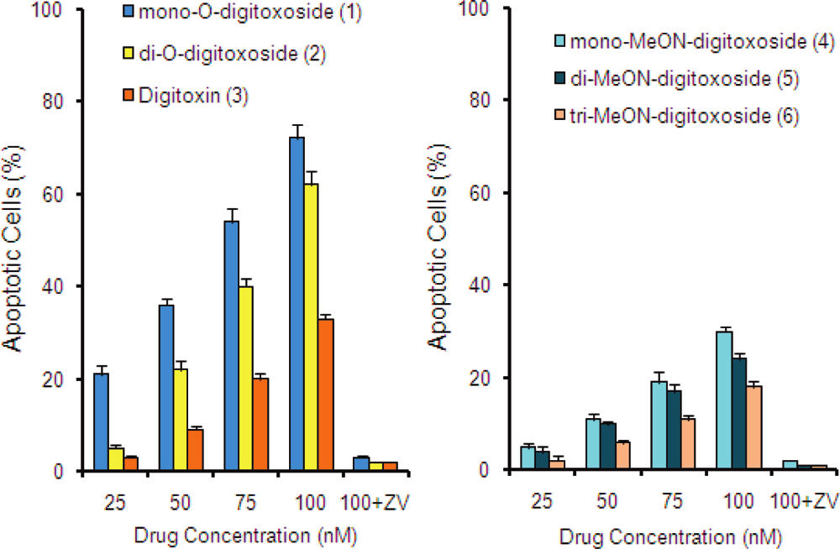
Digitoxin O-saccharides are more potent than digitoxin MeON-saccharides
Iyer et al., 2010

Slide 13
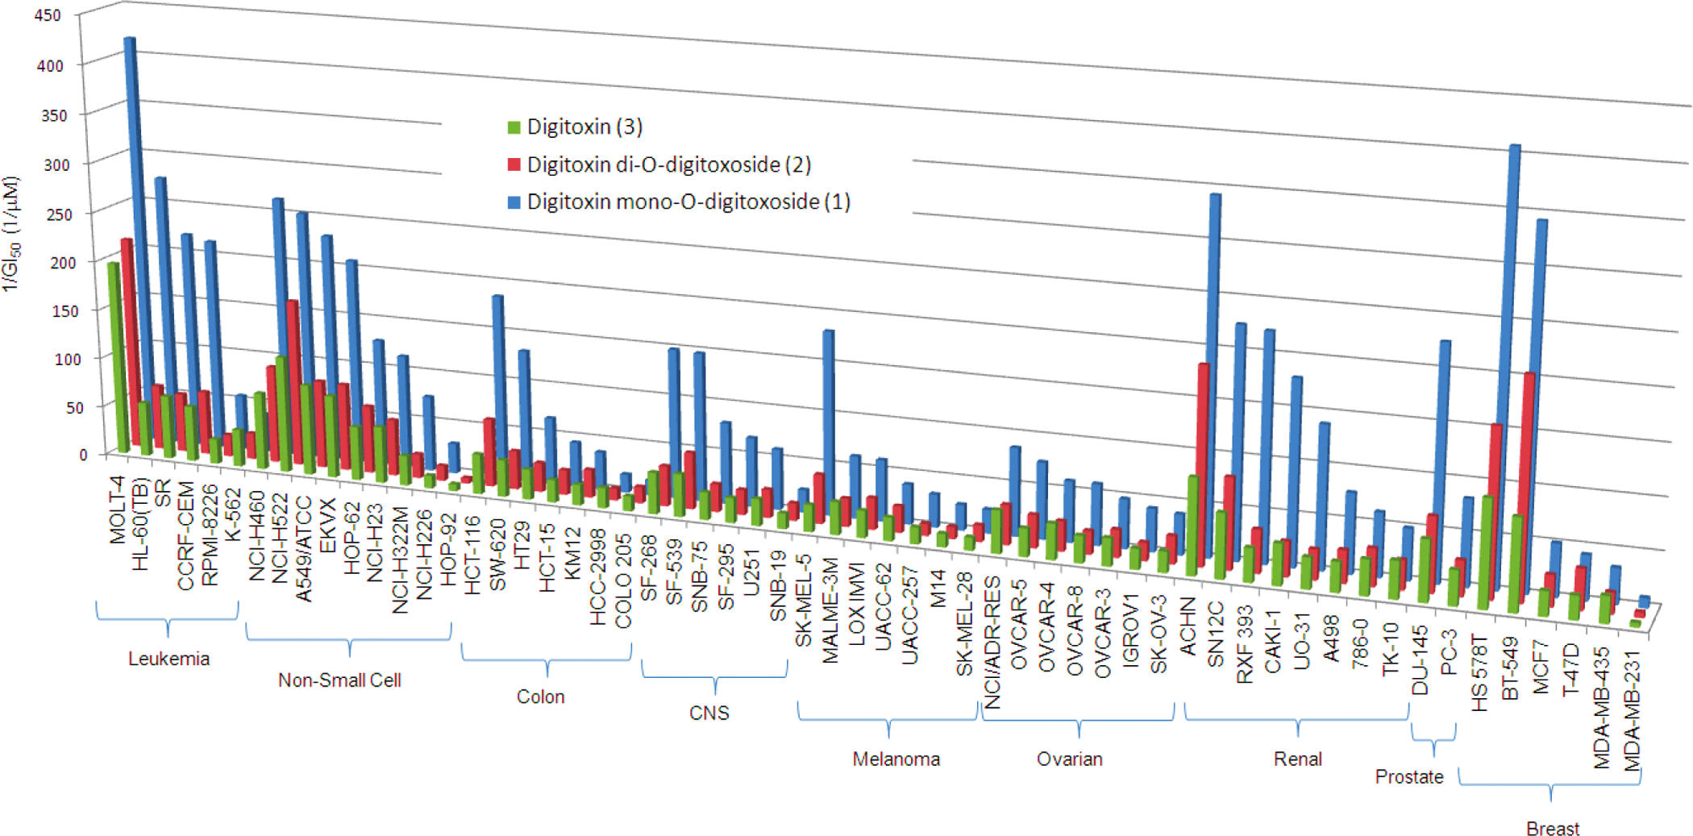
Digitoxin monosaccharide analogs are more potent anticancer agents than their disaccharide and trisaccharide counterparts
Iyer et al., 2010

Slide 14
Digitoxin affects Na⁺/K⁺ATPase differently depending on its concentration
Digitoxin (0.5-5μM)
Digitoxin (10-100 nM)
Na⁺/K⁺ ATPase
inhibition
Na⁺/K⁺ ATPase signalosome
(MAPK, SRC, Akt, and PLC signaling)
Intracellular
Na⁺ ⬆⬆
Na⁺/Ca²⁺ exchanger
activation
Intracellular events
Manipulated gene expression
Cancer specific genes ⬇⬇
Intracellular Ca²⁺ ⬆⬆
Intracellular events
Cell death

Slide 15
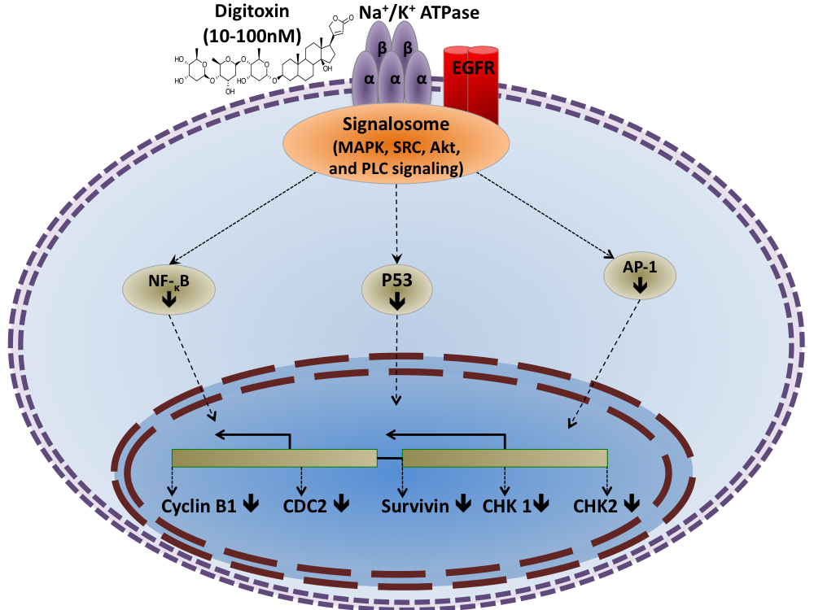
CGs reduce cell cycle regulatory proteins that are specifically overexpressed in cancer cells by blocking AP-1 and NF-κB signaling

Slide 16
Conclusions and future directions
How do digitoxin and analog cause G2/M phase arrest and apoptosis in cancer cells?
What are potential p53-independent therapeutic target(s) that mediate cancer cell death?
How do digitoxin and d6-ma inhibit survivin and p53 expression in cancer cells?
Would digitoxin and D6-MA induce mitotic catastrophe in cancer cells? if so, how?

Slide 17
Digitoxin and a synthetic monosaccharide analog inhibit cell viability in lung cancer cells
Outline
  Introduction
  Objectives and hypothesis
  Results
  Discussion and conclusions

Slide 18
Introduction
Appropriate cell cycle progression is crucial for cell viability.
In vitro CGs studies showed apoptosis, autophagy, and cell cycle arrest; however, mechanism is unclear.
Wang et al. synthesized and compared several digitoxin monosaccharide analogs for lethal and growth inhibitory effects.
Three monosaccharide analogues showed at least a 5-fold increase in antineoplastic potency in NSCLC.
Understanding the cytotoxic mechanism of CGs in NSCLC will help in developing safer and more effective anti-cancer drugs.

Slide 19
Objective and Hypothesis
NCI-H460 cells were chosen as a model for NSCLC because
  NSCLC cells are more sensitive to digitoxin and D6-MA
  Recalcitrance of NSCLC cells to chemotherapy
Objective:
  compare digitoxin with D6-MA with respect to their cytotoxic mechanisms
Hypothesis:
  therapeutically relevant doses of digitoxin and D6-MA would decrease cell viability due to G2/M arrest and induce apoptosis in NCI-H460 cells , with D6-MA being more potent.

Slide 20
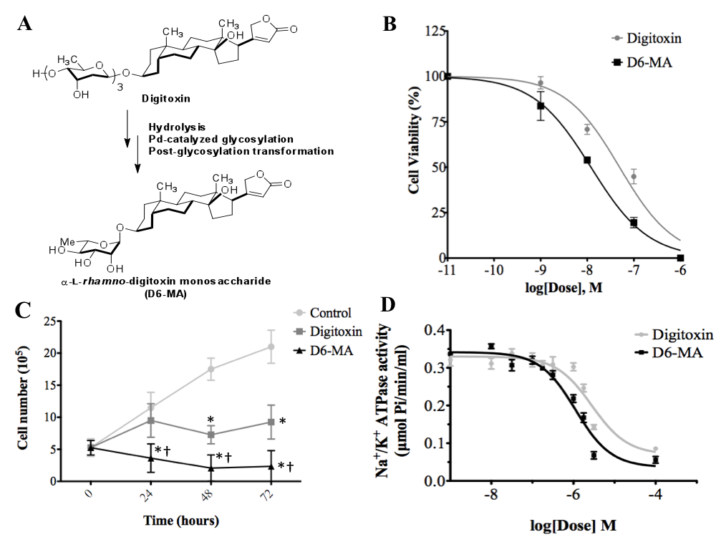
Digitoxin and D6-MA causes inhibition of NCI-H460 cell viability and Na⁺/K⁺ATPase enzyme activity

Slide 21
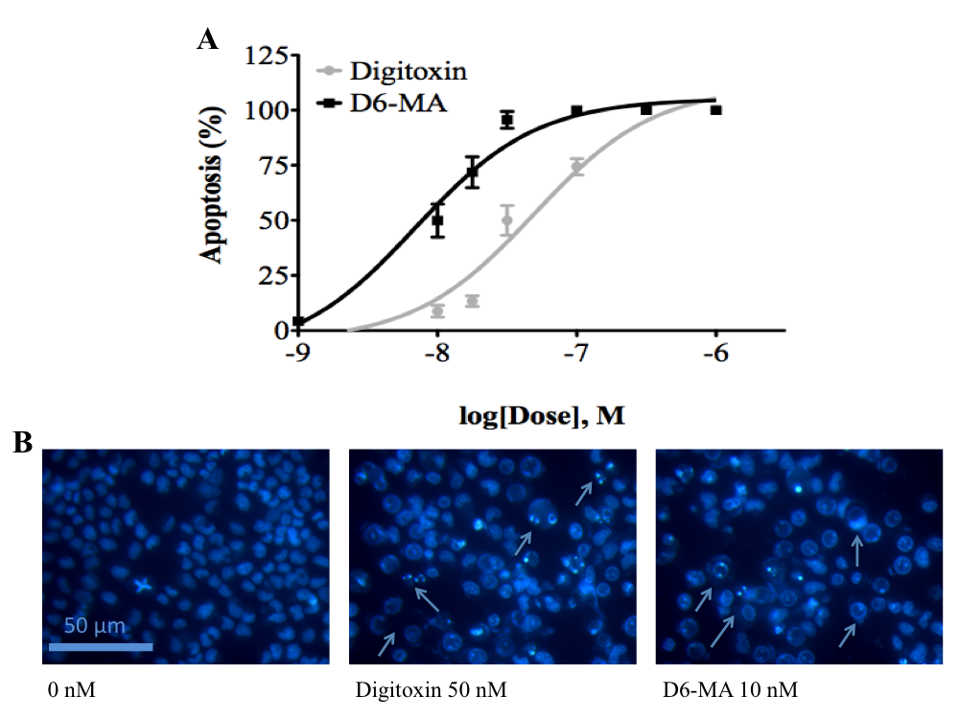
Digitoxin and D6-MA induces apoptosis in NCI-H460 cells

Slide 22
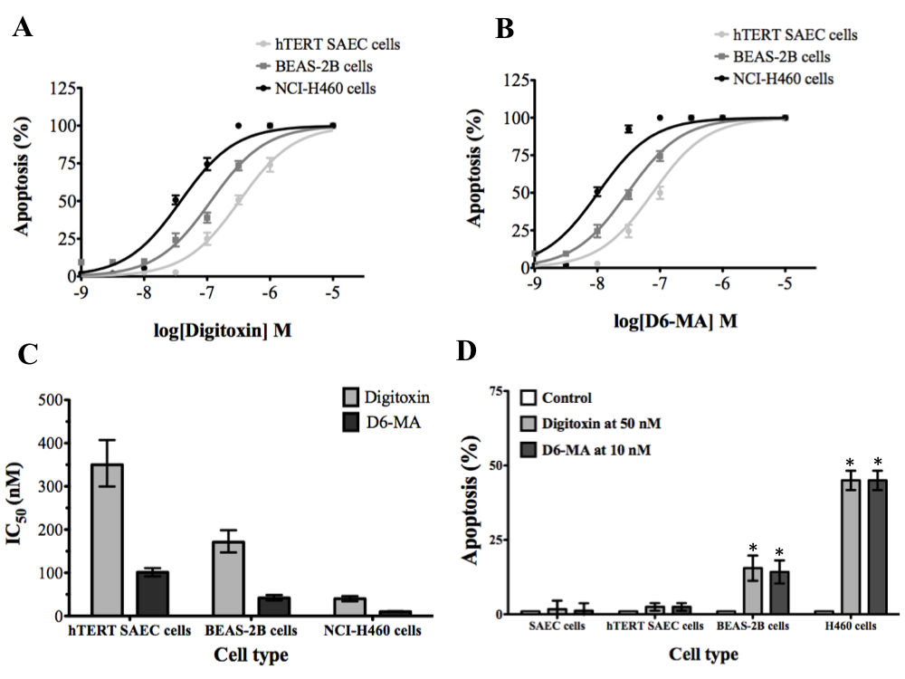
D6-MA exhibits selective cytotoxicity to NSCLC cells

Slide 23
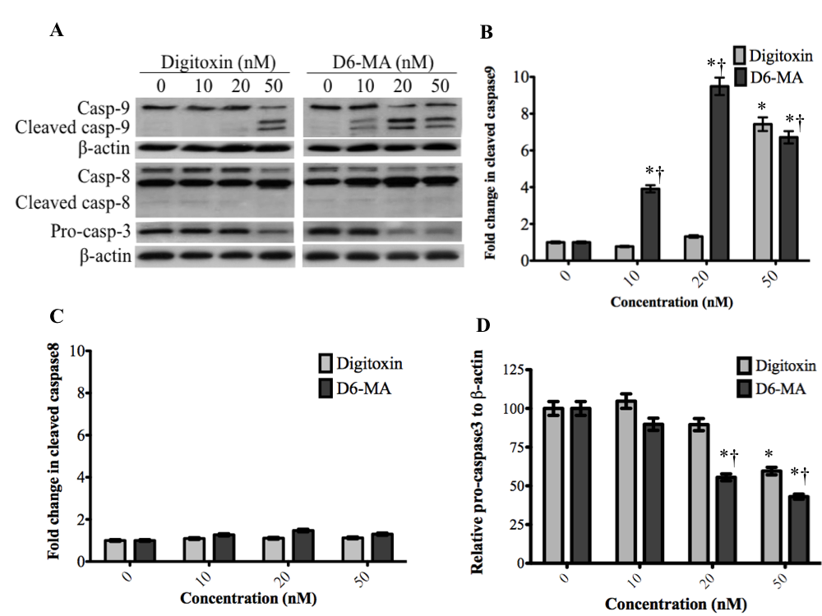
Digitoxin and D6-MA induces extensive caspase-9 cleavage

Slide 24
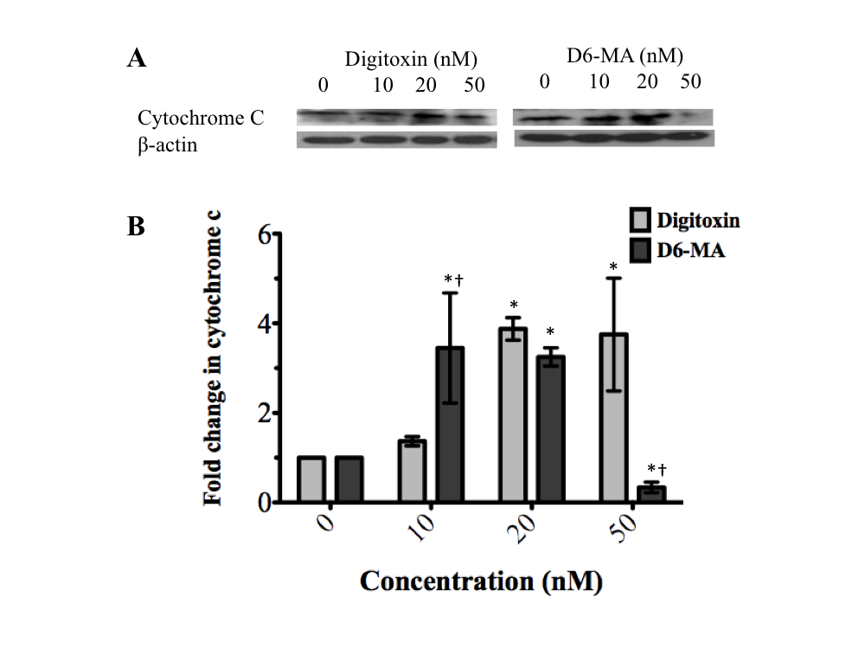
Digitoxin and D6-MA induces expression of cytochrome c

Slide 25
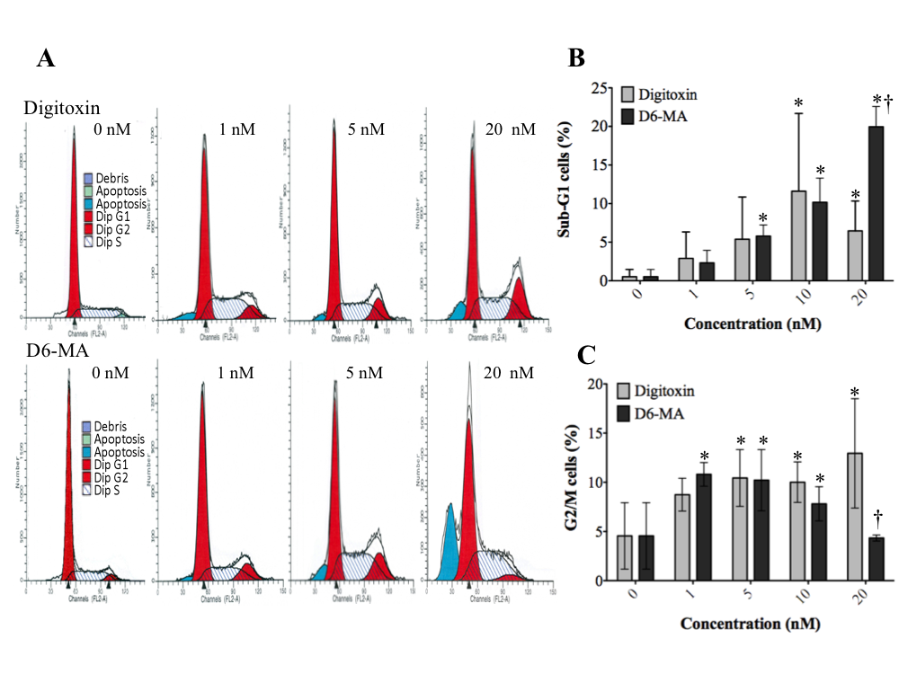
Digitoxin and D6-MA induce G2/M phase arrest

Slide 26
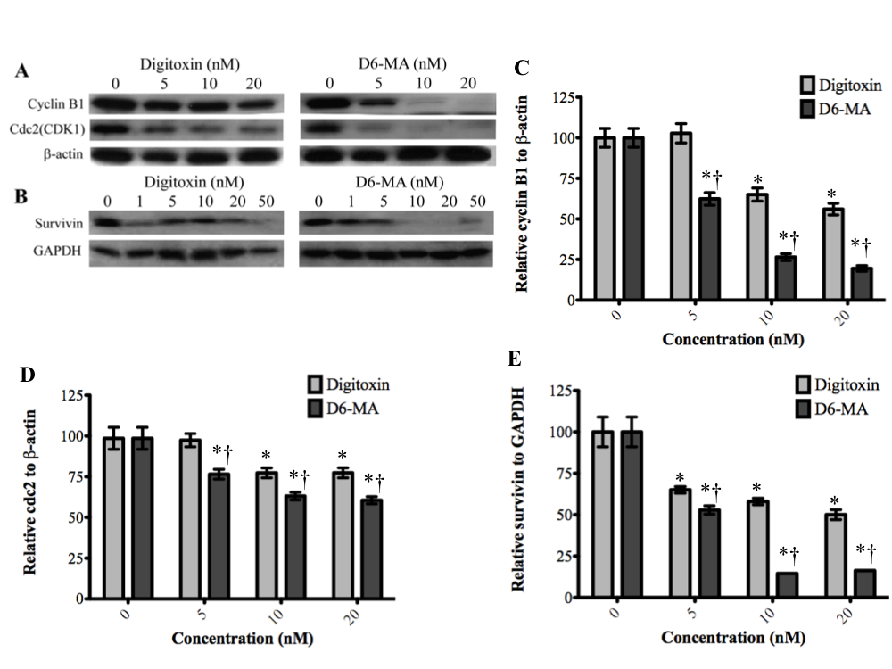
Digitoxin and D6-MA induced down-regulation of cyclin B, cdc2, and survivin

Slide 27
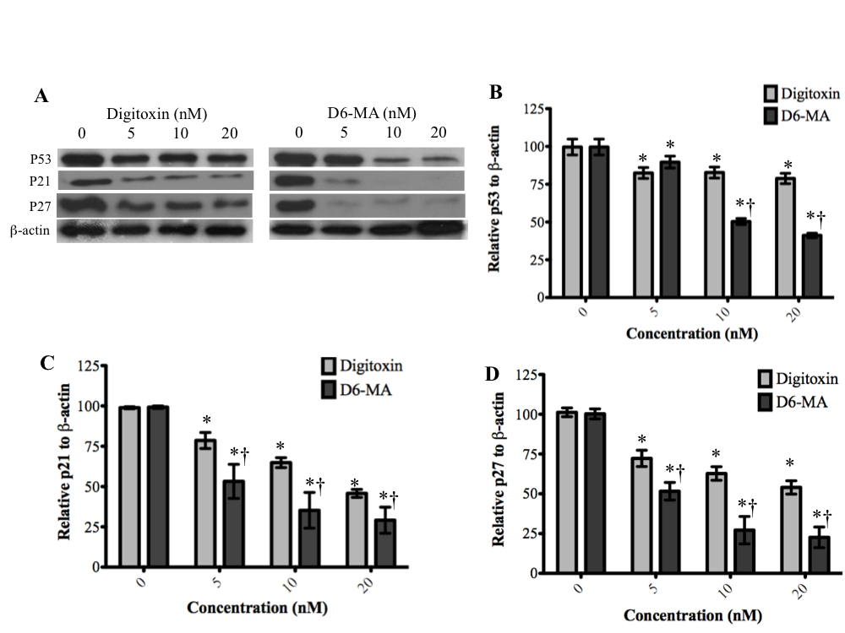
Digitoxin and D6-MA-mediated G2/M phase arrest does not correlate with up-regulation of p53-related signaling

Slide 28
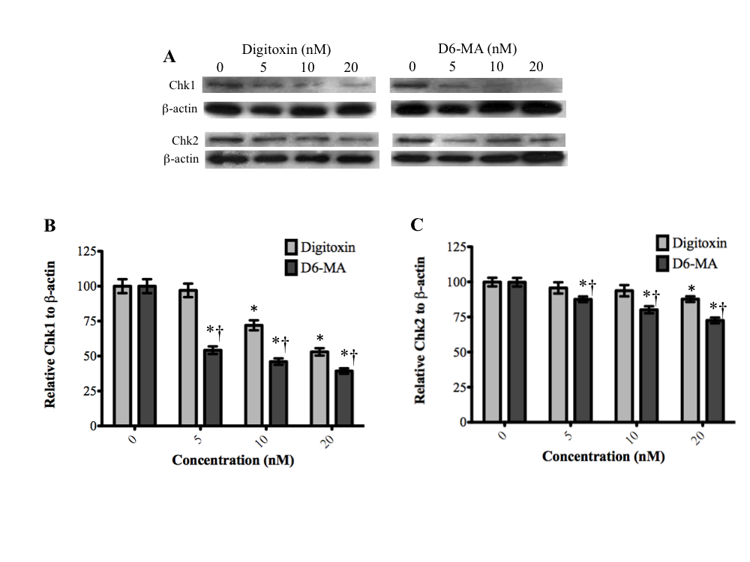
Digitoxin and D6-MA-mediated G2/M phase arrest does not correlate with up-regulation of Chk1/2

Slide 29
Discussion and Conclusions
Na+/K+ ATPase inhibition by either digitoxin or D6-MA does not account for drug or analog cytotoxic effects.
Na+/K+ ATPase signalsome activation is a viable possibility.
Digitoxin and D6-MA are selective to NSCLC cells.
Digitoxin and D6-MA induced differential caspase-9 cleavage, but not caspase-8.

Slide 30
Discussion and Conclusions
Digitoxin and D6-MA induce cytochrome c expression which contrasts previous claims of general inhibition of protein synthesis.
Inhibiting the expression of cyclin B1, cdc2, survivin, and Chk1/2 explain the potent and selective cytotoxic effect of digitoxin and D6-MA at therapeutic concentrations.
Digitoxin and D6-MA induce G2/M phase arrest and cyclinB1 and cdc2 down-regulation.
G2/M phase arrest and down regulation of cyclinB1 and cdc2 are not directly controlled by up-regulation of p53 signaling or checkpoint kinase signaling.

Slide 31

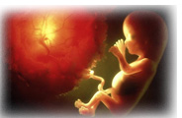
Clinical Pharmacology & Biopharmaceutics
Related Journals
Clinical & Experimental Pharmacology
Pharmaceutical Care & Health Systems
Journal of Developing Drugs

Slide 32

For more details on conferences related to Clinical Pharmacology & Biopharmaceutics Journal please visit the link given below
http://www.pharmaceuticalconferences.com/

Slide 33


OMICS International Open Access Membership
Open Access Membership with OMICS International enables academic and research institutions, funders and corporations to actively encourage open access in scholarly communication and the dissemination of research published by their authors.
For more details and benefits, click on the link below:
http://omicsonline.org/membership.php

