Slide 1
OMICS Group
OMICS Group International through its Open Access Initiative is committed to make genuine and reliable contributions to the scientific community. OMICS Group hosts over 400 leading-edge peer reviewed Open Access Journals and organizes over 300 International Conferences annually all over the world. OMICS Publishing Group journals have over 3 million readers and the fame and success of the same can be attributed to the strong editorial board which contains over 30000 eminent personalities that ensure a rapid, quality and quick review process. OMICS Group signed an agreement with more than 1000 International Societies to make healthcare information Open Access.
Contact us at: contact.omics@omicsonline.org

Slide 2
OMICS Journals are welcoming Submissions
OMICS Group welcomes submissions that are original and technically so as to serve both the developing world and developed countries in the best possible way.
OMICS Journals are poised in excellence by publishing high quality research. OMICS Group follows an Editorial Manager® System peer review process and boasts of a strong and active editorial board.
Editors and reviewers are experts in their field and provide anonymous, unbiased and detailed reviews of all submissions.
The journal gives the options of multiple language translations for all the articles and all archived articles are available in HTML, XML, PDF and audio formats. Also, all the published articles are archived in repositories and indexing services like DOAJ, CAS, Google Scholar, Scientific Commons, Index Copernicus, EBSCO, HINARI and GALE.
For more details please visit our website: http://omicsonline.org/Submitmanuscript.php

Slide 3
Electrical Brain Imaging-Brain Mapping (QEEG)-LORETA Z-score Neurofeedback in Neuropsychiatric Practice J. Lucas Koberda, MD, PhD, Professor of Neurology
Tallahassee NeuroBalance Center,
4838 Kerry Forest Parkway, Tallahassee, FL

Slide 4
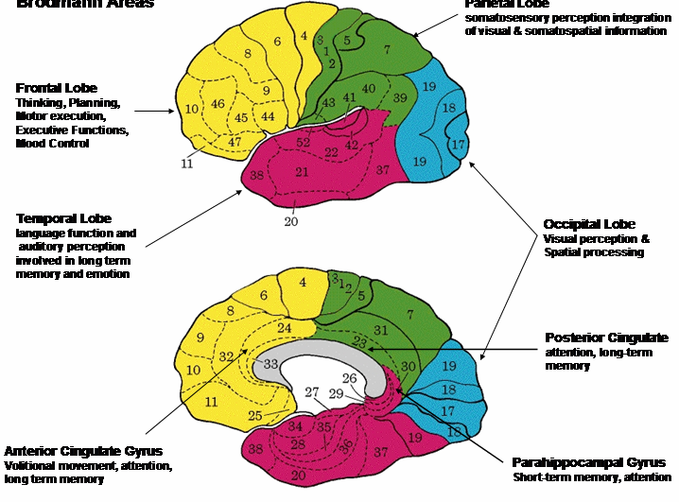
Brodmann cortical areas 1909
Described by Dr. Brodmann approximately 100 years ago but still widely used in research and clinical practice which links specific cortical brain areas to particular functions

Slide 5
Electrical imaging
Blood electrolytes abnormalities –imbalance-hypo- or hyper-(Na, K, Ca) gives well known clinical symptoms-Electrolyte abnormalities are detected based on previously determined normative values.
Brain electrical imbalance (normative database) gives symptoms based on cortical localization-see Brodmann’s Areas

Slide 6
Neuropsychiatric work up
Detailed history (symptoms and complains)
Neurobehavioral questionnaire
Cognitive computerized testing
Brain MRI, LAB’s (B12 deficiency)
QEEG/LORETA

Slide 7
Materials and Methods
LORETA-is a 3D mathematical transformation of QEEG data enabling relatively precise 7-10 mm localization of cortical dysfunction
Neurotrax Corp. is a computerized cognitive testing where patient is compared to aged and education matched healthy controls where mean=100 with 1 standard deviation=15.
This testing has been previously extensively tested for reliability. To minimize learning across sessions, 3 alternate forms of cognitive tests were developed with identical psychometric properties but different items. Equivalence for all three alternate forms was demonstrated to have an acceptable test-retest reliability

Slide 8
Z score NFB
The clinical use of NFB in neuropsychiatry involves 3 steps:
1. Evaluation of patients symptoms and complaints
2. Linking the patient’s symptoms to functional specialization in the brain
3. Real-time Z score neurofeedback of deviant or deregulated brain regions associated with the patient’s symptoms.
Use of real time to an age matched normative database with Z scores or standard deviations to train patients toward Z=O in brain regions associated with particular disorders.

Slide 9
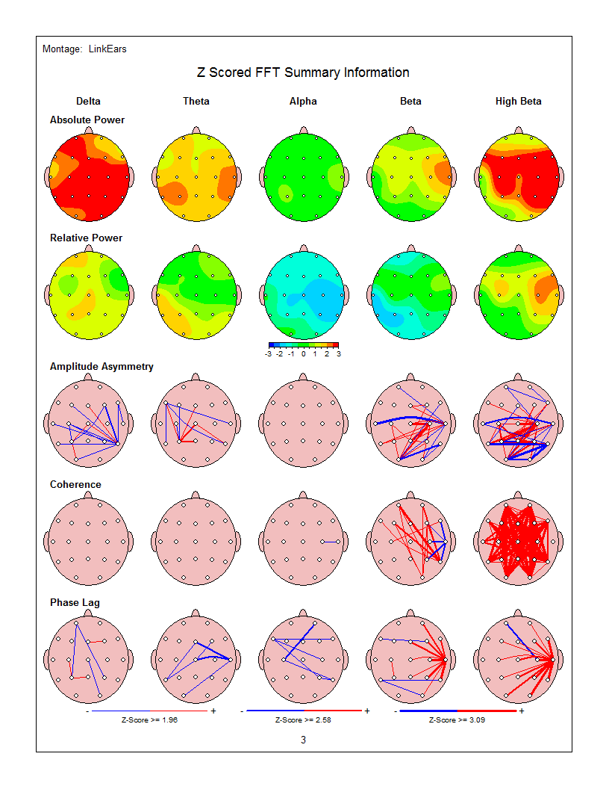
Z-score surface/LORETA 19 electrodes NFB
58 year old female with long history of chronic migraine and daily HA.
Pre-NFB QEEG (brain maps) showed marked increase in frontal and central beta power as well as increased delta and theta powers.

Slide 10
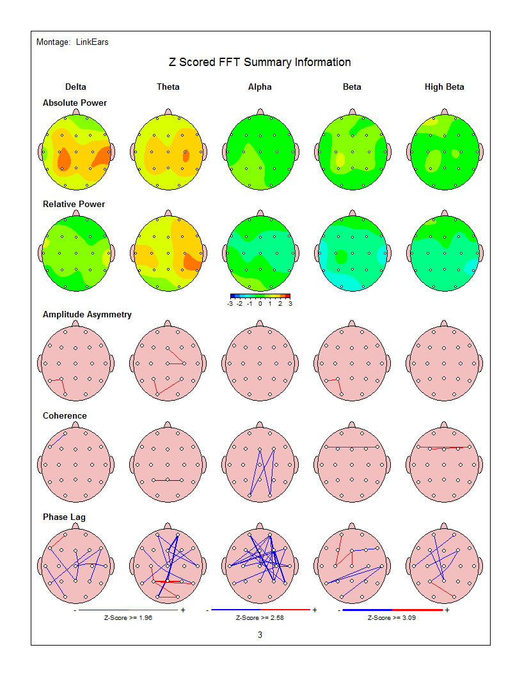
Z-scored surface and LORETA 19-electrodes NFB-continuation
After initiation of NFB and completion of 10 sessions of therapy patient’s HAs practically resolved and were in remission for 2-3 months.
F/U QEEG showed the resolution of frontal and central excess of beta activity (power).

Slide 11
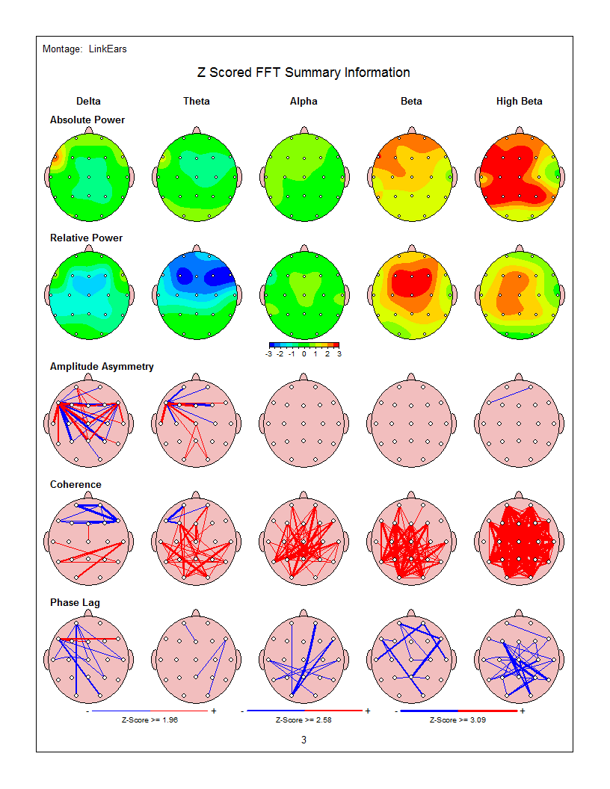
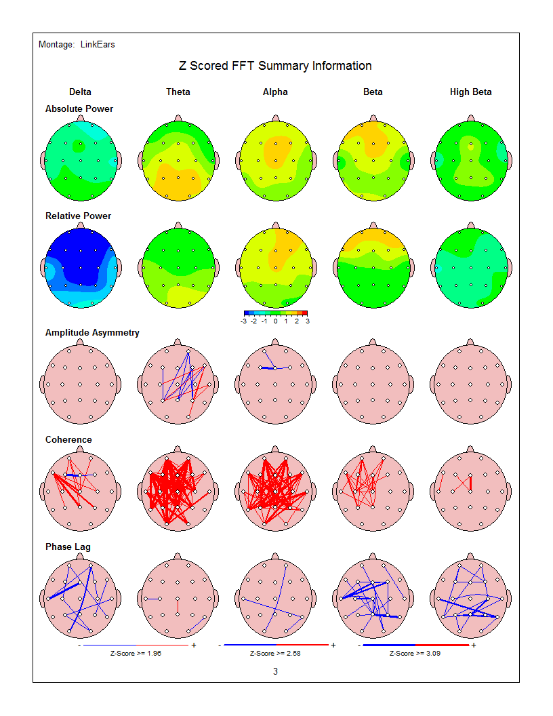
15 year old female competitive horse rider who was complaining of major anxiety before competitions and poor performance. Brain Mapping (QEEG) was completed before Neurofeedback (NFB) and after 15 sessions of NFB. See major reduction of beta activity (red color indicates increased beta activity-responsible for the anxiety) in after NFB maps. After NFB marked improvement of anxiety and performance during the competitions was noted

Slide 12
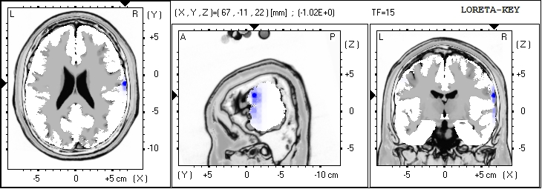
15 F with anxiety-LORETA-before and after 15 NFB sessions: BA 25

Slide 13
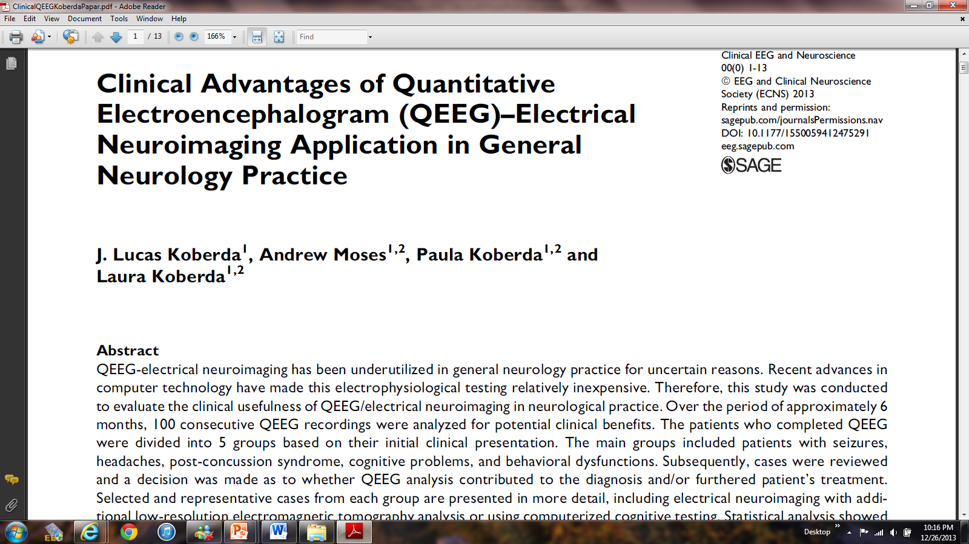

Slide 14
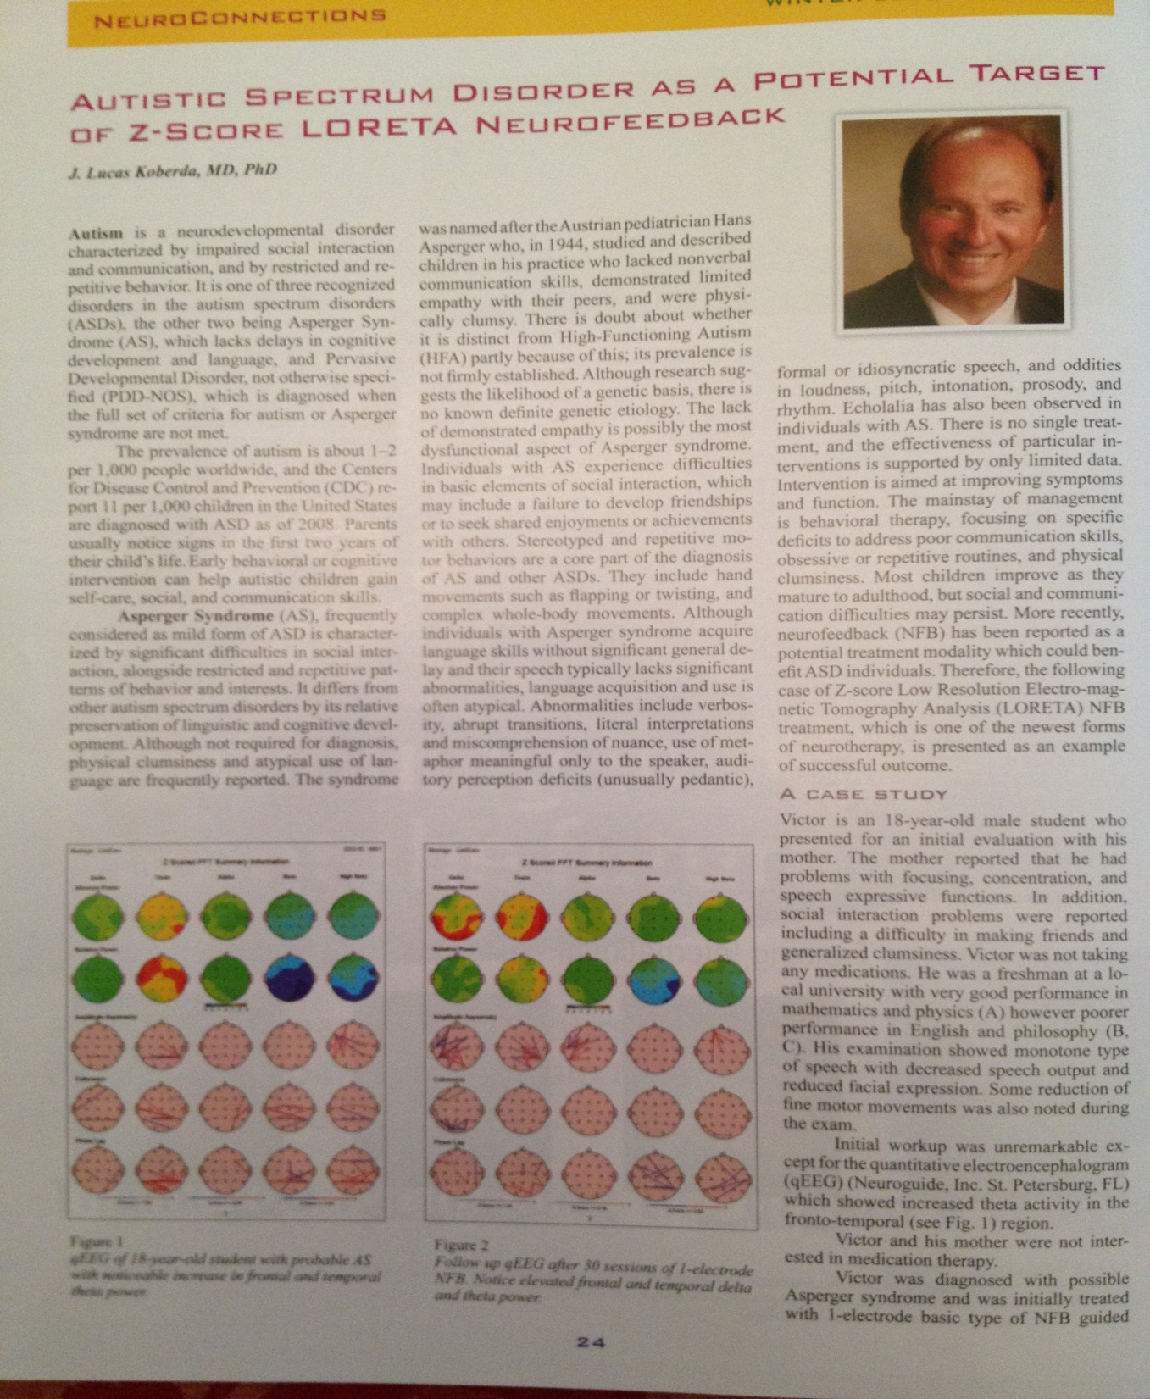
Invited publication 2012

Slide 15
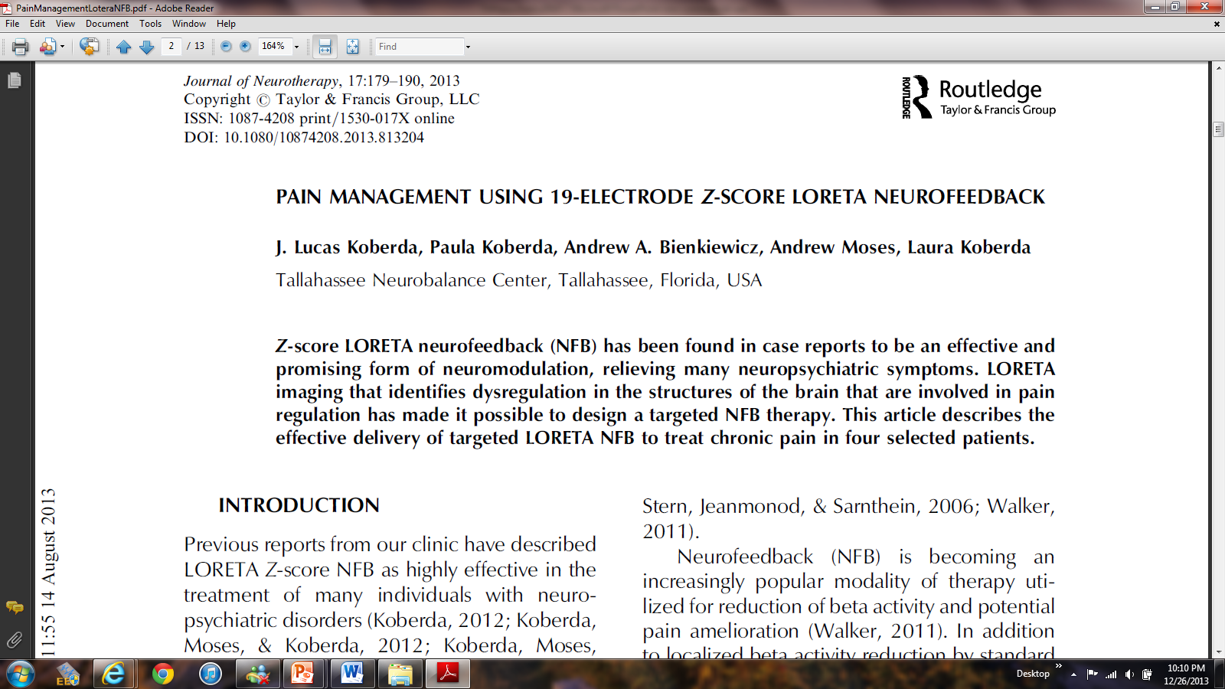

Slide 16
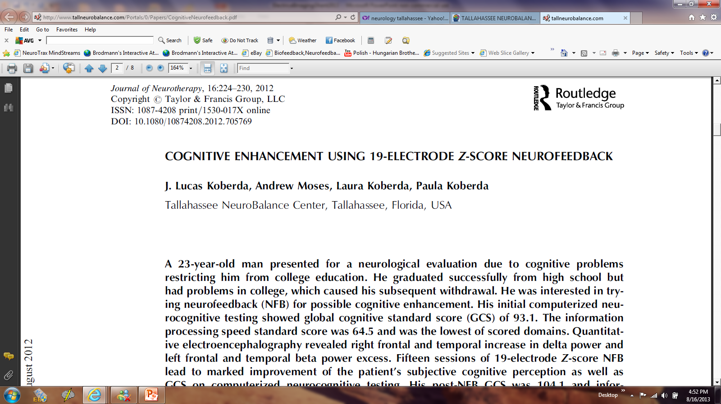

Slide 19
16 M after mTBI-Computerized cognitive testing after 10 sessions of NFB
Global CS: 82.3 110.7
Memory: 85.9 105.6
Executive Function: 65.7 108.4
Attention: 49.2 108.1
Info Proc. Speed 82.7 113.1
Visual Spatial: 107.3 113.9
Verbal Function: 85.3 114.2
Motor Skills: 100.1 111.6

Slide 20
32 M-with mTBI-after he was assaulted in psychiatric hospital-computerized cognitive testing before and after NFB
Global CS: 91.5 95.6 101 104
Memory 90.5 99.6 101.3 107.8
Info Processing Speed: 64.2 74 89.9 90.3

Slide 21
32 M-with mTBI-after he was assaulted in psychiatric hospital-computerized cognitive testing before and after NFB
Global CS: 91.5 95.6 101 104
Memory 90.5 99.6 101.3 107.8
Info Processing Speed: 64.2 74 89.9 90.3

Slide 22
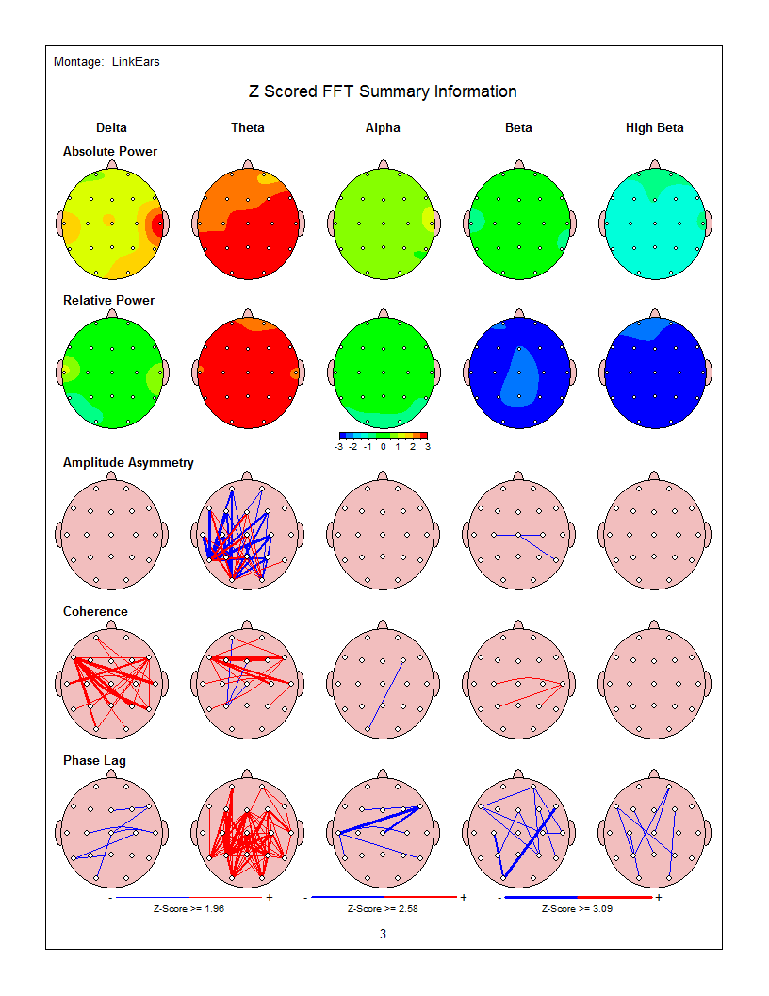
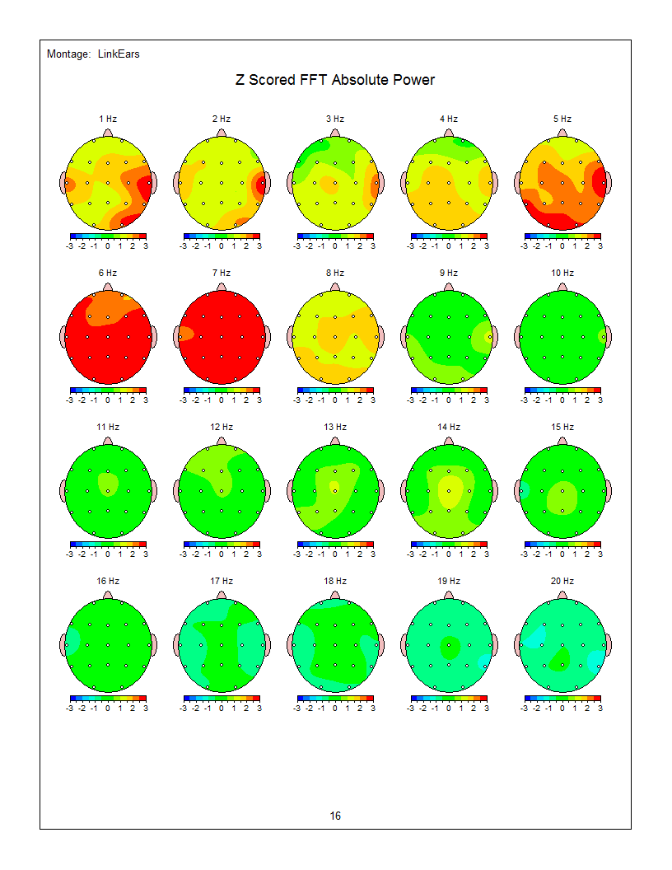
68 y.o. female with 1-2 years of progressive forgetfulness due to mild AD (second opinion after visit with another neurologist/neuropsychologist-recommended Aricept)

Slide 26
OMICS Group
OMICS Group International through its Open Access Initiative is committed to make genuine and reliable contributions to the scientific community. OMICS Group hosts over 400 leading-edge peer reviewed Open Access Journals and organizes over 300 International Conferences annually all over the world. OMICS Publishing Group journals have over 3 million readers and the fame and success of the same can be attributed to the strong editorial board which contains over 30000 eminent personalities that ensure a rapid, quality and quick review process. OMICS Group signed an agreement with more than 1000 International Societies to make healthcare information Open Access.
Contact us at: contact.omics@omicsonline.org

Slide 27
OMICS Journals are welcoming Submissions
OMICS Group welcomes submissions that are original and technically so as to serve both the developing world and developed countries in the best possible way.
OMICS Journals are poised in excellence by publishing high quality research. OMICS Group follows an Editorial Manager® System peer review process and boasts of a strong and active editorial board.
Editors and reviewers are experts in their field and provide anonymous, unbiased and detailed reviews of all submissions.
The journal gives the options of multiple language translations for all the articles and all archived articles are available in HTML, XML, PDF and audio formats. Also, all the published articles are archived in repositories and indexing services like DOAJ, CAS, Google Scholar, Scientific Commons, Index Copernicus, EBSCO, HINARI and GALE.
For more details please visit our website: http://omicsonline.org/Submitmanuscript.php

Slide 28
Emergency Mental Health Related Journals
International Journal of School and Cognitive Psychology
Psychology & Psychotherapy
Psychiatry: Open Access
Psychological Abnormalities in Children

Slide 29
Emergency Mental Health Related Conferences
Annual Conference on Fostering Human Resilience
Annual Summit on Sleep Disorders and Medicine
Euro Global Summit and Medicare Expo on Psychiatry

Slide 30
OMICS Group Open Access Membership
OMICS publishing Group Open Access Membership enables academic and research institutions, funders and corporations to actively encourage open access in scholarly communication and the dissemination of research published by their authors.
For more details and benefits, click on the link below:
http://omicsonline.org/membership.php

