Slide 1

OMICS Journals are welcoming Submissions
OMICS International welcomes submissions that are original and technically so as to serve both the developing world and developed countries in the best possible way.
OMICS Journals are poised in excellence by publishing high quality research. OMICS International follows an Editorial Manager® System peer review process and boasts of a strong and active editorial board.
Editors and reviewers are experts in their field and provide anonymous, unbiased and detailed reviews of all submissions.
The journal gives the options of multiple language translations for all the articles and all archived articles are available in HTML, XML, PDF and audio formats. Also, all the published articles are archived in repositories and indexing services like DOAJ, CAS, Google Scholar, Scientific Commons, Index Copernicus, EBSCO, HINARI and GALE.
For more details please visit our website: http://omicsonline.org/Submitmanuscript.php

Slide 2
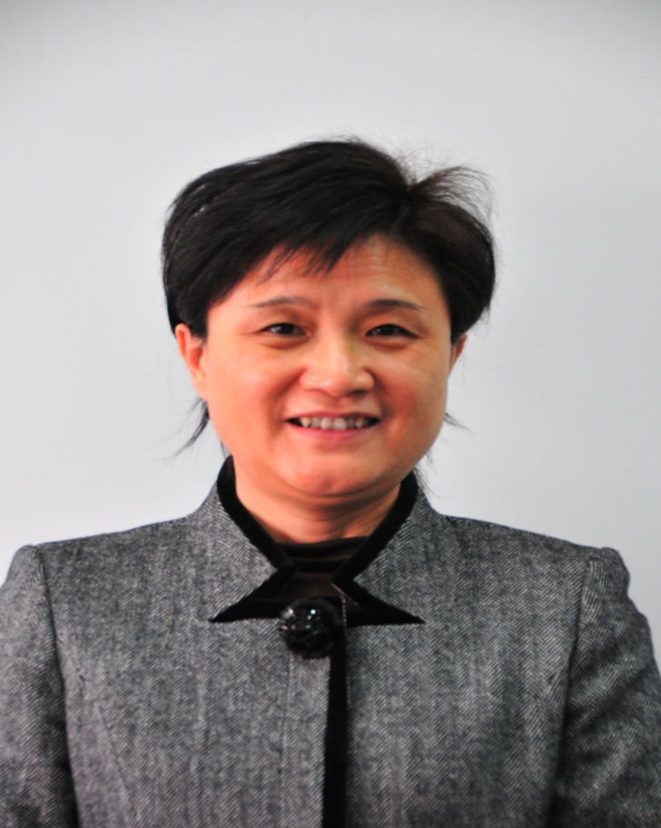
Research Interests and the facilities in Prof. Jian-Zhi Wang’ Lab
Notes:
recent passport size photo, your C.V, Biography (150 words) & Research Interests ( a short description in the form of PPT within 10-15 slides) to display at Journal website. We will publish the power point slides based on your research interest without any charge in Journal website.

Slide 3
Research Interests in prof. JZ Wang’ Lab
To explore the mechanisms underlying Alzheimer’s neurodegeneration, especially the role of tau and the nature of Neurodegenration.
To develop methods, cell and animal models for measuring the abnormal tau proteins and the cellular or systemic effects of tau proteins
To search for new strategies arresting the disease progression.

Slide 4
Research Interests in prof. JZ Wang’ Lab (major findings)
Tau hyperphosphorylation renders the cells more resistant to the chemically induced apoptosis, simultaneously the hyperphosphorylated tau impairs the cell functions.
Based on these findings, we have proposed that the nature of “AD neurodegeneration” may represent a new type of tau-regulated chronic neuron death, namely “neurodegenerasis”.

Slide 5
Research Interests in prof. JZ Wang’ Lab (major findings)
We speculate that transient tau phosphorylation helps cells abort from an acute apoptosis, while persistent tau hyperphosphorylation & accumulation may trigger cell senescence with a destiny of neurodegeneration.

Slide 6
Research Interests in prof. JZ Wang’ Lab (major findings)
We reveal that molecular mechanisms underlie tau-induced cell anti-apoptosis involves substrate competition of tau and β-catenin for GSK-3β; activation of Akt; preservation of Bcl-2 and suppression of Bax, cytosolic cytochrome-c, and caspase-3 activity; and upregulation of unfolded protein response (UPR) during ER stress.

Slide 7
Research Interests in prof. JZ Wang’ Lab (major findings)
Glycogen synthase kinase-3β and protein phosphatase-2A may be the most crucial kinase and phosphatase in Alzheimer-like tau pathologies.
Tau proteins isolated from the Alzheimer’s brain is abnormally glycosylated, and O-glycosylation is negatively correlated with the phosphorylation of tau.

Slide 8
Recent reprehensive papers (from >130)
Zhang Z, Song M , Liu X, Kang SS, Kwon IS, Duong DM, Seyfried NT, Hu WT, Liu Z, Wang JZ, Cheng L, Sun YE, Yu SP, Levey AI and Ye K*. Proteolytic processing of tau by asparagine endopeptidase mediates the neurofibrillary pathology in Alzheimer’s disease­. Nat Med. Accepted
Yang Y, Shu X, Liu D, Shang Y, Wu Y, Pei L, Xu X, Tian Q, Zhang J, Qian K, Wang YX, Petralia RS, Tu W, Zhu LQ, Wang JZ, Lu Y. EPAC null mutation impairs learning and social interactions via aberrant regulation of miR-124 and Zif268 translation. Neuron. 2012 Feb 23;73(4):774-88.
Zhu LQ, Zheng HY, Peng CX, Liu D, Li HL, Wang Q and Wang JZ. Protein Phosphatase 2A Facilitates Axonogenesis by Dephosphorylating CRMP2. J Neurosci. 2010, 30:3839-3848.
Zhu LQ, Liu D, Hu J, Cheng J, Wang SH, Wang Q, Wang F, Chen JG, and Wang JZ. GSK-3β inhibits presynaptic vesicle exocytosis by phosphorylating P/Q-type calcium channel and interrupting SNARE complex formation. J Neurosci. 2010, 30:3824-3833.
Li HL, Wang HH, Liu SJ, Deng YQ, Zhang YJ, Tian Q, Wang XC, Chen XQ, Yang Y, Zhang JY, Wang Q, Xu H, Liao FF, Wang JZ. Phosphorylation of tau antagonizes apoptosis by stabilizing beta-catenin, a mechanism involved in Alzheimer's neurodegeneration. Proc Natl Acad Sci U S A. 2007, 104(9):3591-3596.
Zhu LQ, Wang SH, Yin YY, Liu D, Zheng HY, Shi HR, Tian Q, Wang XC, Wang Q, Chen JG, Wang JZ. Activation of glycogen synthase kinase-3 inhibits long term potentiation with synapse-associated impairments. J Neurosci. 2007, 27:12211–12220.

Slide 9
Resources and Techniques in prof. JZ Wang’ Lab
Plasmids
wt and site mutated tau40: R406W, V337M, G272V, P301L, S262E, S262A, S199E, S199A, S404D, S396D, S409A
tau46,tau39,tau24
wt and swe mutated APP
wt and site mutated GSK-3, PKC, AKT, p38, CDK5,PP-2A, SET, PTPA
Mitochondria related proteins: Mito, OPA1, Mfn1, Mfn2
ER related proteins: Bip, SiL1
Synaptic proteins: VAMP2, SypI, GluT1, GluT4

Slide 10
Cell Lines & Transgenic Mice
N2a, N2a/APP, N2a/tau40; HEK293, HEK293/tau; SH-SY5Y, SK-N-SH; PC12; CHO......
Tg2576; APP/PS1; htau(ki)/mtau(ko); mtau(ko); 3Xtg AD; TRPC1 ko; GSK-3beta Flox-ko…..
Sporadic AD model (hHcy rats) …….

Slide 11
Electrophysiology & Imaging
Patch Clamp (EPSP, AP)
In-vitro multi-channel electrophysiological recording (LTP in rat and mouse brains……)
In-vivo multi-channel electrophysiological recording (Spiking recording in rats with photostimulations…….)
Ca2+ Oscillations
FRAP
FRET

Slide 12
Animal Experiments
Morris water maze
Barnes circular maze
Elevated plus maze
Radial arm maze
T-maze
Stereotaxic brain injection
Contextual fear conditioning
Active/Passive avoidance
Forcing swimming
Step-down test
Open Field

Slide 13
Biochemistry & Molecular Biology
Western blot
Immunohistochemistry
Immunofluorescence
Immunoprecipitation
Flow cytometry
ELISA
Site-specific mutagenesis
q-PCR
RT-PCR
RNA/DNA extraction
……..

Slide 14
Cell Morphology and Biology
Nissl staining
Golgi staining (synapse morphologies)
Silver staining (neurofibrillary tangles)
H&E staining
Cell lines subculture
Primary neuron culture
Transfection
Cell migration
Single cell injection
………

Slide 15

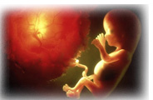
Neurological Disorders
Related Journals
Journal of Neurology & Neurophysiology
Journal of Neuroinfectious Diseases
International Journal of Neurorehabilitation
 | International Journal of Neurorehabilitation

Slide 16

For Related Conferences, visit
www.conferenceseriese.com

