Slide 1

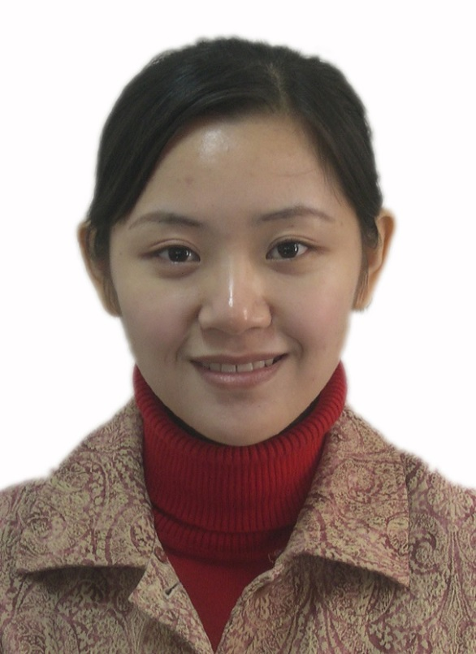
Jianing You
Associate Professor
Center for Studies of Psychological Application & School of Psychology
South China Normal University
Guangzhou
China
E-mail: youjianing@gmail.com

Slide 2
Jianing You is an Associate Professor at Center for Studies of Psychological Application and School of Psychology, South China Normal University. She received her Ph.D. from Department of Psychology, The Chinese University of Hong Kong. Her research interests lie in adolescent non-suicidal self-injury, emotional disorders, and personality disorders. She has published several articles in international peer-reviewed journals. Apart from doing research, Dr. You is also enthusiastic about serving the community. She has delivered many lectures and held numerous workshops for adolescents, teachers, and parents in order to promote adolescents’ psychological well-being.
Biography

Slide 3
Adolescent Non-suicidal Self-injury Emotional Disorders Personality Disorders
Research interest

Slide 4
Jianing You, Min-Pei Lin, Freedom Leung (2014) A Longitudinal Moderated Mediation Model of Nonsuicidal Self-injury among Adolescents. J Abnorm Child Psychol
Jianing You, Min Pei Lin, Kei Fu, Freedom Leung (2013) The best friend and friendship group influence on adolescent nonsuicidal self-injury. J Abnorm Child Psychol 41: 993-1004
Jianing You, Min-Pei Lin, Freedom Leung (2013) Functions of nonsuicidal self-injury among Chinese community adolescents. J Adolesc
Jianing You, Freedom Leung, Katty Kit Yee Lai, Kei Fu (2012) Factor structure and psychometric properties of the Pathological Narcissism Inventory among Chinese university students. J Pers Assess
Ching Man Lai, Freedom Leung, Jianing You, Fanny Cheung (2012) Are DSM-IV-TR borderline personality disorder, ICD-10 emotionally unstable personality disorder, and CCMD-III impulsive personality disorder analogous diagnostic categories across psychiatric nomenclatures? J Pers Disord 26: 551-67
Recent Publications

Slide 5
Jianing You, Freedom Leung, Kei Fu (2012) Exploring the reciprocal relations between nonsuicidal self-injury, negative emotions and relationship problems in Chinese adolescents: a longitudinal cross-lag study. J Abnorm Child Psychol 40: 829-836
Ching Man Lai, Freedom Leung, Jianing You, Fanny Cheung (2012) Are DSM-IV-TR Borderline Personality Disorder, ICD-10 Emotionally Unstable Personality Disorder, and CCMD-III Impulsive Personality Disorder Analogous Diagnostic Categories Across Psychiatric Nomenclatures? J Pers Disord
Jianing You, Freedom Leung (2012) The role of depressive symptoms, family invalidation and behavioral impulsivity in the occurrence and repetition of non-suicidal self-injury in Chinese adolescents: a 2-year follow-up study. J Adolesc
Jianing You, Freedom Leung, Ching Man Lai, Kei Fu (2012) The associations between non-suicidal self-injury and borderline personality disorder features among Chinese adolescents. J Pers Disord 26: 226-37

Slide 6


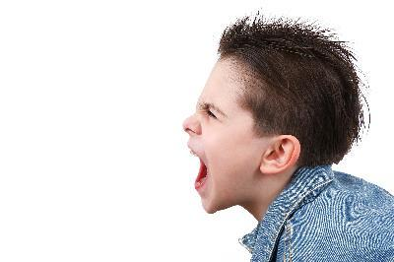
Emotional/Behavioral
disorder (EBD)

Slide 7
Emotional Disturbance?
The IDEA defined emotional disturbance as:
“a condition exhibiting one or more of the following characteristics over a long period of time and to a marked degree”

Slide 8
An inability to learn which cannot be explained by intellectual, sensory, or health factors
An inability to build or maintain satisfactory interpersonal relationships with peers and teachers
Inappropriate types of behavior or feelings under normal circumstances
A general pervasive mood of unhappiness or depression
A tendency to develop physical symptoms or fears associated with personal or school problems

Slide 9
Causes?
Biological Factors:
Abnormal brain development or brain injury
Genetics
Person’s behavioral style or way of responding to situations
Environmental Factors:
Relationship with parents during early years
School
Gang membership, drug and alcohol use, deviant behavior

Slide 10
Characteristics
Externalizing:
    Uncontrolled, acting out style
    Behaviors described as aggressive, arguing, impulsive, coercive, and noncompliant
    Hyperactivity
Internalizing:
    Overcontrolled, inhibited style
    Behaviors described as withdrawn, lonely, depressed, and anxious

Slide 11
Other:
    Attention deficit
    Poor social skills
    Skill deficit
    Performance deficit
    Academic deficit
    Learning problems
    Distorted thinking
    Immaturity

Slide 12
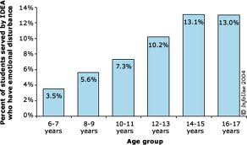
Statistics as per IDEA

Slide 13


OMICS International
www.omicsonline.org
OMICS International (and its subsidiaries), is an Open Access publisher and international conference Organizer, which owns and operates peer-reviewed Clinical, Medical, Life Sciences, and Engineering & Technology journals and hosts scholarly conferences per year in the fields of clinical, medical, pharmaceutical, life sciences, business, engineering, and technology. Our journals have more than 3 million readers and our conferences bring together internationally renowned speakers and scientists to create exciting and memorable events, filled with lively interactive sessions and world-class exhibitions and poster presentations. Join us!
OMICS International is always open to constructive feedback. We pride ourselves on our commitment to serving the Open Access community and are always hard at work to become better at what we do. We invite your concerns, questions, even complaints. Contact us at contact.omics@omicsonline.org. We will get back to you in 24-48 hours. You may also call 1-800-216-6499 (USA Toll Free) or at +1-650-268-9744 and we will return your call in the same timeframe.
Contact us at: contact.omics@omicsonline.org

