Slide 1
OMICS Journals are Welcoming Submissions
OMICS Group welcomes submissions that are original and technically so as to serve both the developing world and developed countries in the best possible way.
OMICS Journals are poised in excellence by publishing high quality research. OMICS Group follows an Editorial Manager® System peer review process and boasts of a strong and active editorial board.
Editors and reviewers are experts in their field and provide anonymous, unbiased and detailed reviews of all submissions.
The journal gives the options of multiple language translations for all the articles and all archived articles are available in HTML, XML, PDF and audio formats. Also, all the published articles are archived in repositories and indexing services like DOAJ, CAS, Google Scholar, Scientific Commons, Index Copernicus, EBSCO, HINARI and GALE.
For more details please visit our website: http://omicsonline.org/Submitmanuscript.php

Slide 2
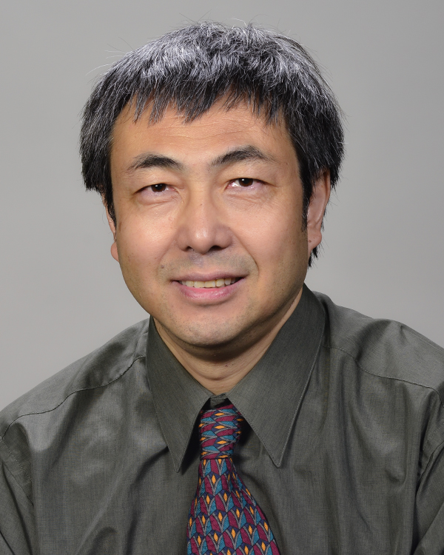
Pancreatic Disorders & Therapy
Jiazhi Sun, MD
Assistant Professor
Department of Pharmaceutical Science and Biochemistry
University of South Florida
USA
Editor for
Pancreatic Disorders & Therapy

Slide 3
BIOGRAPHY
Dr. Jiazhi Sun has been trained in the field of basic medical science and molecular biology and received M.D. degree from Peking University in 1986. After completing his residency and fellowship training at Peking University in 1990 and graduate studies on targeting Q-binding protein into yeast mitochondria at West Virginia University in 1994, he received two-terms postdoc training at the University of Pittsburgh and H. Lee Moffitt Cancer Center in the field of Pharmacology, Biochemistry and Drug Discovery from 1994 to 2003.

Slide 4
RESEARCH INTERESTS
Dr. Jiazhi Sun focuses on Ras and ER signaling study, HDL-Receptor RNA alternative processing, and K-Ras, GPCR, BH3 protein and VDR/ER drug discovery targeting by utilizing Target-Guided Synthesis (TGS) approach and conventional intervention. Dr. Sun has more than 20-year professional experience in academic field including Drug Discovery, Signal Transduction, Apoptosis, Cancer Biology and Cardiovascular field, also leading collaborative Institutional and Pharmaceutical Industry rational design/targeted-therapeutic approach and development of FTI, GGTI and Kinase inhibitors (tyrosine, serine/threonine and sphingosine) and nuclear hormone receptor mimics as well as BH3-mimics as drug candidates and “Chemical-Genetics” tool/model. Recently Dr. Sun’s lab has been focus on scFv and ADC development in terms of targeting EGFR/K-Ras in Cre-activated K-rasG12D transgenic mouse models.

Slide 5
RECENT PUBLICATIONS
Prediction of the likelihood of drug interactions with kinase inhibitors based on in vitro and computational studies.
Prediction of drug-target interactions for drug repositioning only based on genomic expression similarity.
The BH3 alpha-helical mimic BH3-M6 disrupts Bcl-X(L), Bcl-2, and MCL-1 protein-protein interactions with Bax, Bak, Bad, or Bim and induces apoptosis in a Bax- and Bim-dependent manner.
Apogossypol derivatives as antagonists of antiapoptotic Bcl-2 family proteins.
Bcl-XL-templated assembly of its own protein-protein interaction modulator from fragments decorated with thio acids and sulfonyl azides.
Structure-based design of imidazole-containing peptidomimetic inhibitors of protein farnesyltransferase.
Cucurbitacin Q: a selective STAT3 activation inhibitor with potent antitumor activity.

Slide 6
What is apoptosis?
There are two ways that a cell can die: necrosis and apoptosis. Necrosis occurs when a cell is damaged by an external force, such as poison, a bodily injury, an infection or getting cut off from the blood supply (which might occur during a heart attack or stroke). When cells die from necrosis, it's a rather messy affair. The death causes inflammation that can cause further distress or injury within the body.
Apoptosis, on the other hand, is relatively civil, even though it may not sound so at first -- it's when a cell commits suicide. How is that better than necrosis? For one thing, the cleanup is much easier. It's sometimes referred to as programmed cell death, and indeed, the process of apoptosis follows a controlled, predictable routine.
When a cell is compelled to commit suicide (we'll get to the triggers for apoptosis in just a minute), proteins called caspases go into action. They break down the cellular components needed for survival, and they spur production of enzymes known as DNases, which destroy the DNA in the nucleus of the cell.

Slide 7
It's like roadies breaking down the stage in an arena after a major band has been through town. The cell shrinks and sends out distress signals, which are answered by vacuum cleaners known as macrophages. The macrophages clean away the shrunken cells, leaving no trace, so these cells have no chance to cause the damage that necrotic cells do.
Apoptosis also differs from necrosis in that it's essential to human development. For example, in the womb, our fingers and toes are connected to one another by a sort of webbing. Apoptosis is what causes that webbing to disappear, leaving us with 10 separate digits. As our brains develop, the body creates millions more cells than it needs; the ones that don't form synaptic connections undergo apoptosis so that the remaining cells function well. Programmed cell death is also necessary to start the process of menstruation.
Scientists are trying to learn how they can modulate apoptosis, so that they can control which cells live and which undergo programmed cell death. Anti-cancer drugs and radiation, for example, work by triggering apoptosis in diseased cells. Many diseases and disorders are linked with the life and death of cells -- increased apoptosis is a characteristic of AIDS, Alzheimer's and Parkinson's disease, while decreased apoptosis can signal lupus or cancer. Understanding how to regulate apoptosis could be the first step to treating these conditions.

Slide 8
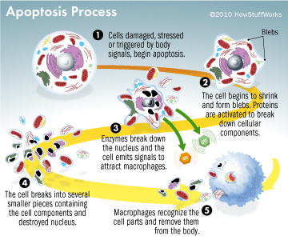

Slide 9
Pancreatic Disorders & Therapy Related Journals
Journal of the Pancreas
Journal of Gastrointestinal & Digestive System

Slide 10
OMICS Group Open Access Membership
OMICS publishing Group Open Access Membership enables academic and research institutions, funders and corporations to actively encourage open access in scholarly communication and the dissemination of research published by their authors.
For more details and benefits, click on the link below:
http://omicsonline.org/membership.php

