Slide 1
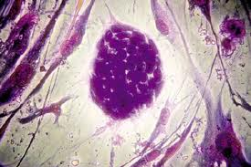
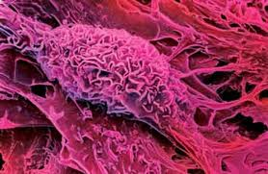
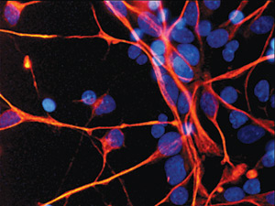
The Research Progress of Stem Cell Based Therapies for Regenerating Inner Ear Hair Cells
Professor Wang Jinfu
College of Life Sciences, Zhejiang University
Institute of Cell and Developmental Biology

Slide 2
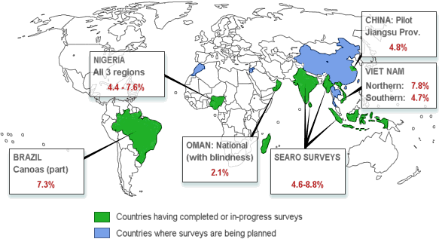
The global deaf population is about 280 million
The deaf population in our country is about 30 million
Data sources ： WHO，http://www.who.int； http://www.cdpf.org.cn

Slide 4
1
Inner ear stem cells
2
Embryonic stem cells
3
Mesenchymal stem cells
4
Induced pluripotent stem cells

Slide 5
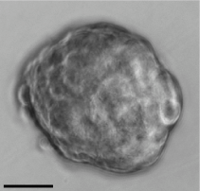
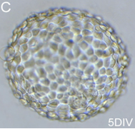
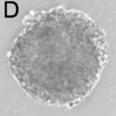
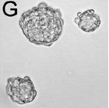
A
B
Inner ear stem cells have been isolated from Vestibular utricle (Fig A), Cochlea corti (Fig B), Spiral ganglion (Fig C) and Stria vascularis (Fig D). These cells form typical cell mass under culture in vitro. It is one of the most typical growth characteristics of inner ear stem cells.
C
D
Oshima, K et al. JARO. 2007.

Slide 6
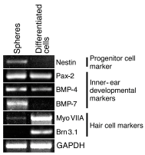
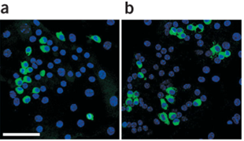
A
B
espin
C
Li, W et al. Nature medicine. 2003.
The stem cells from utricle could differentiated into hair cells in vitro. Induced cells expressed specific markers of hair cells，such as myosin VIIA、espin、parvalbumin 3 and Brn3.1.

Slide 7
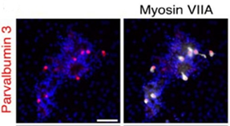
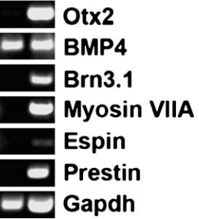
E
D
E
F
E
Oshima, K et al. JARO. 2007.
The stem cells from Cochlea corti could also differentiate into hair cells in vitro. Induced cells expressed the specific marker genes such as myosin VIIA、Espin、Parvalbumin3 and prestin.

Slide 8
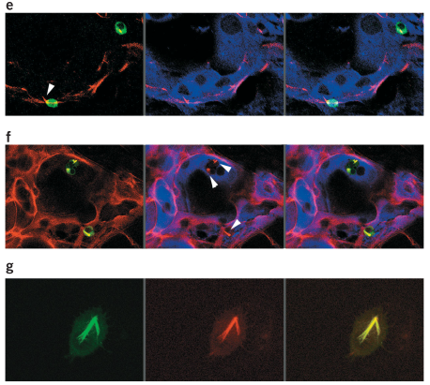
The inner ear stem cells could be induced into hair cell-like cells in vitro, and express the specific marker genes such as myosin VIIA (Fig e) and espin (Fig f). The protrude stereociliary bundle–like protrusions on the surface of these hair cell–like cells.
Li, W et al. Nature medicine. 2003.

Slide 9
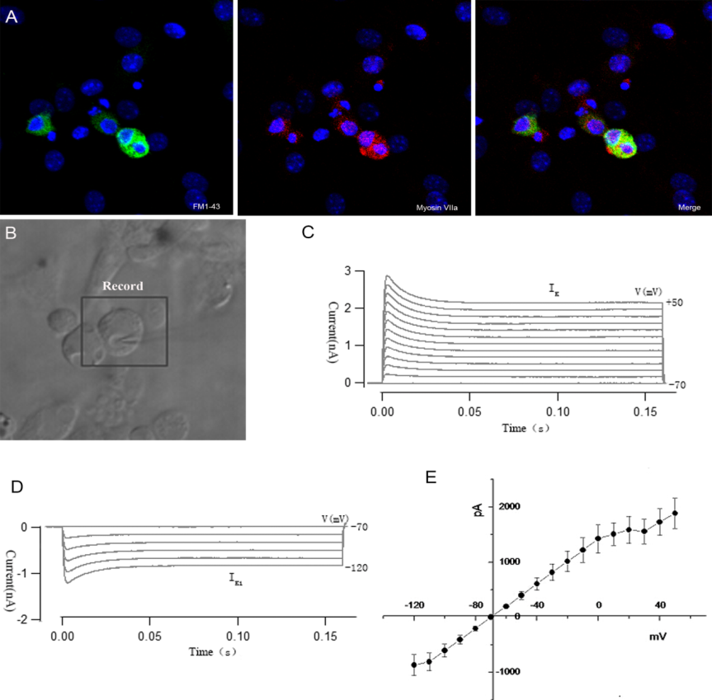
Voltage-dependent currents elicited from inner-ear stem-cell-derived FM1-43 positive cells. (A) FM1-43-positive cells (green, left) co-expressed the hair cell marker myosin VIIa (red, center). (B) White light image of a recording electrode on an FM1-43-positive cell. (C) Outward K⁺ currents recorded from hair-cell-like cells. (D) Inward K⁺ currents recorded from hair-cell-like cells. (E) Average current-voltage (I-V) curve for the outward and inward K⁺ current measured at the steady-state level (100–160 ms).
Liu, QW et al. unpublished.

Slide 10
Kojima, K et al. Acta Otolaryngol. 2004.
Kojima et al. injected the inner ear stem cells from cochlea into the mouse model of hearing loss. They found that the transplanted cells could survive in the inner ear，and could migrated into the cochlea epidermis.

Slide 11
Lou, X. The Doctoral Dissertation of east china normal university, 2007
Lou et al. injected the inner ear stem cells into the inner ears of the normal (Fig C) or deaf (Fig D) guinea pig . They found that the transplanted cells not only survived in the inner ear, but also could migrate to the basement membrane and corti.

Slide 12
1
Inner ear stem cells
2
Embryonic stem cells
3
Mesenchymal stem cells
4
Induced pluripotent stem cells

Slide 23
1
Inner ear stem cells
2
Embryonic stem cells
3
Mesenchymal stem cells
4
Induced pluripotent stem cells

Slide 32
1
Inner ear stem cells
2
Embryonic stem cells
3
Mesenchymal stem cells
4
Induced pluripotent stem cells

Slide 39
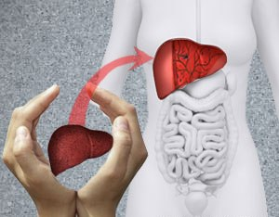
Transplantation Technologies & Research Related Journals
Hair: Therapy & Transplantation
Liver: Disease & Transplantation
Surgery: Current Research

Slide 40
Transplantation Technologies & Research Related Conferences
4th International Conference on Surgery and Anesthesia
World Summit on Pediatric Cardiology and Cardiac Surgery

