Slide 1



Journal of Oceanography
Dr. Joel Fluerence
Editorial Board member
Professor
Department of Marine Biology
University of Nantes
France

Slide 2
Biography
Dr. Joel Fluerence
Dr. Fleurence currently holds the position of a professor of marine biology in the University of Nantes, France.
His professional experience includes: Researcher in Chemical Industry (Roussel-Uclaf, Romainville, France) (1985-1989) Researcher in Seaweed Center (CEVA, Pleubian, France) (1990-1993) Researcher in the French Organism for the Sea exploitation (IFREMER, Nantes (1994-2002) Professor in the Nantes University-Head of the Marine Biology Laboratory (since 09/2002)
Academic experience:
Habilitation à diriger des recherches (HDR) (Nancy University, France) (1998) PhD in Biology (Montpellier University, France) (1988) DEA ( Master 2) of Agronomic Sciences (Montpellier University, France) (1985) Master of Biochemistry (Montpellier University, France) (1984) Scientific production and international attractiveness:
Publications in peer review journals: 70 Patents: 3 Chapters in Books: 2 h index: 24 (Publish or Perish) Member of Editorial Board: Journal of Algal Biomass Utilization and E-Journal of Chemistry

Slide 3
Research Interests
Marine Biotechnologies applied to seaweeds and microalgae
Recent Publications
Chemical Composition And Antioxidant Activity Of Tropical Brown Algae Padina Australis FROM PRAMUKA ISLAND, DISTRICT OF SERIBU, J Santoso, F Podungge - Jurnal Ilmu dan, 2014 - jesl.journal.ipb.ac.id
Nutritional study of Kapparazii powderTM as a food ingredient,N Ramli, R Daik, MA Yarmo, Z Ajdari - Journal of Applied Phycology, 2014 - Springer

Slide 4
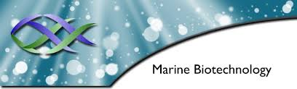
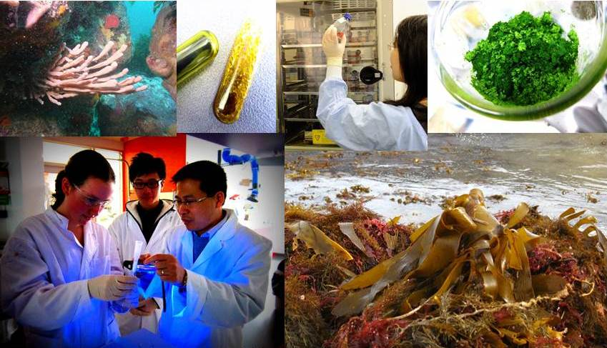
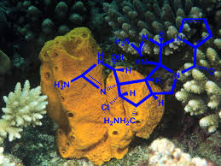
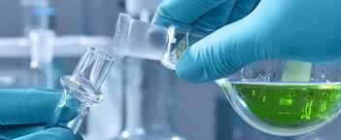
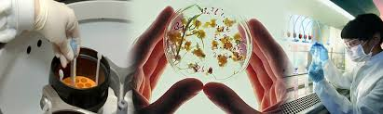

Slide 5
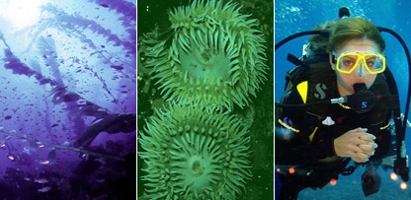
Marine Biotechnology
Marine Biotechnology is the study of how the various organisms and actions of the ocean can be used to provide services and products to us.
Marine Biotechnology is the use of living marine resources at (eco)system, concept, organism or molecular level to provide beneficial solutions for the society.

Slide 6
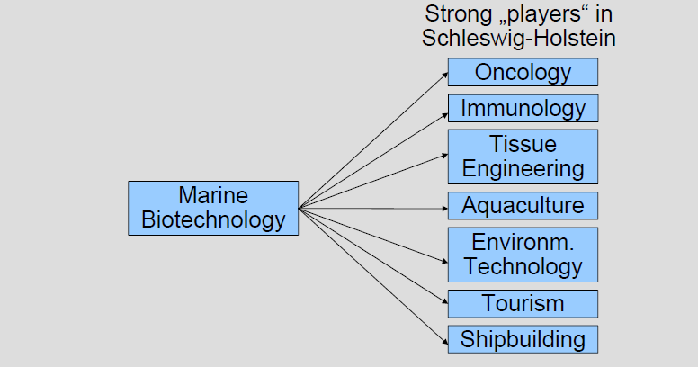

Slide 7
Related to industry and agriculture
Marine Biotechnology is providing many new solutions to Industry and Agriculture, including environmentally friendly pesticides and salt-resistant enzymes that are helpful in many industrial applications.
BEGAN FROM…..
Marine Biotechnology is a relatively new field of study, having emerged in the past few years. It began in 1998 when scientists from the Scripps Institution of Oceanography and various departments of the University of California, San Diego, came together and formed the Center for Marine Biotechnology and Biomedicine.

Slide 8
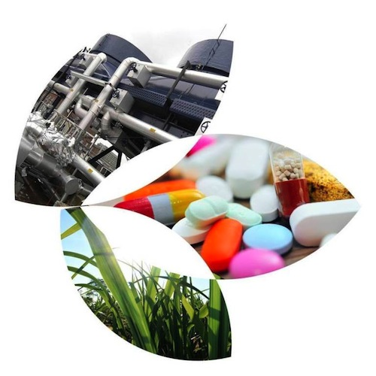
Marine Biotechnology faces the following challenges
There are three main challenges to Marine Biotechnology. These are:
Biosafety (testing Living Modified Organisms may disrupt the natural ecosystem of the ocean.)
Access to Marine Organisms/Resources (Because Marine Biotechnology takes place in the ocean, the borders between different nations can sometimes erupt in disputes over access to certain resources/creatures.)
Intellectual Property Rights (The North wants stricter rights to discoveries made in the South, where marine resources are high, while the South feels that because the North is researching in their "property" they should be able to reap some benefits.)

Slide 9
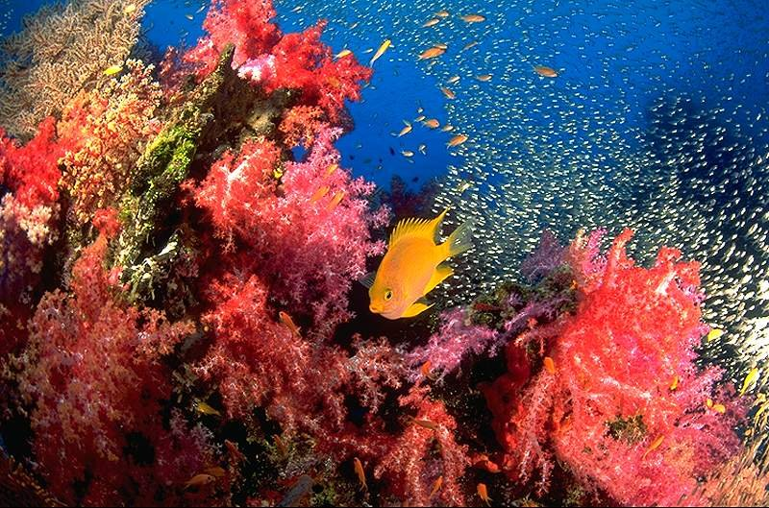
Future of Marine Biotechnology as it relates to Agriculture and Industry
Scientists in this field of Marine Biotechnology are studying the various enzymes and proteins of marine life in hopes of solving many problems that plague the area of Agriculture and Industry today. These problems include trying to find anti-corrosive coatings and "self-cleaning" surfaces for industrial use.

Slide 10
Innovators and Innovations
Products and Services Relating to Industry and Agriculture available through the use of Marine Biotechnology
Agricultural Technique
Aquaculture is the branch of marine biotechnology most closely related to agriculture. Marine Biotechnology has dramatically improved aquaculture to engineer sea species to yield higher nutrition, and more off spring to help the growing demand for seafood.
Species include shellfish, striped bass and salmon, and abalone and blue mussels. Research is still being done to improve nutritional values and offspring in various species .
The National Science Foundation (NSF) and other federal government agencies support research on this "marine agriculture."
Hopefully, this research should be able to meet the huge demand for seafood expected in the coming years.
The National Oceanic and Atmospheric Administration (NOAA) is leading the initiative to help the United States become more self-sufficient in the production of seafood.

Slide 11
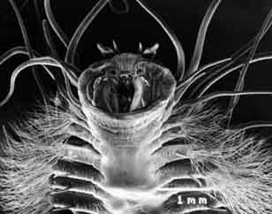
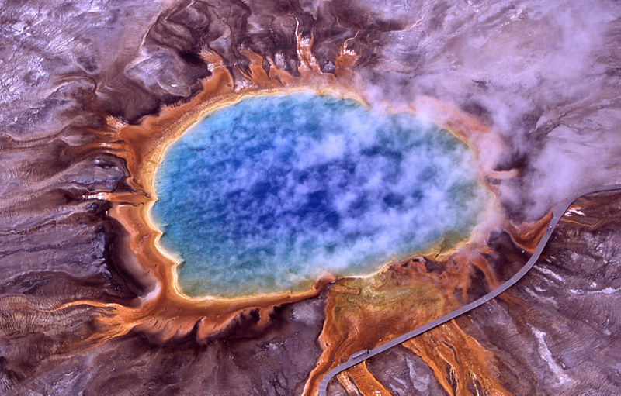
Industrial Products
One of the latest amazing aquatic discoveries is directly related to marine biotechnology-that of thermophiles and psychrophiles. These are organisms that are capable of living in extreme environments.
Thermophiles flourish in extremely hot places like Yellowstone National Park's thermal pools; while psychrophiles are the opposite, preferring freezing cold areas to live, like the waters in and beneath the polar regions. Thermophiles were discovered in 1966 by Thomas Brock.
Enzymes produced by thermophiles have great importance in the industry of biotechnology. Those enzymes are the basis of the process known as polymerase chain reaction, or PCR. PCR is widely used with the development in the field of biotechnology, including DNA fingerprinting.
Psychrophile
Grand Prismatic Spring, Yellowstone National Park

Slide 12
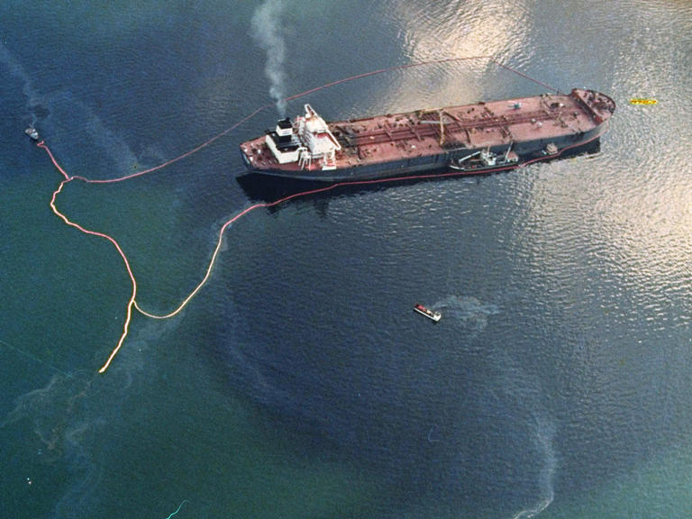
Bioremediation
Bioremediation speeds the natural degradation process. it is being used to clean up sewage, sludge, seafood wastes, and toxins in marine areas. By using genetically modified marine organisms, scientists are able to clean up or contain oil spills. For example, this approach achieved great success after the oil spill from the Exxon Valdez in Alaska.
Bioremediation was invented by George M. Robinson.

Slide 13
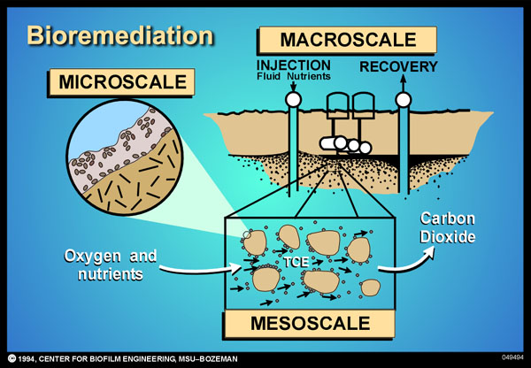

Slide 14
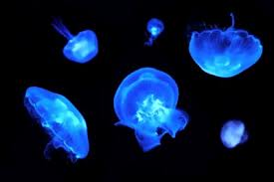
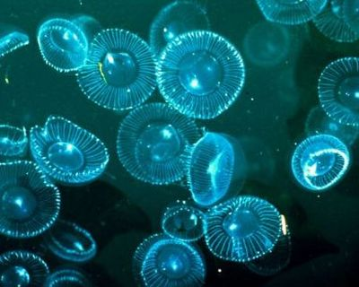
Impact on Society
Economic Impact
WIth new advances in aquaculture, marine biotechnology is significantly improving economic efficiency in the yield of various seafoods. Already, in Santa Barbara, environmentally friendly and economically efficient industries have been created that are producing sea urchins, abalones, algae, etc. to help meet the growing demand for seafood. In addition, many enzymes found in sea creatures are being used as the basis for many biotechnology applications, a multi-billion dollar industry.
Research done on the Eastern Oyster has also produced the discovery of Polyaspartic Acid, which helps plants take in more nutrients from the soil without using as much fertilizer. This is helping to stimulate agriculture even further.

Slide 15
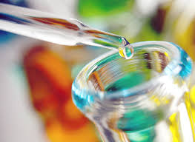
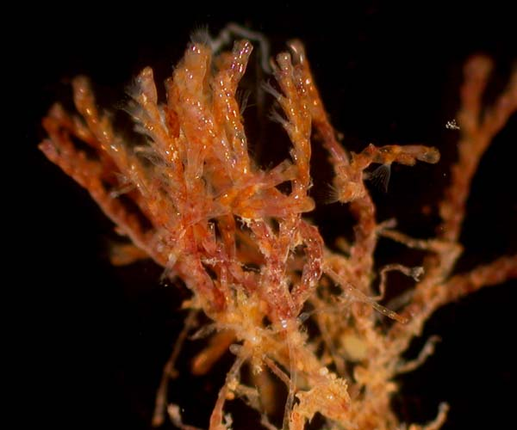
Social Impact
New drugs are being discovered through the use of marine biotechnology that has helped the Drug Industry begin producing drugs to combat things such as cancer and AIDS. One such example is the discovery of a bacteria found in the small marine animal called Bugula Neritina. This bacteria is being developed to fight a great variety of cancers, which greatly impacts many in the public.

Slide 16
Political Impact
Marine Biotechnology has sparked many disputes over territory. Because virtually all species and resources for Marine Biotechnology are found in the ocean, disagreements between various countries have come up due to the uncertainty of where one country ends and the other begins.

Slide 17
Ethical and Legal Issues
Marine Biotechnology currently faces a variety of ethical and legal issues.
One example is the studying and use of organisms and resources found in other countries' terrirtory.
Just because one country may have much richer resources and a better selection of marine life, it doesn't mean that just any country can come nad infringe on that terrirtory for their own research.
Scientists are still struggling with this today as they try to come to terms with scientists of other countries.
One such example are the disputes between U.S. scientists and the countries south of the equator, where marine resources are rich.
Another ethical issue is to make sure that ecosystems and species remain stable. When scientists modify living organisms, it poses the possible threat of damaging the surrounding wildlife and habitat. So marine biotechnologists must remain conscious of what they are doing and make sure to keep the environment healthy and stable.

Slide 18
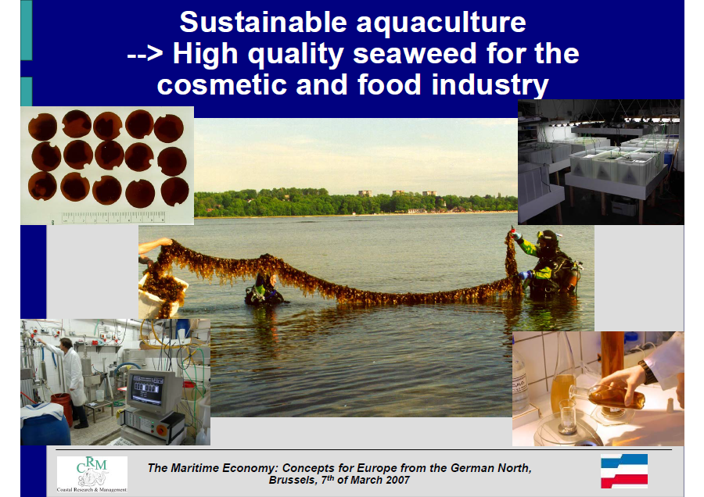

Slide 19
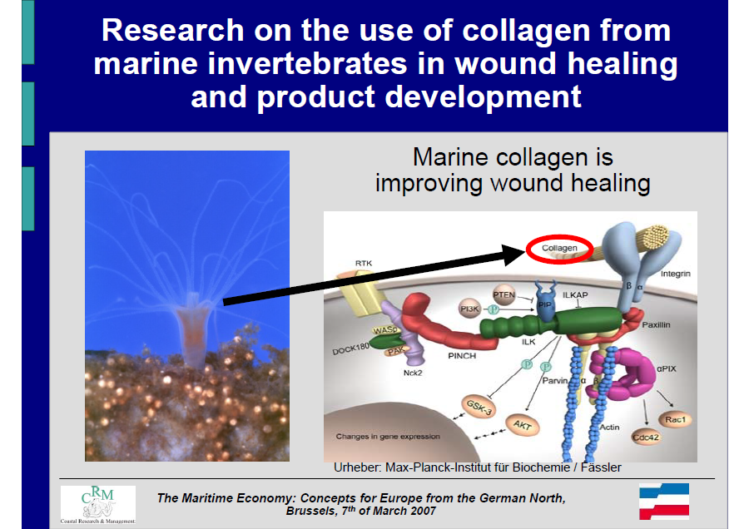

Slide 20


OMICS International Open Access Membership
OMICS International Open Access Membership enables academic and research institutions, funders and corporations to actively encourage open access in scholarly communication and the dissemination of research published by their authors.
For more details and benefits, click on the link below:
http://omicsonline.org/membership.php

