Slide 1

Innovation of Acoustic Research on Biomedical Applications
Jun Qin, Ph. D.
Assistant Professor
Department of Electrical and Computer Engineering The College of Engineering
Southern Illinois University, Carbondale, IL, USA

Slide 2
Acoustic Research Projects in Our Lab
1. Applications on Therapeutic Ultrasound
--- Innovation of Shock Wave lithotripsy (SWL) on Treatment of Kidney Stone Diseases
--- Cavitation Bubbles – Cell Interaction for Ultrasound Enhanced Gene Activation
2. Applications on Audible Sound
--- Research on Noise-Induced Human Hearing Loss
--- Diagnosis and Treatment of Human Tinnitus

Slide 3
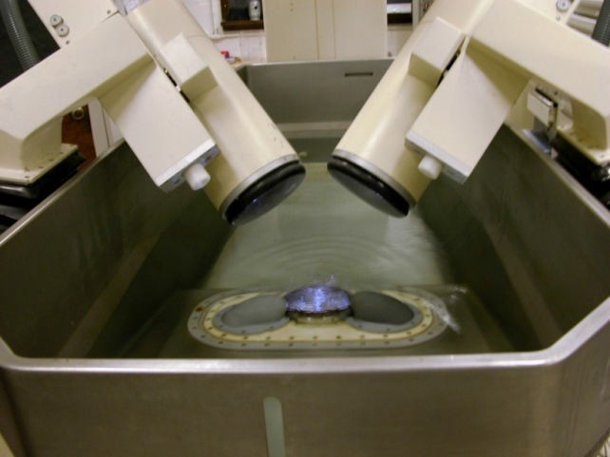
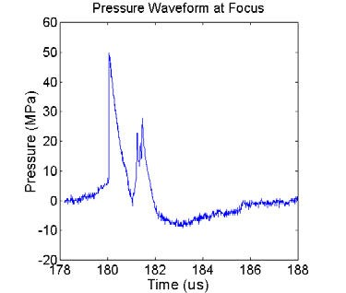
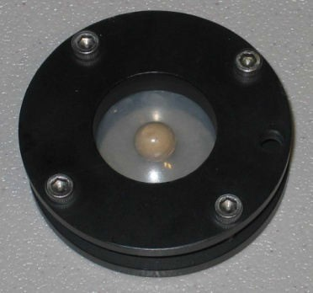
PART I:
Comparison of Electrohydraulic (EH) and Electromagnetic (EM) SWLs
Introduction to SWLs.
Characterization of acoustic fields
Stone fragmentation in vitro and in vivo

Slide 4
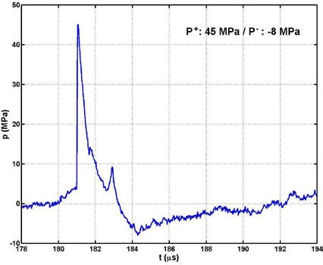
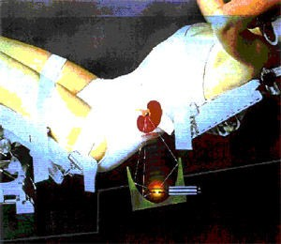
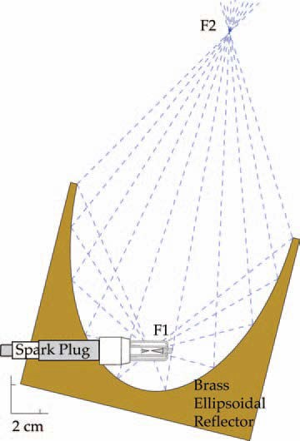
Shock Wave lithotripsy
_{P}+
Lithotripter shock wave
_{P}-

Slide 5

Electromagnetic (EM) Shock Wave Generator
Widely use in the newer generation lithotripters
Stable and highly reproducible shock waves, long life time
High peak pressure and narrow focal beam size
Newer generation machines:
Less effective in stone comminution
Higher propensity for tissue injury
1st generation---
Dornier HM-3:
“Gold standard”
Newer is not better! Why?

Slide 6
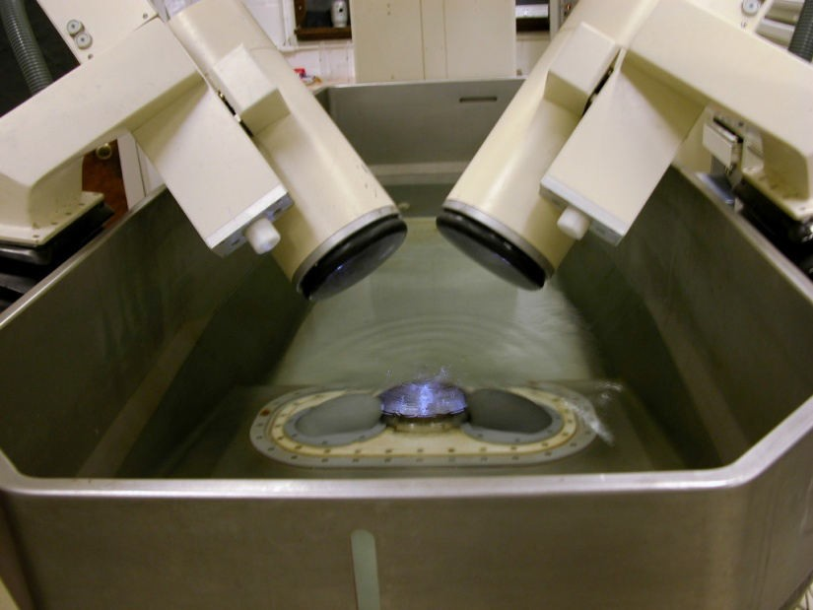
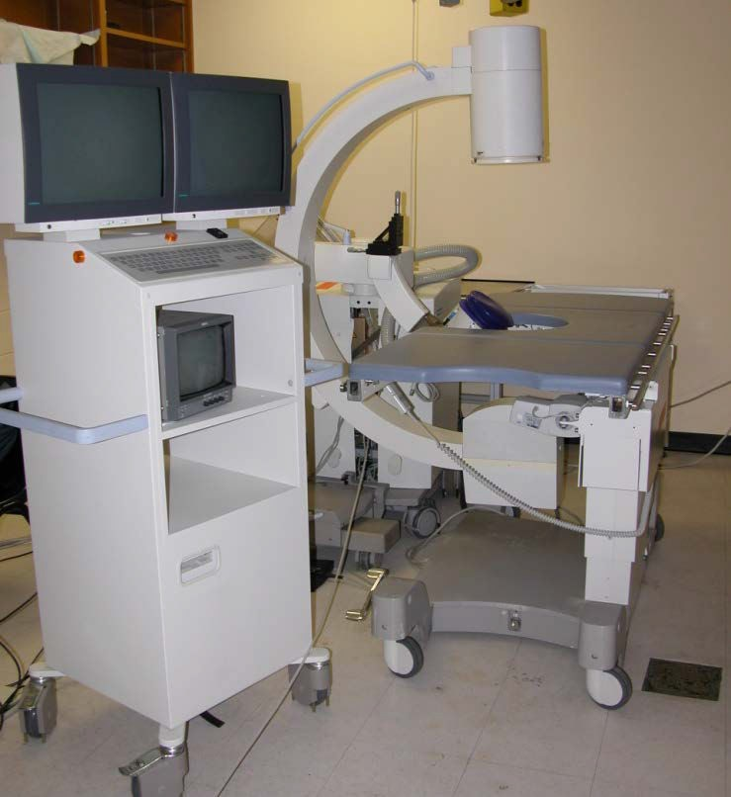
Comparison of EH and EM Lithotripters
Electrohydraulic:
Unmodified HM-3 at 20 kV
Electromagnetic
Siemens Modularis at E4.0
In vitro comparison
Acoustic fields Stone fragmentation
In vivo comparison
Stone fragmentation

Slide 7
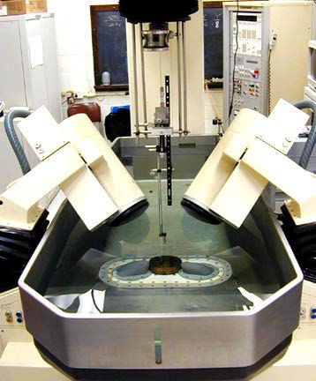
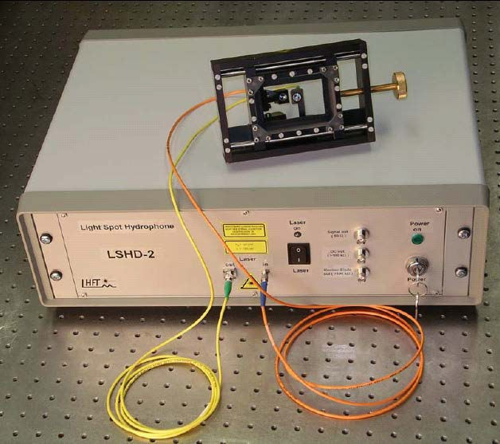
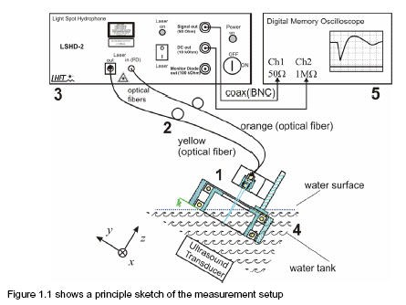
Acoustic Field Measurement
Light Spot Hydrophone (LSHD-2)
(Siemens/University of Erlangen-Nuremberg)

Slide 8

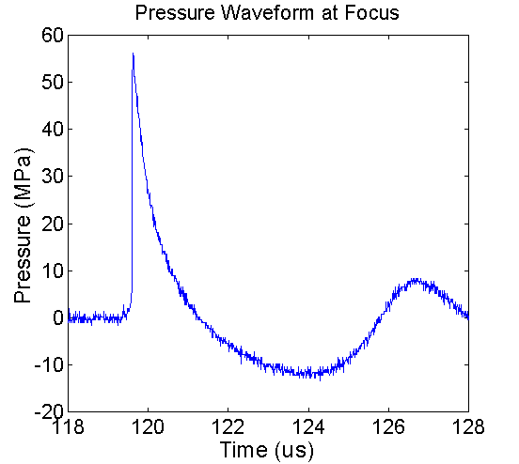



Pressure Waveforms at Focus
Dual-Peak Structure 1st P+
₁st
P+
2nd P+
P-
P-
HM3 at 20 kV
Modularis at E4.0

Slide 9
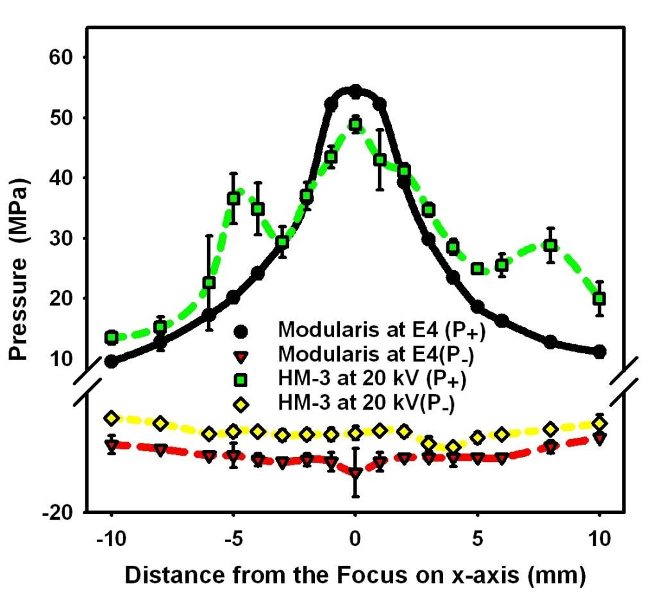
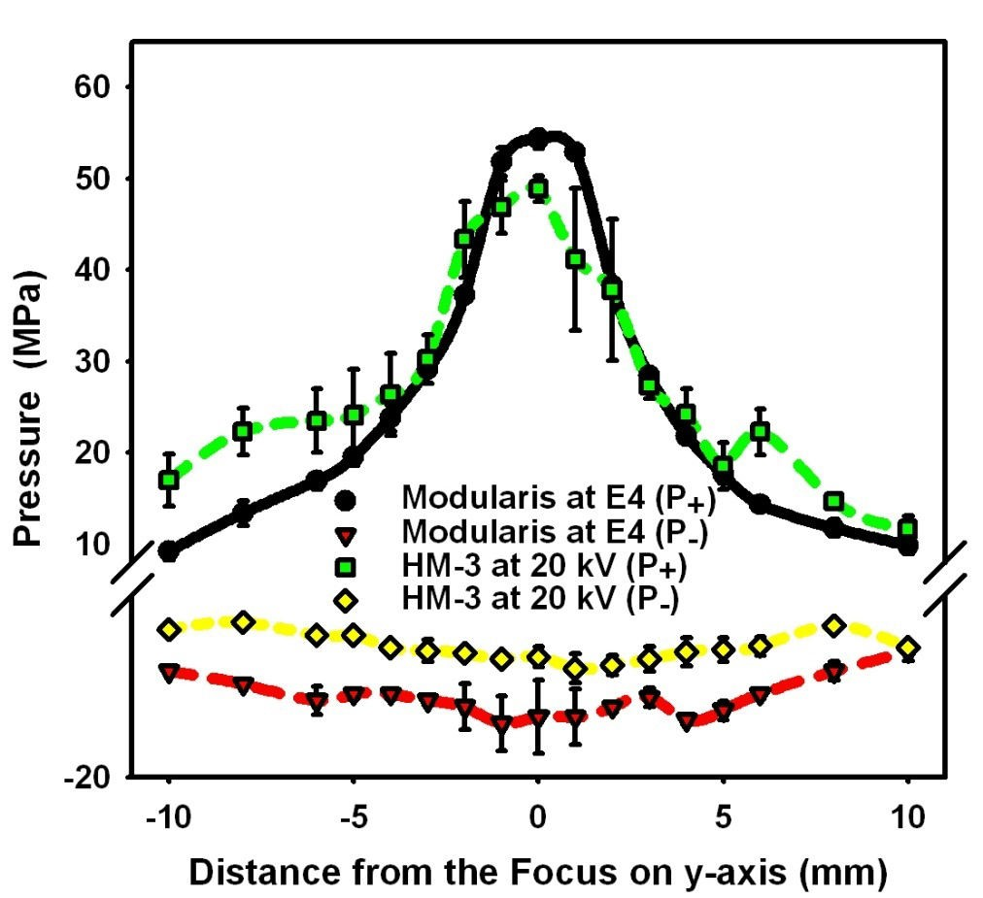
Pressure Distribution and Characteristics of Acoustic Fields
Peak P+ Peak P- -6 dB Beam Size, -6dB Beam Size, Effective (MPa) (MPa) Head-Foot (mm) Left-Right (mm) Energy (mJ)
HM3 at 20 kV | 48.9 ± 1.3 | -10.7 ± 0.6 | 12.5 | 9.3 | 42.9
Modularis at E4.0 | 54.3 ± 1.0 | -14.4 ± 3.4 | 6.8 | 6.6 | 62.1

Slide 10
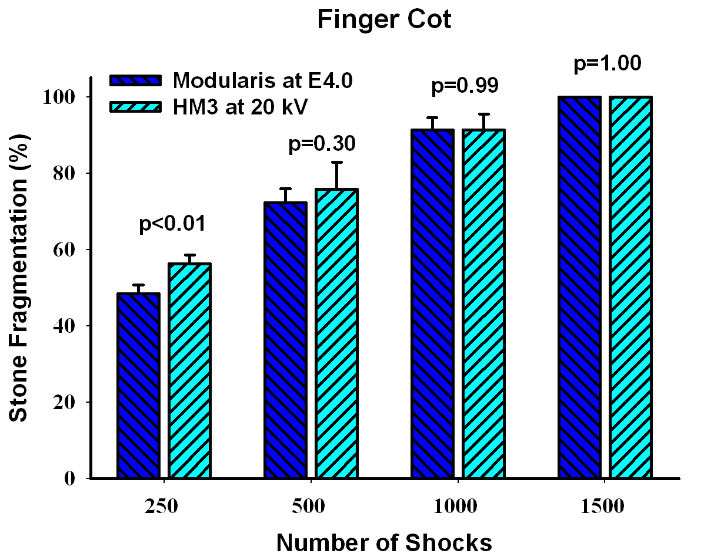
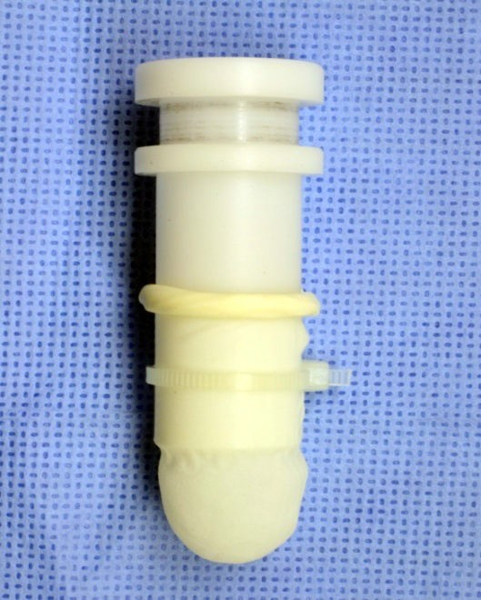
Stone Fragmentation in a Finger Cot Holder
Finger Cot Holder
15mm
Stone fragments are always kept in a 15 mm diameter area during SWL
Do not represent stone fragmentation in vivo

Slide 11
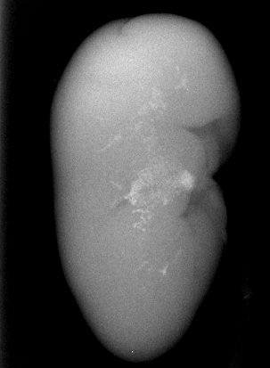
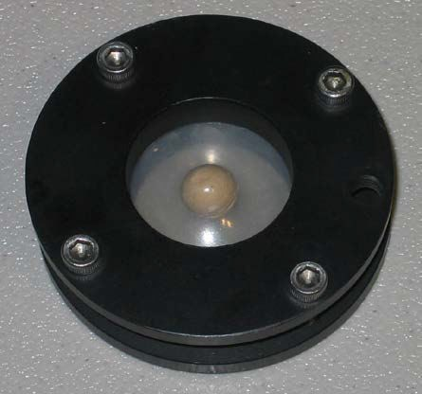
New Stone Holder: Membrane Holder
Finger Cot Holder
Membrane Holder
30 mm
30 mm
15mm
Allow fragments to accumulate & spread out laterally
Mimic more closely stone fragmentation in vivo
Stone fragments are always kept in a 15 mm diameter area during SWL
Do not represent stone fragmentation in vivo
Focal Area of HM-3
2000 shocks in vivo

Slide 12
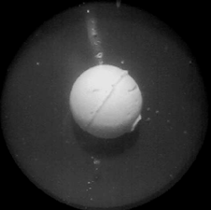
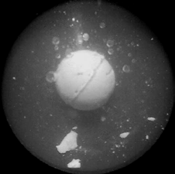
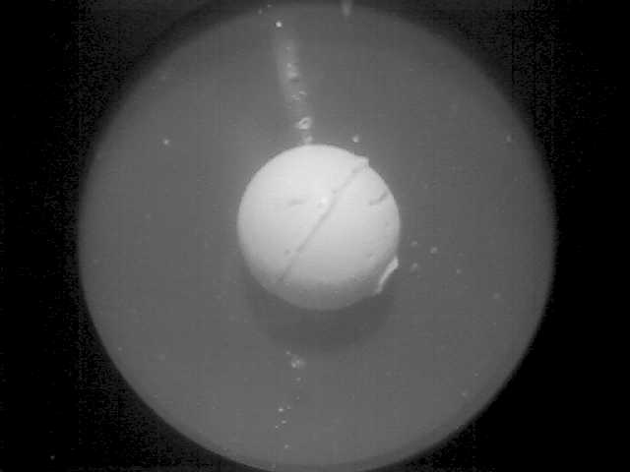
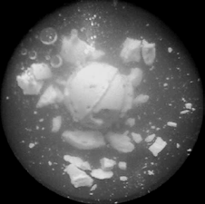
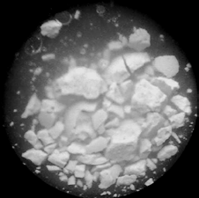
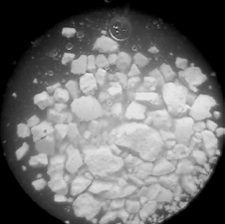
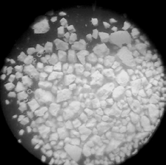
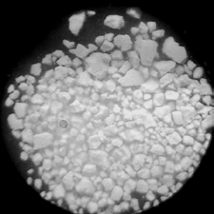
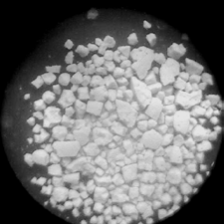
Spreading of Fragments in a Membrane Holder
0 shocks
50 shocks
100 shocks
250 shocks
500 shocks
1000 shocks
Focal Area of HM-3
1500 shocks
2000 shocks

Slide 13
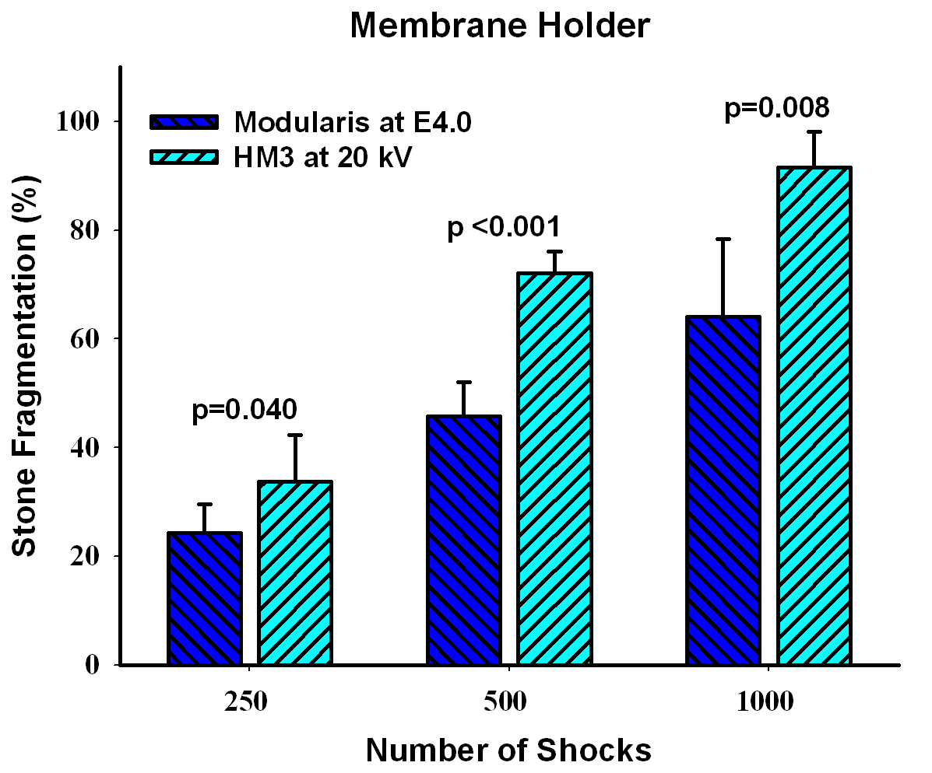
Stone Fragmentation in a Member Holder
Membrane Holder
30 mm
Allow fragments to accumulate & spread out laterally
Mimic more closely stone fragmentation in vivo

Slide 14
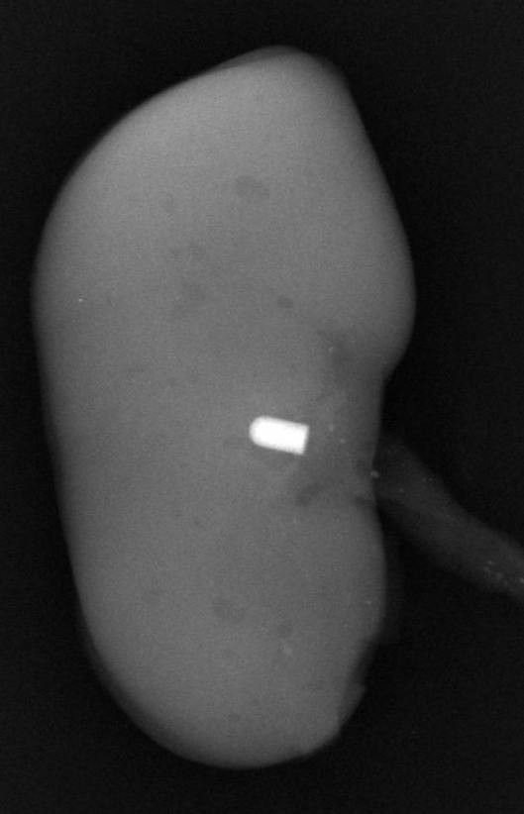
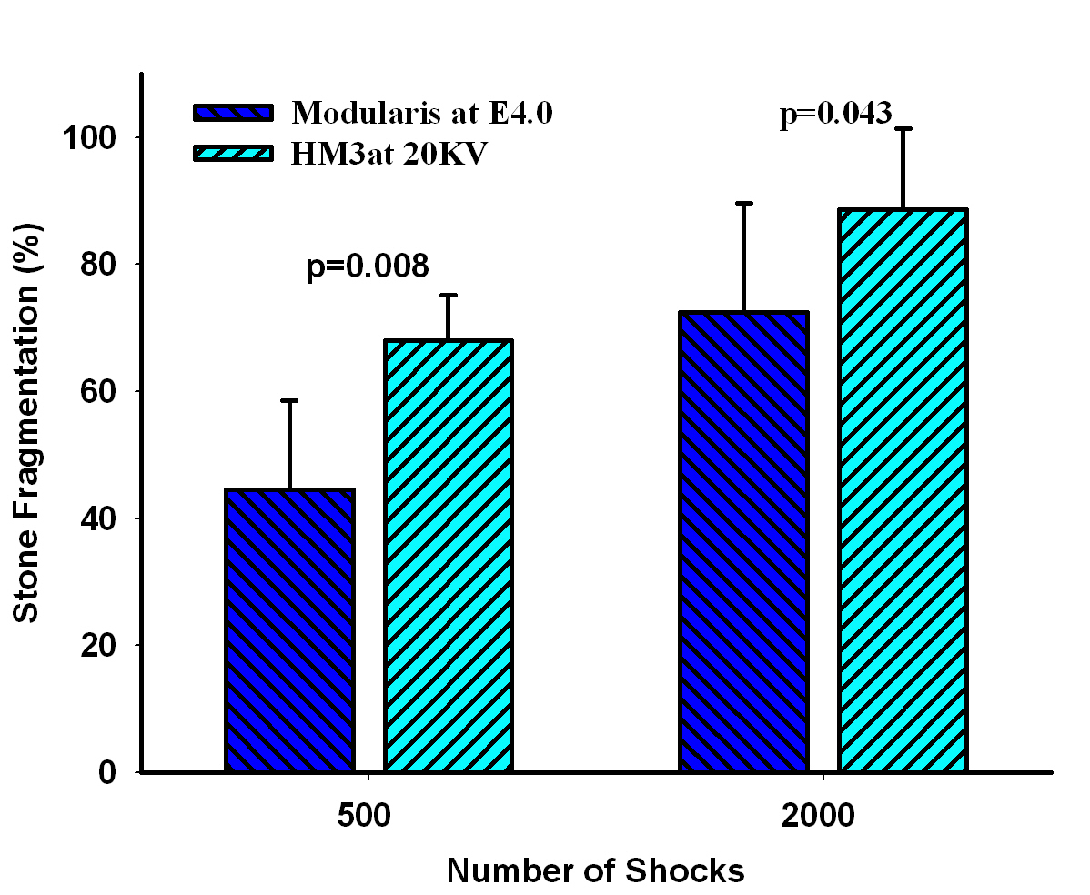
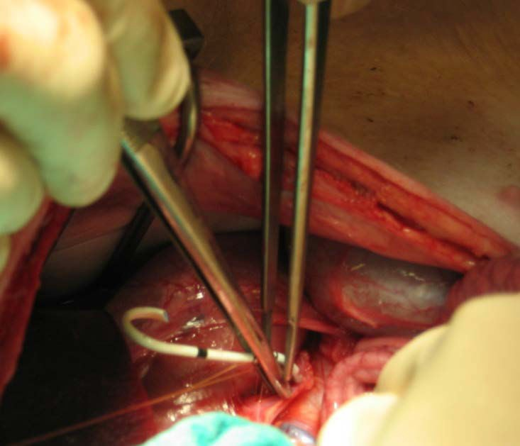
Stone Fragmentation in vivo

Slide 15


Summary of PART I
Stone fragmentation produced by the EM lithotripter is lower than that of the EH lithotripter both in vivo and in the membrane holder.
The acoustic field characterization demonstrates two distinct differences between EM and EH lithotripters
  2nd compressive component in EM pulse, which could reduce maximum bubble size by 50%
  EM lithotripter has much narrower beam size than EH lithotripter

Slide 16
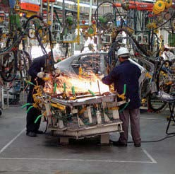
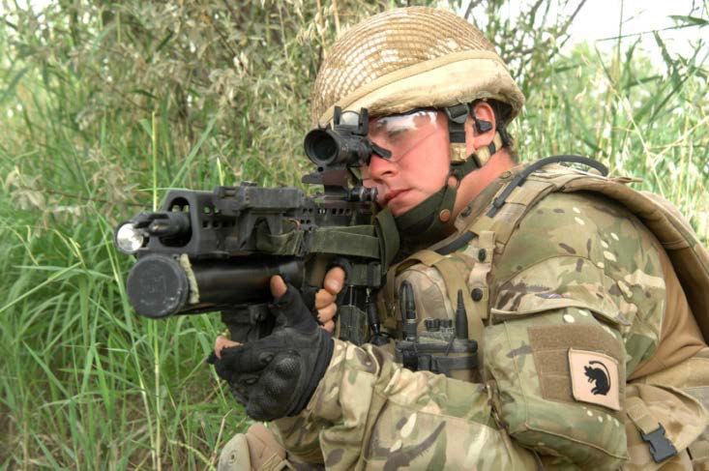
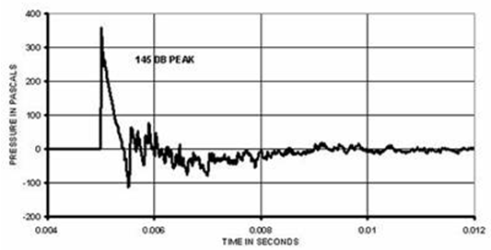
PART II:
Development of a Noise Exposure System for Research on Impulse Noise Induced Hearing Loss
Anatomy of Human Ear
Noise Induced Hearing Loss
Development of the Impulse Noise Exposure System

Slide 17

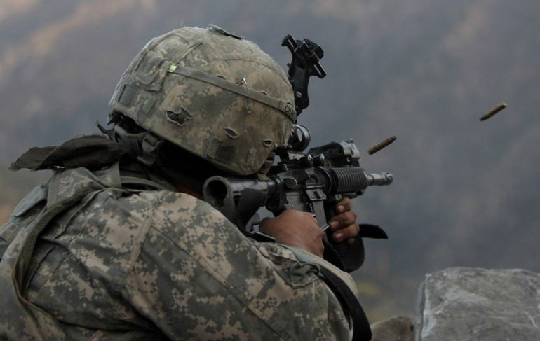
Noise-Induced Hearing Loss (NIHL)
When an individuals hearing is damaged or altered by noise
  One of the most common occupational disabilities in the United States
    More than 30,000,000 American workers exposed to unsafe noise levels at their job
    Estimated 600 million people worldwide exposed to hazardous noise levels

Slide 18
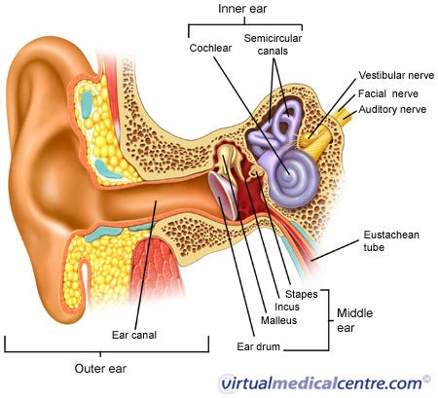
Anatomy of the Human Ear
Pinna
Tragus
Exterior Auditory Canal
Tympanic Membrane
Ossicles
Scala Vestibuli
Scala Tympani
Cochlea

Slide 19
Anatomical Areas Affected by Different Noise Exposure
Gaussian Noise (Steady State Noise): Cochlea and Stria Vascularis
Impulse/Impact Noise: Cochlea and Stria Vascularis and possible tympanic membrane and ossicular damage depending on level
Kurtosis Noise (complex noise): A combination of Gaussian and impulse/impact noise which can damage all of the above areas depending on the noise content.

Slide 20
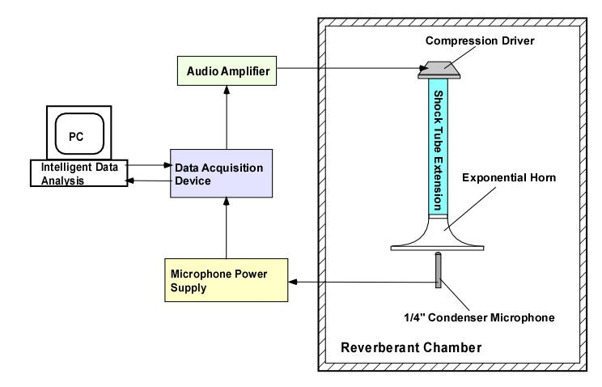
Noise Exposure System

Slide 21
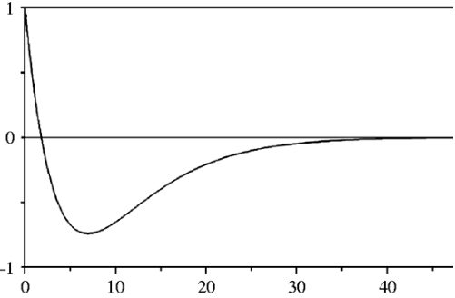
Impulse Noise
Friedlander’s Wave
P(t) = P_{s} e
−t / t*
(1− ^{t} * )
t
(http://www.arl.army.mil/www/default.cfm?page=352)
P_{s} = peak sound pressure
t* = the time at which the pressure crosses the x-axis

Slide 22
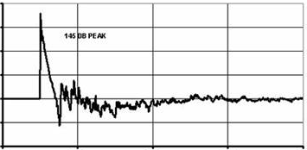
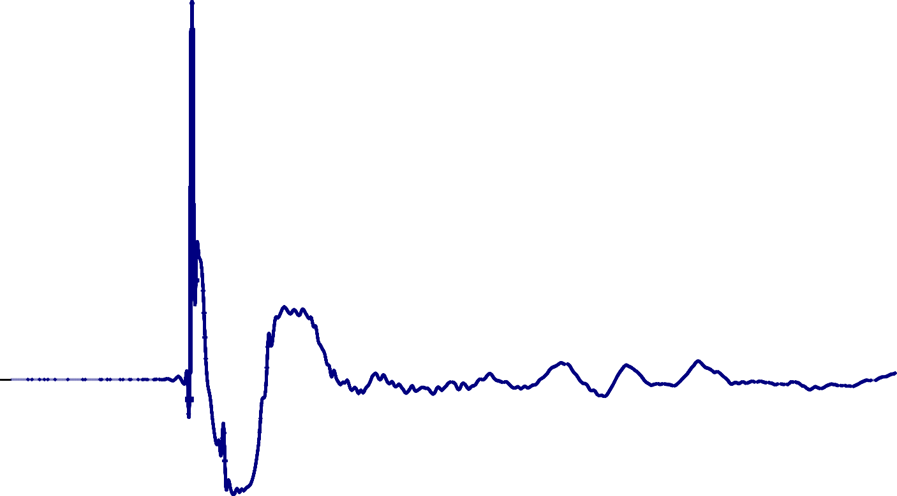
Simulated Wave vs. Field-Measured Wave
400
300
Peak SPL = 158 dB
1500
200
100
0
Pressure (Pa)
1000
-100
P
-200
R
E
0
4
6
8
10
S
S
500
U
TIME IN SECONDS
×10
-3
R
E
0
-500
0
1
2
3
Time (ms)
4
5
6

Slide 23
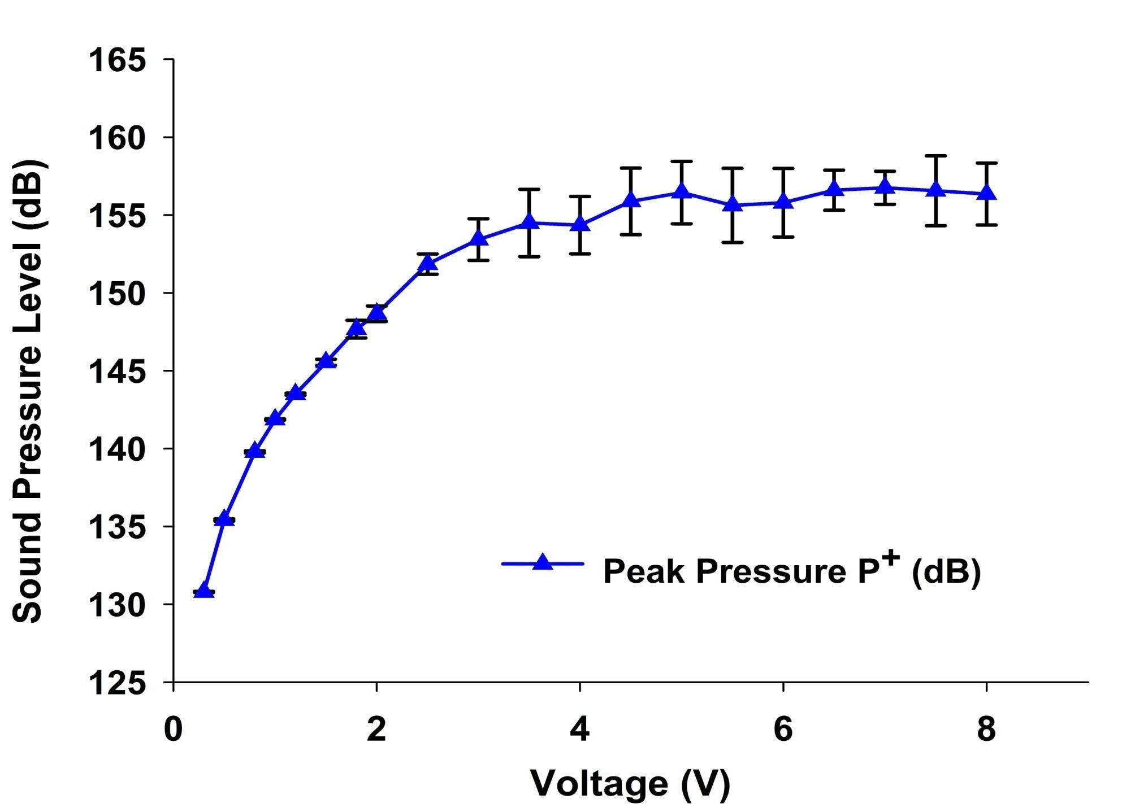
Peak Pressure vs. Output Voltage
P(t)
SPL = 20 log
dB
10
^{P}ref

Slide 24
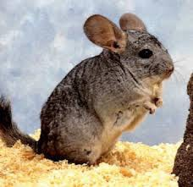
Animal Study Verifying the Impulse
Noise Induced Hearing Loss
Animal Model: Chinchilla
  10150daBniSmPaLls were tested
Noise Exposure: impulse noise with peak SPL=155 dB at 2 Hz pulse repartition rate for 75 seconds (150 pulses).
Auditory brainstem response (ABR) were measured before and 21 days after noise exposure

Slide 25
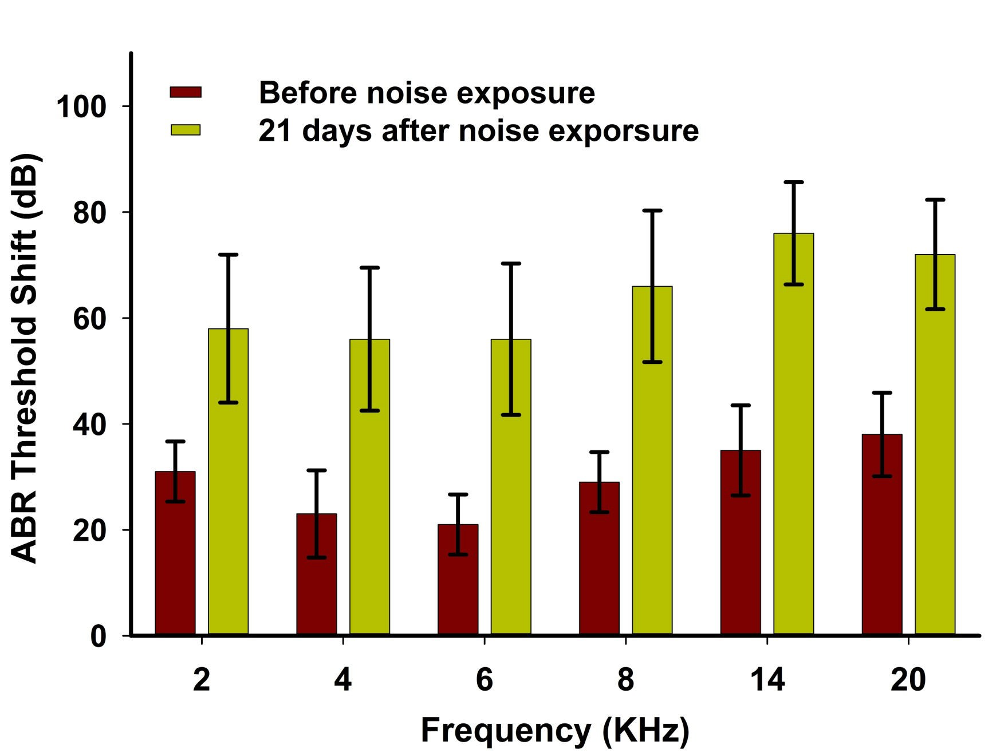
Animal Study Results
105 dB SPL

Slide 26
Summary of PART II
A digital noise exposure system has been developed to generate the impulse noise.
The waveforms of impulse noise are comparable to the field measurement test performed by the U.S. Army
Impulse noise produces significant hearing loss in animal study.
Future work includes Kurtosis noise simulate and high level impulse noise generation.

Slide 27
Upcoming Conference
For upcoming conferences please follow the below mentioned link
http://www.conferenceseries.com/

