Slide 1


OMICS Group
OMICS Group International through its Open Access Initiative is committed to make genuine and reliable contributions to the scientific community. OMICS Group hosts over 400 leading-edge peer reviewed Open Access Journals and organizes over 300 International Conferences annually all over the world. OMICS Publishing Group journals have over 3 million readers and the fame and success of the same can be attributed to the strong editorial board which contains over 30000 eminent personalities that ensure a rapid, quality and quick review process. OMICS Group signed an agreement with more than 1000 International Societies to make healthcare information Open Access.
Contact us at: contact.omics@omicsonline.org

Slide 2

OMICS Journals are welcoming Submissions
OMICS Group welcomes submissions that are original and technically so as to serve both the developing world and developed countries in the best possible way.
OMICS Journals are poised in excellence by publishing high quality research. OMICS Group follows an Editorial Manager® System peer review process and boasts of a strong and active editorial board.
Editors and reviewers are experts in their field and provide anonymous, unbiased and detailed reviews of all submissions.
The journal gives the options of multiple language translations for all the articles and all archived articles are available in HTML, XML, PDF and audio formats. Also, all the published articles are archived in repositories and indexing services like DOAJ, CAS, Google Scholar, Scientific Commons, Index Copernicus, EBSCO, HINARI and GALE.
For more details please visit our website: http://omicsonline.org/Submitmanuscript.php

Slide 3
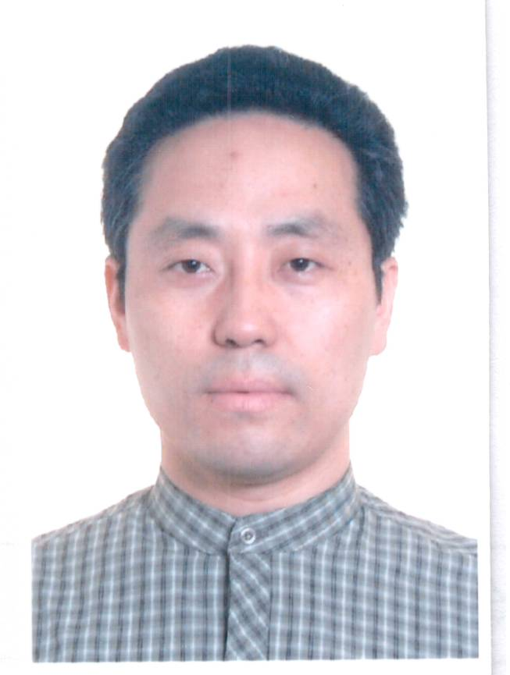
NAME: Jun Yang, Prof. MD, PhD, doctoral supervisor
Gender: Male
Birth Date: April 11st, 1972
Department of Pathology,The Second Affiliated Hospital, Xi'an Jiaotong University
No. 157#, The West 5th Road
Xi'an, Shaanxi, China 710004
Email:yangjundr@163.com
QQ: 1583309590
http://yangjundoctor.haodf.com/

Slide 4
Main fields:
Histopathology of digestive system and female genital and breast tumors
Histopathology and pathogenesis of Hirschsprung's disease and hirschsprung'sallied disease
Cytopathology and cytological technology
Tumor immunity and biological immunotherapy
Screening and identification of molecular targets of carcinoma, and using new technology for early diagnosis in carcinoma
Detecting tumor-associated molecular targets for individualized treatment of cancers.
Researching in biotechnology and translational medicine

Slide 5
The research results and clinical outcomes have been presented at conferences
Chen K, Zhang S, Ji Y, Li J, An P, Ren H, Liang R, Yang J, Li Z. Baicalein inhibits the invasion and metastatic capabilities of hepatocellular carcinoma cells via down-regulation of the ERK pathway. PLoS One. 2013 Sep 6;8(9):e72927. PMID: 24039823
Yang J, Zhang M, Su B, Chen X, Kang A. A novel tissue microarray instrumentation: the HT-1 tissue microarrayer. IJPM.2012:55(3): 314-318.
Liang RR, Zhang S, Qi JA, Wang ZD, Li J, Liu PJ, Huang C, Le XF, Yang J, Li ZF. Preferential inhibition of hepatocellular carcinoma by the flavonoid Baicalein through blocking MEK-ERK signaling. Int J Oncol. 2012;41(3):969-78.
Yang J, Li S, Kang A, Chen X, Su B, Jin Y. A giant intrathoracic osteolipoma: A case report and review of the literature.Int J Surg Case Rep. 2012;3(7):290-2.
Yang J, Guo R, Kang A, Chen X, Su B, Huang X, Jin Y, Li Z. A novel histological typing and grading-scale system of colorectal cancer.Nan Fang Yi Ke Da Xue Xue Bao. 2014 Feb;34(2):169-73.
Yang J, Liu N, Zhang T, Zhao S, Qiang L, Su B, Kang A, Li Z. Prediction and identification of B-cell linear epitopes of hepatitis B e antigen Nan Fang Yi Ke Da Xue Xue Bao. 2013 Feb;33(2):253-7.
Yang J, Liu N, Kang A, Jin Y, Wang J, Su B, Chen X, Li Z. Expression of TMEM16A in gastric carcinoma and its clinical implicationsNan Fang Yi Ke Da Xue Xue Bao. 2012 Jun;32(6):794-7.
Yang J, Zhang MJ, Qiang L, Su BS, Wang YL, Si LS. Preparation and activity detection of chicken egg yolk IgY antibody against human papillomavirus 16 type L1 main capsid protein.Nan Fang Yi Ke Da Xue Xue Bao. 2008 Mar;28(3):324-7.
Yang J, Chen X, Su B, Zhao S, Qiang L. A new grossing knife with two parallel blades for preparing uniform thickness gross tissue sections. J Clin Pathol. 2008 Sep;61(9):1069-70.
Ren S, Zhang S, Li M, Huang C, Liang R, Jiang A, Guo Y, Pu Y, Huang N, Yang J, Li Z. NF-κB p65 and c-Rel subunits promote phagocytosis and cytokine secretion by splenic macrophages in cirrhotic patients with hypersplenism.Int J Biochem Cell Biol. 2013;45(2):335-43. PMID: 23195252

Slide 6
The research results and clinical outcomes have been presented at conferences
Jiang A, Zhang S, Li Z, Liang R, Ren S, Li J, Pu Y, Yang J. miR-615-3p promotes the phagocytic capacity of splenic macrophages by targeting ligand-dependent nuclear receptor corepressor in cirrhosis-related portal hypertension.Exp Biol Med (Maywood). 2011;236(6):672-80. PMID: 21565892
Wang J, Zhang S, Li Z, Yang J, Huang C, Liang R, Liu Z, Zhou R. (1)H-NMR-based metabolomics of tumor tissue for the metabolic characterization of rat hepatocellular carcinoma formation and metastasis.Tumour Biol. 2011;32(1):223-31. PMID: 20890798
Chen XL, Zhou L, Yang J, Shen FK, Zhao SP, Wang YL. Hepatocellular carcinoma-associated protein markers investigated by MALDI-TOF MS.Mol Med Rep. 2010;3(4):589-96. PMID: 21472284
Li M, Su BS, Chang LH, Gao Q, Chen KL, An P, Huang C, Yang J, Li ZF. Oxymatrine induces apoptosis in human cervical cancer cells through guanine nucleotide depletion.Anticancer Drugs. 2014;25(2):161-73.
Li HL, Zhang S, Wang Y, Liang RR, Li J, An P, Wang ZM, Yang J, Li ZF. Baicalein induces apoptosis via a mitochondrial-dependent caspase activation pathway in T24 bladder cancer cells. Mol Med Rep. 2013;7(1):266-70.
Li ZF, Wang J, Huang C, Zhang S, Yang J, Jiang A, Zhou R, Pan D. Gas chromatography/time-of-flight mass spectrometry-based metabonomics of hepatocarcinoma in rats with lung metastasis: elucidation of the metabolic characteristics of hepatocarcinoma at formation and metastasis.Rapid Commun Mass Spectrom. 2010;24(18):2765-75. PMID: 20814984
Wang ZD, Huang C, Li ZF, Yang J, Li BH, Liang RR, Dai ZJ, Liu ZW. Chrysanthemum indicum ethanolic extract inhibits invasion of hepatocellular carcinoma via regulation of MMP/TIMP balance as therapeutic target.Oncol Rep. 2010 Feb;23(2):413-21.PMID: 20043102
Li ZF, Zhang S, Lv GB, Huang Y, Zhang W, Ren S, Yang J, Dang SS. Changes in count and function of splenic lymphocytes from patients with portal hypertension.World J Gastroenterol. 2008 Apr 21;14(15):2377-82.PMID: 18416465
Li B, Chang J, Chu Y, Kang H, Yang J, Jiang J, Ma H. Membrane proteomic analysis comparing squamous cell lung cancer tissue and tumour-adjacent normal tissue.Cancer Lett. 2012 Jun 1;319(1):118-24. doi: 10.1016/j.canlet.2011.12.037. Epub 2012 Jan 15.
Chen KL, Li J, Bo WJ, Zhang S, Zhang J, An P , Yang J , Li ZF. Effect of emodin/baicalein on calcium overload of pancreatic acinar cells by sodium taurocholate[C]//JOURNAL OF GASTROENTEROLOGY AND HEPATOLOGY. 111 RIVER ST, HOBOKEN 07030-5774, NJ USA: WILEY-BLACKWELL, 2013, 28: 679-679.
Li Z, An P, Liang R, et al. DNA damage repair pathway as a potential target in Baicalein-induced enhancement on MMC cytotoxicity[C]//JOURNAL OF GASTROENTEROLOGY AND HEPATOLOGY. 111 RIVER ST, HOBOKEN 07030-5774, NJ USA: WILEY-BLACKWELL, 2013, 28: 656-656.
Li Mu, Yang Jun, Su Boshan, Xue Xiang, Gao Qing, Li Zhaorong, Li Zongfang. Clinicopathological parameters of cervical cancer based on the expression of p16INK4A proteins Journal of Medical Colleges of PLA 27 (2012) 278-285

Slide 7
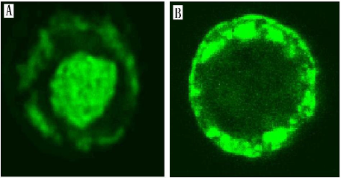
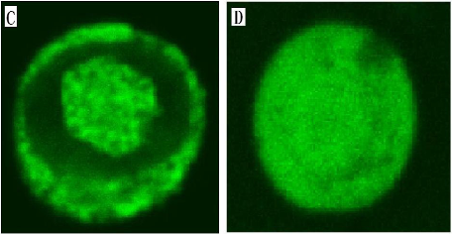
present interest
Tab.1 The histological typing, grading-scale system of colorectal cancer (score)
colorectal cancer (CRC) no mucin-producing adenocarcinoma (1-3 points) tubular adenocarcinoma (1-3 points) well differentiated tubular adenocarcinoma (1point) moderately differentiated tubular adenocarcinoma (2 points) poorly differentiated tubular adenocarcinoma (3 points) sieve-like acne adenocarcinoma (2 points) medullary carcinoma (2 points) serrated adenocarcinoma (2 points) micropapillary carcinoma (3 points) mucin-producing adenocarcinoma (3-4 points) mucinous adenocarcinoma (3 points) signet ring cell carcinoma (4 points). squamous cell carcinoma (1-3 points) well differentiated squamous cell carcinoma (1point) moderately differentiated squamous cell carcinoma (2 points) poorly differentiated squamous cell carcinoma (3 points) neuroendocrine tumors (1-4 points) neuroendocrine tumors (NET) (1-4 points) NET G1 (1point) NET G2 (1point) neuroendocrine carcinoma (NEC) (3-4 points) small cell NEC (3 points) large cell NEC (4 points) mixed adenocarcinoma-neuroendocrine carcinoma (the score was accumulated) the special type of CRC (4 points) adenosquamous carcinoma (the score were accumulated) clear cell carcinoma (4 points) pindle cell carcinoma (4 points) Undifferentiated carcinoma (5 points)
Histopathology and pathogenesis of digestive system and Female genital and breast tumors
Yang J, et al. A novel histological typing and grading-scale system of colorectal cancer.Nan Fang Yi Ke Da Xue Xue Bao. 2014;34(2):169-73.
Fig HPV16L1-NLS-EGFP expressed in sf-9 cells

Slide 8
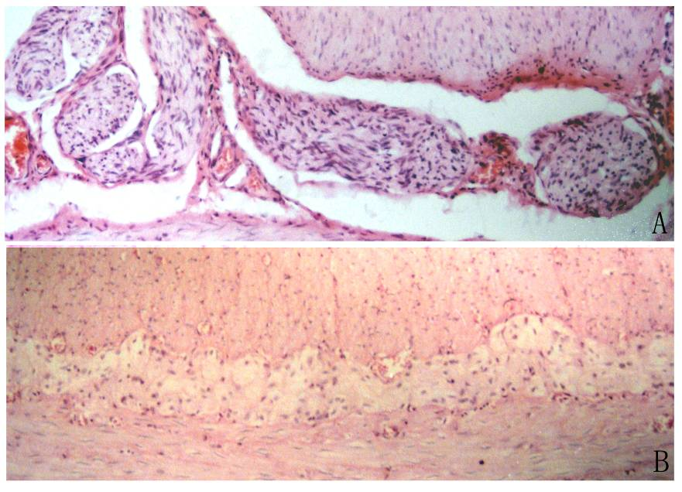
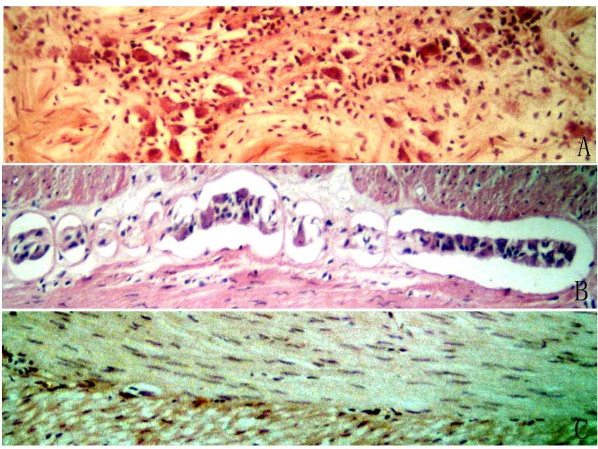
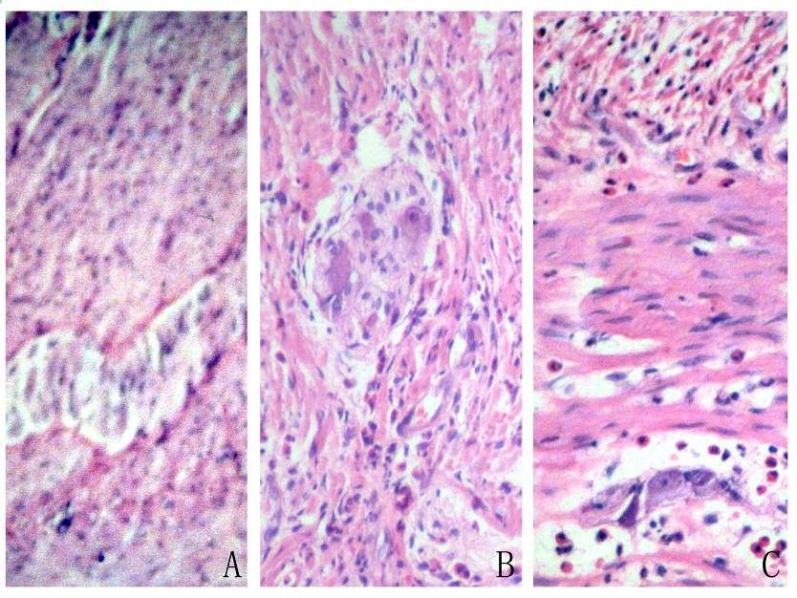
present interest
Histopathology and pathogenesis of Hirschsprung's disease and hirschsprung's allied disease
YANG Jun, et al. Hirschsprung's disease and its allied diseases: a clinicopathologic analysis. J Diag Pathol，2012; 19(6):431-433.

Slide 9
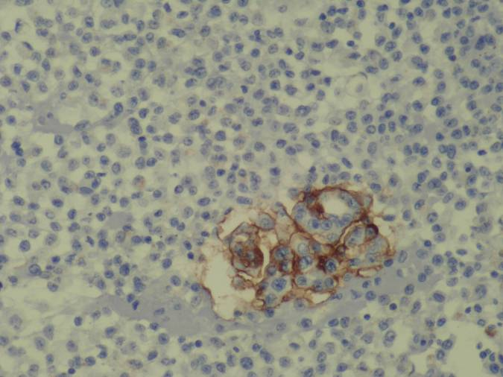
present interest
Cytopathology and Cytological technology
diagnostic cytopathology of the cervical cytology and pleural effusion.
enriching of cells,
making cytological cell blocks, DNA image analysis, detecting circulating tumor cells,
using staining techniques, and ICH or FISH of cytological samples.
detecting Her-2 in cytological samples by ICH.
Automatic DNA quantitative analysis technology /Automatic DNA image cytometry

Slide 10
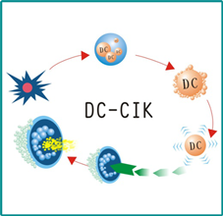
present interest
Tumor immunity and biological immunotherapy

Slide 11
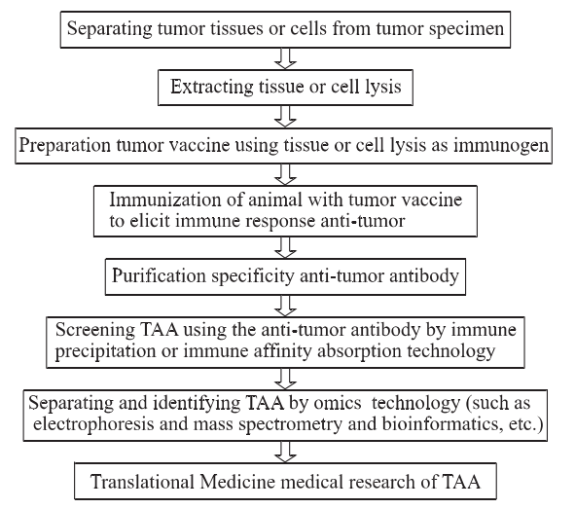
present interest
Screening and identification of molecular targets of carcinoma
interesting in biomarker discovery technology to screen tumor-associated Biomarker and using new technology for early diagnosis in carcinoma.
Fig．Schematic diagram of using cancer Cancer antigenomics for screening TAA

Slide 12
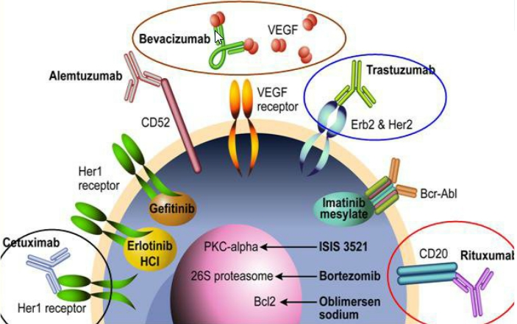
present interest
Detecting tumor-associated molecular targets for individualized treatment of cancers.
using IHH, RT-PCR, FISH and sequencing analysis to provide guideline to aid individualized decision-making in the clinical management of cancers.

Slide 13
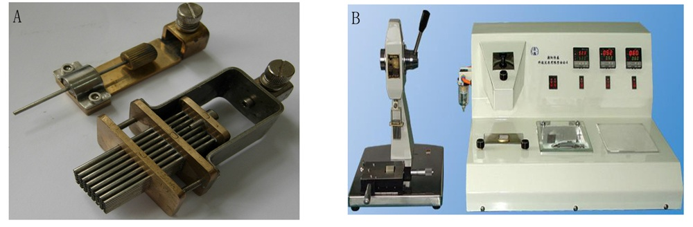
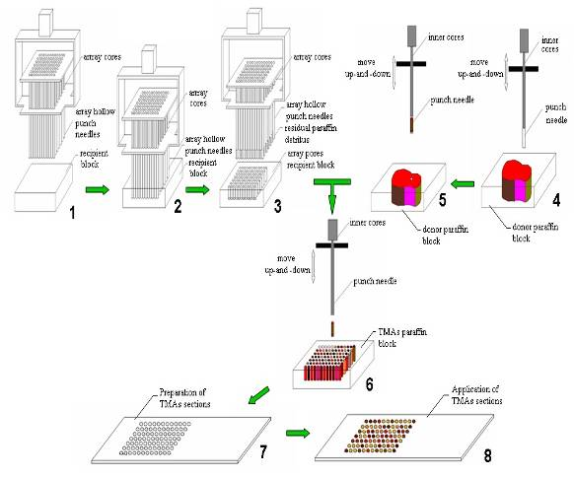
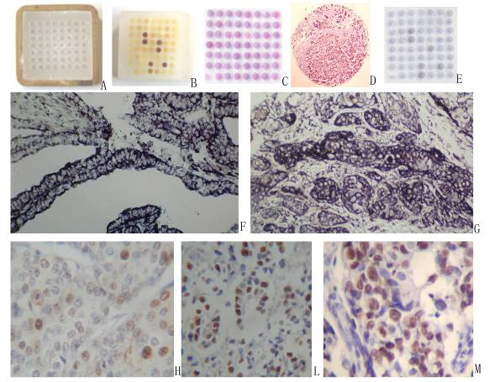
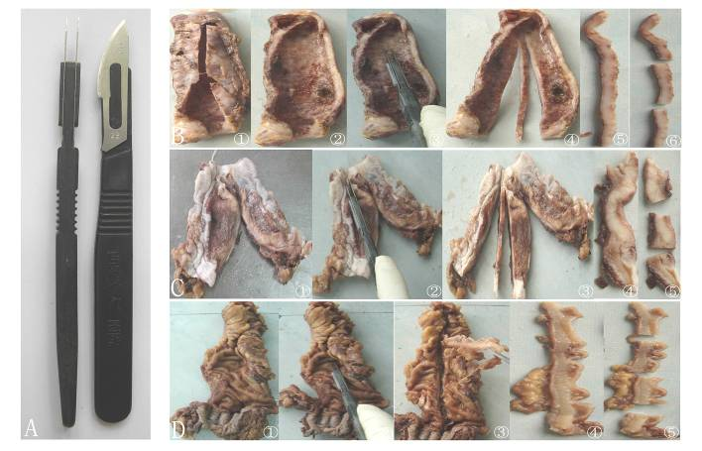
present interest
Research in biotechnology and Translational medicine for diagnostic cytopathology and histopathology,
Figure. Working flow of the HT-1 tissue microarrayer, and TMAs recipient paraffin block and TMAs paraffin block and TMAs sections.
Yang J, et al.A new grossing knife with two parallel blades for preparing uniform thickness gross tissue sections. J Clin Pathol. 2008 Sep;61(9):1069-70.
Yang J, et sl. A novel tissue microarray instrumentation: the HT-1 tissue microarrayer. IJPM.2012:55(3): 314-318.

Slide 14

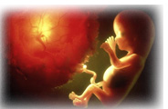
Journal of Clinical & Experimental Pathology
Journal of Neuroinfectious Diseases
Journal of the Pancreas
Immunome Research
Journal of Osteoporosis and Physical Activity
Journal of Plant Pathology & Microbiology

Slide 15

Clinical & Experimental Pathology
Related Conferences
International Conference on Clinical Trials- July 27-29, 2015 Florida, USA

Slide 16
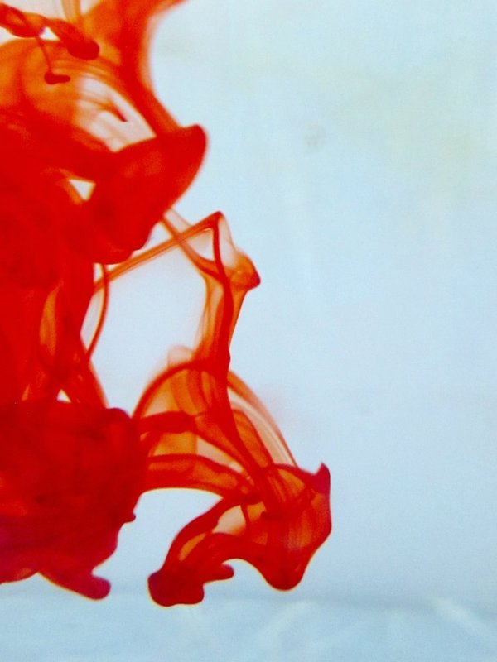

OMICS Group Open Access Membership
OMICS publishing Group Open Access Membership enables academic and research institutions, funders and corporations to actively encourage open access in scholarly communication and the dissemination of research published by their authors.
For more details and benefits, click on the link below:
http://omicsonline.org/membership.php

