Slide 1

OMICS International
OMICS International through its Open Access Initiative is committed to make genuine and reliable contributions to the scientific community. OMICS International signed an agreement with more than 1000 International Societies to make healthcare information Open Access.
Contact us at: contact.omics@omicsonline.org

Slide 2

OMICS Journals are welcoming Submissions
OMICS International welcomes submissions that are original and technically so as to serve both the developing world and developed countries in the best possible way.
OMICS Journals are poised in excellence by publishing high quality research. OMICS International follows an Editorial Manager® System peer review process and boasts of a strong and active editorial board.
Editors and reviewers are experts in their field and provide anonymous, unbiased and detailed reviews of all submissions.
The journal gives the options of multiple language translations for all the articles and all archived articles are available in HTML, XML, PDF and audio formats. Also, all the published articles are archived in repositories and indexing services like DOAJ, CAS, Google Scholar, Scientific Commons, Index Copernicus, EBSCO, HINARI and GALE.
For more details please visit our website: http://omicsonline.org/Submitmanuscript.php

Slide 3
Junwang Tang
Editor PPT

Slide 4
Biography
Dr. Tang received his PhD in Physical Chemistry in 2001 from Dalian Institute of Chemical Physics. Between 2002-2005, he had been a Japan Society for the Promotion of Science (JSPS) Fellow & NIMS researcher working on solar energy conversion in NIMS, Japan. After that, he moved to the Department of Chemistry, Imperial College and then the Department of Chemical Engineering, UCL as a Senior Researcher, Lecturer in Energy, and then promoted Senior Lecture and Reader. He has been recognized by an Outstanding President’s Award of Chinese Academy of Sciences (2001), JSPS Fellowship (2003) and Young Scientist Award by the International Association of Catalysis Societies (2008).
He is the Guest Editor-in-Chief of a special issue of International Journal of Photoenergy, 2012, Associate Editor of Chinese Journal of Catalysis and sits on the editorial board of several international journals. He is an Honorary Lecturer in Chemistry at Imperial College London and Adjunct Professor in Chinese Academy of Sciences and Nanjing Tech University. Up to now, he has published ~100 papers with a total citation of >3100.

Slide 5
Research Interests
His Research Interests lie in Nanostructured crystals and films synthesis, in particular by microwave promoted flow chemistry; Solar H2 synthesis; CO2 capture and conversion to a renewable fuel (Artificial Photosynthesis); CH4 conversion; Photocatalytic contaminant decomposition; Biomaterials; Microwave catalysis.

Slide 6
Solar Hydrogen Synthesis

Slide 7
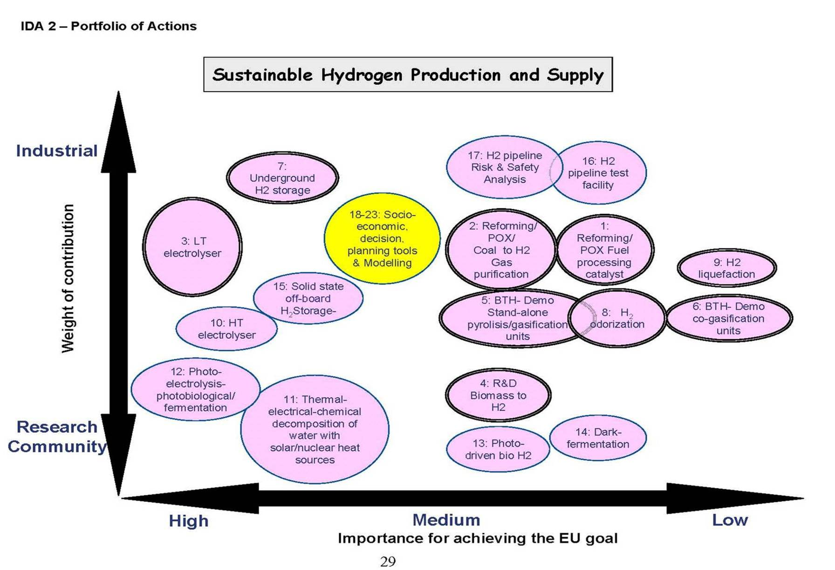

Slide 8
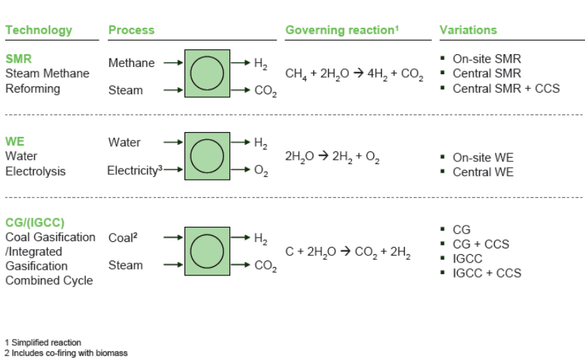
Hydrogen production – benchmark processes for solar technologies

Slide 9
Energy Routes
Solar Energy
Heat
Radiation
Solar-thermal
Fossil Resources
Biomass
PV
CO₂
Heat
Synthetic Fuels
Mechanical Energy
Power
Thermochemistry
Electrolysis
Photochemistry
Hydrogen

Slide 10


Principle of the solar fuel production
Recourses
Natural Gas
Water, CO₂
Wireless
electricity
Chemical
Reactor
Fuel
H₂
CO + H₂
Solar Tower
Industry
Transportation
Energy Converter
Fuel Cell
Transportation
Power Production

Slide 11
CO2 Reduction by solar heating of state of the art processes like steam methane reforming and coal gasification

Slide 12
Efficiency comparison for solar hydrogen production from water
Process | T [°C] | Solar plant | Solar-receiver + power [MWth] | η T/C (HHV) | η Optical | η Receiver | η Annual Efficiency Solar – H₂
Direct solar driven water splitting | 25 | No need | semiconductor | NA | NA | NA | >10%
Elctrolysis (+solar-thermal power) | NA | Actual Solar tower | Molten Salt 700 | 30% | 57% | 83% | 14%
High temperature steam electrolysis | 850 | Future Solar tower | Particle 700 | 45% | 57% | 76,2% | 20%
Hybrid Sulfur-process | 850 | Future Solar tower | Particle 700 | 51% | 57% | 76% | 22%
Hybrid Copper Chlorine-process | 600 | Future Solar tower | Molten Salt 700 | 49% | 57% | 83% | 23%
Nickel Manganese Ferrit Process | 1800 | Future Solar dish | Rotating Disc < 1 | 52% | 77% | 62% | 25%

Slide 13
Related Journals
Chemical Sciences Journal
Chemical Engineering & Process Technology

Slide 14


Slide 15


OMICS International Open Access Membership
OMICS International’s Open Access Membership enables academic and research institutions, funders and corporations to actively encourage open access in scholarly communication and the dissemination of research published by their authors.
For more details and benefits, click on the link below:
http://omicsonline.org/membership.php

