Slide 1
OMICS Journals are welcoming Submissions
OMICS International welcomes submissions that are original and technically so as to serve both the developing world and developed countries in the best possible way.
OMICS Journals are poised in excellence by publishing high quality research. OMICS International follows an Editorial Manager® System peer review process and boasts of a strong and active editorial board.
Editors and reviewers are experts in their field and provide anonymous, unbiased and detailed reviews of all submissions.
The journal gives the options of multiple language translations for all the articles and all archived articles are available in HTML, XML, PDF and audio formats. Also, all the published articles are archived in repositories and indexing services like DOAJ, CAS, Google Scholar, Scientific Commons, Index Copernicus, EBSCO, HINARI and GALE.
For more details please visit our website: http://omicsonline.org/Submitmanuscript.php

Slide 2
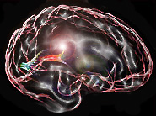
Associate Professor Karen E Waldie
Research Interests
Notes:
already be familiar with, some new (questions, discussions, email papers)

Slide 3
Neurodevelopmental disorders
Antecedents, risk factors, correlates, Gene-environment interactions | Neurological and cognitive biomarkers | Remediation / training
Longitudinal research - DMHDS - ABC - GUiNZ | EEG research fMRI research DTI research | New area – stay tuned
Notes:
Mark Sagar, Bret Talfer & Kristine Weibels
In collaboration with the Laboratory for Animate Technologies (human-computer interaction)
Biography
Mark Sagar is the director of The Laboratory for Animate Technologies based at the Auckland Bioengineering Institute.
The laboratory is creating interactive autonomously animated systems which will help define the next generation of human-computer interaction and facial animation.
Academy Award winner Associate Professor Sagar previously worked as the Special Projects Supervisor at Weta Digital. He was involved with the creation of technology for the digital characters in blockbusters such Avatar, King Kong, and Spiderman 2.
His pioneering work in computer-generated faces was recognised with two consecutive Oscars at the 2010 and 2011 Sci-tech awards, a branch of the Academy Awards that recognises movie science and technological achievements.
The former medical researcher started his career building computer simulations of the human eye for virtual surgery. He has a Bachelor of Science and a PhD in Engineering from the University of Auckland.
Associate Professor Sagar’s postgraduate research involved a landmark study in how to develop an anatomically correct virtual eye and realistic models of biomechanically simulated anatomy. It was one of the first examples of how lifelike human features could be created on a screen by combining computer graphics with mathematics and human physiology.
Associate Professor Sagar is a recipient of the University of Auckland’s 2012 Distinguished Alumni Award.

Slide 4
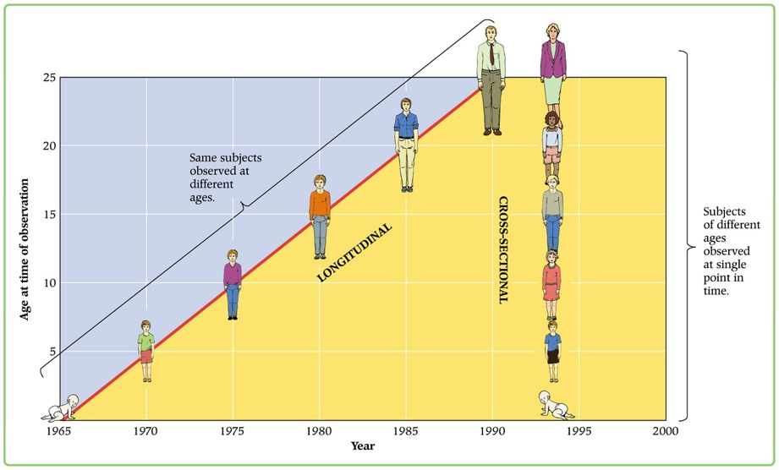
NZ Longitudinal Research
Dunedin Multidisciplinary Health and Development study (DMHDS) Associate Investigator (http://dunedinstudy.otago.ac.nz/)
Auckland Birthweight Collaborative (ABC) study Named Investigator (http://weightmanagement.hiirc.org.nz/page/9732/auckland-birthweight-collaborative-study/?section=21)
Growing Up in NZ (GUiNZ) study Named Investigator (www.growingup.co.nz)

Slide 6
What is Growing Up in New Zealand?
A longitudinal study following a group of New Zealand children, in the context of their families, from pre-birth to early adulthood
6846 babies (52% male)
born in Auckland, Counties-Manukau and Waikato district health board areas
interviews done in homes antenatally, at 9 months, and 2 years (-planning 4.5 year assessment)
91% born at term (37-41 weeks)

Slide 7
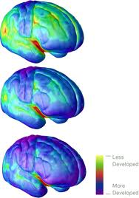
Neurodevelopmental disorders
Overall aim of research: Cognitive and Neurological biomarkers
Dyslexia: phonological awareness
Dyscalculia: number sense
ADHD: executive functioning
Aspergers: social awareness
Can insights from neuroscience provide usable knowledge for educators?
Notes:
already be familiar with, some new (questions, discussions, email papers)

Slide 8
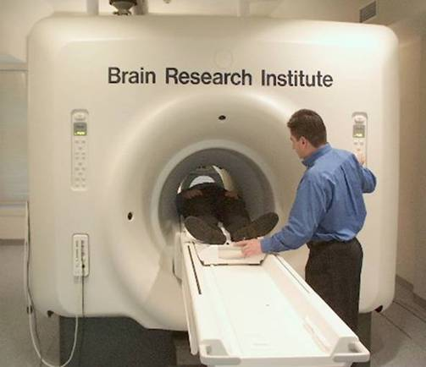
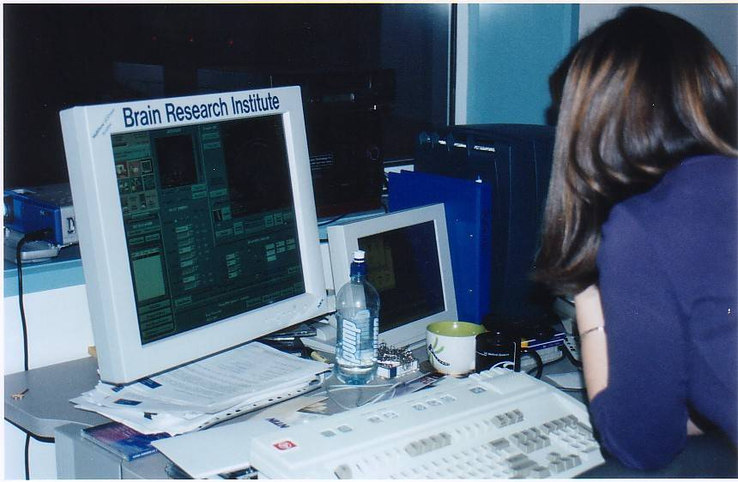
fMRI allows us to map increases in oxygenated blood flow
that accompany local brain activity during mental tasks

Slide 9
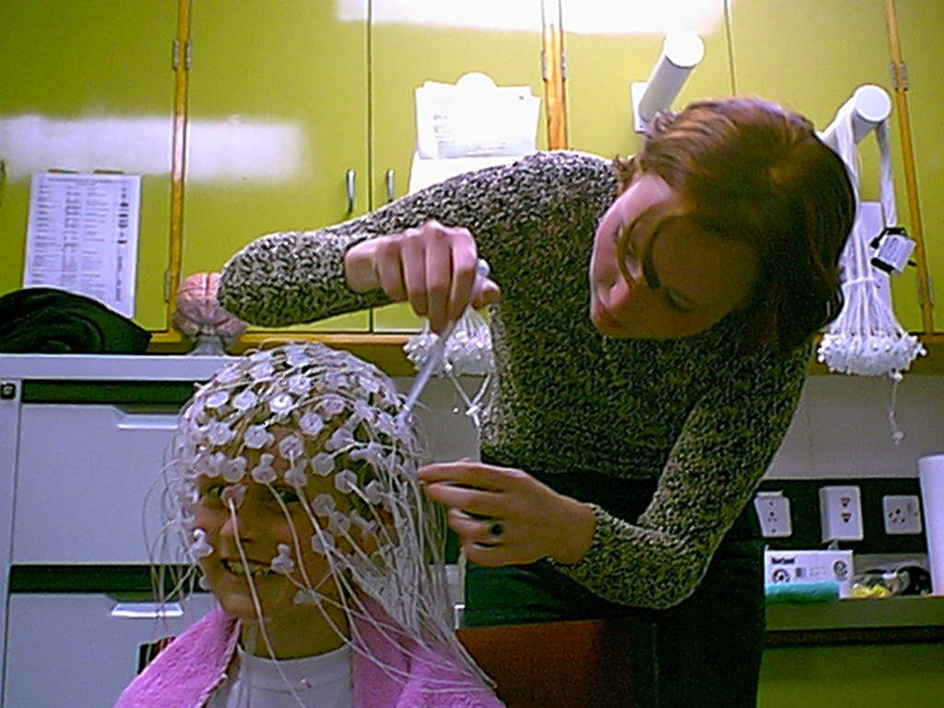
129 EEG electrodes

Slide 10
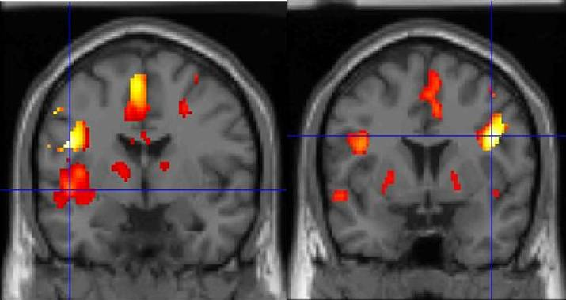
Dyslexia: Left hemisphere networks functionally disrupted
WALDIE KE. Introduction to developmental neuroscience: Neurological development and the mechanisms underlying reading.
In Jason Low and Paul Jose (Eds., pp.20-30), Lifespan Development: The New Zealand Context. Auckland, Pearson, 2005
Minimal left, maximal in right inferior frontal areas
A. Normal readers B. Dyslexic adults
L
Notes:
My 1st brain imaging study

Slide 12
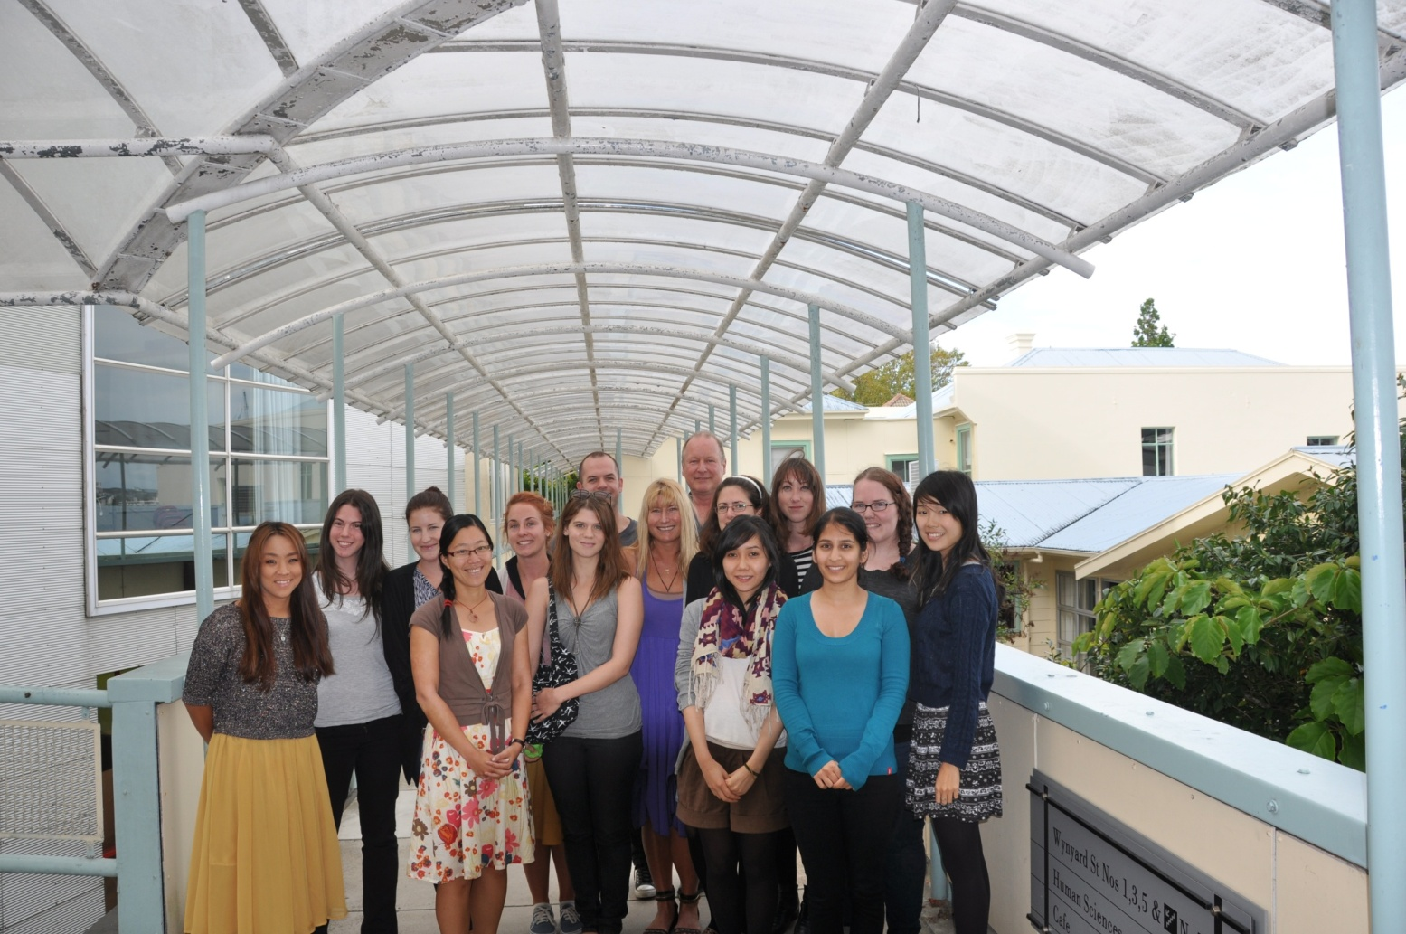
Postdoctoral fellow / colleagues
Anna J Wilson, Ian J Kirk, Michael Corballis, Ed Mitchell, John Thompson
The University of Auckland Faculty of Science Development Research Fund (2007-2014)

Slide 13
International Journal of School and Cognitive Psychology Related Conferences
2nd International Conference on Alzheimer's Disease and Dementia
3rd International Conference on Psychology, Autism & Alzheimer's Disease

Slide 14
For upcoming conferences visit www.conferenceseries.com

Slide 15
OMICS Group Open Access Membership
OMICS publishing Group Open Access Membership enables academic and research institutions, funders and corporations to actively encourage open access in scholarly communication and the dissemination of research published by their authors.
For more details and benefits, click on the link below:
http://omicsonline.org/membership.php

