Slide 1


OMICS international
OMICS International through its Open Access Initiative is committed to make genuine and reliable contributions to the scientific community. OMICS International hosts over 700 leading-edge peer reviewed Open Access Journals and organizes over 1000 International Conferences annually all over the world. OMICS International journals have over 10 million readers and the fame and success of the same can be attributed to the strong editorial board which contains over 50000 eminent personalities that ensure a rapid, quality and quick review process. OMICS International signed an agreement with more than 1000 International Societies to make healthcare information Open Access.
Contact us at: contact.omics@omicsonline.org

Slide 2

OMICS Journals are welcoming Submissions
OMICS International welcomes submissions that are original and technically so as to serve both the developing world and developed countries in the best possible way.
OMICS Journals are poised in excellence by publishing high quality research. OMICS International follows an Editorial Manager® System peer review process and boasts of a strong and active editorial board.
Editors and reviewers are experts in their field and provide anonymous, unbiased and detailed reviews of all submissions.
The journal gives the options of multiple language translations for all the articles and all archived articles are available in HTML, XML, PDF and audio formats. Also, all the published articles are archived in repositories and indexing services like DOAJ, CAS, Google Scholar, Scientific Commons, Index Copernicus, EBSCO, HINARI and GALE.
For more details please visit our website: http://omicsonline.org/Submitmanuscript.php

Slide 3
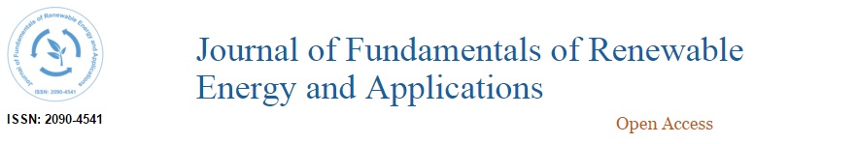


Editor
Journal of Fundamentals of Renewable Energy and Applications
Krapivsky Evgenii Isaakovich
Professor
University of Mines
Russia

Slide 4
Biography:
Krapivsky Evgenii Isaakovich, was born in Leningrad (19.08.1939), graduated Leningrad Mining Institute (1962). Made a practical work in the exploration and geophysical organizations in the Urals, the Far East, Kazakhstan. He holds a PhD degree (1970), the degree of Doctor of geological - mineralogical sciences (1982 - cum GM 000550), title of senior researcher (1975), the title of professor in the Department of Physics (1998 - 003 582 certificate). He has qualification of mining engineer and geophysicist. Member of the Academy of Natural Sciences (1997). Member of the Council of RAS on the application of nuclear physics, a member of the Scientific and Methodological Council on geophysical technologies, a member of the Euro-Asian Geophysical Society. From 1962 to 1965 he worked in the direction of the expedition Sosnovskaya 1 Chief Geological Department of the Ministry of Geology of the USSR (Irkutsk).

Slide 5
From 1965 to 1983 he worked at the All-Union Scientific Research Institute of Exploration Geophysics (VIRG, Leningrad). Positions were from senior engineer to senior researcher. He was awarded the title of "Best inventor”. In 1975 he was awarded sign and the title of "Excellence in invention and rationalization” by the All-Union Society of Inventors and Innovators. He has a sign "Inventor of the USSR." Graduated courses inventors and patent engineers, financial brokers foreign languages. He worked as a lecturer at the refresher courses at the Leningrad Mining Institute. He had internship in Spain technology condition monitoring of pipelines (2000). Professionally owns a computer and specialized mathematical and graphic programs. From 1983 to 1995 he worked at the All-Union Scientific Research and Design Institute of Mechanical Processing of Minerals (VNIPI Mekhanobr,, Lenin-grad) in the position of head of the department of geophysical technologies. Since 2007 Professor of the Department of Mining transport machines SPMI.

Slide 6
He is author of more than 360 publications, including 22 books and pamphlets, 83 inventions and patents. Three works were published in the United States, one in Scotland, one in England, two in France, six in Spain, one in Bulgaria, one in Poland, one in Czechoslovakia.

Slide 7
Research Interest:
Minning Engineering and Geophysics.

Slide 8


Journal of Fundamentals of Renewable Energy and Applications
Related Journals
International Journal of Waste Resources
Hydrology: Current Research
Innovative Energy & Research
Advances in Recycling & Waste Management
Journal of Nuclear Energy Science & Power Generation Technology

Slide 9

Journal of Fundamentals of Renewable Energy and Applications
Related Conferences
2nd International Congress and Expo on Biofuels & Bioenergy
Global Energy Summit & Expo

Slide 10
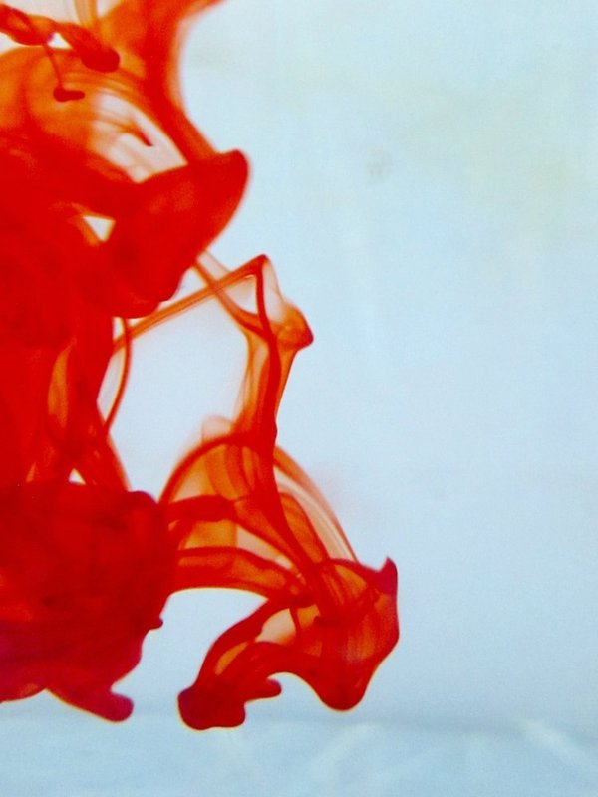

OMICS International Open Access Membership
OMICS International Open Access Membership enables academic and research institutions, funders and corporations to actively encourage open access in scholarly communication and the dissemination of research published by their authors.
For more details and benefits, click on the link below:
http://omicsonline.org/membership.php

