Slide 1





OMICS International
OMICS International through its Open Access Initiative is committed to make genuine and reliable contributions to the scientific community. OMICS International signed an agreement with more than 1000 International Societies to make healthcare information Open Access.
Contact us at: contact.omics@omicsonline.org

Slide 2

OMICS Journals are welcoming Submissions
OMICS International welcomes submissions that are original and technically so as to serve both the developing world and developed countries in the best possible way.
OMICS Journals are poised in excellence by publishing high quality research. OMICS International follows an Editorial Manager® System peer review process and boasts of a strong and active editorial board.
Editors and reviewers are experts in their field and provide anonymous, unbiased and detailed reviews of all submissions.
The journal gives the options of multiple language translations for all the articles and all archived articles are available in HTML, XML, PDF and audio formats. Also, all the published articles are archived in repositories and indexing services like DOAJ, CAS, Google Scholar, Scientific Commons, Index Copernicus, EBSCO, HINARI and GALE.
For more details please visit our website:
http://omicsonline.org/Submitmanuscript.php

Slide 3

LAM MAN KEE
Editor PPT

Slide 4
Biography
Dr. Lam Man Kee is currently working at the Department of Chemical Engineering, Universiti Teknologi PETRONAS, Malaysia.
His research interests include biodiesel and bioethanol production technology, microalgae cultivation, catalysis and life cycle assessment.

Slide 5
Recent Publications
Lam, M. K. & Lee, K. T. (2014). Cultivation of Chlorella vulgaris in a pilot-scale sequential-baffled column photobioreactor for biomass and biodiesel production. Energy Conversion and Management, 88, 399-410.
Lam, M. K. & Lee, K. T. (2012). Microalgae biofuels: A critical review of issues, problems and the way forward. Biotechnology Advances, 30, 673-690.
Lam, M. K., Lee, K. T., & Mohamed, A. R. (2009). Sulfated tin oxide as solid superacid catalyst for transesterification of waste cooking oil: An optimization study. Applied Catalysis B: Environmental, 93(1-2), 134-139.

Slide 6

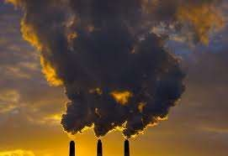
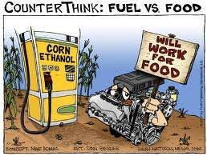
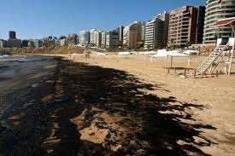

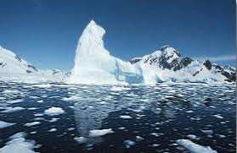
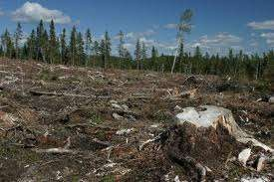
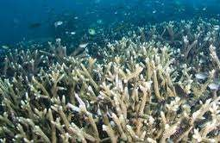
Fuel: Current environmental and social issues
Fossil fuel
Renewable fuel
Air pollution
Food vs fuel
Water pollution
High cost
Green house gas effect
Deforestation
Acidification

Slide 7
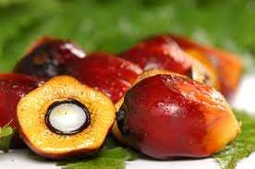
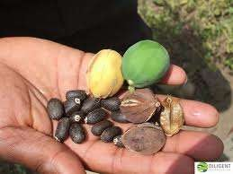
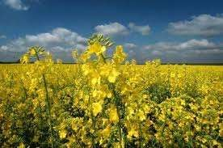
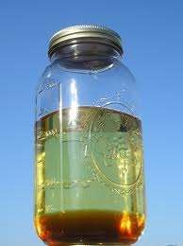
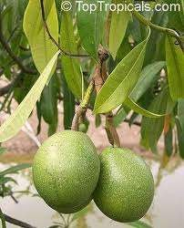
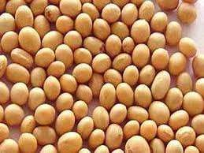
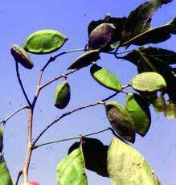
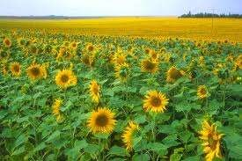
Biodiesel sources
Biodiesel
Non-Edible Oil
Edible Oil

Slide 8
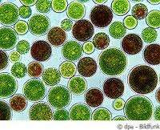
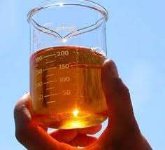
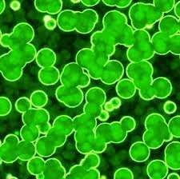
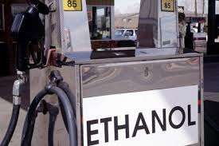
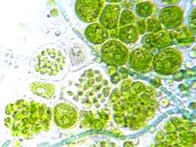
Microalgae as the third generation of biofuel
Microalgae
-One of the oldest living microorganism on Earth
More than 30,000 species
Freshwater & Marine
Main constituents in the microalgae cell:
Lipids
Biodiesel
Carbohydrate
Bioethanol

Slide 9
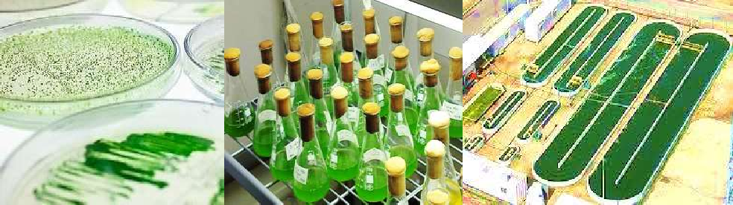
Advantages of microalgae biofuel
-Does not compete with food supply
-Relatively high lipid productivity compared to terrestrial oil plants
Microalgae Palm oil Jatropha
-> 54-126 tonne/ha/year
-> 3.62 – 10 tonne/ha/year
-> 0.14 - 4.13 tonne/ha/year
High photosynthetic efficiency -> Able to utilize CO₂ efficiently
High growth rate -> 100 times faster than land based plant

Slide 10


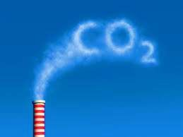
Cultivation of microalgae biofuel
Light
Water
Nutrients
Carbon

Slide 11

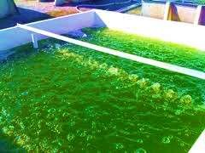
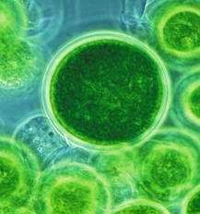
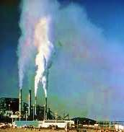
An ideal microalgae biofuel production flow
Sunlight
Free and abundantly available
CO₂
mitigation
Wastewater as
nutrient source
CO₂ CO₂
CO₂
CO₂
Alternative carbon source
Biofuel production
CO₂ from flue gases

Slide 12
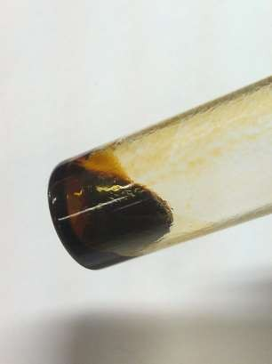
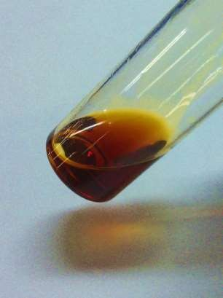
Biodiesel production from microalgae lipid
Transesterification
Crude microalgae lipid
Microalgae biodiesel

Slide 13
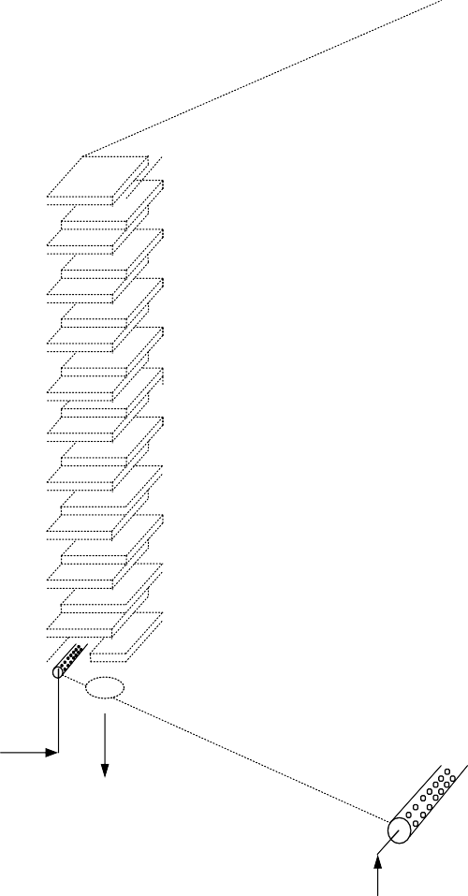
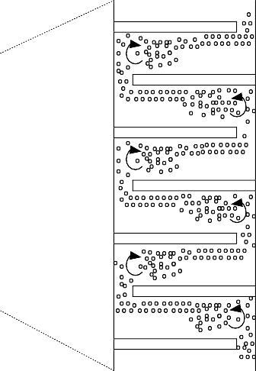
Sequential Baffled Photobioreactor (SBP)
100 liter cultivation – Pilot scale
10 cm
30 cm
The flow of bubbles in the baffled system
CO₂
Drainage
Sparger
CO₂
170 cm
140 cm
10 cm

Slide 14
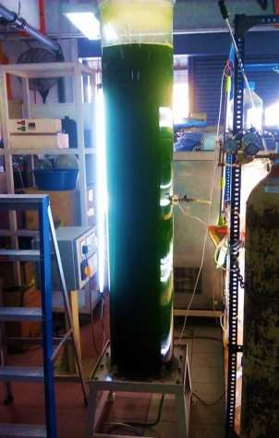
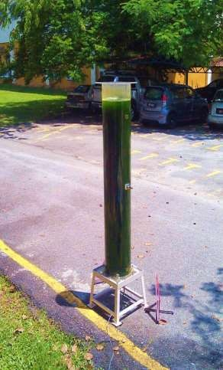
SBP: Microalgae cultivation under indoor and outdoor environment
Indoor
Outdoor

Slide 15
Problems with microalgae cultivation for biofuel production
Availability of nutrients source: Nitrogen & Phosphorus
Chemical nutrients – high cost
not environmentally friendly
Wastewater – inconsistent nutrients concentration
serious contamination
Availability of carbon source: CO₂
Atmospheric air – low concentration, 0.03 %
Flue gas – toxic compounds: CO, NO_{x}, SO_{x}
high temperature: 65ºC-450ºC

Slide 16
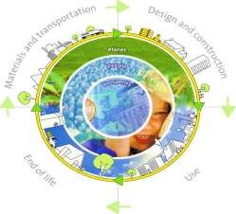

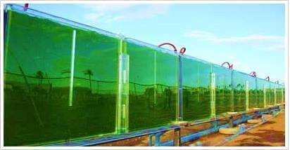
Problems with microalgae cultivation for biofuel production
Life cycle energy balance – not well understood
Economic potential - not well understood
Feasibility of outdoor cultivation

Slide 17
Related Journals
Chemical Sciences Journal
Chemical Engineering & Process Technology

Slide 18

Signature:

Slide 19



OMICS International Open Access Membership
OMICS International’s Open Access Membership enables academic and research institutions, funders and corporations to actively encourage open access in scholarly communication and the dissemination of research published by their authors.
For more details and benefits, click on the link below: http://omicsonline.org/membership.php

