Slide 1
OMICS Journals are Welcoming Submissions
OMICS International welcomes submissions that are original and technically so as to serve both the developing world and developed countries in the best possible way.
OMICS Journals are poised in excellence by publishing high quality research. OMICS International follows an Editorial Manager® System peer review process and boasts of a strong and active editorial board.
Editors and reviewers are experts in their field and provide anonymous, unbiased and detailed reviews of all submissions.
The journal gives the options of multiple language translations for all the articles and all archived articles are available in HTML, XML, PDF and audio formats. Also, all the published articles are archived in repositories and indexing services like DOAJ, CAS, Google Scholar, Scientific Commons, Index Copernicus, EBSCO, HINARI and GALE.
For more details please visit our website: http://omicsonline.org/Submitmanuscript.php

Slide 2
JOURNAL OF METABOLIC SYNDROME
Leonardo Silva Borges Roever
Department of Cardiovascular Research
Universidade Federal de Uberla
Brazil
Editor for
Journal of Metabolic Syndrome

Slide 3
BIOGRAPHY
Dr. Leonardo Roever was Graduated in 2002, had his specialization in 2003, Master's degree in Health Sciences from the UFU (2008), and improvement by the National Heart, Lung, and Blood Institute NHLBI-USA (2014). He has experience in healthcare, with emphasis on Cardiology acting on the following topics: atherosclerosis, ectopic adipositophaty, biomarkers, inflammatory markers, metabolic syndrome, coronary artery disease, cardiovascular prevention, clinical epidemiology, clinical research, biostatistics, aging and the development of new diagnostic and therapeutic methods. Reviewer journals such as Circulation, European Heart Journal, JACC, Stem Cells, Nature (EJCN), Stroke, Neurology, Chest, Critical Care Medicine and others. Ad Hoc is the American Heart Association (AHA-USA) and the National Institute of Health (NIH, USA). Author and co-author of more than 20 national and international scientific publications. Chief Editor of Research Topics: Cardiac Remodeling: New Insights in Physiological and Pathological Adaptations of Frontiers in Physiology in Switzerland. Academic Editor of Medicine (USA-Baltimore, Maryland).

Slide 4
RESEARCH INTERESTS
Dr. Leonardo Roever research interests are Atherosclerosis, Ectopic adipositophaty, Biomarkers, Inflammatory markers, Metabolic syndrome, Coronary artery disease, Cardiovascular prevention, Clinical epidemiology.

Slide 5
RECENT PUBLICATIONS
The association of left ventricular mass with coronary atherosclerosis and myocardial ischemia: cause and effect or simple association?

Slide 6
Metabolic Syndrome
Metabolic syndrome is a disorder of energy utilization and storage, diagnosed by a co-occurrence of three out of five of the following medical conditions: abdominal (central) obesity, elevated blood pressure, elevated fasting plasma glucose, high serum triglycerides, and low high-density cholesterol (HDL) levels.
Metabolic syndrome increases the risk of developing cardiovascular disease, particularly heart failure, and diabetes.Some studies have shown the prevalence in the USA to be an estimated 34% of the adult population, and the prevalence increases with age.

Slide 7
Metabolic syndrome is also known as metabolic syndrome X, cardiometabolic syndrome, syndrome X, insulin resistance syndrome, Reaven's syndrome (named for Gerald Reaven), and CHAOS (in Australia).
Metabolic Syndrome and Diabetes
Metabolic syndrome is a disorder of energy utilization and storage, diagnosed by a co-occurrence of three out of five of the following medical conditions: abdominal (central) obesity, elevated blood pressure, elevated fasting plasma glucose, high serum triglycerides, and low high-density cholesterol (HDL) levels. Metabolic syndrome increases the risk of developing cardiovascular disease, particularly heart failure, and diabetes

Slide 8
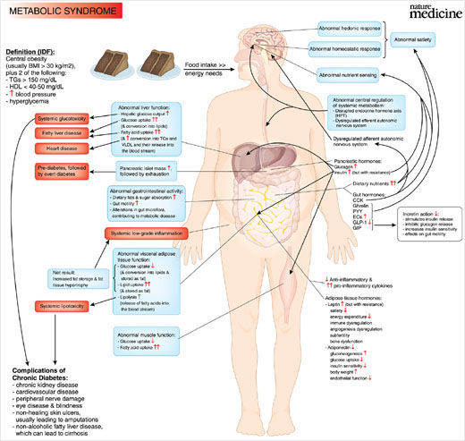

Slide 9
METABOLIC SYNDROME RELATED JOURNALS
Metabolomics:Open Access
Journal of Diabetes & Metabolism
Endocrinology & Metabolic Syndrome
Diabetology & Metabolic Syndrome
Diabetes, Metabolic Syndrome and Obesity: Targets and Therapy
Metabolic Syndrome and Related Disorders
Journal of Diabetes & Metabolic Disorders
Global Journal of Obesity, Diabetes and Metabolic Syndrome

Slide 10
METABOLIC SYNDROME RELATED CONFERENCES
2nd International Conference on Endocrinology
5th International Conference on Diabetes & Metabolism

Slide 11
OMICS International Open Access Membership
OMICS publishing International Open Access Membership enables academic and research institutions, funders and corporations to actively encourage open access in scholarly communication and the dissemination of research published by their authors.
For more details and benefits, click on the link below:
http://omicsonline.org/membership.php

Slide 13
Electronic Signature
Leonardo Roever

