Slide 1
OMICS Journals are welcoming Submissions
OMICS International welcomes submissions that are original and technically so as to serve both the developing world and developed countries in the best possible way.
OMICS Journals are poised in excellence by publishing high quality research. OMICS International follows an Editorial Manager® System peer review process and boasts of a strong and active editorial board.
Editors and reviewers are experts in their field and provide anonymous, unbiased and detailed reviews of all submissions.
The journal gives the options of multiple language translations for all the articles and all archived articles are available in HTML, XML, PDF and audio formats. Also, all the published articles are archived in repositories and indexing services like DOAJ, CAS, Google Scholar, Scientific Commons, Index Copernicus, EBSCO, HINARI and GALE.
For more details please visit our website: http://omicsonline.org/Submitmanuscript.php

Slide 2
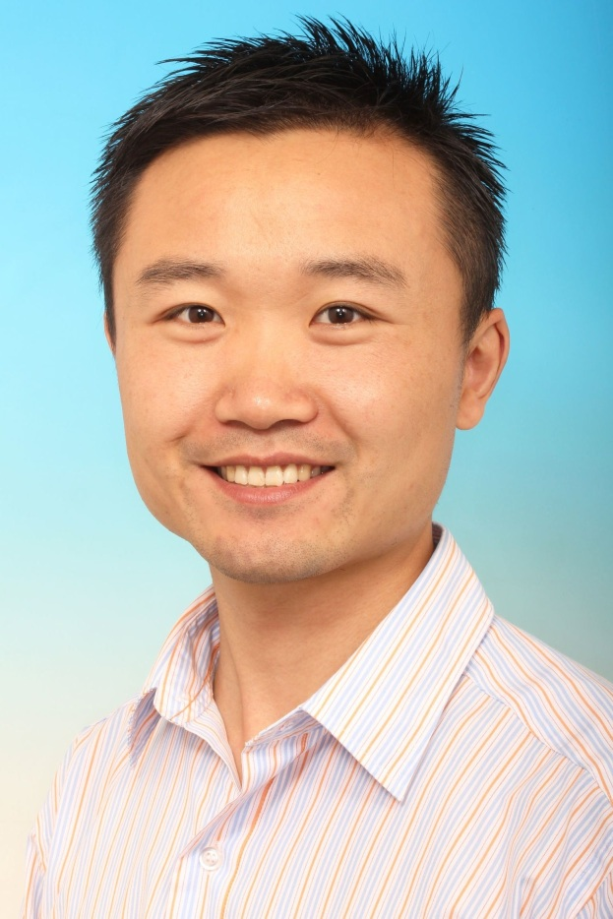
Li Mei BDS, DDS, PhD
is a principal investigator and orthodontist specialist
Faculty of Dentistry, University of Otago
310 Great King Streeet
9016 Dunedin
New Zealand

Slide 3
Dr. Li Mei
Research fields:
Oral biofilm and bacterial adhesion
Oral hygiene in orthodontic patients
Enamel demineralization and remineralization
Dental biomaterials, antimicrobial materials
Randomized controlled clinical trial (RCT)
Evidence-based dentistry
Atomic Force Microscopy (AFM)

Slide 4
The research results and clinical outcomes have been presented at conferences:
Mei L, Farella M. Prevention of enamel demineralisation using CPP-ACP: is it effective in vivo? 49th Australian Begg Society of Orthodontists Meeting (ABSO) Cairns, Australia (2014). (Oral Presentation).
Mei L, Peng Y, Farella M. Enhancing Oral Hygiene in Patients With Fixed Appliances: A Randomized Controlled Trial. 14th Annual Session of American Association of Orthodontists (AAO) New Orleans, US (2014). (Oral Presentation).
Mei L, Antoun JS, Farella M. Prevention of enamel demineralisation using CPP-ACP: is it effective in vivo? 49th Australian Begg Society of Orthodontists (ABSO) Meeting, Cairns, Australia (2014). (Oral Presentation).
Mei L, Peng Y, Stacknik S, Qu W, Farella M. A randomized clinical trial comparing four different modalities for reducing orthodontic biofilms. 89th Congress of the European Orthodontic Society (EOS), Reykjavik, Iceland (2013).
Mei L. A contact-killing surface to prevent oral biofilm. 9th World Biomaterials Congress (9th WBC) Chengdu, China (2012). (Oral Presentation).
Mei L, Sandham A, Chen YX, Van der Mei HC, Busscher HJ. Biofilm formation on different orthodontic biomaterials. International Symposium of Microbial Biofilm (ISMB), Chengdu, China (2011). (Oral Presentation).
Mei L, Ren Y, Van der Mei HC, Busscher HJ. Preventive measures for biofilm formation on orthodontic composite resin. 87th Congress of the European Orthodontic Society (EOS) Istanbul, Turkey (2011).
Mei L, Ren Y, Van der Mei HC, Busscher HJ. Orthodontic biofilms: clinical and research concerns. W.J. KOLFF Annual Conference (BMSA) Schiermonnikoog, The Netherlands (2011).

Slide 5
The research results and clinical outcomes have been presented at conferences:
Mei L. Biofim prevention on orthodontic composite resin. 14th China Stomatological Association Annual Meeting (CSA), Sep 2012, Xi An, China.
Mei L, Han X, Xu X, Chen Y. Biofilm formation: orthodontic bracket matters. 2012 Sino-Japan Dental Conference, Apr 2012, Chengdu, China.
Mei L. Bifilms in orthodontics: something old, something new, something borrowed. 2012 Sino-Japan Dental Conference, Apr 2012, Chengdu, China.
Mei L, Ren Y, Van der Mei HC, Busscher HJ. Bacterial adhesion forces mediating biofilm formation to orthodontic materials, 7th International Orthodontic Congress (WFO), Sydney, Australia (2010).
Mei L, Ren Y, Van der Mei HC, Busscher HJ. Oral bacterial adhesion forces on bovine enamel coated with saliva, W.J. KOLFF Annual Conference (BMSA) Schiermonnikoog, The Netherlands (2010).
Mei L, Henk Busscher, Ren Y, Henny Van der Mei. Influence of adhesive surface roughness on streptococcal adhesion forces, 86th Congress of the European Orthodontic Society (EOS), Portoroz, Slovenia (2010).
Mei L, Ren Y, Busscher HJ, Van der Mei HC. Bacterial adhesion forces at the bracket-adhesive-enamel junction. 85th Congress of the European Orthodontic Society (EOS) Helsinki, Finland (2009). (Oral Presentation).
Mei L, Ren Y, Guo J. Comparison of the efficiency of two treatment approaches for lingually displaced teeth. 84th Congress of the European Orthodontic Society (EOS) Lisbon, Portugal (2008).
Mei L, Guo J, Qu W, Chen Y. Comparison of the efficiency of two approaches in making space for lingually displaced teeth: A randomized clinical trial. 15th International Students Congress of Medical Science, Groningen, The Netherlands (2008).

Slide 6
The research results and clinical outcomes have been published:
Li J, Xie X, Wang Y, Yin W, Antoun JS, Farella M, Mei L. Long-term remineralizing effect of casein phosphopeptide-amorphous calcium phosphate (CPP-ACP) on early caries lesions in vivo: A systematic review. Journal of Dentistry 2014;(14)00096-7. doi: 10.1016.
Yuan H, Li J, Chen L, Cheng L, Cannon RD, Mei L. Esthetic comparison of white spot lesion treatment modalities using spectrometry and fluorescence. The Angle Orthodontist 2014; 84(2):343-349.
Peng Y, Wu R, Qu W, Wu W, Chen J, Fang J, Chen Y, Farella M, Mei L. The effect of visual method vs. plaque disclosure in enhancing oral hygiene in adolescents and young adults: a single blind randomized controlled trial. American Journal of Orthodontics and Dentofacial Orthopedics 2014; 145:280-286.
Pei Z, Wang B, Zhang F, Niu Z, Shi S, Cannon RD, Mei L. Response of human periodontal ligament cells to baicalin. Journal of Periodontology, 2014 Jan 30 (Epub ahead of print).
Ren Y, Jongsma MA, Mei L, van der Mei HC, Busscher HJ. Orthodontic treatment with fixed appliances and biofilm formation-a potential public health threat? Clinical Oral Investigations, 2014 Apr 13. [Epub ahead of print].
Mei L, Busscher HJ, van der Mei HC, Ren Y. Influence of surface roughness on streptococcal adhesion forces to composite resins. Dental Materials, 2011; 27: 770–778.
Mei L, Ren Y, Busscher HJ, Van der Mei. Poisson analysis of streptococcal bond-strengthening on saliva-coated enamel. Journal of Dental Research 2009; 88:841-845.
Mei L, Ren Y, Loontjens TJ, Van der Mei HC, Busscher HJ. Contact killing of adhering streptococci by a quaternary ammonium compound incorporated in an acrylic resin. International Journal of Artificial Organs. 2012; 35:854-863.

Slide 7
The research results and clinical outcomes have been published:
Duan P, Zhang L, Zhao Q, Mei L. Research progress on the biomechanics of self-ligating bracket systems. International Journal of Stomatology, 2012(5): 661-663.
Mei L, Van der Mei HC, Ren Y, Norde W, Busscher HJ. Poisson analysis of streptococcal bond strengthening on stainless steel with and without a salivary conditioning film. Langmuir 2009; 25:6227-6231.
Mei L, Busscher HJ, Van der Mei HC, Chen Y, Ren Y. Oral bacterial adhesion forces to biomaterial surfaces constituting the bracket-adhesive-enamel junction in orthodontic treatment. European Journal of Oral Sciences 2009; 117:419-426.
Li JY, Lim AJZ, Lum SHB, Saion MAM, Mei L. Clinical Applications of Cone-Beam Computed Tomography in Endodontics: A Systematic Review. Journal of Dental Applications. 2014;1(2): 16-20.
Mei L, Guo Jun, Chen Yangxi. Displacement of impacted mandibular canine: a case report. West China Journal of Stomatology 2008; 26:457-458.
Mei L, Ye Q, Qiao J, Qu W, Wu TX. Dissemination and application of Evidence-based Medicine in orthodontic practices. Chinese Journal of Evidence-Based Medicine. 2005; 5(11): 882-884.
Peng Y, Chen YX, Mei L. Biofilms in orthodontics: a review. Journal of Modern Stomatology. 2013; 2(27): 109-113.
Duan P, Mei L, Chen Y. Development and clinical application of fixed functional appliances. International Journal of Stomatology. 2010; 5(23): 58-60.
Guo J, Mei L, Gong H, et al. Designs of vertical loops for correcting lingually displaced teeth. West China Journal of Stomatology, 2007; 6(25): 96-97.

Slide 8
Biofilm in Orthdontics
Orthodontic treatment with fixed appliances and biofilm formation—a potential public health threat

Slide 9
Scanning electron micrograph of a multistrand wire used for fixed retainers. Biofilm formation in the niches between the wires is clearly visible

Slide 10
White spot lesions, cavities (upper dentition), and gingival inflammation (lower dentition) caused by orthodontic biofilms after removal of fixed orthodontic appliance

Slide 11
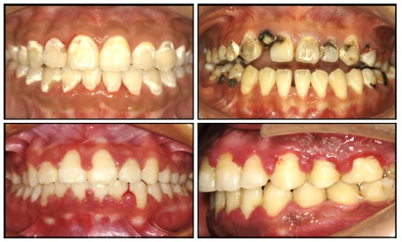
Images illustrating the severe consequences of biofilm accumulation, including enamel demineralization and gingival inflammation.

Slide 12
Four different treatments of WSLs.
Resin infiltration is more effective than NaF or CPP-ACP in providing esthetic improvement of WSLs.

Slide 13
Effect of visual method vs. plaque disclosure in enhancing oral hygiene in adolescents and young adults. The use of images showing the severe consequences of biofilm accumulation enhanced the oral hygiene of patients treated with fixed appliances.

Slide 14
Summary
The number of patients at risk of biofilm-related complications, including WSLs, caries, and gingivitis, has increased tremendously over the past two decades.
Fixed braces and other orthodontic appliances hamper the maintenance of oral hygiene and provide numerous surfaces in the oral cavity to which bacteria can adhere and form a biofilm.
Improved preventive measures and antimicrobial materials are urgently required to prevent biofilm-related complications of orthodontic treatment from overshadowing its functional and esthetic advantages.

Slide 15
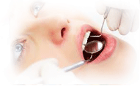
Dentistry Related Journals
JBR Journal of Interdisciplinary Medicine and Dental Science
Journal of Oral Hygiene & Health
Oral Health and Dental Management

Slide 16
Dentistry Related Conferences
OMICS International Organises 1000+ Global Events Every Year across USA, Europe & Asia. For further details, please visit http://www.omicsonline.org/international-scientific-conferences/

Slide 17
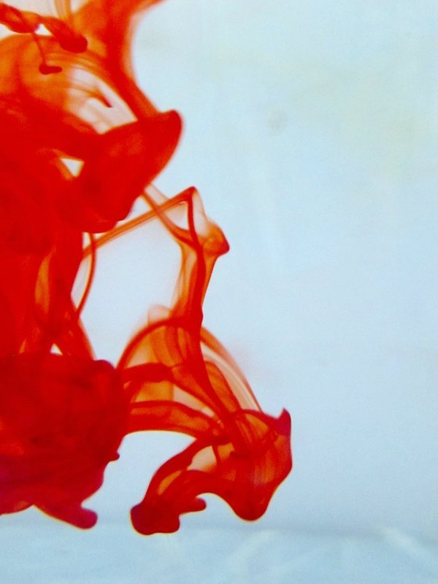
OMICS International Open Access Membership
OMICS International Open Access Membership enables academic and research institutions, funders and corporations to actively encourage open access in scholarly communication and the dissemination of research published by their authors.
For more details and benefits, click on the link below:
http://omicsonline.org/membership.php

