Slide 1
OMICS Journals are welcoming Submissions
OMICS International welcomes submissions that are original and technically so as to serve both the developing world and developed countries in the best possible way.
OMICS Journals are poised in excellence by publishing high quality research. OMICS International follows an Editorial Manager® System peer review process and boasts of a strong and active editorial board.
Editors and reviewers are experts in their field and provide anonymous, unbiased and detailed reviews of all submissions.
The journal gives the options of multiple language translations for all the articles and all archived articles are available in HTML, XML, PDF and audio formats. Also, all the published articles are archived in repositories and indexing services like DOAJ, CAS, Google Scholar, Scientific Commons, Index Copernicus, EBSCO, HINARI and GALE.
For more details please visit our website: http://omicsonline.org/Submitmanuscript.php

Slide 2
SCIENTIFIC EVIDENCE OF INTERVENTIONS WITH STROKE PATIENTS
Luci Fuscaldi Teixeira-Salmela, PT, Ph.D.
Christina Danielli Coelho de Morais Faria, PT, Ph.D.
Janaíne Cunha Polese, PT, M. Sc.
Aline Alvim Scianni, PT, Ph.D.
Neurological Rehabilitation Research Group
Department of Physical Therapy
Universidade Federal de Minas Gerais, Belo Horizonte, Brazil

Slide 3
Learning outcomes
At the end of this lecture, the readers should be able to:
Identify the discussed strategies, including their theoretical principles;
Understand the cost and benefit of all included strategies; and
Select the most appropriate strategies, according to their scientific evidence, to develop an effective intervention program.

Slide 4
Lecture overview
In this lecture, the most commonly used intervention strategies applied within stroke rehabilitation are presented, along with their definitions, principles, and advantages.
The evidence regarding the strategies are discussed, as follows:
Clearly established evidence was defined as strategies that have been addressed in systematic reviews with meta-analyses and showed positive results.
Limited evidence was defined as those found in randomized clinical trials or other studies.

Slide 5
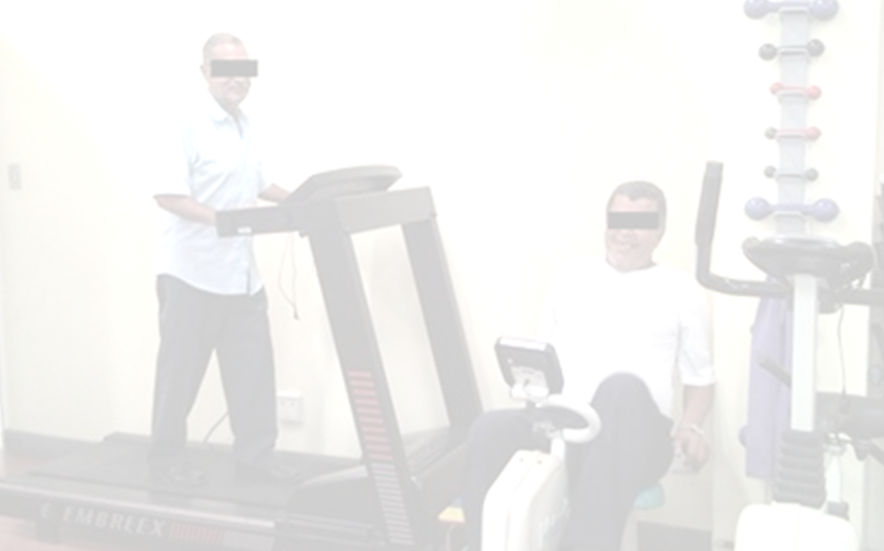
Fitness training
Definition: It consists of planned and structured activities with appropriate intensity, involving continuous rhythmic movements and various muscular groups, aimed at maintaining or increasing components related to physical fitness. It is based upon physiological principles, which increase the ability to transport and use oxygen during physical activity.
Advantages: Easy administration and relatively low cost. Possibility of being delivered to groups.
Clearly established evidence for stroke patients with mild to moderate impairments at both the acute and chronic stages in outcomes, such as maximal oxygen consumption, gait capacity and speed.
Limited scientific evidence to improve quality of life.
(ACSM, 2009; Brazelli et al., 2011)

Slide 6
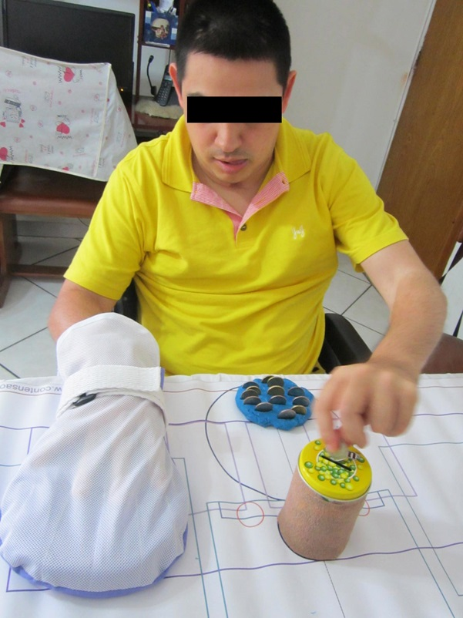
Constraint-induced movement therapy
Definition: It is a behavioural approach, which focuses on improving and increasing the use of the paretic limb in people with asymmetrical use of the limbs. Comprises three pillars: (1) restriction of the non-paretic limb; (2) intensive task-oriented training (task practice and shaping); and (3) a transfer package.
Advantages: The activities to be trained may be those that are part of the patients’ daily lives and be administered within their life context.
Clearly established evidence for stroke patients at the acute, sub-acute, and chronic stages in outcomes related to the quantity and quality of the use of their paretic upper limb in daily life, dexterity, and motor recovery.
Limited scientific evidence for the lower limbs, in outcomes related to strength and gait.
(Stock and Mork, 2009; Nijland et al., 2011; McIntyre et al., 2012)

Slide 7
Biofeedback
Definition: It is delivered using equipment to provide patients with information regarding physiological processes during the performance of a given movement, activity, or task, in order to improve performance and learning.
Advantages: The physiological information is continuously and simultaneously delivered in a objective manner and is specific to the trained movement, activity, or task.
Clearly established evidence for stroke patients at the acute, sub-acute, and chronic stages to improve activity performances more related to the lower limbs (stand-up, gait, and sit-to-stand).
Limited scientific evidence for sensorimotor impairments, activities related to the upper limbs, and spasticity that interferes with activity or personal care.
(National Stroke Foundation, 2010; Stanton et al., 2011; van Vliet et al., 2010)

Slide 8
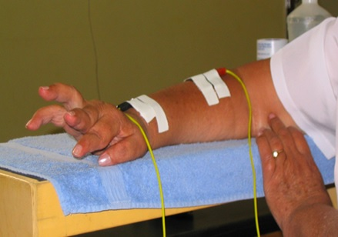
Electrical stimulation
Definition: It refers to the stimulation of an intact lower motor neuron by an electrical current generated by an apparatus. It can be used to activate paralyzed or paretic muscles, aiming at generating muscular contractions or modulating neural activity, to regain voluntary contractions or to prevent abnormal muscular reactions.
Advantages: In precise sequences and magnitudes, electrical stimulation can be used to directly accomplish functional tasks.
Clearly established evidence for patients at the sub-acute and chronic stages to improve muscular strength and activity performance.
Limited scientific evidence to prevent or treat swelling of the extremities and to deal with spasticity, that interferes with activity or personal care.
(National Stroke Foundation, 2010; Ijzerman et al., 2009)

Slide 9
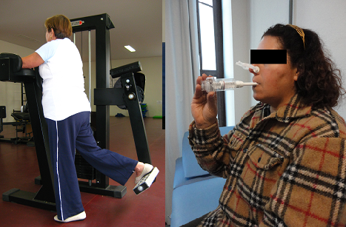
Progressive resistance training
Definition: Refers to the use of progressive overload applied to a specific muscular group, to stimulate further adaptation toward specific training goals.
Advantages: Low cost, easy to administer, and may be delivered in groups. It can be used for muscles of different segments (upper limbs, lower limbs, and trunk) and also for the respiratory muscles.
Clearly established evidence for for weak patients at the acute, sub-acute, and chronic stages, without any adverse effects, even on spasticity, to improve strength, gait performance, quality of life, and oxygen consumption (peak VO₂).
Limited scientific evidence to improve mobility, sit-to-stand, stairclimb, the performance of activities related to the upper limbs, and functional performance in general.
(ACSM, 2009; Ada et al., 2006; National Stroke Foundation, 2010; Pak et al., 2008)

Slide 10
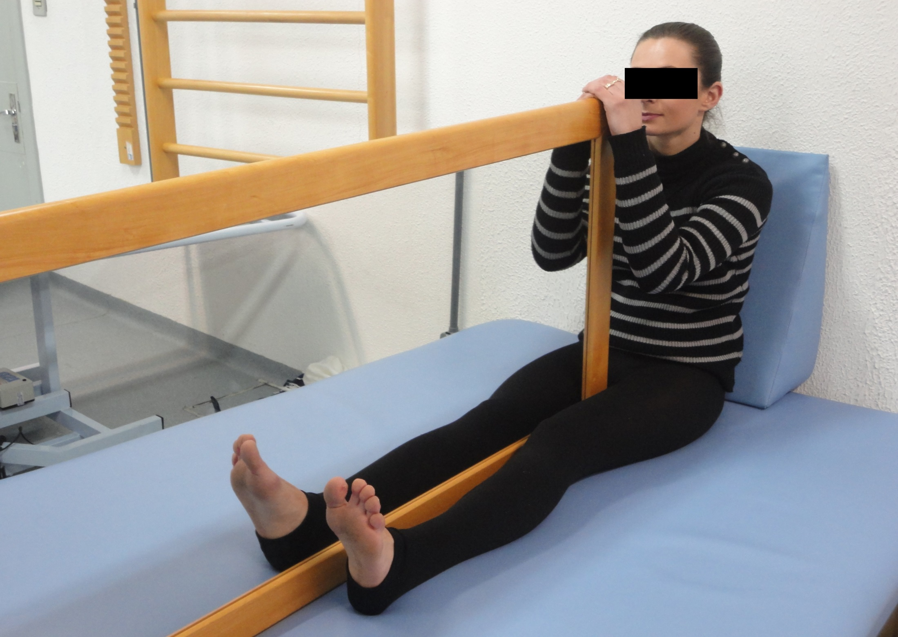
Mirror therapy
Definition: It focuses on moving the unimpaired limb, while the patient watches its mirror reflection superimposed over the impaired limb that is unseen, thus creating a visual illusion of the movement capability of the impaired limb.
Advantages: Low cost and is easily performed. The patients may perform the intervention by themselves.
Clearly established evidence for weak patients at the acute, sub-acute, and chronic stages to improve the following outcomes related to the upper limbs: Pain, motor function, and the performance of functional activities.
Limited scientific evidence to improve range of motion, visual-spatial neglect, and the performance of activities of daily living.
(National Stroke Foundation, 2010; Sütbeyaz et al., 2007; Thieme et al., 2012)

Slide 11
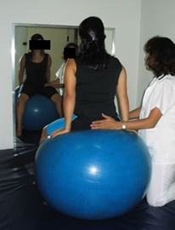
Bobath concept
Definition: It is defined by the International Bobath Instructors Training Association (IBITA), as a problem solving approach for the assessment and treatment of individuals with disturbances of function, movement, and postural control due to a lesion of the central nervous system. The aims are to identify and analyze problems within functional activities and participation in everyday life, as well as analyse movement components and underlying impairments. It is based upon afferent information, named facilitation, to enable successful movement and task performance.
Advantages: It is a global strategy with a holistic approach, but it requires expert training to be delivered.
Evidence: There is no evidence that the Bobath Concept is superior to other approaches.
(Lennon, 1996; Graham et al., 2009)

Slide 12
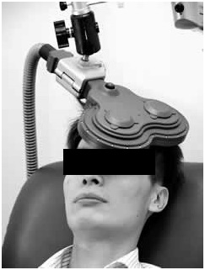
Transcranial magnetic stimulation
Definition: It is an intervention aiming at altering the excitability of the motor cortex. Improvements in motor performance after stroke have been found after inhibiting the unaffected hemisphere, as well as increasing the excitability of the affected hemisphere.
Advantages: It can be implemented for stroke patients with severe motor impairments.
Limited scientific evidence to improve motor recovery at the acute and chronic stages. At the moment, no adverse effects have been reported.
(Khedr et al., 2010; Sung et al., 2013)

Slide 13
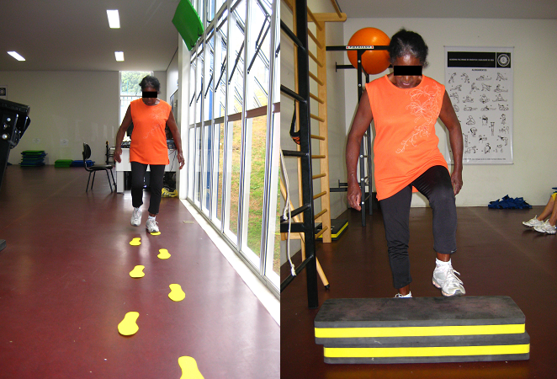
Task-specific training
Definition: It consists of repetitive training of movements directly related to functional activities.
Advantages: It can be performed as circuit training and delivered to groups. The intensity of training can be adjusted and progressed to fit the individuals’ needs.
Clearly established evidence for stroke patients at the sub-acute and chronic stages to improve balance, sit-to-stand, reaching, manipulation, and walking performance.
(French et al., 2010; Rensink et al., 2009)

Slide 14
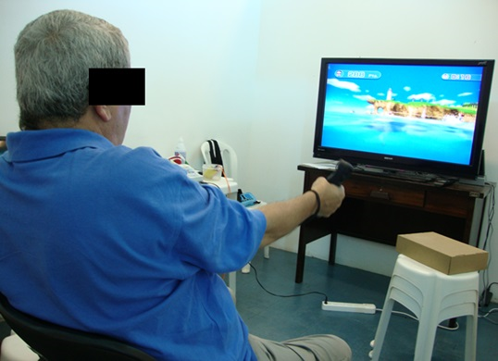
Virtual reality therapy
Definition: It refers to use of interactive simulations generated from images, such as computer processors, to provide the users the opportunity to interact with environments that simulate real objects and events. Through a virtual environment rich in detail, virtual reality simulates functional tasks that are intensively practiced.
Advantages: Virtual reality programs simulate real life functional activities in an interesting and challenging manner and may encourage the practice of a higher number of repetitions. Moreover, the difficulty of the tasks can be graded and the physiotherapists can simulate tasks that could not be trained within clinical settings, such as crossing a street.
Limited scientific evidence of the benefits of virtual reality compared with the same doses of conventional rehabilitation strategies for measures of upper limb function and daily life activities. There is limited evidence on the effectiveness of virtual reality in measures of grip strength and gait speed.
(Laver et al., 2011)

Slide 15
Mental practice
Definition: It is a cognitive strategy, in which a brain area related to specific motor action is triggered repeatedly, through the activation of the imagination, with the goal of improving the patients’ performance.
Advantages: For many individuals with nervous system damage, the execution of certain movements is very difficult and, sometimes, even impossible, which hampers their active participation in the rehabilitation process. In this sense, mental practice allows the realization of all movements.
Limited scientific evidence of the benefits of mental practice in addition to other rehabilitation strategies for measures of upper limb function. No adverse effects with stroke patients at the acute, sub-acute and chronic stages were observed.
(Refshauge et al., 2005; Barclay-Goddard et al., 2011)

Slide 16
References
Ada L, Dorsch S, Canning CG. Strengthening interventions increase strength and improve activity after stroke: A systematic review. Aus J Physiother. 2006; 52: 241-248.
AMERICAN COLLEGE OF SPORTS MEDICINE. Progression models in resistance training for healthy adults. Med Dci Sports Exerc. 2009;41(3):687-708.
Barclay-Goddard RE, Stevenson TJ, Poluha W, Thalman L. Mental practice for treating upper extremity in individuals with hemiparesis after stroke. The Cochrane database Syst Rev, 11(5): 1-32, 2011.
Brazzelli M, Saunders DH, Greig CA, Mead GE. Physical fitness training for stroke patients. Cochrane Database Syst Rev. 2011 Nov 9;(11):CD003316.
French B, Thomas L, Leathley M, Sutton C, McAdam J, Forster A et al. Does repetitive task training improve functional activity after stroke? A Cochrane systematic review and meta-analysis. J Rehabil Med. 2010;42(1):9-14.
Graham JV, Eustace C, Brock K, Swain E, Irwin-Carruthers S. The Bobath concept in contemporary clinical practice. Top Stroke Rehabil. 2009;16(1):57-68.
Ijzerman MJ, Renzenbrink GJ, Geurts AC. Neuromuscular stimulation after stroke: from technology to clinical deployment. Expert Rev Neurother. 2009 Apr;9(4):541-52.
Khedr EM, Etraby AE, Hemeda M, Nasef AM, Razek AAE. Long-term effect of repetitive transcranial magnetic stimulation on motor function recovery after acute ischemic stroke. Acta Neurol Scand. 2010;121: 30–37.
Laver KE, George S, Thoms S, Deutsch JE, Crotty M. Virtual reality for stroke rehabilitation. Cochrane Database Syst Review. 2011 Sep 7;(9):CD008349
Lennon S. The Bobath concept: A critical review of the theoretical assumptions that guide physiotherapy practice in stroke rehabilitation. Phys Ther Rev. 1996;1:35–45.
McIntyre A, Viana R, Janzen S, Mehta S, Pereira S, Teasell R. Systematic review and meta-analysis of constraint induced movement therapy in the hemiparetic upper extremity more than six months post stroke. Top Stroke Rehabil. 2012;19(6):499-513.
National Stroke Foundation. Clinical Guidelines for Stroke Management 2010. Melbourne Australia.
. Nijland R, Kwakkel G, Baker J, van Wegen E.Constraint-induced movement therapy for the upper paretic limb in acute or sub-acute stroke: a systematic review. Int J Stroke. 2011;6(5):425-33.
Pak S, Patten C. Strengthening to promote functional recovery poststroke: An evidence-based review. Top Stroke Rehabil. 2008;15(3): 177-199.
Refshauge K, Ada L, Ellis E. Since-based rehabilitation. New York: Elsevier, 2005.
Renseink M, Schuurmans M, Lindeman E, Hafsteinsdóttir T. Task-oriented training in rehabilitation after stroke: systematic review. J Adv Nurs. 2009;65(4):737-54.
Stanton R, Ada L, Dean CM, Preston E. Biofeedback improves activities of the lower limb after stroke: a systematic review. J Physiother. 2011;57(3):145-55.
Stock R, Mork PJ. The effect of an intensive exercise programme on leg function in chronic stroke patients: a pilot study with one-year follow-up. Clin Rehabil. 2009;23(9):790-9.
Sutbeyaz S, Yavuzer G, Sezer N, Koseoglu F. Mirror therapy enhances lower- extremity motor recovery and motor functioning after stroke: a randomized controlled trial. Arch Phys Med Rehabil. 2007;88(5):555-9.
Sung WH, Wang CP, Chou CL, Chen YC, Chang YC, Tsai PY. Efficacy of Coupling Inhibitory and Facilitatory Repetitive Transcranial Magnetic Stimulation to Enhance Motor Recovery in Hemiplegic Stroke Patients. Stroke. 2013;44:1375-1382.
Thieme H, Mehrholz J, Pohl M, Behrens J, Dohle C. Mirror therapy for improving motor function after stroke. Cochrane Database Syst Rev. 2012 Mar 14;3:CD008449.
Van Vilet PM, Wulf G. extrinsic feedback for motor learning after stroke: what is the evidence? Disabil Rehabil. 2006;15-30;28(13-14):831-40.

Slide 17
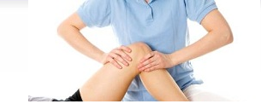
Journal of Novel Physiotherapies
Related Journals
International Journal of Physical Medicine & Rehabilitation
Journal of Yoga & Physical Therapy
Journal of Sports Medicine & Doping Studies

Slide 18
Journal of Novel Physiotherapies
Related Conferences
2nd International Conference and Exhibition on Physical Medicine & Rehabilitation

Slide 19
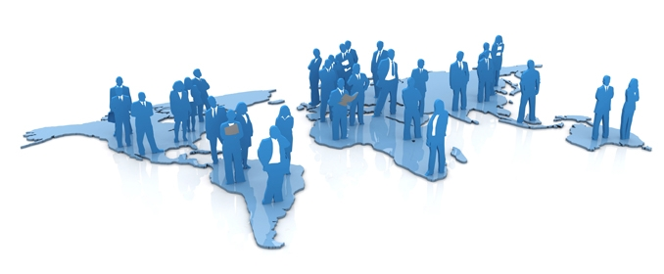
OMICS Group Open Access Membership
OMICS International Open Access Membership enables academic and research institutions, funders and corporations to actively encourage open access in scholarly communication and the dissemination of research published by their authors.
For more details and benefits, click on the link below:
http://omicsonline.org/membership.php

