Slide 1
OMICS Journals are welcoming Submissions
OMICS International welcomes submissions that are original and technically so as to serve both the developing world and developed countries in the best possible way.
OMICS Journals are poised in excellence by publishing high quality research. OMICS International follows an Editorial Manager® System peer review process and boasts of a strong and active editorial board.
Editors and reviewers are experts in their field and provide anonymous, unbiased and detailed reviews of all submissions.
The journal gives the options of multiple language translations for all the articles and all archived articles are available in HTML, XML, PDF and audio formats. Also, all the published articles are archived in repositories and indexing services like DOAJ, CAS, Google Scholar, Scientific Commons, Index Copernicus, EBSCO, HINARI and GALE.
For more details please visit our website: http://omicsonline.org/Submitmanuscript.php

Slide 2
Calcium metabolism and its regulation
Dr M Adak
Professor of Biochemistry
Anna Medical College and Research Center
Mauritius

Slide 3
Distribution

Slide 4
Different Forms of Calcium
Most of the calcium in the body exists as the mineral hydroxyapatite, Ca₁₀(PO₄)₆(OH)₂.
Calcium in the plasma:
45% in ionized form (the physiologically active form)
45% bound to proteins (predominantly albumin)
10% complexed with anions (citrate, sulfate, phosphate)
Both total calcium and ionized calcium measurements are available in many laboratories

Slide 5
Body requirements
Age (in years) Calcium Requirement
1 – 3 500mg
4 - 8 800mg
9 - 18 1300mg
19 - 50 1000mg
51+ 1500mg
*Pregnant and lactating women are recommended a daily calcium intake of 1000mg.

Slide 6
source
Calcium is found in milk and dairy products,
Green leafy vegetables,
seafood,
almonds,
blackstrap molasses,
broccoli,
enriched soy and rice milk products, figs,
soybeans and tofu.

Slide 7
Absorption of Ca
Absorption is taking place from the first and second part of duodenum against concentration gradients
Absorption required a carrier protein , helped by Ca-dependent ATPase
Increased absorption-
- calcitriol , active form of Vit-D
- PTH
- acidic pH
- Lys and Arg
Inhibiting absorption -
- phytic acid
- oxalates
- phosphate
- Mg
- caffeine

Slide 8
Biological functions of Calcium
Bone and teeth mineralization
Regulate neuromuscular excitability
Blood coagulation
Secretory processes
Membrane integrity
Plasma membrane transport
Enzyme reactions
Release of hormones and neurotransmitters
Intracellular second messenger

Slide 9
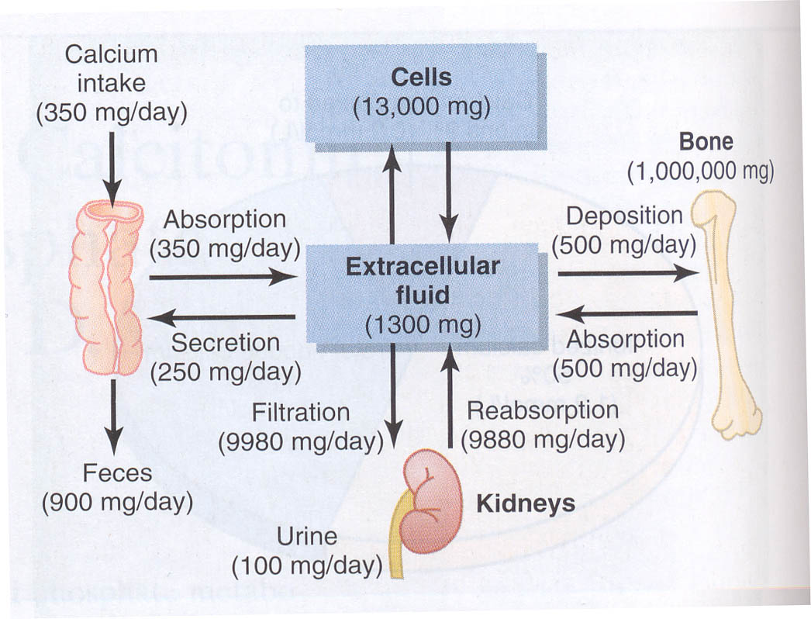
Calcium turnover

Slide 10
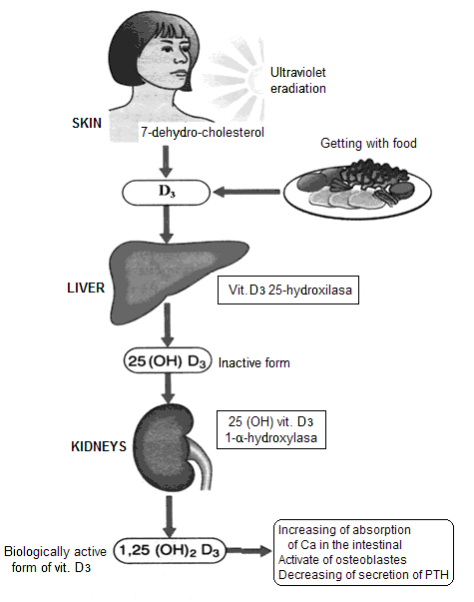
Hormone regulation of calciummetabolism
Vitamin D
Parathyroid hormone (PTH)
Organ-target: bones, kidneys
Function of PTH - increase of Ca concentration in plasma
Mechanisms:
1. Releasing of Са by bones (activation of osteoclasts – resumption of bones)
2. Increase of Са reabsorbing in kidneys
3. Activation of vit. Dз synthesis
and increase of absorption
in the intestine
Calcitonin
Organ-target - bones
Function - decrease of Ca concentration in plasma

Slide 11
Vitamin D3
Dietary cholesterol is converted into 7-dehydrocholesterol and transported to skin
UV sunlight (290-320nm) penetrates the skin to break provitamine ( 7-dehydrocholesterol ) to previtamine and it is then converted to Cholecalciferol by the process of isomerisation
In the liver, cholecalciferol undergoes 25-hydroxylation to yield 25(OH) Vit-D ( calcidiol)
In the kidney , calcidiol undergoes further 1α-hydroxylation to produce 1,25 –dihydroxy Vit-D (Calcitriol). Its production in the kidney is catalyzed by 1α -hydroxylase .
1α -hydroxylase activity is increased by :
Decreased serum Ca2+
Increased PTH level
Decreased serum phosphate
Action of 1,25-dihydroxycholecalcififerol(Calcitriol)
Increases intestinal Ca2+ absorption
Increases intestinal phosphate absorption
Increase renal reabsorption of Ca2+ and phosphate
Increases osteoclast activity
Notes:
Levels of 1,25 OHD do not decrease until defy is severe
D2 - ergocalciferol

Slide 12
Vitamin D3 and Calcium Control
Vitamin D3 (Cholecalciferol)
Converted to precursor in liver
Initially stored
Converted to 25-Hydroxycholecalciferol
Feedback control limits concentration
Converted to active form in kidney
1,25-Dihydroxycholecalciferol
Under the feedback control of parathyroid hormone (PTH)
The main action of 1,25-(OH)₂-D is to stimulate absorption of Ca²⁺ from the intestine.
1,25-(OH)₂-D induces the production of calcium binding proteins which sequester Ca²⁺, buffer high Ca²⁺ concentrations that arise during initial absorption and allow Ca²⁺ to be absorbed against a high Ca²⁺ gradient

Slide 13
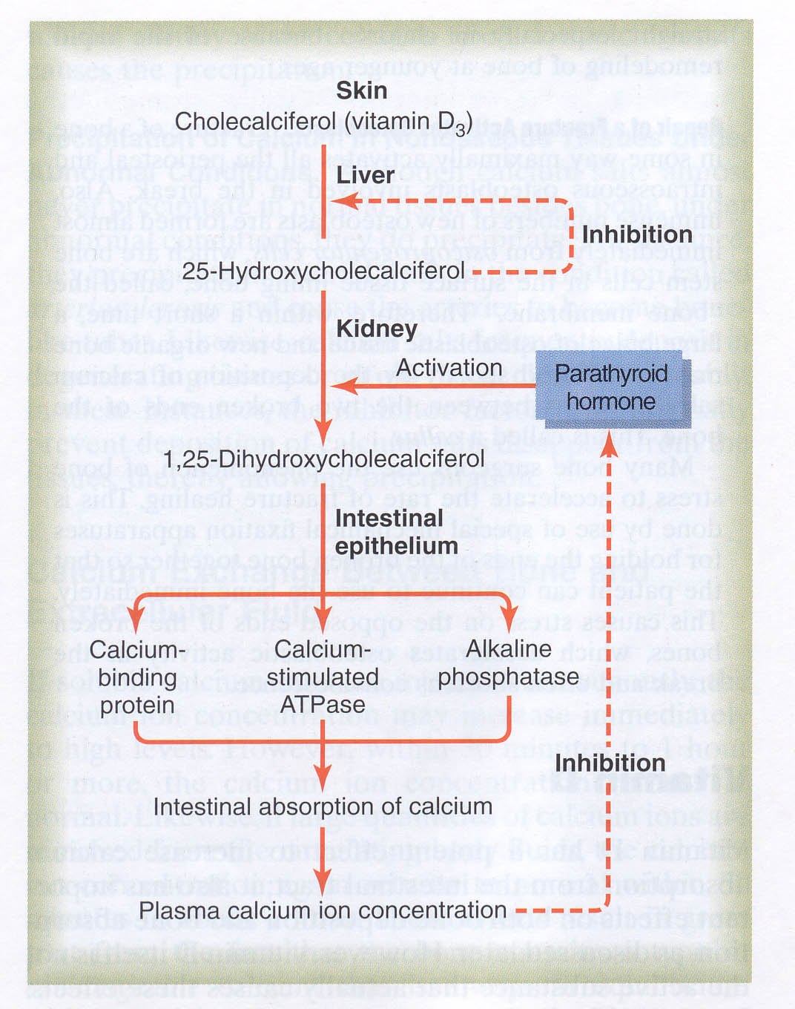
Vitamin D3 and Calcium Control

Slide 14
Vitamin D3 promotes intestinal calcium absorption
Vitamin D3 acts via steroid hormone like receptor to increase transcriptional and translational activity
One gene product is calcium-binding protein (CaBP)
CaBP facilitates calcium uptake by intestinal cells
Estrogen, prolactin and growth hormone also stimulate 1α -hydroxylase thus increasing Ca absorption during pregnancy, lactation and growth

Slide 15
Vitamin D3 Actions on Bones
Another important target for 1,25-(OH)₂-D3 is the bone.
Osteoblasts, but not osteoclasts have vitamin D3 receptors.
1,25-(OH)₂-D3 acts on osteoblasts which produce a paracrine signal that activates osteoclasts to resorb Ca⁺⁺ from the bone matrix.
1,25-(OH)₂-D3 also stimulates osteocytic osteolysis.
In its absence, excess osteoid accumulates from lack of 1,25-(OH)₂-D3 repression of osteoblastic collagen synthesis.
Inadequate supply of vitamin D3 results in rickets, a disease of bone deformation

Slide 16
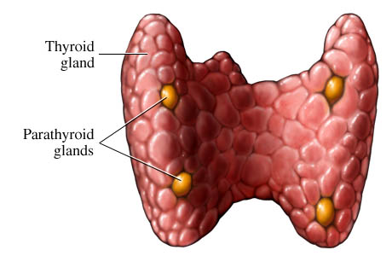
):
Parathyroid hormone (PTH
It is synthesised as pre-pro-PTH(115aa) and is
cleaved to pro-PTH(90aa) with cleavage before
secretion of PTH(84aa).
Intact PTH T_{1/2} 3-4 mins
Normal levels 1.3 – 6.8 pmol/L
Secreted from the chief cells of the parathyroid glands.
Function:
Increase renal phosphate excretion , and increases plasma calcium by:
Increasing osteoclastic resorption of bone (occurring rapidly).
Increasing intestinal absorption of calcium (a slower response).
Increasing synthesis of 1,25-(OH)2D3 (stimulating GIT absorption).
Increasing renal tubular reabsorption of calcium

Slide 17
PTH action
The overall action of PTH is to increase plasma Ca⁺⁺ levels and decrease plasma phosphate levels.
PTH acts directly on the bones to stimulate Ca⁺⁺ resorption and kidney to stimulate Ca++ reabsorption in the distal tubule of the kidney and to inhibit reabosorptioin of phosphate (thereby stimulating its excretion).
PTH also acts indirectly on intestine by stimulating 1,25-(OH)₂-D synthesis.
PTH indirectly increases Calcium absorption from GIT

Slide 18
Regulation of PTH
The dominant regulator of PTH is plasma Ca²⁺.
Secretion of PTH is inversely related to [Ca²⁺].
Maximum secretion of PTH occurs at plasma Ca²⁺ below 3.5 mg/dL.
At Ca²⁺ above 5.5 mg/dL, PTH secretion is maximally inhibited.
PTH secretion responds to small alterations in plasma Ca²⁺ within seconds.
A unique calcium receptor within the parathyroid cell plasma membrane senses changes in the extracellular fluid concentration of Ca²⁺.
This is a typical G-protein coupled receptor that activates phospholipase C and adenylate cyclase—result is increase in intracellular Ca²⁺ via generation of inositol phosphates and decrease in cAMP which prevents exocytosis of PTH from secretory granules.
When Ca²⁺ falls, cAMP rises and PTH is secreted.
1,25-(OH)₂-D inhibits PTH gene expression, providing another level of feedback control of PTH.
Despite close connection between Ca²⁺ and PO₄, no direct control of PTH is exerted by phosphate levels.

Slide 19
Calcitonin
This is produced from the C-cells of the thyroid.
Ploypeptide(32 aa) , MW 35KD , T_{1/2} 10 mins
The major stimulus of calcitonin secretion is a rise in plasma Ca⁺⁺ levels
Calcitonin is a physiological antagonist to PTH with regard to Ca⁺⁺ homeostasis
The target cell for calcitonin is the osteoclast.
Calcitonin acts via increased cAMP concentrations to inhibit osteoclast motility and cell shape and inactivates them.
The major effect of calcitonin administration is a rapid fall in Ca²⁺ caused by inhibition of bone resorption.

Slide 20
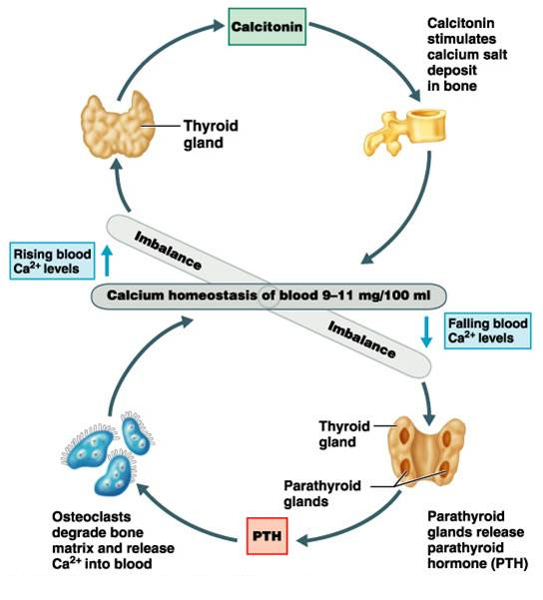

Slide 21
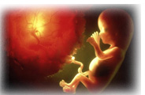
Biochemistry & Pharmacology Journal
Related Journals
Biochemistry & Physiology
Biochemistry & Analytical
Biochemistry
Biomolecular Research & Therapeutics
Plant Biochemistry and Physiology

Slide 22
For more details on Conferences related to Biochemistry & Pharmacology: Open Access journal please visit the link given below
www.conferenceseries.com/pharmaceutical-sciences-meetings

Slide 23
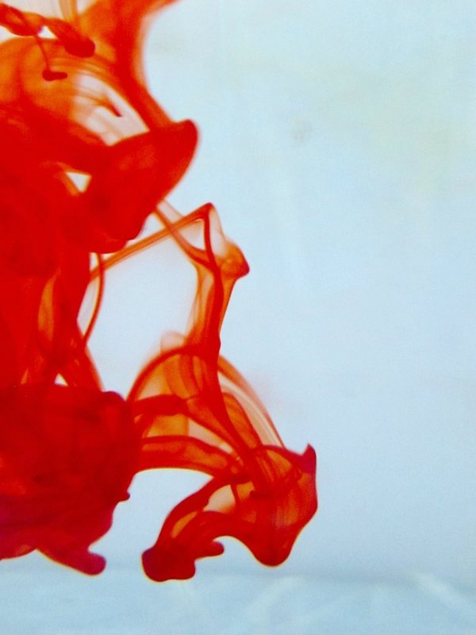
OMICS International Open Access Membership
Open Access Membership with OMICS International enables academic and research institutions, funders and corporations to actively encourage open access in scholarly communication and the dissemination of research published by their authors.
For more details and benefits, click on the link below:
http://omicsonline.org/membership.php

