Slide 1
Editor
Journal of Transplantation Technologies & Research
Maroun Miled Abou-Jaoude, MD
Professor of surgery
Lebanese University
Lebanon

Slide 2
Biography:
Graduated in medicine from St-Joseph University - Lebanon 1984, than trained in General Surgery, Laparoscopic Surgery and Multi-Organ Transplant Surgery in Canada FRCS©, FACS, FICS and American board of Surgery Professor of surgery at both the Lebanese University and Balamand, University - Lebanon Hold a total of 13 international and 3 national degrees and diplomas. Recipient of 8 national and international awards Member of more than 26 international and national academic and professional societies and member of the editorial board of “International Surgery” Journal Scientific achievements: More than 45 scientific publications, 2 book reviews, more than 100 medical abstracts and more than 130 medical presentations in national and international medical meetings Involved as a Fellow in London, Canada, in performing the first successful combined liver-small bowel transplantation in the world. November 1988 I succeeded to perform the first living-related lung transplant in the Middle-East August 1997 at St-Georges Hospital, Beirut, Lebanon combined Lebanese-French team. I succeeded to perform the first combined Kidney-Pancreas transplant in Lebanon November 1999 at St-Georges Hospital, Beirut, Lebanon.

Slide 3
Research Interest:
Cardiothoracic Surgery
Lung Transplantation.

Slide 4
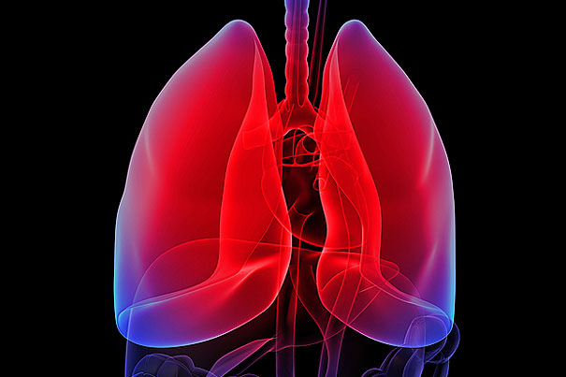
Pulmonary Transplantation:
Pulmonary Transplantation is a technique of transferring lung from a healthy individual to a patient with end-stage lung disease.

Slide 5
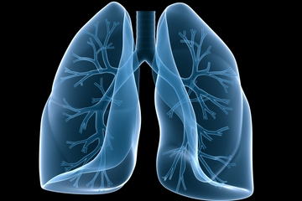
Pulmonary Transplantation is the ultimate treatment of choice for patients with end stage lung disease as it offers better long term survival and quality of life compared to therapeutics.

Slide 6
Criteria for Lung Donor:
There should not be any evidence of preexisting pulmonary diseases
Donor should not contain any transmissible diseases.

Slide 7
Donor should have the relative or similar blood group.
They should have excellent medical condition with normal lung function.
Donor should not have the age above 70 years.

Slide 8
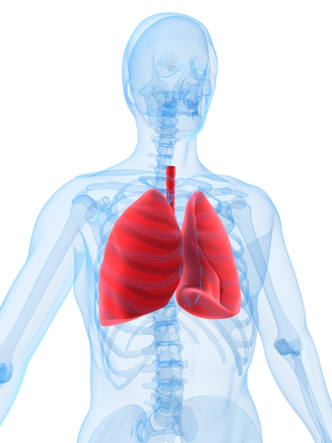
The first human pulmonary transplant was performed in a patient with bronchogenic carcinoma who died because of renal failure after 18 days of pulmonary transplantation in 1963.

Slide 9
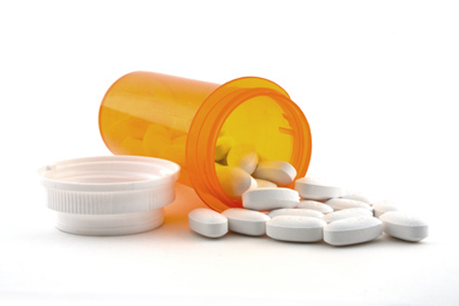
Pulmonary transplantation is the therapeutic option for patients with severe pulmonary disease who are refractory to medical therapy.

Slide 10
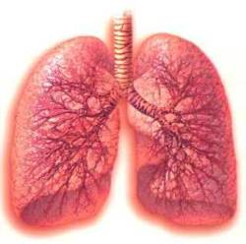
The most common form of interstitial lung disease of unknown origin
is idiopathic pulmonary fibrosis.

Slide 11
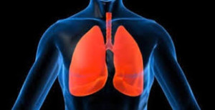
Pulmonary transplantation has become one of the treatments of choice for patients with advanced idiopathic pulmonary fibrosis.

Slide 12
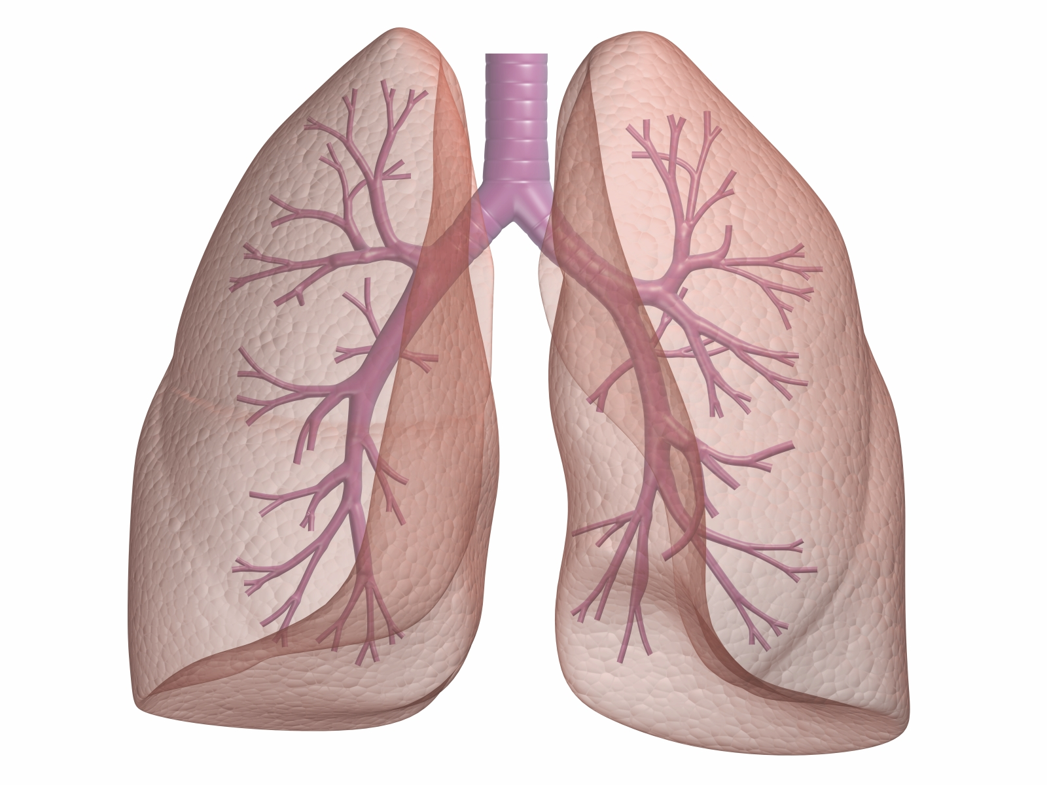
Pulmonary transplant has been the preferable treatment for above 40 years for several end-stage respiratory diseases.

Slide 13
Blood loss during pulmonary transplantation is a most complex issue affected not only by the clotting reserve

Slide 14
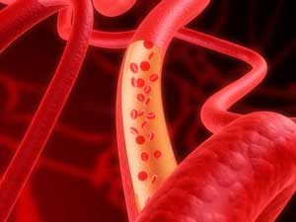
but also by operative methods and presence of other factors like portal hypertension which may play a vital role in the bleeding tendency of the patients.

Slide 15
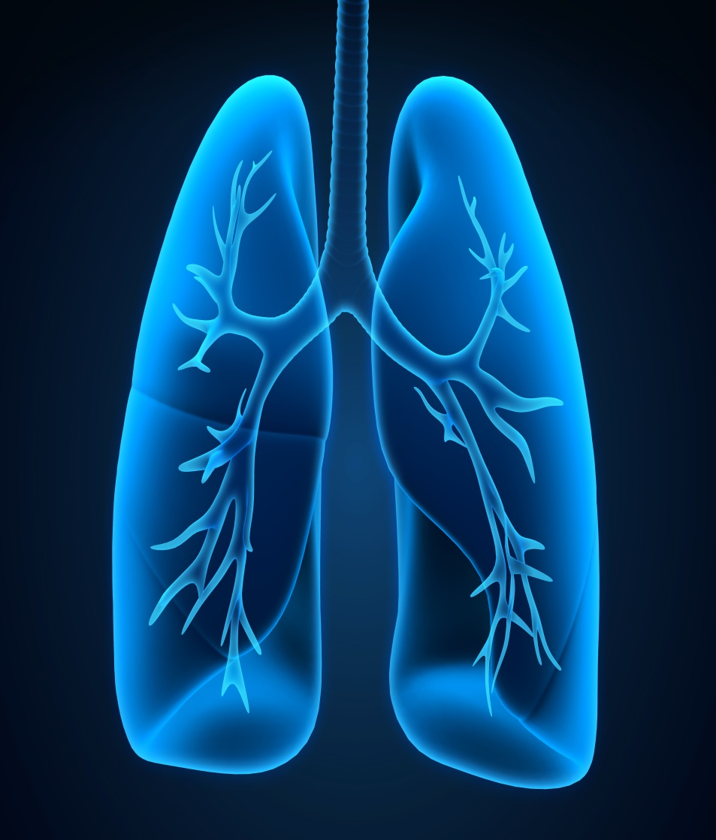
Although pulmonary transplantation is the most favorable method, it should be considered for patients with progressive lung
disease only when no other options are available.

Slide 16
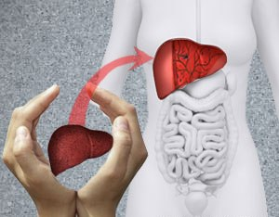
Transplantation Technologies & Research Related Journals
Hair: Therapy & Transplantation
Liver: Disease & Transplantation
Surgery: Current Research

Slide 17
Transplantation Technologies & Research Related Conferences
4th International Conference on Surgery and Anesthesia
World Summit on Pediatric Cardiology and Cardiac Surgery

