Slide 1


OMICS international
OMICS International through its Open Access Initiative is committed to make genuine and reliable contributions to the scientific community. OMICS International hosts over 700 leading-edge peer reviewed Open Access Journals and organizes over 1000 International Conferences annually all over the world. OMICS International journals have over 10 million readers and the fame and success of the same can be attributed to the strong editorial board which contains over 50000 eminent personalities that ensure a rapid, quality and quick review process. OMICS International signed an agreement with more than 1000 International Societies to make healthcare information Open Access.
Contact us at: contact.omics@omicsonline.org

Slide 2

OMICS Journals are welcoming Submissions
OMICS International welcomes submissions that are original and technically so as to serve both the developing world and developed countries in the best possible way.
OMICS Journals are poised in excellence by publishing high quality research. OMICS International follows an Editorial Manager® System peer review process and boasts of a strong and active editorial board.
Editors and reviewers are experts in their field and provide anonymous, unbiased and detailed reviews of all submissions.
The journal gives the options of multiple language translations for all the articles and all archived articles are available in HTML, XML, PDF and audio formats. Also, all the published articles are archived in repositories and indexing services like DOAJ, CAS, Google Scholar, Scientific Commons, Index Copernicus, EBSCO, HINARI and GALE.
For more details please visit our website: http://omicsonline.org/Submitmanuscript.php

Slide 3


Editorial Board
Mauro Prato
Professor
University of Turin
Italy

Slide 4
Biography
Dr. Mauro Prato attended from 1996 to 2001 the School of Biotechnology at the University of Turin, Italy, achieving the Graduate Degree in Medical Biotechnology ( final grade: 110 out of 110, with honors and print dignity) with a final dissertation titled "Anti-angiogenetic role of IL12: in vitro study of the matrix metalloproteinases (MMPs) activity", performed at the Molecular Angiogenesis Division of the Institute for Research and Therapy of Cancer of Candiolo, Torino, Italy. From 2001 to 2005 he attended PhD studies in Biochemistry and Cellular Biotechnology at the University of Torino achieving the PhD Degree in Biochemistry and Cellular
> > >

Slide 5
Biotechnology with a final dissertation titled "Involvement of matrix metalloproteinases in malaria pathology; study of the MMP-9-mediated regulation of TNFalpha and IL-1beta in human monocytes and their environment after phagocytosis of hemozoin", performed at the Biochemistry Division of the Department of Genetics, Biology and Biochemistry, Medical School, University of Turin, Italy. Since then, he has covered post-doc positions at the University of Torino (2005-2012: Dept. of Genetics, Biology and Biochemistry; 2012-today: Dept. of Neuroscience).
.

Slide 6
Since 2008, he has also been nominated Adjunct Professor of Biochemistry at the Medical School of the University of Torino. His major research interests cover biochemistry and neuroscience fields, including cerebral malaria. In 2005, he firstly demonstated the hemozoin-dependent involvement of matrix metalloproteinases in malaria, hopefully opening a new research field for new antimalarial drugs. Up to now he has published 23 papers (15 full articles, 6 abstracts, 1 letter and 1 editorial) in peer-reviewed international journals, 3 chapters in peer-reviewed international books and 51 communications (19 talks and 32 posters) in well-established national/international conferences.

Slide 7
Mauro Prato research interest include Role of human matrix metalloproteinases in malaria, Oxygen-loaded nanobubbles as therapeutic tools for hypoxia-related diseases

Slide 8
Publications
Blood-Brain Barrier and Cerebral Malaria: The Road So Far
Mauro Prato
Increased TIMP Levels in Malaria Patients: Risk or Protective Factors?
Mauro Prato

Slide 9
Human and Mosquito Lysozymes in Malaria: Old Molecules for New Approaches towards Diagnosis, Therapy and Vector Control
Mauro Prato
New Perspectives for Adjuvant Therapy in Severe Malaria
Mauro Prato and Giuliana Giribaldi

Slide 10

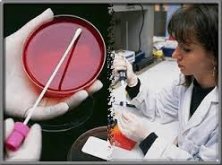
Journal of Air & Water Borne Diseases
Related Journals
Journal of Bacteriology & Parasitology
Journal of Medical Microbiology & Diagnosis
Journal of Microbial & Biochemical Technology
Journal of Plant Pathology & Microbiology
Journal of Vaccines & Vaccination

Slide 11

Journal of Air & Water Borne Diseases
Related Conferences
Allergy Conference
4th Bacteriology and Infectious Diseases Conference
2nd Infectious Diseases Congress

Slide 12
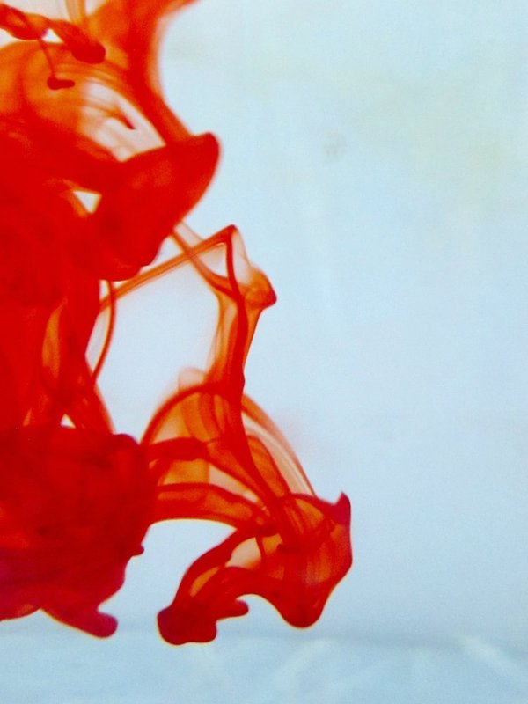

OMICS International Open Access Membership
OMICS International Open Access Membership enables academic and research institutions, funders and corporations to actively encourage open access in scholarly communication and the dissemination of research published by their authors.
For more details and benefits, click on the link below:
http://omicsonline.org/membership.php

