Slide 1
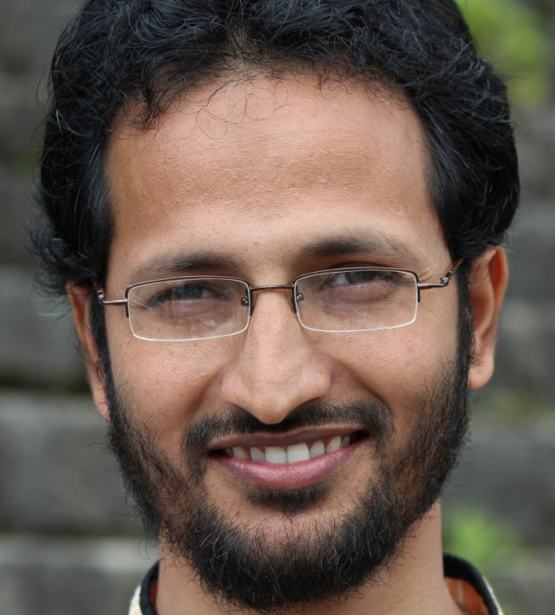
Md. Mamunur Rahman (Monir)
Senior Scientific Officer (SSO)
Farm Management Division
Bangladesh Rice Research Institute (BRRI)
Gazipur-1701, Bangladesh
Email: rahmanmmamunur@gmail.com
Website: http://www.mmamunurrahman.webs.com

Slide 2
Areas of expertise
Environmental science
Molecular biology
Rice Farm Management

Slide 3
Background
Md. Mamunur Rahman graduated (B.Sc.Ag.(Hons.)) from Patuakhali Science and Technology University, Bangladesh in 2006. He completed Masters degree from Bangabandhu Sheikh Mujibor Rahman Agricultural University, Gazipur, Bangladesh in 2010 majoring in Genetics and Plant Breeding. He completed PhD from Kanazawa University, Japan in Environmental Sciences in 2013.

Slide 4
Background
He has been working as a scientist in the division of Farm Management in Bangladesh Rice Research Institute since 2007.
He is the author of one book, one book chapter and has published 28 research articles in different journals.

Slide 5
OMICS International
OMICS international Membership enables academic and research institutions, funders and corporations to actively encourage open access in scholarly communication and the dissemination of research published by their authors.
For more details and benefits, click on the link below:
http://omicsonline.org/membership.php

Slide 6
THANK YOU

