Slide 1




Dr. Mohammad Najafi
Iran University of Medical Sciences
DATA
Introductory For Bioinformatics
DATA
DATA
DATA
DATA
DATA
DATA
DATA
DATA

Slide 2
DATA
DATA
DATA
DATA
DATA
BIOINFORMATICS BIOINFOEMATICS
DATA
DATA
ِDavid Roos: “We are swimming in rapidly rising of data …..how do we help from drowning?”
DATA
DATA

Slide 3
DATA
DATA
DATA
”..We must hook our individual computers into the worldwide network that gives us access to daily changes in the databases and also makes immediate our communications with each other……….. The programs that display and analyze the material for us must be improved - and we must learn to use them more effectively. Like the purchased kits, they will make our life easier, but also like the kits, we must understand enough of how they work to use them effectively…”
Walter Gilbert (1991)
“Towards a paradigm shift in biology” Nature News and Views 349:99
DATA
DATA
DATA
DATA
DATA
DATA

Slide 4
DATA
DATA
DATA
DATA
DATA
BIOINFORMATICS
The field of science is in which Biology ,Computer science and Informational technology merge to form a single discipline
DATA
DATA
DATA
DATA

Slide 5
DATA
DATA
DATA
DATA
DATA
Bioinformatics
The creation and advancement of algorithms, computational and statistical techniques for management and analysis of biological data.
Clinical Bioinformatics
The hypothesis driven of a medical subject using computers and carried out with experiment.
DATA
DATA
DATA
DATA

Slide 6
To computerize the current knowledge of molecular interactions
Metabolic pathways
Regulatory pathways
Molecular assemblies
DATA
DATA
Biochemical Pathways
DATA
DATA
DATA
DATA
DATA
DATA
DATA

Slide 7
DATA
DATA
DATA
DATA
DATA
Current servers
BioCarta
KEGG
MetaCyc
DATA
DATA
DATA
DATA

Slide 8
DATA
DATA
Sectors and Subsectors
DATA
DATA
DATA
DATA
DATA
DATA
DATA

Slide 9

DATA
DATA
Gene Databases
DATA
DATA
DATA
BioCarta
KEEG
MetaCyc
DATA
DATA
DATA
DATA

Slide 10
DATA
DATA
Protein Database
DATA
DATA
DATA
PIR (Protein Information Resource)
PDB (Protein Data Bank)
HPRD (Human Protein Reference Database)
DATA
DATA
DATA
DATA

Slide 11
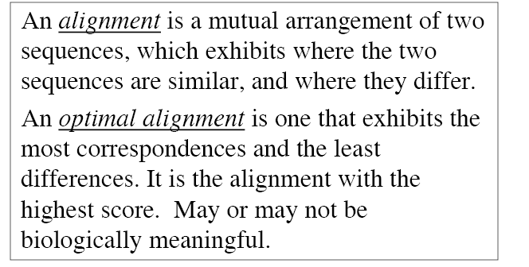
DATA
DATA
DATA
DATA
DATA
ALIGNMENT
DATA
DATA
DATA
DATA

Slide 12
DATA
DATA
DATA
DATA
Similarity between two sequences
DATA
Global
Local
DATA
DATA
DATA
DATA

Slide 13
DATA
DATA
DATA
DATA
what is the best alignment between the two sequences?
DATA
DATA
How should alignments be scored?
How should gaps be scored?
DATA
DATA
DATA

Slide 14
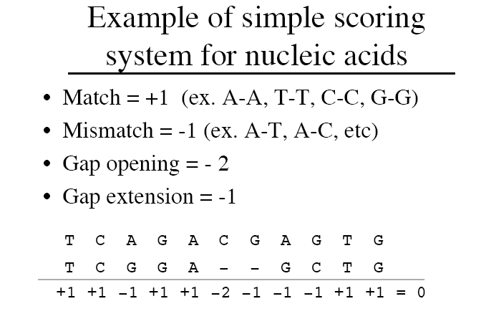
DATA
DATA
DATA
DATA
Scoring system for nucleic acids
DATA
Match = +1 (ex; A-A, T-T, C-C, G-G)
Mismatch = -1(ex; A-T, A-C, etc.)
DATA
DATA
DATA
DATA

Slide 15
DATA
DATA
DATA
DATA
PAM-Point Accepted Mutation
[Evolutionary Model]
DATA
Margaret Dayhoff, 1978
related proteins
DATA
DATA
DATA
DATA

Slide 16
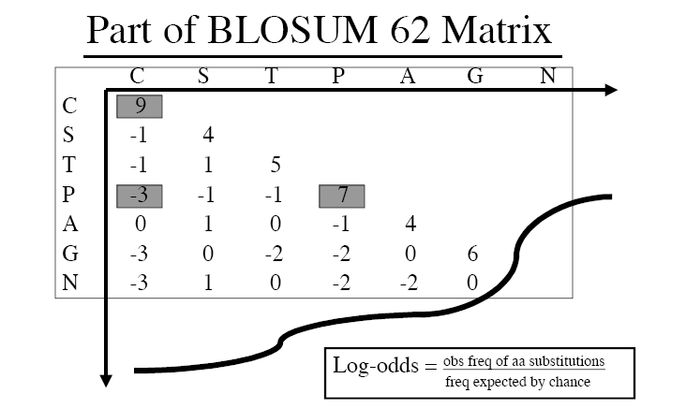
DATA
DATA
DATA
BLOSUM-Block Substitutions
[Conserved Sequence]
DATA
DATA
Henikoff and Henikoff, 1992
conserved, ungapped regions of a protein family
DATA
DATA
DATA
DATA

Slide 17
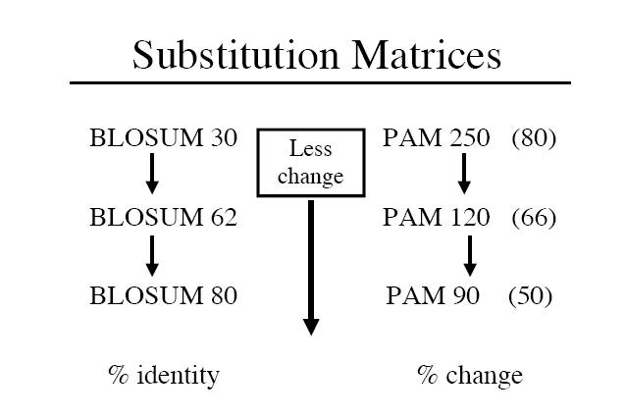
DATA
DATA
DATA
DATA
DATA
DATA
DATA
DATA
DATA

Slide 18
DATA
DATA
DATA
DATA
DATA
DATA
DATA
DATA
DATA

Slide 19
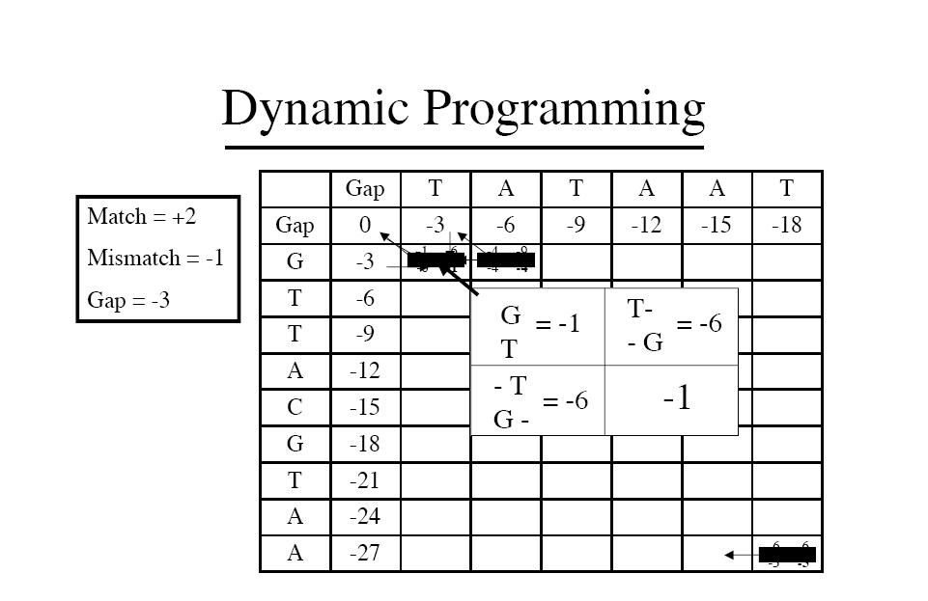

Slide 20
DATA
DATA
Alignment Tools
DATA
DATA
DATA
Pairwise alignment
BLAST
FASTA
Dot Plat
Multiple sequence alignment (MSA)
Induced pairwise method
Progressive method
Statistical Value
Graph
DATA
DATA
DATA
DATA

Slide 21
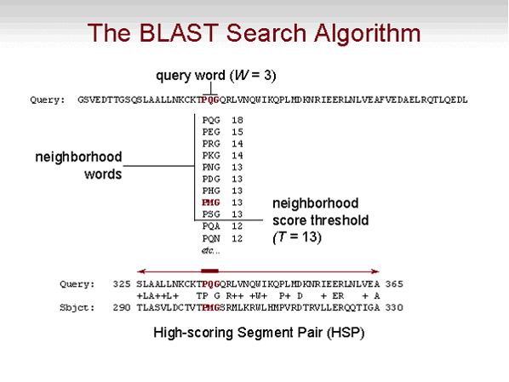
DATA
DATA
DATA
DATA
DATA
DATA
DATA
DATA
DATA

Slide 22
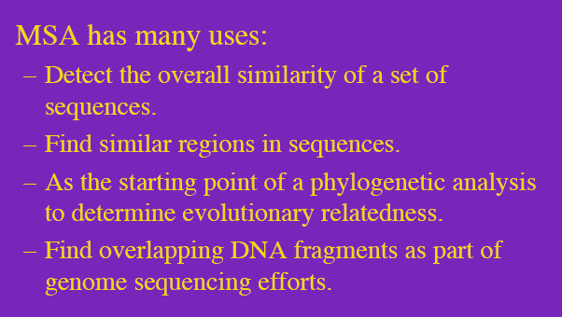
DATA
DATA
Multiple Sequence Alignment
DATA
DATA
DATA
DATA
DATA
DATA
DATA

Slide 23
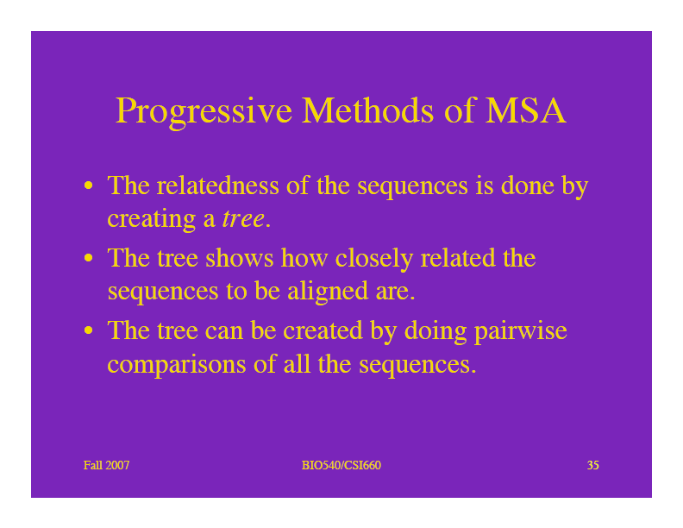
DATA
DATA
Progressive Method
(MSA)
DATA
DATA
DATA
DATA
DATA
DATA
DATA

Slide 24
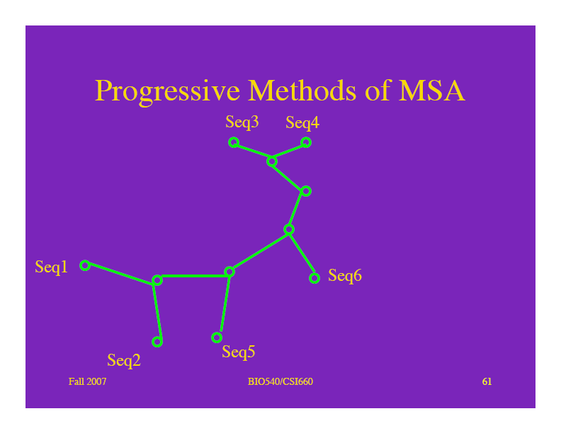
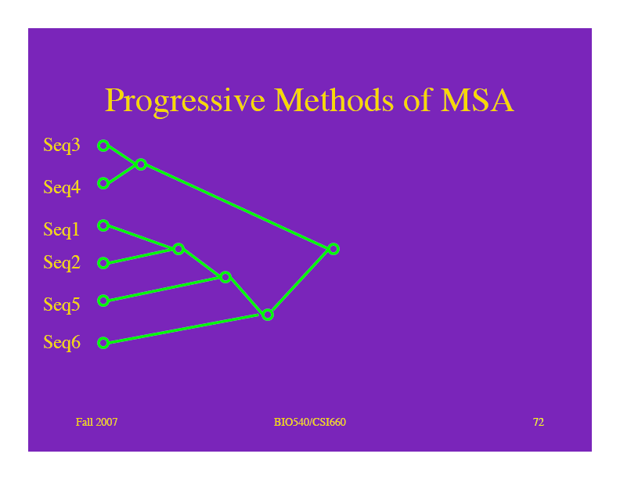
DATA
DATA
Progressive Method
(Tree)
DATA
DATA
DATA
DATA
DATA
DATA
DATA

Slide 25
DATA
DATA
DATA
Secondary Protein Database
DATA
DATA
The Fruits of analyses of the sequences that exit within the
primary sources
DATA
DATA
DATA
DATA

Slide 26
DATA
DATA
DATA
Secondary Protein Database
DATA
DATA
PS | Prosite
BL | blocks
PD | Prodom
PR | prints
IPR | Interpro
PF | pfam
DATA
DATA
DATA
DATA

Slide 27
DATA
DATA
DATA
DATA
Gene Regulation Databases
DATA
Related to compilation of
DNA Elements
&
Protein Regulatory Factors
DATA
DATA
DATA
DATA

Slide 28
DATA
DATA
DATA
DATA
Gene Regulation Databases
DATA
Promoter region
    The element of bind with polymerase II
        - EPD
    The sequence beyond TATA box
    - TRRD
    -TRANCFAC
DATA
DATA
DATA
DATA

Slide 29
DATA
DATA
DATA
DATA
DATA
Genomics
Gene Prediction
ab initio
Homology
Consensus
DATA
DATA
DATA
DATA

Slide 30
DATA
DATA
DATA
DATA
DATA
Proteomics
Mapping protein expression to estimate what’s actually happing in tissue following intervention
DATA
DATA
DATA
DATA

Slide 31
DATA
DATA
Proteome analysis
DATA
DATA
DATA
A procedure for purification
        2-DE
A method to determine structural information
        Sequencing
        Ms
Use of databases
        genebank
Prediction of functional information
using annotations
DATA
DATA
DATA
DATA

Slide 32
References
Najafi M,Jangravi Z. Human PON promoters: from similarity to prediction of polymorphic positions within transcription factor elements. Mini Rev Med Chem. 2010 Sep;10(10):938-45.
Najafi M, Roustazadeh A. Scoring of Matrix Gla protein (MGP) promoter variants within predicted transcription elements. IWBBIO 2013, 393-395.
Najafi M, Alipoor B, Shabani M, Amirfarhangi A, Ghasemi H.Association between rs4673 (C/T) and rs13306294 (A/G) haplotypes of NAD(P)H oxidase p22phox gene and severity of stenosis in coronary arteries. Gene. 2012 10;499(1):213-7.
Najafi M, Roustazadeh A, Alipoor B. Ox-LDL Particles: Modified components, Cellular uptake, Biological roles and Clinical assessments. Cardiovasc Hematol Disord Drug Targets. 2011 Oct 26.
Najafi M, Bioinformatics Tools as Power Hypothetical Predictors.
Biochem Physiol 2012 1:e113.

Slide 33


OMICS International
www.omicsonline.org
OMICS International (and its subsidiaries), is an Open Access publisher and international conference Organizer, which owns and operates peer-reviewed Clinical, Medical, Life Sciences, and Engineering & Technology journals and hosts scholarly conferences per year in the fields of clinical, medical, pharmaceutical, life sciences, business, engineering, and technology. Our journals have more than 3 million readers and our conferences bring together internationally renowned speakers and scientists to create exciting and memorable events, filled with lively interactive sessions and world-class exhibitions and poster presentations. Join us!
OMICS International is always open to constructive feedback. We pride ourselves on our commitment to serving the Open Access community and are always hard at work to become better at what we do. We invite your concerns, questions, even complaints. Contact us at contact.omics@omicsonline.org. We will get back to you in 24-48 hours. You may also call 1-800-216-6499 (USA Toll Free) or at +1-650-268-9744 and we will return your call in the same timeframe.
Contact us at: contact.omics@omicsonline.org

Slide 34


Biochemistry & Physiology: Open Access
Related Journals
Biochemistry & Pharmacology: Open Access
Biochemistry & Analytical Biochemistry
Journal of Plant Biochemistry & Physiology

Slide 35

Biochemistry & Physiology: Open Access
Related Conferences
http://www.omicsonline.org/international-scientific-conferences/

Slide 36


OMICS Group Open Access Membership
OMICS publishing Group Open Access Membership enables academic and research institutions, funders and corporations to actively encourage open access in scholarly communication and the dissemination of research published by their authors.
For more details and benefits, click on the link below:
http://omicsonline.org/membership.php

