Slide 1
Nathalie R. Le Francois
Associate Professor
Oceanography, ecophysiology of fish, aquaculture / conservation
Montreal Biodome Division-living collections and research
Space for Life
Canada

Slide 2
Actual research activities
Funding Antarctica USAP/National Science Fondation
Detrich, Postletwaith, Le François, Desvignes et al.
-Embryogenesis of Notothenia coriiceps exposed to different rearing temperature.
-Semen characterization and cryoconservation of Notothenioidei species (Chaenocephalus aceratus, Notothenia coriiceps).

Slide 3
Funding CRSNG\FQRNT\MITACS\SABM\AIF
Le François, Blier, Lamarre, Vandenberg, Bailey, Imsland et Gunnarsson et al.
-Physiological adjustments induced by compensatory growth in Arctic Charr
-Cryoconservation
-Comparative genetics (Nauyuk, Fraser, Holar)

Slide 4
Blier, Dufresne, Le François, Vandenberg et al.
-Development of Arctic charr strains and hybrids
-Omega-3 and antioxidative capacities in charr (S. alpinus and S. fontinalis).
Le François, Tamigneaux, Dufresne, Blier et al.
-Macroalgae biofiltration in large volume saltwater recirculation system.
-Sulfur denitrification

Slide 5
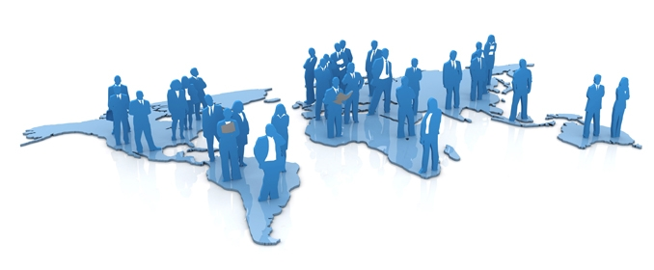
OMICS Group Open Access Membership
OMICS International Membership enables academic and research institutions, funders and corporations to actively encourage open access in scholarly communication and the dissemination of research published by their authors.
For more details and benefits, click on the link below:
http://omicsonline.org/membership.php

