Slide 1
OMICS international
OMICS International through its Open Access Initiative is committed to make genuine and reliable contributions to the scientific community. OMICS International hosts over 700 leading-edge peer reviewed Open Access Journals and organizes over 1000 International Conferences annually all over the world. OMICS International journals have over 10 million readers and the fame and success of the same can be attributed to the strong editorial board which contains over 50000 eminent personalities that ensure a rapid, quality and quick review process. OMICS International signed an agreement with more than 1000 International Societies to make healthcare information Open Access.
Contact us at: contact.omics@omicsonline.org

Slide 2
OMICS Journals are welcoming Submissions
OMICS International welcomes submissions that are original and technically so as to serve both the developing world and developed countries in the best possible way.
OMICS Journals are poised in excellence by publishing high quality research. OMICS International follows an Editorial Manager® System peer review process and boasts of a strong and active editorial board.
Editors and reviewers are experts in their field and provide anonymous, unbiased and detailed reviews of all submissions.
The journal gives the options of multiple language translations for all the articles and all archived articles are available in HTML, XML, PDF and audio formats. Also, all the published articles are archived in repositories and indexing services like DOAJ, CAS, Google Scholar, Scientific Commons, Index Copernicus, EBSCO, HINARI and GALE.
For more details please visit our website: http://omicsonline.org/Submitmanuscript.php

Slide 3
Editor
JBR Journal of Interdisciplinary Medicine and Dental Science
Nissaf Daouahi
Department of Fixed Prosthodontics
Faculty of Dentistry
Monastir University
Tunisia

Slide 4
Biography:
Nissaf Daouahi belongs to the Department of Fixed Prosthodontics and she is working with Monastir University, Tunisia, as faculty of dentistry. Her Research mainly focuses on implantology and prosthodontics.

Slide 5
Research Interest:
Implantology
Prosthodontics

Slide 6
Publications:
Daouahi N, Hadyaoui D, Cherif M (2015) Bonding of all Ceramic Restorations. Dentistry 5: 338.

Slide 7
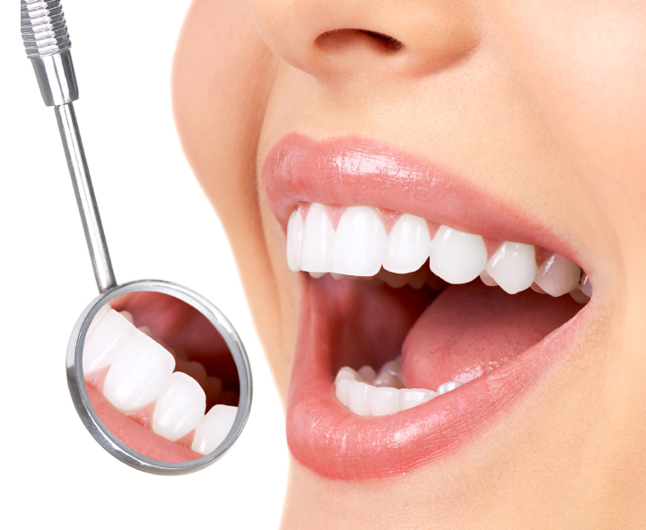
JBR Journal of Interdisciplinary Medicine and Dental Science
Related Journals
Journal of Orthodontics & Endodontics
Dentistry
Journal of Dental Sciences
Dental Health: Current Research
Oral Health Case Reports
Journal of Oral Hygiene & Health
Oral Health and Dental Management
Dental Implants and Dentures: Open Access

Slide 8
JBR Journal of Interdisciplinary Medicine and Dental Science Related Conferences
7th International Conference and Exhibition on Dentistry & Oral Care
International Conference on Orthodontics and Dental Implants
9th World Dental Congress
International Conference on Periodontics and Prosthodontics
10th World Dental Convention and Expo
11th Asia Pacific Congress & Expo on Dental and Oral Health
12th International Conference on Dental Medicine
16th Euro Congress onDental & Oral Health

Slide 9
OMICS International Open Access Membership
OMICS International Open Access Membership enables academic and research institutions, funders and corporations to actively encourage open access in scholarly communication and the dissemination of research published by their authors.
For more details and benefits, click on the link below:
http://omicsonline.org/membership.php

