Slide 1
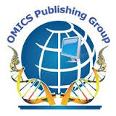
OMICS Group
OMICS Group International through its Open Access Initiative is committed to make genuine and reliable contributions to the scientific community. OMICS Group hosts over 400 leading-edge peer reviewed Open Access Journals and organizes over 300 International Conferences annually all over the world. OMICS Publishing Group journals have over 3 million readers and the fame and success of the same can be attributed to the strong editorial board which contains over 30000 eminent personalities that ensure a rapid, quality and quick review process. OMICS Group signed an agreement with more than 1000 International Societies to make healthcare information Open Access.
Contact us at: contact.omics@omicsonline.org

Slide 2
OMICS Journals are welcoming Submissions
OMICS Group welcomes submissions that are original and technically so as to serve both the developing world and developed countries in the best possible way.
OMICS Journals are poised in excellence by publishing high quality research. OMICS Group follows an Editorial Manager® System peer review process and boasts of a strong and active editorial board.
Editors and reviewers are experts in their field and provide anonymous, unbiased and detailed reviews of all submissions.
The journal gives the options of multiple language translations for all the articles and all archived articles are available in HTML, XML, PDF and audio formats. Also, all the published articles are archived in repositories and indexing services like DOAJ, CAS, Google Scholar, Scientific Commons, Index Copernicus, EBSCO, HINARI and GALE.
For more details please visit our website: http://omicsonline.org/Submitmanuscript.php

Slide 3
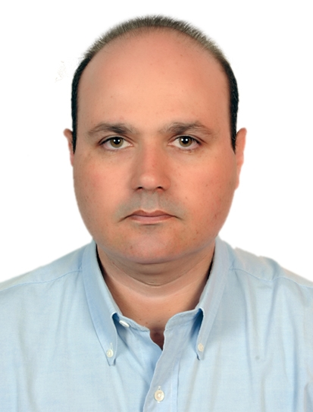
Omar Abd El Sadek El Meligy
Executive Editor
Journal of Oral Hygiene & Health

Slide 4
Biography
Dr. Omar El Meligy is a Professor of Pediatric Dentistry at King Abdulaziz and Alexandria Universities. He received his B.D.S. (1990), M. Sc. (1995) and Ph. D. (2001) from Alexandria University, Egypt and became a Lecturer of Pediatric Dentistry at Alexandria University.
He was a Research Scholar in School of Dentistry, Indiana University, USA from 1998 till 2000. After his three-year career as a lecturer at the Faculty of Dentistry, Alexandria University, he moved to Jeddah, Saudi Arabia, where he was offered a position at King Abdulaziz University.
In addition to teaching, treating patients and conducting research, he is a contributor in the books Principles of Pediatric Dentistry and Pulpal Response Following Pulpotomy. Currently he resides in Jeddah, Saudi Arabia.

Slide 5
Research Interest
His research interests are in pulp therapy and restorative and Pediatric dentistry.

Slide 6
Recent Publications
Sulaiman Mohammed Allazzam, Sumer Madani Alaki, Omar Abdel Sadek El Meligy (2014) Molar incisor hypomineralization, prevalence, and etiology. Int J Dent 2014 8;2014:234508. Epub 2014 May 8.
DR. OMAR ABDEL SADEK EL MELIGY*, DR. DAVID R. AVERY** (2007) Comparison of apexification with mineral trioxide aggregate and calcium hydroxide. Saudi Dental Journal 2007;18(SI)-Abstr.038

Slide 7
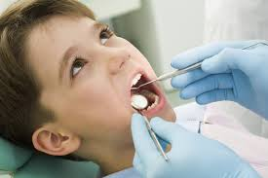
Pediatric dentistry
Pediatric dentistry or paedodontics is the branch of dentistry dealing with children from birth through adolescence.
The specialties recognized by the American Dental Association, Royal College of Dentists of Canada, and Royal Australasian College of Dental Surgeons.

Slide 8
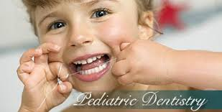
Pediatric dentistry
Pediatric dentists promote the dental health of children as well as serve as educational resources for parents. It is recommended by the American Academy of Pediatric Dentistry (AAPD) and the American Academy of Pediatrics (AAP) that a dental visit should occur within six months after the presence of the first tooth or by a child's first birthday.

Slide 9
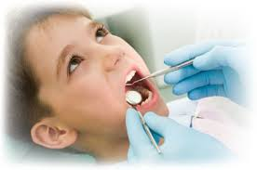
Pediatric dentistry
The AAPD has said that it is important to establish a comprehensive and accessible on-going relationship between the dentist and patient – referring to this as the patient's "dental home".
This is because early oral examination aids in the detection of the early stages of tooth decay.

Slide 10
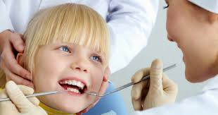
Pediatric dentistry
Early detection is essential to maintain oral health, modify aberrant habits, and treat as needed and as simply as possible.
Additionally, parents are given a program of preventative home care (brushing/flossing/fluorides), a caries risk assessment, information on finger, thumb, and pacifier habits, advice on preventing injuries to the mouth and teeth of children, diet counseling, and information on growth and development.

Slide 11
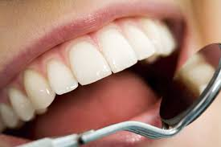
Journal of Oral Health & Hygiene
Oral Cancer
Oral Health
Dentistry
Dental Bonding
Dental caries
Smoking cessation
Pediatric dentistry

Slide 12
Oral Health & Hygiene Related Conferences
International Conference and Exhibition on Dentistry
March 18-20, 2015 Crowne Plaza, Dubai, UAE

Slide 13
OMICS Group Open Access Membership
OMICS publishing Group Open Access Membership enables academic and research institutions, funders and corporations to actively encourage open access in scholarly communication and the dissemination of research published by their authors.
For more details and benefits, click on the link below:
http://omicsonline.org/membership.php

