Slide 1
Petr Dostal
Prof. Ing. Dostál Petr CSc. Professor of Economy and Management Brno University of Technology Faculty of Business and Management Institute of Informatics Czech Republic

Slide 2
BIOGRAPHY
Petr Dostál is a professor of economics and management. He teaches at Brno University of Technology, Czech Republic. His field of interest is the use of soft computing and artificial intelligence such as fuzzy logic, artificial neural networks, evolutionary algorithms, and the theory of chaos in business and public services. As an economic and organisation adviser, he has worked in private firms and institutions. He is a member of international institutions, program and organizing committees, scientific and editorial advisory boards. Editor of Soft Computing Journal – Springer, member of Advisory Board of Egyptian Computer Science Journal, member of Berkeley Initiative in Soft Computing, Society of Computational Economics, Association for Computing Machinery, and member and advisor of International Institution of Forecasters. He gives lectures at various universities at home and abroad. He has published many books and articles in international journals.

Slide 3
Research interest
Fuzzy Logic (FL), - Artificial Neural Networks (ANN)
Genetic Algorithms (GA)
Chaos (CH)
and the combination and classical methods together

Slide 4
Publications
2014
DOSTÁL, P.; SHAMI, A.; LOTFI, A.; COLEMAN, S. Unifed Knowledge Economy Hybrid Forecasting Map. TECHNOLOGICAL FORECASTING AND SOCIAL CHANGE, 2014, vol. 81, no. 1, p. 100-134. ISSN: 0040- 1625.
DOSTÁL, P.; KROPÁČ, J. Correlation between Students Results Obtained during their Studies and at Final State Examinations. TRENDY EKONOMIKY A MANAGEMENTU, 2014, vol. 8, no. 19, p. 9-17. ISSN: 1802- 8527.
DOSTÁL, P.; ŠKAPA, S. Fuzzy Clustering and Loan Risk Evaluation. Advances in Intelligent Systems and Computing, 2014, vol. 289, no. 1, p. 177-184. ISSN: 2194- 5357.

Slide 5
2013
DOSTÁL, P.; PAVELKOVÁ, D. Measuring a Company s Performance: The Identification of Correlation between EVA and Selected Financial Measuring a Companys Performance: The Identification of Correlation between EVA and Selected Financial Indicators with Use of Genetic Algorithm. WSEAS Transactions on Business and Economics, 2013, vol. 10, no. 3,p. 285-293. ISSN: 1109- 9526. Detail
DOSTÁL, P.; BROŽ, Z. Multilingual Dictionary of Forecasting. 1. Brno: CERM, 2013. p. 1-2385. ISBN: 978-80-7204-821- 2. Detail | www
DOSTÁL, P. Soft Computing Methods in Business Optimization. Global Journal of Technology & Optimization, 2013, vol. 4, no. 1, p. 20-21. ISSN: 1985- 9406. Detail
DOSTÁL, P. The Use of Soft Computing in Management. In Handbook of Research on Novel Soft Computing Intelligent Algorithms: Theory and Practical Applications (2 Volumes). 1. USA: IGI Globe, 2013. p. 294-326. ISBN: 9781466644502. Detail | www
DOSTÁL, P. Forecasting of Time Series with Fuzzy Logic. Advances in Intelligent Systems and Computing, 2013, vol. 210, no. 1, p. 155-162. ISSN: 2194- 5357. Detail | www

Slide 6
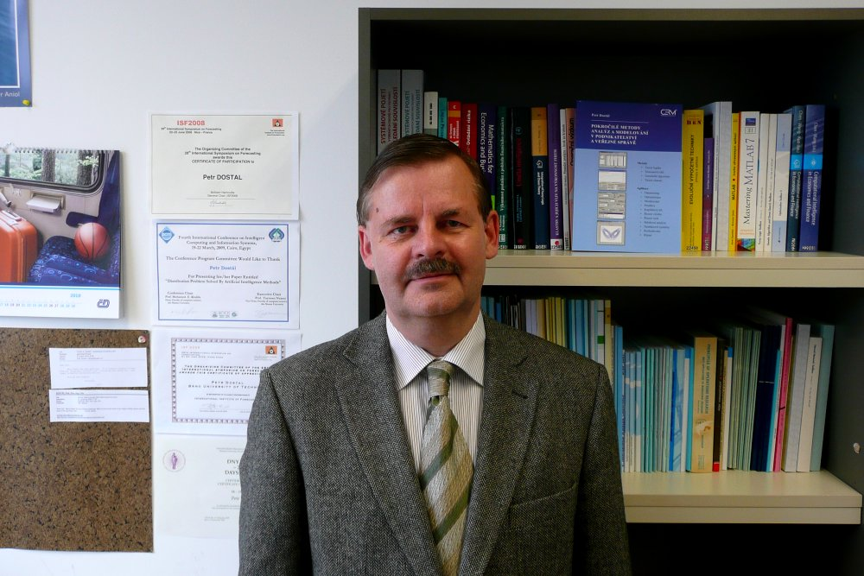
FACULTY OF BUSINESS AND MANAGEMENT Institute of Informatics - professor
Address | Kolejní 2906/4, Královo Pole, 61200, Brno, Česká republika
E-mail | dostal@fbm.vutbr.cz
Work phone | +420 54114 3714
GSM O2 | +420 72681 3714
GSM T-Mobile | +420 60407 3714
Employment contract no. | 01000799

