Slide 1
OMICS Group
OMICS Group International through its Open Access Initiative is committed to make genuine and reliable contributions to the scientific community. OMICS Group hosts over 400 leading-edge peer reviewed Open Access Journals and organizes over 300 International Conferences annually all over the world. OMICS Publishing Group journals have over 3 million readers and the fame and success of the same can be attributed to the strong editorial board which contains over 30000 eminent personalities that ensure a rapid, quality and quick review process. OMICS Group signed an agreement with more than 1000 International Societies to make healthcare information Open Access.
Contact us at: contact.omics@omicsonline.org

Slide 2
OMICS Journals are welcoming Submissions
OMICS Group welcomes submissions that are original and technically so as to serve both the developing world and developed countries in the best possible way.
OMICS Journals are poised in excellence by publishing high quality research. OMICS Group follows an Editorial Manager® System peer review process and boasts of a strong and active editorial board.
Editors and reviewers are experts in their field and provide anonymous, unbiased and detailed reviews of all submissions.
The journal gives the options of multiple language translations for all the articles and all archived articles are available in HTML, XML, PDF and audio formats. Also, all the published articles are archived in repositories and indexing services like DOAJ, CAS, Google Scholar, Scientific Commons, Index Copernicus, EBSCO, HINARI and GALE.
For more details please visit our website: http://omicsonline.org/Submitmanuscript.php

Slide 3
Pramil Tiwari
Editor PPT

Slide 4
Biography
Prof. Pramil Tiwari, M.Pharm., Ph.D., heads the department of Pharmacy Practice at the National Institute of Pharmaceutical Education and Research {NIPER}, Mohali since its inception in 2002. Having completed his education from the Banaras Hindu University, he has a work experience in pharmaceutical academia and industry over the last 25 years.
His most significant contribution is the establishment of the department of pharmacy practice at NIPER, in accordance with the policies of the institute. This has involved engaging with the various stakeholders including the clinicians, students, hospital administrators and collaborators abroad. In ten years of time, he has successfully supervised over 90 students for the M.Pharm. & doctoral degrees. In 2011, the department was entrusted to offer the course leading to M.Pharm. in Clinical Research.
With over 55 peer reviewed papers, 120 abstracts and several book chapters, his research team is very active in emerging areas of pharmacy. His research interests are in clinical pharmacy, understanding drug utilization with especial emphasis on antimicrobials, pharmacotherapy, vaccines, Pharmacoeconomics, and Pharmacovigilance.

Slide 5
Research Interests
Rational use of drugs with special emphasis on antimicrobials.
Pharmaceutical care issues. Pharmacovigilance and Pharmacoeconomics

Slide 6
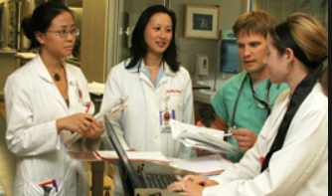
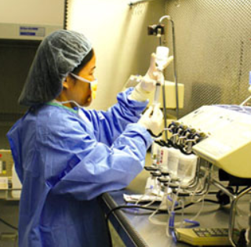
Pharmaceutical Care

Slide 7
Hospital Pharmacists move closer to Patient Care
Changes in Pharmacy Practice
What is Pharmaceutical Care?
The Pharmacist becomes more
specialised as a therapeutic advisor

Slide 8
Pharmaceutical Care
Quality Assurance
of
Drug Therapy
Need Goal Process Outcome

Slide 9
Pharmaceutical care
‘’Pharmaceutical care is the direct, responsible
provision of medication-related care for the
purpose of achieving definite outcomes that
improve a patient’s quality of life.’’
Cure of the disease
Elimination or reduction
of symptoms
Arrest or slowing of a
disease process
Prevention of disease
or symptoms
Hepler CD and Strand LM (1990)

Slide 10
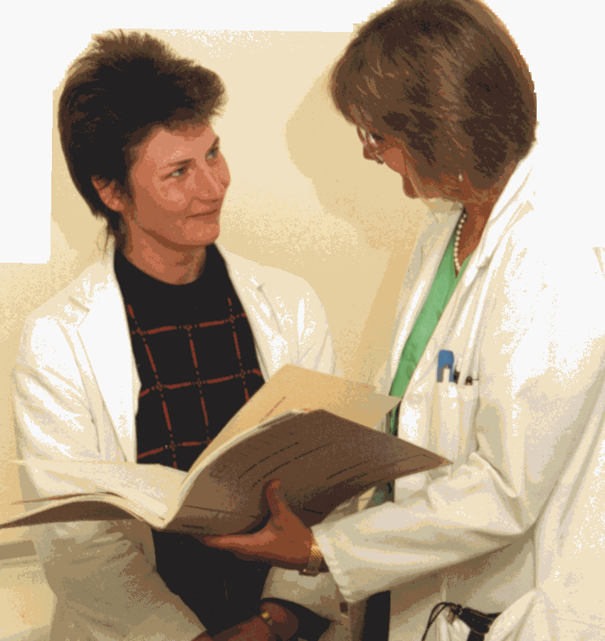
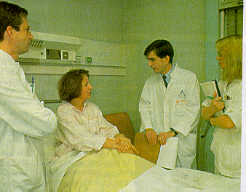
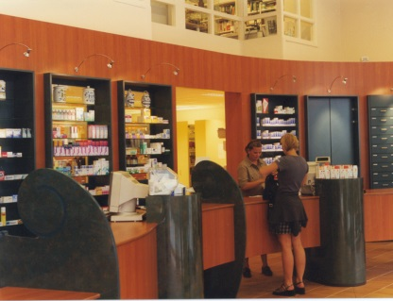
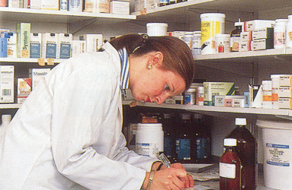
Clinical Pharmacist serves 60 beds
Clinical Pharmacist
integrates into
medical specialties
Pharmacist as
ward visitor
serves 120
beds
Emergence of the Teacher-Practitioner
Variety of models
Pharmacy Patient
Computer Records
and Services to
Elderly Nursing
Homes
Primary Care
Pharmacy
Targeted Services
Community Pharmacy
Patient
Medication Records
Innovations in Pharmacy Services
1970s
1980s
1990s
2000s
30th Nov. 2013

Slide 11
Clinical Management Plan
Verifying
Treatment
Monitoring
Treatment
Confirming Outcomes
of Treatment
Transferring care
30th Nov. 2013

Slide 12
Verification
Confirmation of outcomes
Profile of Patient’s Characteristics
Patient Comprehension/Participation
Confirmation of Need
Achievement of
Treatment Goals
Confirmation of Safety
Drug History
Contra-indications/Interactions
Treatment Plan
Conformity to Guidelines
Unwanted Symptoms
Recorded
Adverse Reaction
Monitoring
Individualised Dose,
Dose Frequency,
Means of Administration
Clinical Monitoring
Laboratory Markers
Adherence
to Treatment

Slide 13
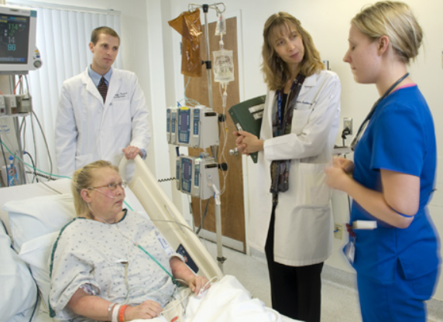
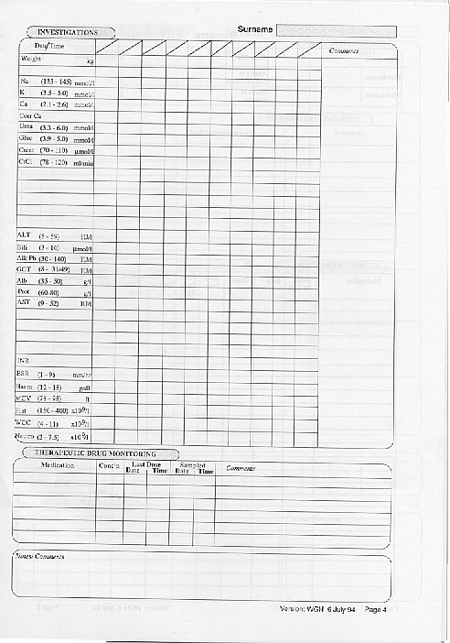
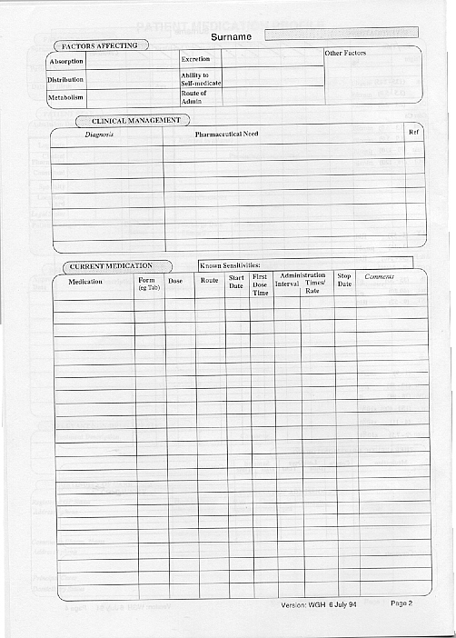
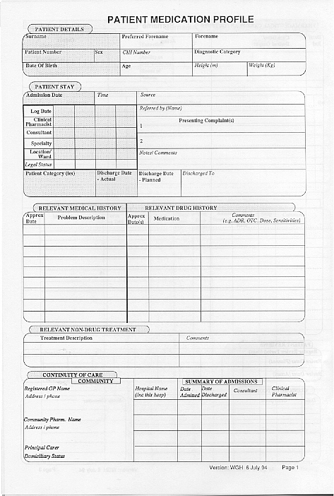
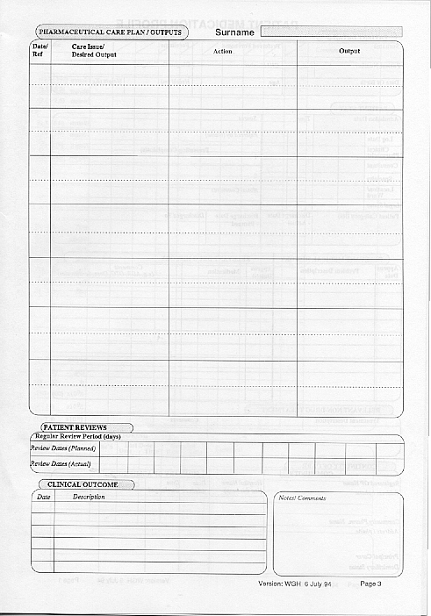
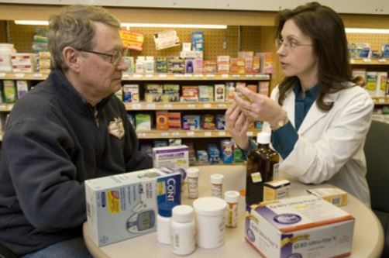
Documentation
Laboratory tests
Pharmaceutical care plan
Medication
Patient Profile
Responsibility

Slide 14
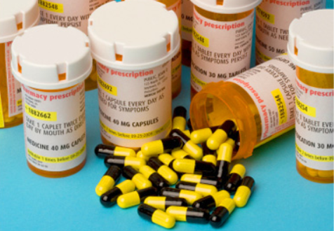
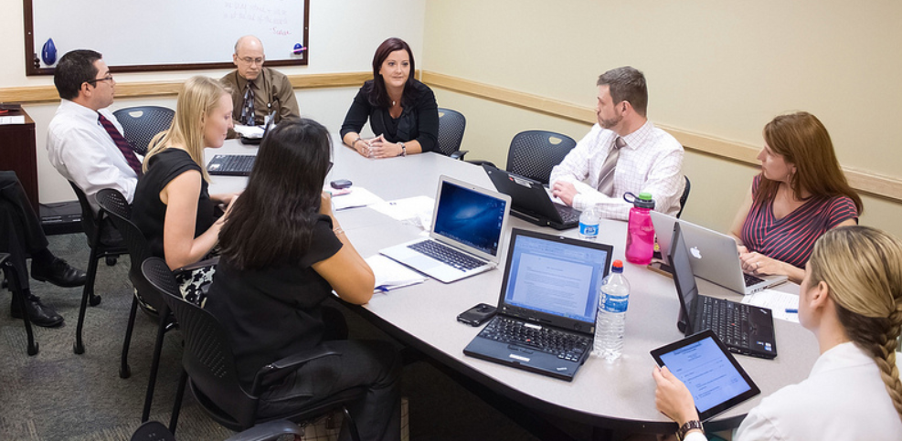
History
1940~1960 Era of Expansion period
1970~1980 Era of Cost containment
1990~ Era of Assessment and
Accountability for Health Outcome

Slide 15
OMICS Group Open Access Membership
OMICS publishing Group Open Access Membership enables academic and research institutions, funders and corporations to actively encourage open access in scholarly communication and the dissemination of research published by their authors.
For more details and benefits, click on the link below:
http://omicsonline.org/membership.php

