Slide 1
OMICS Journals are welcoming Submissions
OMICS International welcomes submissions that are original and technically so as to serve both the developing world and developed countries in the best possible way.
OMICS Journals are poised in excellence by publishing high quality research. OMICS International follows an Editorial Manager® System peer review process and boasts of a strong and active editorial board.
Editors and reviewers are experts in their field and provide anonymous, unbiased and detailed reviews of all submissions.
The journal gives the options of multiple language translations for all the articles and all archived articles are available in HTML, XML, PDF and audio formats. Also, all the published articles are archived in repositories and indexing services like DOAJ, CAS, Google Scholar, Scientific Commons, Index Copernicus, EBSCO, HINARI and GALE.
For more details please visit our website: http://omicsonline.org/Submitmanuscript.php

Slide 2
Raymond Chong, Ph.D.
Executive Editor
Journal of Novel Physiotherapies

Slide 3
Biography
Dr. Raymond Chong is director of the Movement Science Lab at the Department of Physical Therapy, Georgia Regents University, USA. He has joint appointments in the School of Graduate Studies, Vision Discovery Institute & Institute of Neuroscience. He received his PhD in Exercise & Movement Science at the University of Oregon in 1997 and is first author in over 70% of his peer-reviewed papers. He serves in the review panels for the US Department of Veteran Affairs Rehabilitation & Research Development Services NURA, CAMM and CDA sections. He is also an ad hoc reviewer for funding agencies such as the Qatar Foundation and the UK Medical Research Council. In addition to being Executive Editor of the Journal of Novel Physiotherapies, Dr. Chong also serves on the editorial boards of several journals including Gait & Posture.

Slide 4
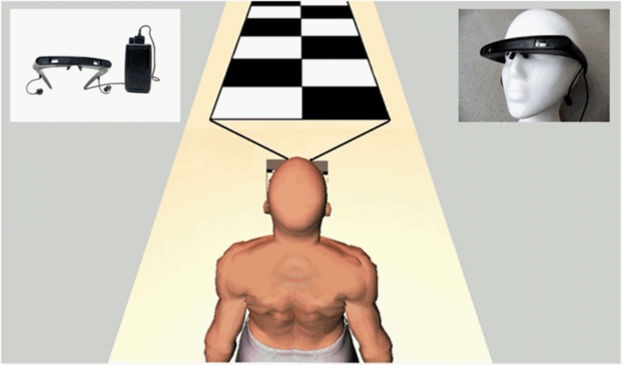
Research Interests
How do we move?
How are movements affected as we age?
When there is a neurologic disease?
When the mind is distracted?
Automatic and volitional multisensory organization and postural control in humans during reaching, stance and walking in healthy and neurological conditions such as Parkinson’s disease
Movement theories

Slide 5
Recent publications
Chong, R.K., Lee, K.H., Morgan, J., & Wakade, C. (2014). Duration of step initiation predicts freezing in Parkinson's disease. Acta Neurologia Scandinavica, in press.
Wakade, C., & Chong, R.K. (2014). A novel treatment target for Parkinson’s disease. Journal of the Neurological Sciences, in press. http://dx.doi.org/10.1016/j.jns.2014.10.024
Wakade, C., Chong, R.K., Bradley, E., Thomas, B., Morgan, J. (2014). Upregulation of GPR109A in Parkinson’s disease. PLoS ONE, 9(10), e109818. http://www.plosone.org/article/info%3Adoi%2F10.1371%2Fjournal.pone.0109818
Chong, R.K., Adams, K., Fenton, K., Gibson, M., Hodges, K., Horne, J., & Wakade, C. (2014). Postural adaptation to a slow sensorimotor set-changing task in Parkinson's disease. Comprehensive Psychology, 3(1), Article 9. http://www.amsciepub.com/doi/abs/10.2466/15.26.CP.3.9
Pillas, D., Kaakinen, M., Tzoulaki, I., Netuveli, G., Rodriguez, A., Fung, E., Chong, RK., et al. (2014). Infant locomotive development and its association with adult blood pressure. European Journal of Pediatrics. http://www.ncbi.nlm.nih.gov/pubmed/24804637
Chong, R.K. (2014). Approximation of the CoM estimate. Journal of Exercise, Sports & Orthopedics, 1(2), 1-3. http://symbiosisonlinepublishing.com/exercise-sports-orthopedics/exercise-sports-orthopedics07.php
Chong, R. K. (2013). Analyses of data: Single trials versus averaging J Nov Physiother 3:e131. http://dx.doi.org/10.4172/2165-7025.1000e131
Chong, R. K. (2012). Towards better evaluation tools. J Nov Physiother 2:e125. http://omicsgroup.org/journals/towards-better-evaluation-tools-2165-7025.1000e125.php?aid=7363
Chong, R. K., Lee, K. H., Morgan, J., Mehta, S., Griffin, J., Merchant, J., Searle, N., Sims, J., Sethi, K. (2011). Closed-loop VR-based interaction for improving walking in Parkinson's disease. J Nov Physiother 1:101. http://omicsgroup.org/journals/2165-7025/2165-7025-1-101.digital/2165-7025-1-101.html
Dr. Chong’s other publications can be viewed here:
http://www.ncbi.nlm.nih.gov/myncbi/browse/collection/45117750/?sort=date&direction=descending

Slide 6
Parkinson's disease
Parkinson's disease is a progressive disorder of the nervous system that affects your movement. It develops gradually, sometimes starting with a barely noticeable tremor in one hand. While a tremor may be a well-known sign of the disease, the disorder also commonly results in stiffness, slowing of movements, postural instability, freezing of gait and non-motor symptoms such as depression, dementia, pain, and sleep disorder.

Slide 7
Neurological Disorders
Neurological disorders are diseases of the central and peripheral nervous system -- the brain, spinal cord, cranial nerves, peripheral nerves, nerve roots, autonomic nervous system, neuromuscular junction, and muscles. These disorders include epilepsy, Alzheimer disease and other dementias, cerebrovascular diseases including stroke, migraine and other headache disorders, multiple sclerosis, Parkinson's disease, neuro-infections, brain tumours, traumatic disorders of the nervous system such as brain trauma, and neurological disorders as a result of neuro-inflammation and malnutrition.
Mental disorders, on the other hand, are "psychiatric illnesses" or diseases which appear primarily as abnormalities of thought, feeling or behaviour, producing either distress or impairment of cognitive functions.

Slide 8
Related Journals
Editorial Board:
Clinical Research on Foot & Ankle
International Journal of Physical Medicine & Rehabilitation

Slide 9
Related Conference
Opening keynote and scientific session chairman:1st International Conference and Exhibition on Physical Medicine & Rehabilitation
http://www.omicsonline.org/intenational-scientific-conferences/

Slide 10
OMICS International Open Access Membership
OMICS International Open Access Membership enables academic and research institutions, funders and corporations to actively encourage open access in scholarly communication and the dissemination of research published by their authors.
For more details and benefits, click on the link below:
http://omicsonline.org/membership.php

Slide 11
Thank you

Slide 12
Signature of the editor
Raymond Chong

