Slide 1
Osmotic Riboflavin and transepithelial CXL

Slide 2
Riboflavin and the eye
Riboflavin plays an important role in a number of important ocular functions including the functioning of the retinal photoreceptors and protection against nuclear cataract^{1,2}.
Also, high levels of riboflavin were measured in the cornea relative to other ocular tissues according to a study by Batey et al.³
1 Miyamoto et al. Proc Natl Acad Sci USA. 1998;95:6097–6102
2 Cumming et al. Ophthalmology. 2000;107:450–456
3 Invest Ophthalmol Vis Sci 1991; 32:1981–1985

Slide 3
Transepithelial, Fact or Fiction?
Despite the critical role played by riboflavin in the cornea and other ocular tissues, the molecular mechanism and regulation of riboflavin translocation is poorly understood.
It was generally believed that molecules traverse the corneal epithelium simply by passive diffusion through a transcellular/paracellular route.
If that is the case, then epithelium removal would be essential for riboflavin to enter the stroma, as the tight junctions would make the cornea an impermeable wall for the riboflavin, hence transepithelial CXL would be Fiction!

Slide 4
Transepithelial, Fact or Fiction?
However, a number of membrane transporters were identified to be involved in the translocation of various nutrients and substances across the epithelium and endothelium.
Ocular transporters include carriers for peptides, amino acids, glucose, lactate, and nucleosides/nucleobases and are primarily localized on the corneal epithelium and endothelium.

Slide 5
Transepithelial, Fact or Fiction?
As demonstrated by Hariharan et al.*, we believe that riboflavin transport is carrier mediated, and this correlates to the clinical results we obtained.
In the light of this information, we know that transepithelial CXL is a FACT!
Corneal epithelium is permeable membrane!
Current Eye Research 2006; 31:811-824
“Keratoconus Surgery & Cross Linking” – 2009; Jaypees

Slide 6
Osmotic Transepithelial CXL Preliminary Laboratory Results

Slide 7
What is microcarriers CXL?
This is transepithelial CXL facilitated by a management of microcarriers.
Microcarriers are used as a penetration enhancers by changing the ionic resistance of the cornea.
Therefore they can be used in very low concentration to enhance the transepithelial riboflavin transport for CXL.

Slide 8
ParaCel™: Osmotic Riboflavin
{
0,25% Riboflavin
Methyl Cellulose
Hypotonic NaCl
Benzalklonium Chloride
Other
ParaCel™:

Slide 9
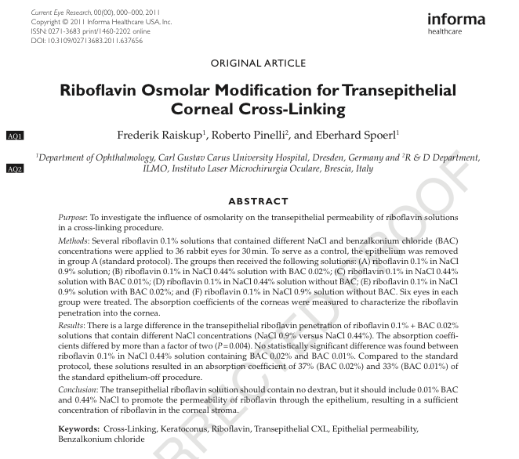
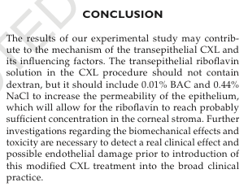
Current Eye Research paper - October 31, 2011

Slide 10
Osmotic Transepithelial CXL First Laboratory Report

Slide 11
Laboratory results
Rabbit corneas were cross-linked in vivo without removal of the epithelium, using ParaCel™ solution.
The corneas were then examined by light and electron microscope for evidence of collagen cross-linking;
Non treated eyes were compared with treated ones.

Slide 12
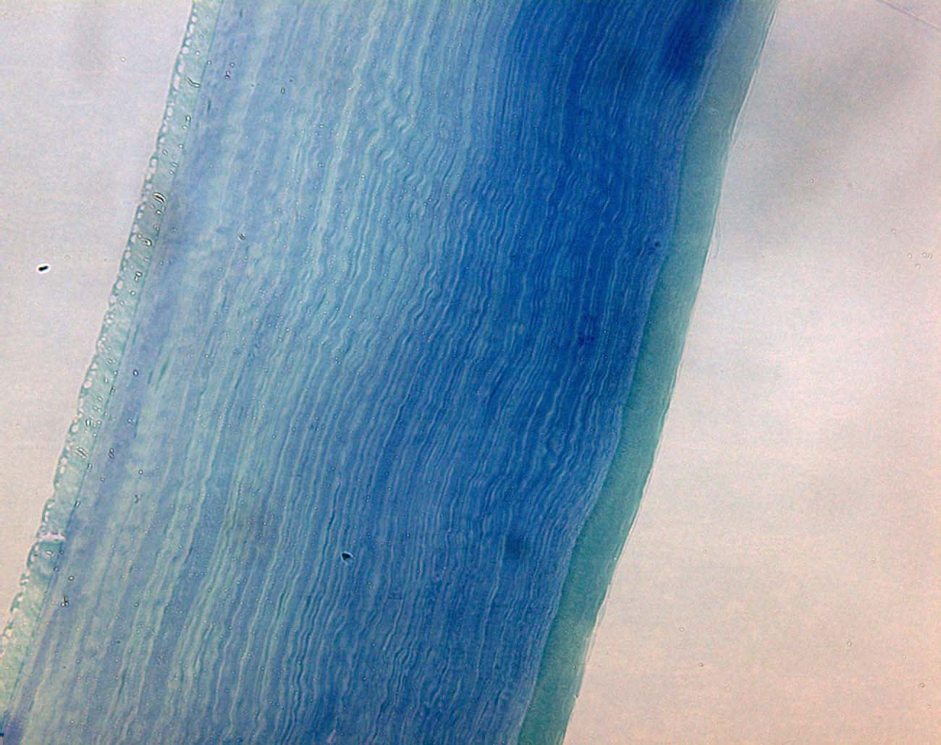
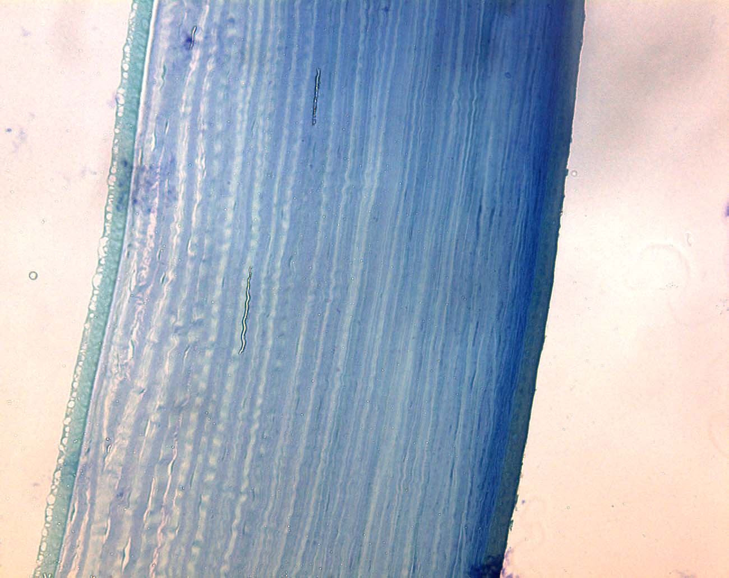
Light Microscope 20X
According to Kohlhaas and Spoerl et al.* CXL stiffens the anterior 200 µm
of the cornea only.
Control
OTCXL
About 40%
*J Cataract Refract Surg 2006; 32:279-283.

Slide 13
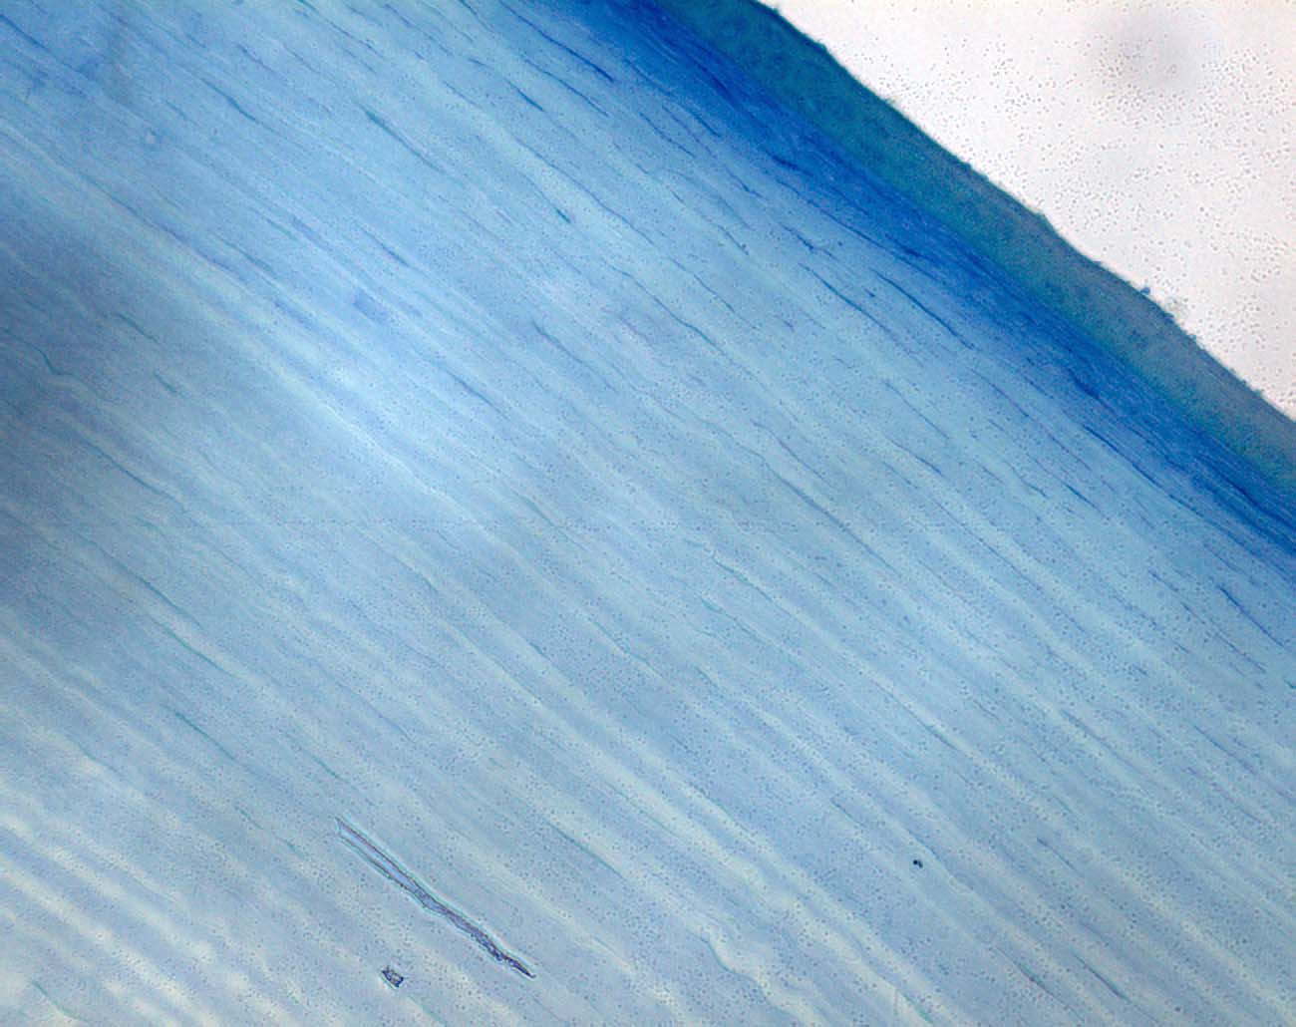
Light Microscope 40X
According to Kohlhaas and Spoerl et al.* CXL stiffens the anterior 200 µm
of the cornea only.
Control
OTCXL
Compact straight fibres

Slide 14
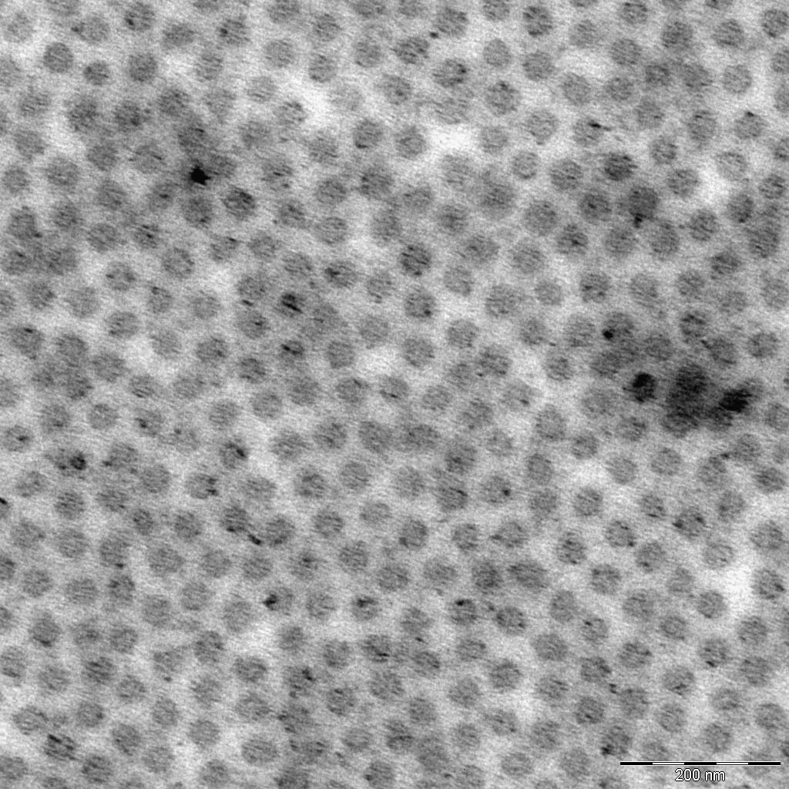
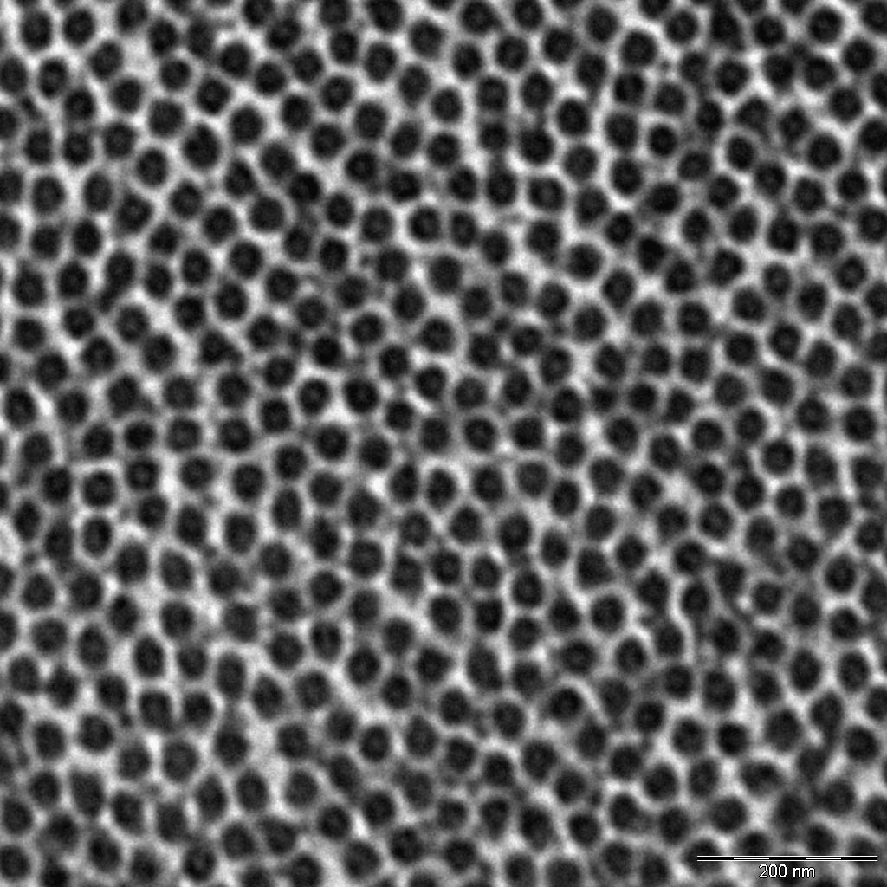
Electron Microscope 16000X (upper 200 µm)
Control
OTCXL
21% more fibres per unit area
49 fibres / 400 nm²
62 fibres / 400 nm²
14

Slide 15
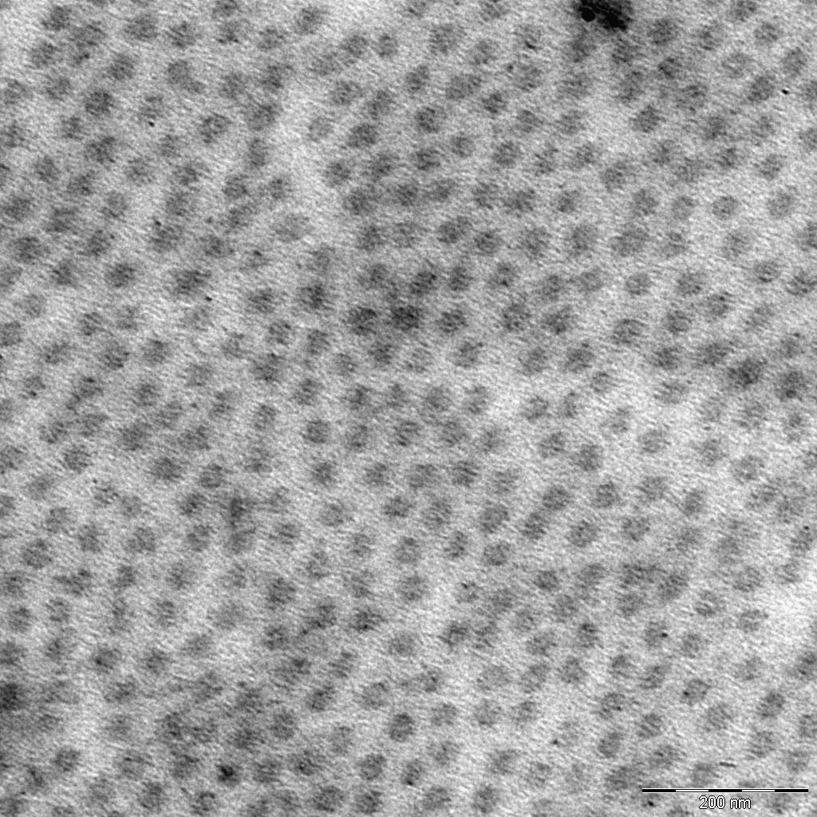
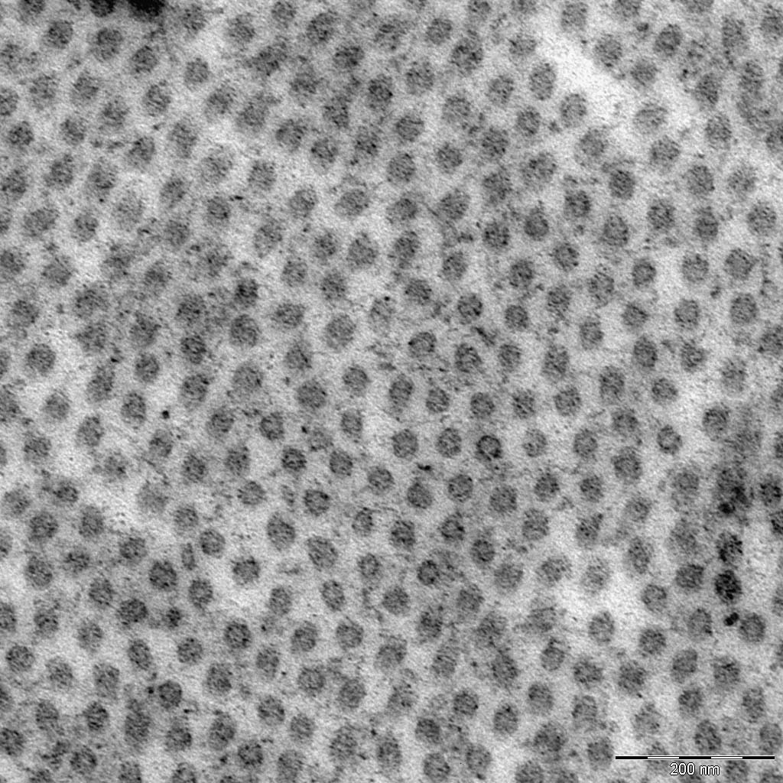
Electron Microscope 16000X (upper 100 µm)
Control
OTCXL
52 fibres / 400 nm²
51 fibres / 400 nm²
15

Slide 16
TAKE HOME MESSAGE
Microwave technology;
Fast CXL (3 minutes);
LASIK Xtra and …PRK Xtra?
ParaCel™: transepithelial riboflavin osmotically efficient

Slide 17
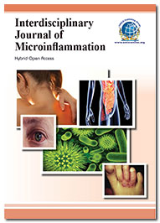
Interdisciplinary Journal of Microinflammation
Related Journals
Clinical Microbiology
Allergy & Therapy
Medical Microbiology & Diagnosis
www.ilmo.it

Slide 18
Interdisciplinary Journal of Microinflammation Related Conferences
3rd International Conference on Clinical Microbiology & Microbial Genomics
www.ilmo.it

Slide 19
OMICS Group Open Access Membership
OMICS publishing Group Open Access Membership enables academic and research institutions, funders and corporations to actively encourage open access in scholarly communication and the dissemination of research published by their authors.
For more details and benefits, click on the link below:
http://omicsonline.org/membership.php
www.ilmo.it

Slide 20
THANK YOU!
www.ilmo.it

