Slide 1

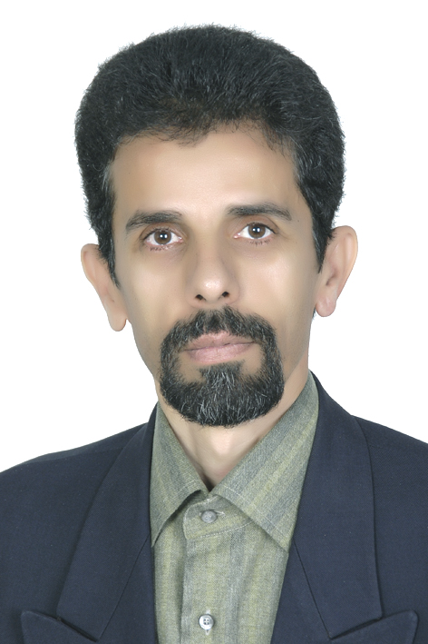

SENSOR NETWORKS AND DATA COMMUNICATIONS
Open Access
S.H Sabzpoushan,
Ph.D.,

Slide 2
BIOGRAPHY
S.H Sabzpoushan is with the School of Electrical Engineering in Iran University of Sciences and Technology (IUST). His main interests are in the applications of control and electronics in Medicine and industry. He has published several books in the field of the industrial control, Distributed control systems and the applications of the information technology in the control of power systems.

Slide 3

RESEARCH INTERESTS
Control and Biomedical Engineering.

Slide 4


Slide 5
What is biomedical engineering?
Biomedical engineering is the application of engineering principles and techniques to the medical field. This field seeks to close the gap between engineering and medicine. It combines the design and problem solving skills of engineering with medical and biological sciences to improve healthcare diagnosis and treatment.

Slide 6
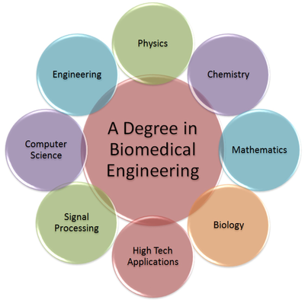

Slide 7
How does biomedical engineering help us?
Biomedical engineering helps:
Veterans that have lost their arms, legs, etc.
Babies with birth defects.
People who were in accidents (ex. Car crashes).
Elderly people.

Slide 8
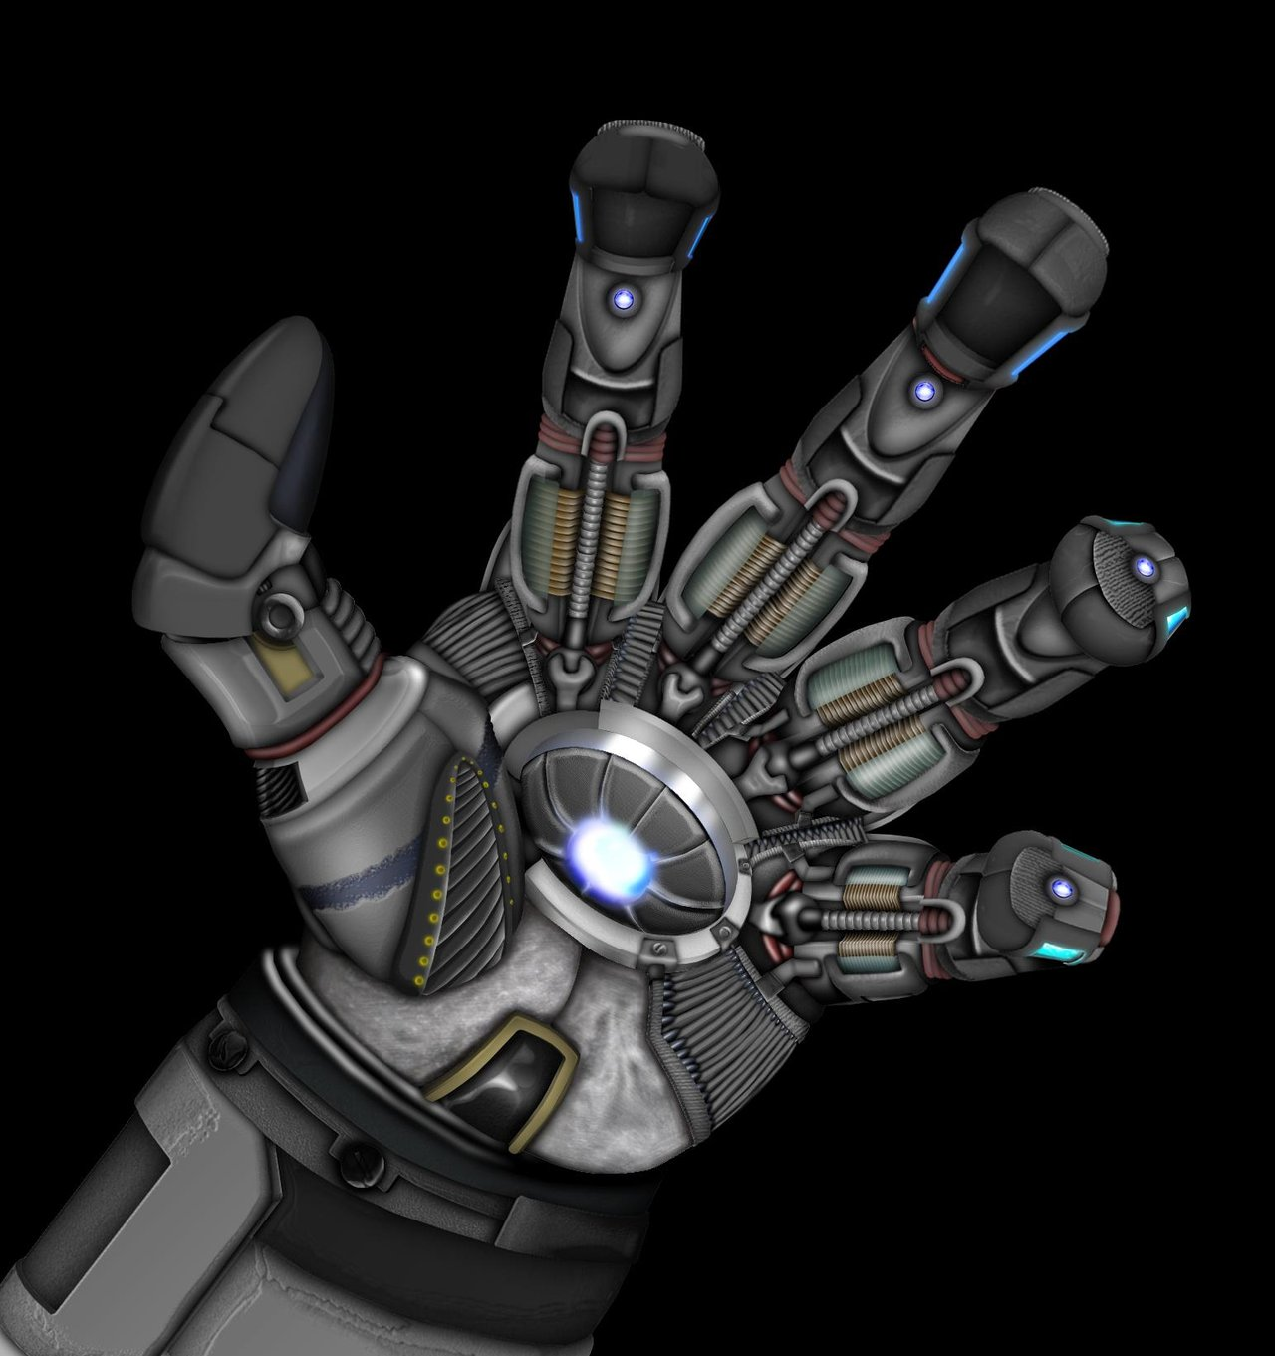
What does it look like???
This is a bionic arm. It is for people who have lost or have no arms.

Slide 9
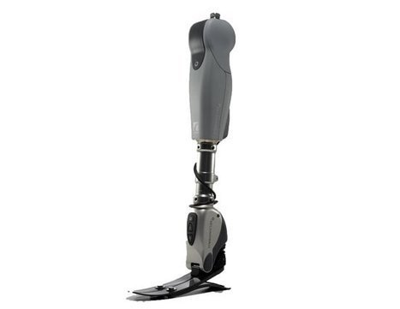
Bionic Leg
This is a bionic leg. It has the same concept as the bionic arm but it is a leg.

Slide 10
How do bionic body parts work?
First, a small control device is implanted into the human’s body. The small part then sends a message to the bionic arm, leg etc. what to do. Then, the body part will respond to the message by moving with controls.

Slide 11
What can biomedical engineering do?
Biomedical engineering is capable of:
Helping people walk.
Helping people pick up/grab things.
Helping people see.
Helping people pump blood to their body.
Helping physicians to prevent, diagnose and treatment
diseases.

Slide 12
RECENT PUBLICATIONS
S.H.Sabzpoushan, A. Sajjadi, " A new seeded region growing technique for retinal blood vessel extraction", Journal of Medical Signals & Sensors, vol 4, issue 3, pp 223-230, Jul-Sep 2014.
S.H.Sabzpoushan, S.Shahhosseini, S.Esmaeilli,"A Markov Model of Cell Membrane Potassium Channel and Prediction of Channel Status ", Int Jou for computational Biology(IJCB). , vol 3, No.2, pp. 24-36, Aug, 2014.
S.H.Sabzpoushan, F.Pourhasanzade, Z.Agin "Four dimensional modeling of the GBM brain tumor growth using cellular automata", Iranian journal of biomedical engineering, vol.7, No.1, pp 65-73, 2013.
S.H.Sabzpoushan, Z.Daneshparvar "A minimal two state variables model for the action potential of the human ventricular cell", Iranian journal of biomedical engineering, vol.7, No.3, pp 187-200, 2013.
S.H.Sabzpoushan, A.Ayatollahi, D.Noble, P.J.Noble, "A survey on linear relations between main electrical components during action potential in ventricular cell", Applied Mathematics and Computation, vol 188, pp. 148-153, 2007.

Slide 13
RECENT PUBLICATIONS
S.H.Sabzpoushan, R.Zargari Marandi "Improving reading activity recognition in daily life situations using DTW-based string matching algorithm in EOG signal processing", Iranian journal of biomedical engineering, vol 6, pp 279-285, 2013.
S.H.Sabzpoushan, Neda Falah, Ramtin Zargari Marandi, " The study of visual cueing effects …", IOSR-JEEE, vol 9, Issue 1, pp 06-10, Jan-2014.
S.H.Sabzpoushan, A.Ayatolahi, P.J.Noble, F.Towhidkhah," Identification of two main independent components of fibrillating heart muscle" Iranian journal of Electrical &Electronic Engineering, vol.2, No.1, Jan 2006.
S.H.Sabzpoushan, A.Ayatollahe, P.Noble, F.Towhidkhah, "A fibralation model based on noninvasive observations", WSEAS Transactions on systems, vol.4, Nov 2005.
S.H.Sabzpoushan, A.Ayatollahe,"An improved method for adaptive noise cancellation of ECG signal in difficult conditions", Iranian Journal of Electrical and Computer Engineering, Vol.1, NO.1,2003.

Slide 14
SENSOR NETWORKS AND DATA COMMUNICATIONS
RELATED JOURNALS
Biosensors & Bioelectronics
Biosensors Journal

Slide 15

SENSOR NETWORKS AND DATA COMMUNICATIONS RELATED CONFERENCES
Global Summit on Electronics and Electrical Engineering, November 03-05, 2015 Valencia, Spain
4th International Conference and Exhibition on Biometrics & Biostatistics, November 16-18, 2015 San Antonio, USA
2ndInternational Conference on Big Data Analysis and Data Mining, November 30-December 02, 2015 San Antonio, USA
2nd International Conference and Business Expo on Wireless & Telecommunication April 21-22, 2016 Dubai, UAE

Slide 16


OMICS International Open Access Membership
OMICS International Open Access Membership enables academic and research institutions, funders and corporations to actively encourage open access in scholarly communication and the dissemination of research published by their authors.
For more details and benefits, click on the link below:
http://omicsonline.org/membership.php

Slide 17


