Slide 1
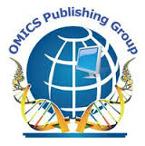
Malaria Control & Elimination
Dr. Sandro Percario Editorial Board Member
Professor
Ph.D., Federal University of Para, Brazil
Guest Researcher
US Centers for Disease Control and Prevention, USA
.

Slide 2
Biography
Sandro Percario Graduated in Biological Sciences - Medical Modality, Paulista School of Medicine, Brazil (1989), Master of Morphology, Federal University of São Paulo – UNIFESP, Brazil (1995), having developed the experimental part of the study at Saint Michaels Hospital, University of Toronto - Canada. Doctor of Science from the Federal University of São Paulo, Brazil (2000). Obtained the title of Full Professor at São José do Rio Preto Medical College, Brazil (2009).
Former Professor, Discipline of Vascular Surgery, Federal University of São Paulo, Brazil, from 2000 to 2004. Currently Associate Professor at the Institute of Biological Sciences - ICB, Federal University of Pará – UFPA, Brazil, and Guest Researcher at the U.S. Centers for Disease Control and Prevention – CDC, USA. PhD and Master Adviser for the Postgraduate Program of Pathology of Tropical Diseases, NMT/UFPA and in Biology of Infectious and Parasitic Agents, BAIP/UFPA , which he is a former Coordinator. Experience in the area of biochemistry, with emphasis on Oxidative Biochemistry, acting on the following topics: free radicals, oxidative stress, antioxidants, malondialdehyde, nitric oxide, atherosclerosis and malaria. Has more than 60 full papers published and 130 communications at scientific events.

Slide 3
Research Interest
Biochemistry of oxidative stress, Oxidative stress mechanisms in human/animal disease, and Redox regulation of cell signalling

Slide 4
Recent Publications
http://www.malariajournal.com/orderreprints/s12936-015-0717-0
http://www.malariajournal.com/content/pdf/s12936-015-0643-1.pdf
http://www.mdpi.com/1422-0067/13/12/16346
http://www.ncbi.nlm.nih.gov/pmc/articles/PMC4211349/
http://www.ncbi.nlm.nih.gov/pubmed/24952413
http://www.ncbi.nlm.nih.gov/pubmed/24362491
http://www.ncbi.nlm.nih.gov/pmc/articles/PMC3905823/
http://link.springer.com/article/10.1007%2Fs10571-015-0157-y
http://www.journalofsurgicalresearch.com/article/S0022-4804%2815%2900805-7/abstract
http://www.publish.csiro.au/paper/RD14454.htm

Slide 5
OXIDATIVE STRESS

Slide 6
INTRODUCTION
Our body constantly reacts with oxygen as you breathe and your cells produce energy.
As a consequence of this activity, highly reactive molecules are produced known as free radicals.

Slide 7
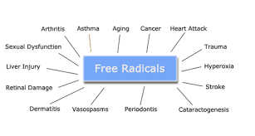
Free radicals interact with other molecules within cells. This can cause oxidative damage to proteins, membranes and genes.
Oxidative damage has been implicated in the cause of many diseases, such as cancer and Alzheimer's and has an impact on the body's aging process.

Slide 8
Antioxidants
To counteract oxidative stress, the body produces an armoury of antioxidants to defend itself. It's the job of antioxidants to neutralise or 'mop up' free radicals that can harm our cells.

Slide 9
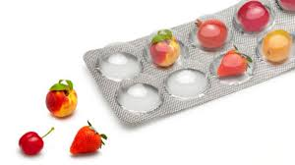
How much do we need?
Our body's internal production of antioxidants is not enough to neutralise all the free radicals.
We can help our body to defend itself by increasing your dietary intake of antioxidants.

Slide 10
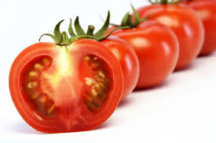
Foods and antioxidants
Tomatoes
Tomatoes contain a pigment called lycopene that is responsible for their red colour but is also a powerful antioxidant.
Tomatoes in all their forms are a major source of lycopene, including tomato products like canned tomatoes, tomato soup, tomato juice and even ketchup.
Lycopene is also highly concentrated in watermelon.

Slide 11
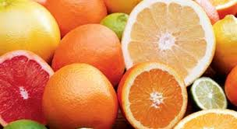
Citrus fruits
Oranges, grapefruit, lemons and limes possess many natural substances that appear to be important in disease protection, such as carotenoids, flavonoids, terpenes, limonoids and coumarins.
Together these phytochemicals act more powerfully than if they were given separately.
It's always better to eat the fruit whole in its natural form, because some of the potency is lost when the juice is extracted.

Slide 12
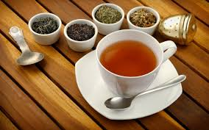
Tea
Black tea, green tea and oolong teas have antioxidant properties. All three varieties come from the plant Camellia sinenis.
Common brands of black tea do contain antioxidants, but by far the most potent source is green tea (jasmine tea) which contains the antioxidant catechin.
Black tea has only 10 per cent as many antioxidants as green tea.
Oolong tea has 40 per cent as many antioxidants as green tea.
This because some of the catechins are destroyed when green tea is processed (baked and fermented) to make black tea.

Slide 13
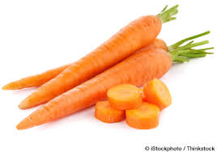
Carrots
Beta-carotene is an orange pigment that was isolated from carrots 150 years ago.
It is found concentrated in deep orange and green vegetables (the green chlorophyll covers up the orange pigment).
Beta-carotene is an antioxidant that has been much discussed in connection with lung cancer rates. The evidence is conflicting, with one study showing an increase in risk, but further research is being done to see if it has a protective effect.

