Slide 1





OMICS International
OMICS International through its Open Access Initiative is committed to make genuine and reliable contributions to the scientific community. OMICS International signed an agreement with more than 1000 International Societies to make healthcare information Open Access.
Contact us at: contact.omics@omicsonline.org

Slide 2


OMICS Journals are welcoming Submissions
OMICS International welcomes submissions that are original and technically so as to serve both the developing world and developed countries in the best possible way.
OMICS International are poised in excellence by publishing high quality research. OMICS International follows an Editorial Manager® System peer review process and boasts of a strong and active editorial board.
Editors and reviewers are experts in their field and provide anonymous, unbiased and detailed reviews of all submissions. The journal gives the options of multiple language translations for all the articles and all archived articles are available in HTML, XML, PDF and audio formats. Also, all the published articles are archived in repositories and indexing services like DOAJ, CAS, Google Scholar, Scientific Commons, Index Copernicus, EBSCO, HINARI and GALE.
For more details please visit our website:
http://omicsonline.org/Submitmanuscript.p

Slide 3
Recent Progress of Selective
Monohydrolysis of Symmetric Diesters
Satomi Niwayama Graduate School of Engineering Muroran Institute of Technology

Slide 4










Synthesis of Pharmaceuticals with the use of half-esters
half-ester
half-ester
half-ester

Slide 5
Previous examples of monosaponification
C₆H₅ COOC₂H₅ H₃C COOC₂H₅
KOH
EtOH
r.t. 100hrs
C₆H₅ COOC₂H₅ H₃C COOH
Vecchi, A.; Melone, G.
J. Org. Chem. 1959, 24,
109
(yield unknown)
COOC₂H₅ COOC₂H₅
KOH EtOH
COOC₂H₅ COOH
74.6 %
Corey, E. J.
J. Am. Chem. Soc.
1952, 74, 5897
Pr
Pr
r.t. 20 hrs
COOC₂H₅ COOC₂H₅
KOH
EtOH
r.t. 1.5 hrs
COOC₂H₅
C₆H₅
Corey, E. J.
J. Am. Chem. Soc.
1952, 74, 5897
C₆H₅
COOH
98.5 % (as a crude product)

Slide 6
New Selective Monohydrolysis
aqueous NaOH or KOH THF or other co-solvent
CO₂R
CO₂H
CO₂R R=Me, Et
0ºC
+
H₃O
CO₂R

Slide 7
Comparison to Classical Conditions
NaOH/MeOH (1eq.)
CO₂Me
CO₂Me
CO₂H CO₂Me
+ diester + dicarboxylic acid
r.t.
10%
yellowish
THF/aqueous NaOH (2eq.)
CO₂Me CO₂Me
CO₂H CO₂Me
~quant.
white cryst.
m.p. 106-107ºC (lit. 108-109ºC)
0ºC, 30-60 min.

Slide 8
Monohydrolysis of Symmetric Diesters
entry
diester
product
yield (%)ª
entry
diester
product
yield (%)ª
1
MeO₂C
CO₂Me _{HO2C}
CO₂Me
70%
O
O O
6
O
CO Me
>99%
1a
1b
2
CO₂Me
CO₂H CO₂Me
CO₂Me
CO₂Me _{79%}
6a
6b
2 MeO₂C
HO₂C
2a
2b
Ph
CO₂CH₂CH₃ CO₂CH₂CH₃
7a
Ph
CO₂H CO₂CH₂CH₃
7b
96%
7
3
MeO₂C
CO₂Me
HO₂C CO₂Me
3b
95%^{b}
3a
8
CO₂CH₂CH₃ CO₂CH₂CH₃
CO₂H CO₂CH₂CH₃
>99%
4
CO₂Me
CO₂Me
CO₂H CO₂Me
>99%
8a
8b
4a
4b
9
O
CO H
5
O
CO₂Me
CO₂Me
O
CO H
CO₂CH₂CH₃O CO₂CH₂CH₃
2
>99%
2
CO₂Me
>99%
9a
CO₂CH₂CH₃
5a
5b
9b
Yields are isolated yields from silica gel column chromatography based on the amounts of the diesters submitted to the reaction.
The yield was diminished due to the slight volatility of 3b.

Slide 9
Potential Mechanism
-
CO₂
H₂O
H₂O
⁻O₂C
CO ⁻
CO₂R
2
CO₂R_{RO2C}
RO₂C
H₂
O
-
O₂C
CO₂R
CO₂
-
^{CO}2^{R}RO₂C
RO₂C
H O
2
-
O₂C
CO₂
-
-
CO₂
H₂O
H₂O
Soap-like aggregates prohibit further hydrolysis

Slide 10
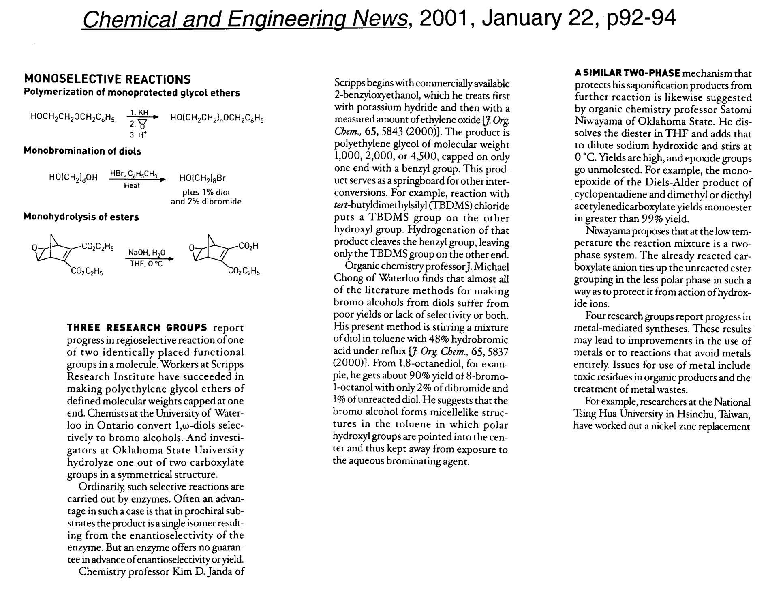

Slide 11
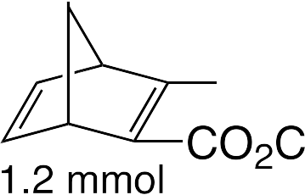

Solvent Effects

Slide 12

Effects of Kinds of Co-Solvent

Slide 13
Conformational Preference of the Starting Diesters
δ+
δ−
O
δ−
O
R
MeO
R
δ−
δ+
O
Me
O
δ−
R or
δ+
OMe
R
O
δ+
OMe
A
B
H
.
O
O
H
a) high pressure
b) i) BF₃ OEt₂
O
_{H}Me CO₂Me ₊
Me CHO H
O
+
SnBu₃
heating or BF₃ OEt₂
ii) H₂ , Pd/C
.
Yamamoto, Y. ; Nemoto, H.; Kikuchi, R.;
Komatsu, H.; Suzuki, I.
J. Am. Chem. Soc. 1990, 112, 8598
anti-Cram 82-90
Cram 18-10
:
H
δ−
O
H
δ−
O
H
H
or
O
OMe
Nu⁻
Nu⁻
R
δ+
R
H _{δ}+
δ+
Me
H
OMe^{δ+ Me}
δ−
O
δ−

Slide 14
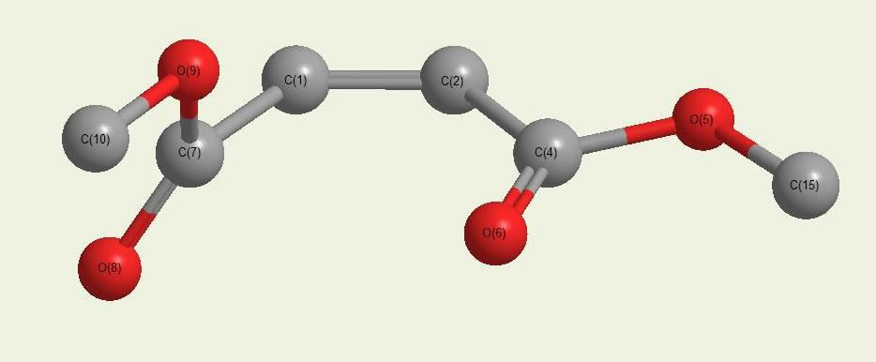


The Conformer of Dimethyl Maleate with the Lowest Energy
(MP2/6-31G(d)//B3LYP/6-31G(d))
72.6º
7.4º
111.2º
2.850Å_{8.3o}
dihedral angles
n->π* interaction

Slide 15
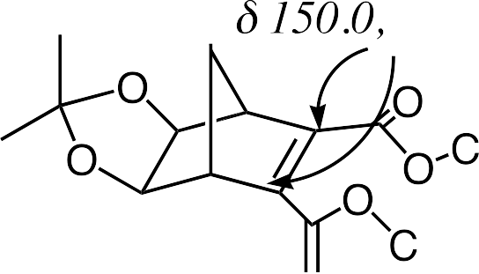


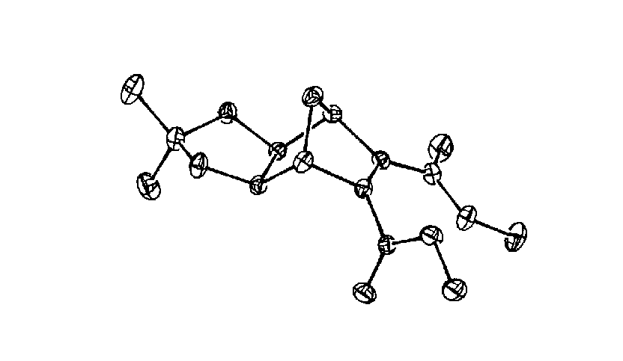
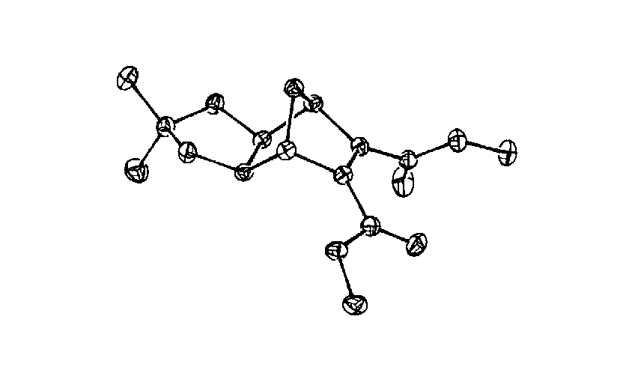
Experimental Support for the Predominant Conformation
by Theoretical Studies

Slide 16


Slide 17
1) aqueous MOH THF/H₂O, 0 C
CO₂CH₃ CO₂CH₃
o
CO₂H CO₂CH₃
a
CO₂H CO₂H
b
NaOH
M=Li, Na, K, Cs
2) H₃O⁺
LiOH
+
Reaction time/min. a (%) b (%) ratio a:b
a (%) b (%) ratio a:b
diester | 20 | 66.2 | 33.8 | 1.96 |  | 67.8 | 32.2 | 2.11
consumed | 25 | 61.1 | 38.9 | 1.57 |  | 67.4 | 32.6 | 2.07
 | 30 | 59.2 | 40.8 | 1.45 |  | 61.4 | 38.6 | 1.59
 | 35 | 55.9 | 44.1 | 1.27 |  | 60.9 | 39.1 | 1.56
KOH CsOH
Reaction time/min.
a (%)
b (%)
ratio a:b
a (%)
b (%)
ratio a:b
10
86.8
13.2
6.58
82.2
17.8
4.62
diester consumed
15
20
25
74.5
69.0
67.9
25.5
31.0
32.1
2.92
2.23
2.12
67.8
64.6
51.9
32.2
35.4
48.1
2.11
1.82
1.08
Selectivity: K>Cs>Na≥Li
Electropositive character: Cs≥K>Na≥Li

Slide 18








New Conditions for Monohydrolysis of Linear Diesters
100g $306
~96% purity
~100% purity
More hydrophobic

Slide 19




Slide 20






Slide 21
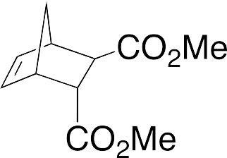
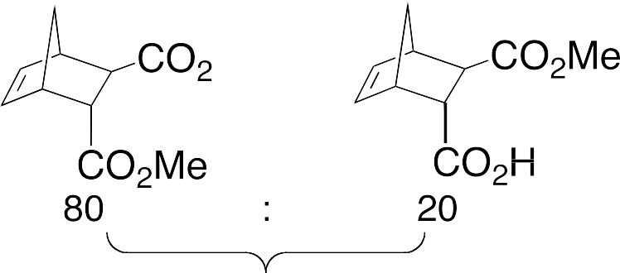
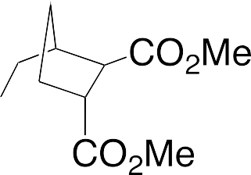

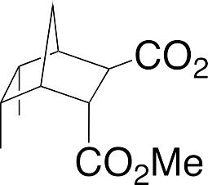
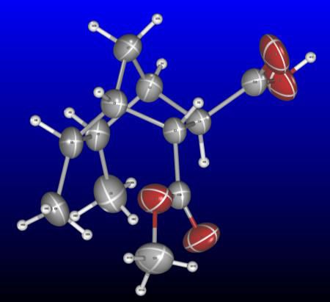
Recognition of Steric Environment
0 ºC
0 ºC

Slide 22
Summary
co-solvent aqueous base
CO₂R
CO₂H
CO R
0ºC
H₃O⁺
CO₂R
2
R=Me, Et
A highly efficient, mild, straightforward reaction using
co-solvent-aqueous base at 0 ºC was found to produce pure half-esters
from symmetric diesters in high yields.
This reaction has been licensed by Kishida Chemical
Co.Ltd., Japan
www.kishida.co.jp

Slide 23


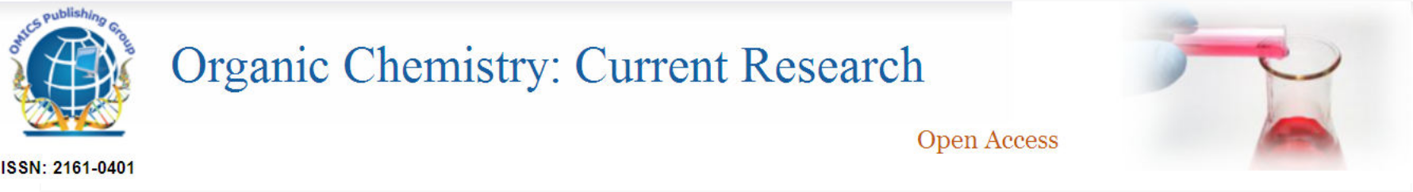




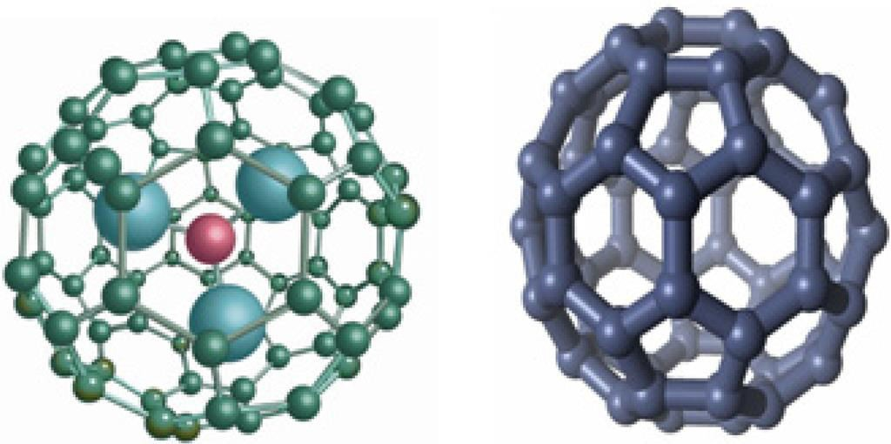
Organic Chemistry: Current Research
Pharmaceutica Analytica Acta
Clinical Pharmacology &
Biopharmaceutics

Slide 24


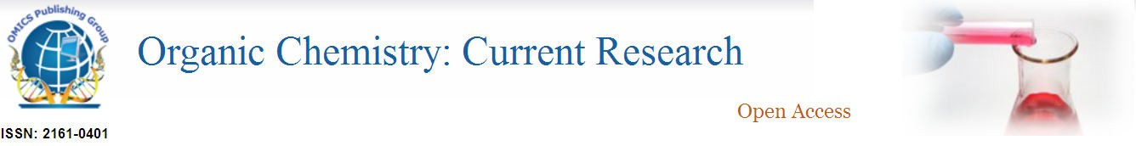


4th International Conference on
Medicinal Chemistry & Computer Aided Drug Designing

Slide 25
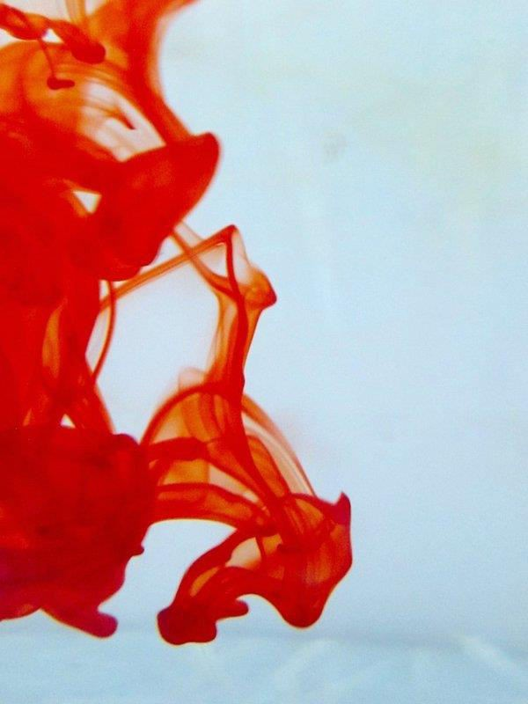




OMICS International Open Access Membership
OMICS International Open Access Membership enables academic and research institutions, funders and corporations to actively encourage open access in scholarly communication and the dissemination of research published by their authors.
For more details and benefits, click on the link below: http://omicsonline.org/membership.ph p

