Slide 1

OMICS Journals are welcoming Submissions
OMICS International welcomes submissions that are original and technically so as to serve both the developing world and developed countries in the best possible way.
OMICS Journals are poised in excellence by publishing high quality research. OMICS International follows an Editorial Manager® System peer review process and boasts of a strong and active editorial board.
Editors and reviewers are experts in their field and provide anonymous, unbiased and detailed reviews of all submissions.
The journal gives the options of multiple language translations for all the articles and all archived articles are available in HTML, XML, PDF and audio formats. Also, all the published articles are archived in repositories and indexing services like DOAJ, CAS, Google Scholar, Scientific Commons, Index Copernicus, EBSCO, HINARI and GALE.
For more details please visit our website: http://omicsonline.org/Submitmanuscript.php

Slide 2


MODELLING OF AUTOMOTIVE FUEL DROPLET HEATING AND EVAPORATION
Sergei S Sazhin
The Sir Harry Ricardo Laboratories, School of Computing, Engineering and Mathematics,
University of Brighton, UK

Slide 3
Concept
(Engineering Mathematics)
Modelling of individual processes (numerical or analytical)
Example: modelling of deformation of individual droplets
Strength: allows in-depth analysis and understanding of underlying physics
Weakness: does not take into account the effects of other processes in realistic engineering systems

Slide 4
Concept
(Computational Fluid Dynamics)
Modelling of realistic engineering systems (numerical)
Example: modelling of Diesel engines
Strength: takes into account the interaction between various processes (fluid dynamics, heat/mass transfer etc)
Weakness: too simplistic models for individual processes are used; difficult to understand the underlying physics

Slide 5
Analysis of realistic engineering systems requires a combined approach using the methods of engineering mathematics and Computational Fluid Dynamics (CFD)

Slide 6
MODELS FOR DOPLET HEATING AND EVAPORATION
(Conventional CFD models)
1. The Infinite Thermal Conductivity (ITC) models based on
the energy balance equation of the droplet as a whole were used.
2. Droplets were assumed to be opaque grey spheres.
3. Droplet radii were assumed to be constant during each time step.
4. Too complex or too simplistic models for heating and evaporation of multi-component droplets were used.
5. Kinetic and molecular dynamic effects on droplet evaporation were ignored

Slide 7
Conduction limit. Effective conductivity

Slide 8
where θ_{R} is the radiation temperature, R_{d} is the droplet radius,
θR can be assumed equal to the external temperature T_{ext} in the case of an optically thin gas in the whole domain.

Slide 9
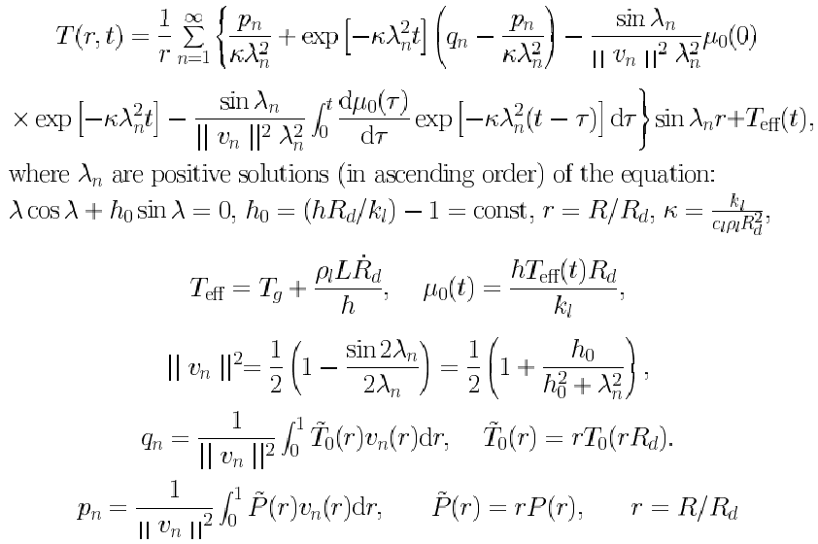
Analytical solution for h=const

Slide 10
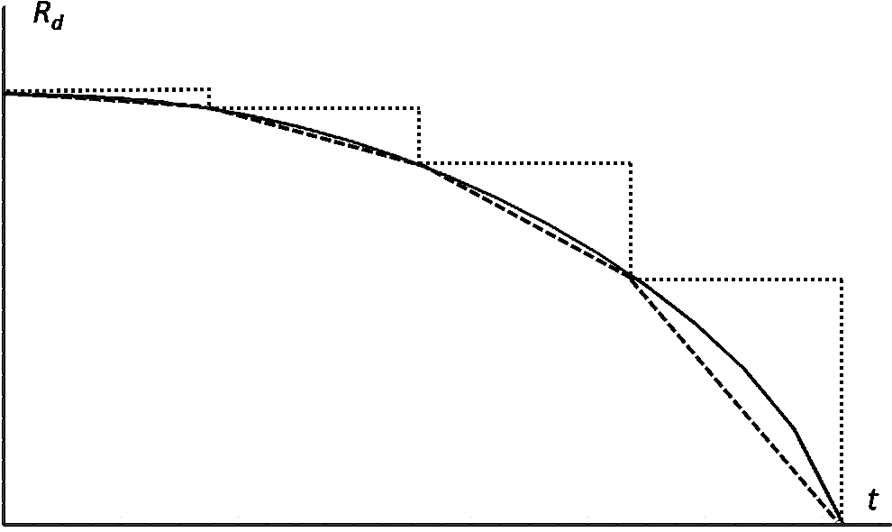
Effect of the moving interface

Slide 11
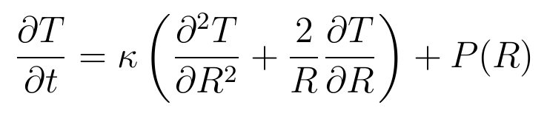
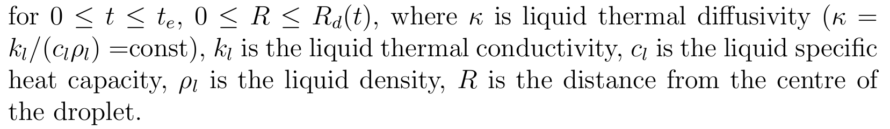
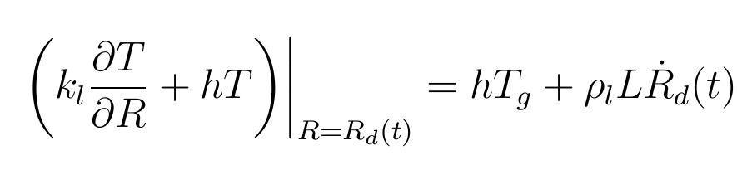
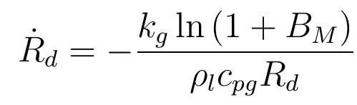

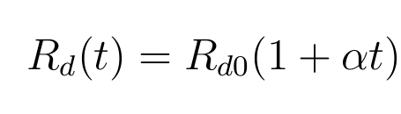
Effect of the moving interface

Slide 12
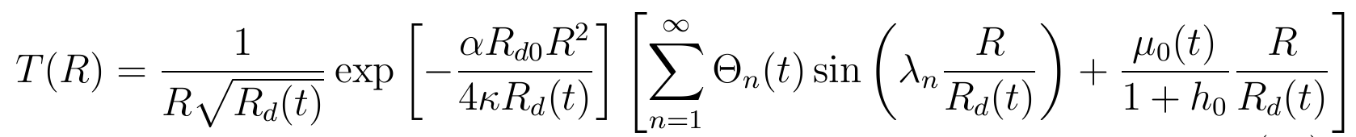
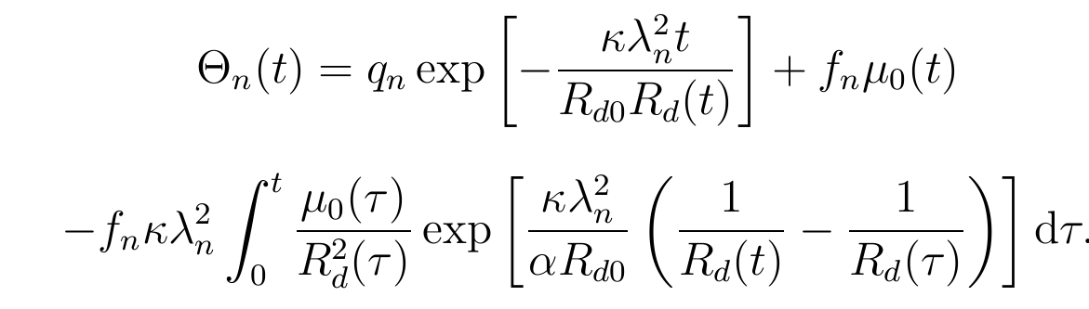
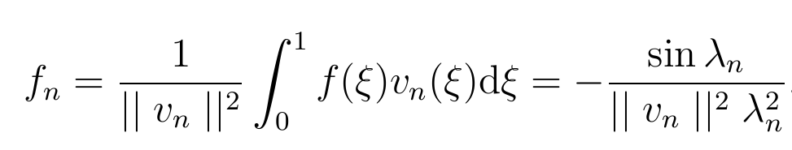

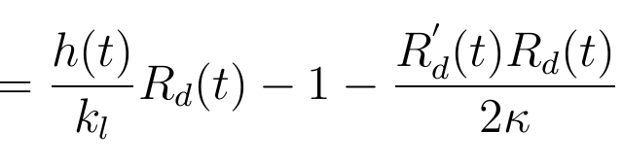
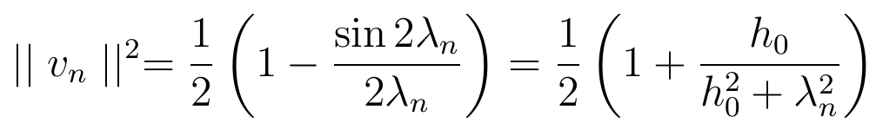

Analytical solution
Sazhin, S.S., Krutitskii, P.A., Gusev, I.G., Heikal, M. (2010) Transient heating of an evaporating droplet, Int. J Heat Mass Transfer, 53 (13-14), 2826-2836

Slide 13
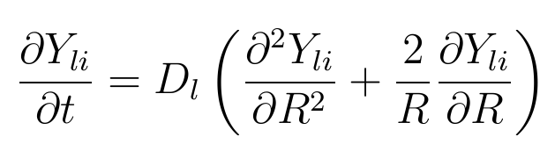
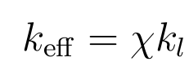
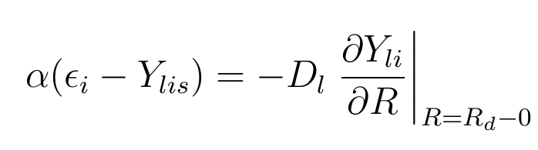
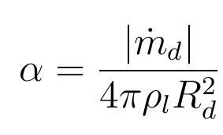
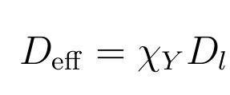
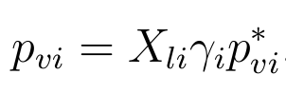
Discrete Components Model

Slide 14
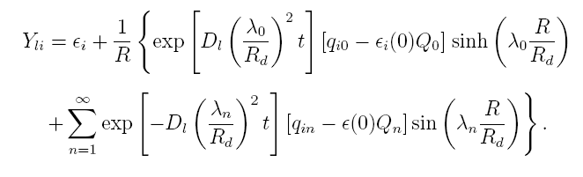
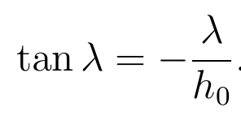
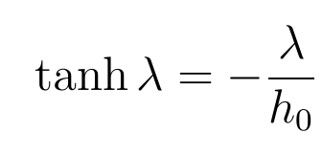
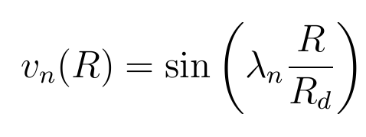
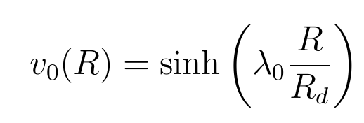
Solution to the species diffusion equation

Slide 15
Multi-Dimensional Quasi-Discrete Model
Realistic Diesel fuel

Slide 16
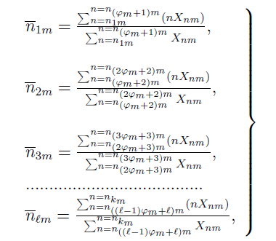
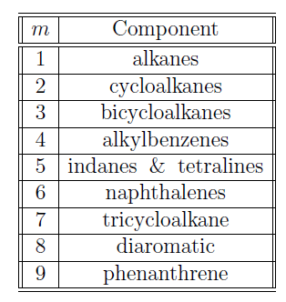
Multi-Dimensional Quasi-Discrete Model

Slide 17
T
ρ
ρ
s
,
s
T
Rd
,
Rd
Kinetic
Hydrodynamic
region
region
j
V
q
δ
x
Rd
1
2

Slide 18
United Atom Model (UAM)
Similarly, we were able to show that for the same values of parameters, the best approximation for the droplet surface temperature, predicted by the kinetic model, can be achieved using the following formula:
,
.

Slide 19
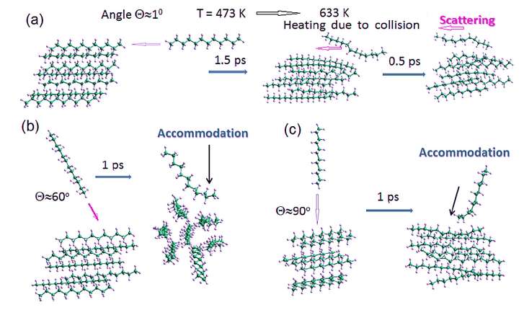
A study of the evaporation and condensation of n-alkane clusters and nanodroplets using quantum chemical methods
Gun'ko, V.M., Nasiri, R., Sazhin, S.S. (2014) A study of the evaporation and condensation of n-alkane clusters and nanodroplets using quantum chemical methods, Fluid Phase Equilibria, 366 99-107.

Slide 20


Slide 21


Slide 22

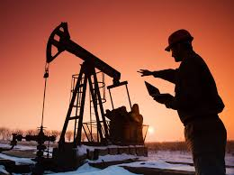
Oil & Gas Research
Related Journals
Journal of Petroleum & Environmental Engineering
Pollution Effects & Control
Bioremediation & Biodegradation

Slide 23

Oil & Gas Research
Related Conferences
For upcoming Conference visit http://www.conferenceseries.com/

