Slide 1
OMICS Journals are welcoming Submissions
OMICS International welcomes submissions that are original and technically so as to serve both the developing world and developed countries in the best possible way.
OMICS Journals are poised in excellence by publishing high quality research. OMICS International follows an Editorial Manager® System peer review process and boasts of a strong and active editorial board.
Editors and reviewers are experts in their field and provide anonymous, unbiased and detailed reviews of all submissions.
The journal gives the options of multiple language translations for all the articles and all archived articles are available in HTML, XML, PDF and audio formats. Also, all the published articles are archived in repositories and indexing services like DOAJ, CAS, Google Scholar, Scientific Commons, Index Copernicus, EBSCO, HINARI and GALE.
For more details please visit our website: http://omicsonline.org/Submitmanuscript.php

Slide 2
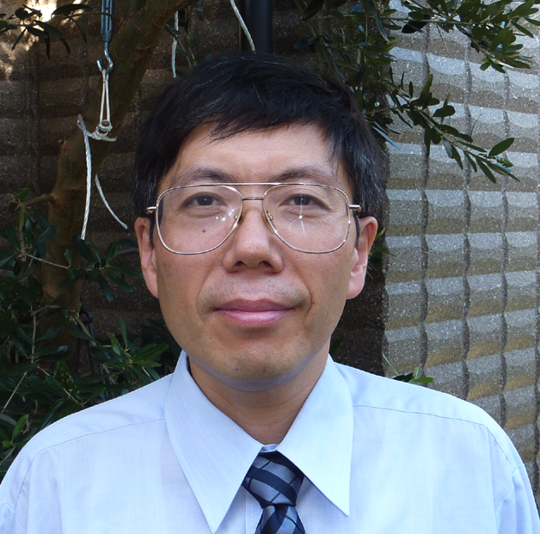
Shouji Shimoyama, MD. PhD.
President
Gastrointestinal Unit,
Settlement Clinic
Tokyo, Japan.
Shimoyama@apost.plala.or.jp

Slide 3
General: My research topics are:
Genetic alterations that may
-affect efficacy of treatment against malignancies.
-help predict adverse events.
Interactions of targeted molecules that may cause
treatment resistance.

Slide 4
Research concepts:
Elucidation of genetic alterations affecting efficacy
and/or adverse events that could help select right patients
to the right treatment.
This could ultimately establish molecularly guided
personalized treatment.

Slide 5
Fluorouracil:
Genetic alterations of enzymes that are involved in
fluorouracil metabolism.
Shimoyama S.
Chemotherapy for gastric cancer. Current achievements in survival improvement and therapy individualization.
In: Gastric Cancer Research Trends. Editor: Tompkins MB. Nova Science Publisher NY, USA, 2008, pp 1-40
Shimoyama S.
Pharamacogenetics of fluoropyrimidine and cisplatin. A future application to gastric cancer treatment.
J Gastroenterology and Hepatology. 2009, 24, 970-981.

Slide 6
Cisplatin:
Genetic alterations of enzymes that are involved in
cisplatin metabolism.
Shimoyama S.
Cisplatin: Its Clinical Application and Therapy Individualization in Gastric and Esophageal Cancers.
In: Cisplatin: Pharmacology, Clinical Uses and Adverse Effects
Editors: Toshiko Kojima and Yoko Morita
Nova Science Publisher NY, USA, 2012, pp 97-122.

Slide 7
Irinotecan:
Interethnic difference of drug metabolism due to
genetic polymorphism relevant to enzymatic activity.
Shimoyama S.
Pharmacogenetics of irinotecan: An ethnicity-based prediction of irinotecan adverse events.
World J Gastrointest Surg 2010; 2: 14-21.

Slide 8
BRAF:
Overview of BRAF mutations that could help
understanding of resistance to anti-BRAF therapy.
Shimoyama S.
BRAF mutations and their implications in molecular targeting therapies for gastrointestinal cancers.
Editorial: J Pharmacogenom Pharmacoproteomics 2011, 2: e102.
http://www.omicsonline.org/ArchiveJPP/CurrentissueJPP.php

Slide 9
Trastuzumab:
Molecular interactions that provide hints to
overcome trastuzumab resistance.
Shimoyama S.
Unraveling trastuzumab and lapatinib in gastric cancer. Future steps.
Mol Clin Oncol 2014; 2, 175-181.

Slide 10
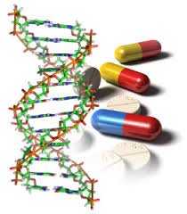
Pharmacogenomics & Pharmacoproteomics Related Journals
Journal of Molecular and Genetic Medicine
Journal of Data Mining in Genomics & Proteomics
Journal of Proteomics & Bioinformatics

Slide 11
Pharmacogenomics & Pharmacoproteomics Related Conferences
For further details regarding the conference please visit
http://www.conferenceseries.com/pharmaceutical-sciences-meetings/

Slide 12
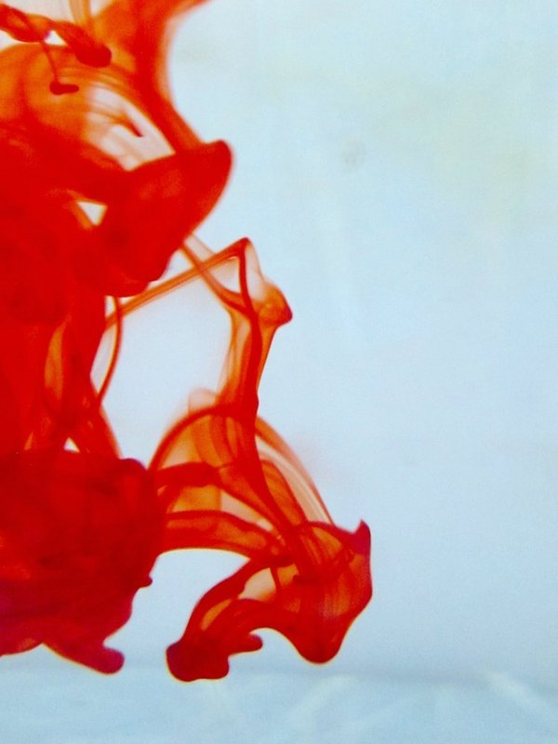
OMICS Group Open Access Membership
Open Access Membership with OMICS international enables academicians and research institutions, funders and corporations to actively encourage open access in scholarly communication and the dissemination of research published by their authors.
For more details and benefits, click on the link below:
http://omicsonline.org/membership.php

