Slide 1
OMICS Journals are welcoming Submissions
OMICS International welcomes submissions that are original and technically so as to serve both the developing world and developed countries in the best possible way.
OMICS Journals are poised in excellence by publishing high quality research. OMICS International follows an Editorial Manager® System peer review process and boasts of a strong and active editorial board.
Editors and reviewers are experts in their field and provide anonymous, unbiased and detailed reviews of all submissions.
The journal gives the options of multiple language translations for all the articles and all archived articles are available in HTML, XML, PDF and audio formats. Also, all the published articles are archived in repositories and indexing services like DOAJ, CAS, Google Scholar, Scientific Commons, Index Copernicus, EBSCO, HINARI and GALE.
For more details please visit our website: http://omicsonline.org/Submitmanuscript.php

Slide 2
Lipid Based Oral Drug Delivery System (LBODDS)
Srinivasan Shanmugam, Ph.D.

Slide 3
LBODDS???
An emerging platform for oral delivery of drugs with poor aqueous solubility
Utilization of lipid as a carrier for the delivery of poorly water soluble, lipophilic drugs
BA enhancement & normalization
Targeted lymphatic delivery
Notes:
Normalization is necessary for the narrow therapeutic index drugs

Slide 4
Why Low Bioavailability ???
Low Dissolution
High First-Pass Metabolism
Low Solubility
Low Permeability
High Pre-absorptive Metabolism
High Efflux Transportation

Slide 5
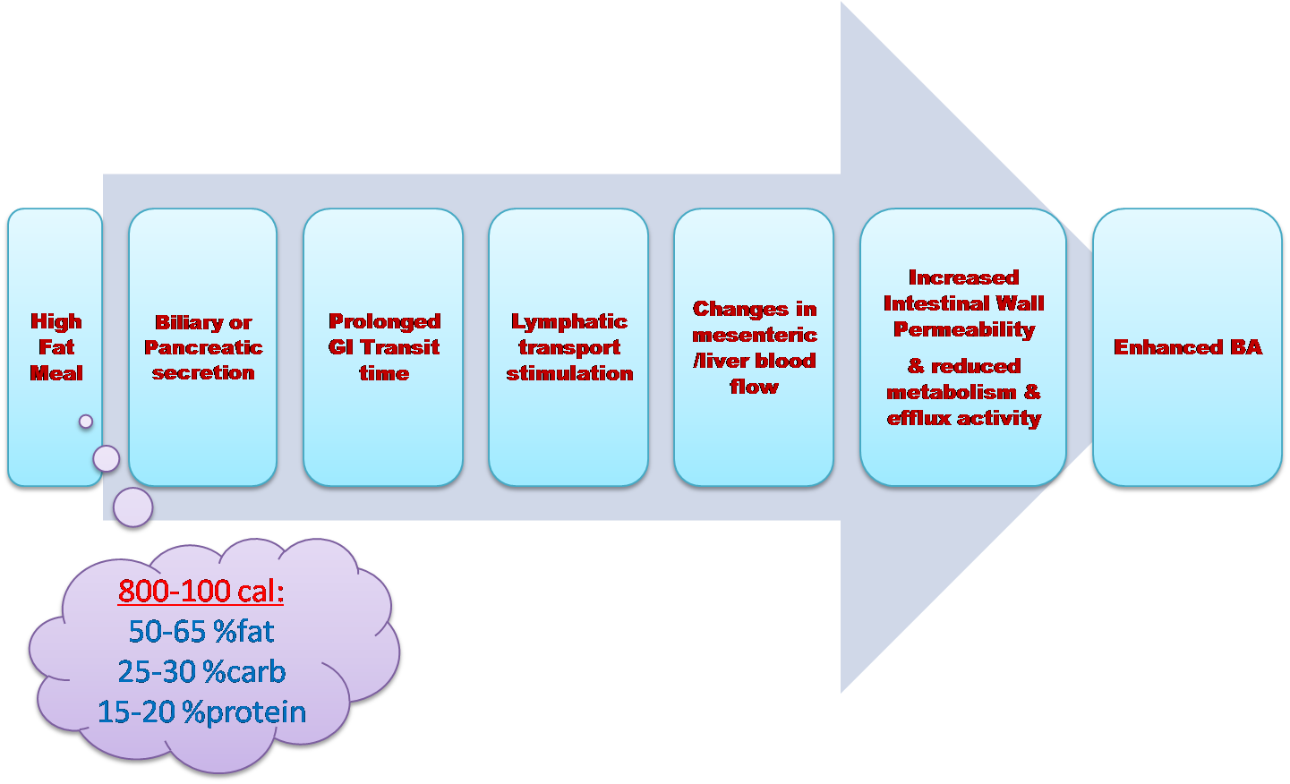
LBODDS: Advantages
Active uptake transporters: FATP4/SRB1
Efflux transporters: Pgp/BCRP/MRP

Slide 6
Lipid Delivery: Is this Really New???
A BIG NO (X)
Long been practiced
Vegetable dressings with olive oil, cheese or mayonnaise
Enhance absorption of water-insoluble vitamins/nutrients
Eg.: Fat-soluble vitamins, carotenoids like beta-carotene, lutein, etc.

Slide 7
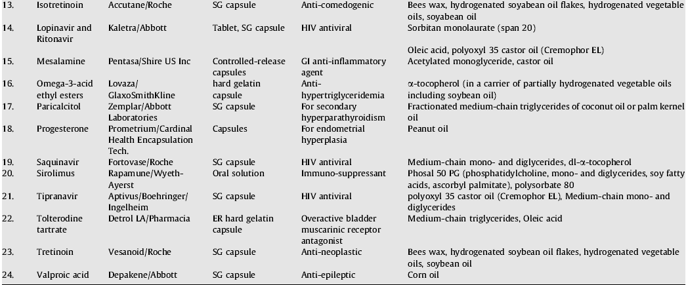
LBODDS: Commercial Products
Country | Product % | No. of Products
UK | 2% | 21
US | 3% | 27
Japan | 4% | 8

Slide 8
PRESENTATION SCOPE
Understanding of lipids
Understanding the role of lipids in the process of BA enhancement
Mechanisms involved in the digestive process & transcellular transport
LBODDS formulation design approaches
Evaluation of LBODDS

Slide 9
Lipids: Advantages
Physicochemical diversity
Biocompatibility
Ability to enhance oral BA through lymphatic delivery

Slide 10
Lipid Delivery: Challenges!
Complex physicochemical properties
Challenges in stability & manufacturing
Limited solubility of some poorly water-soluble drugs in lipids
Pre-absorptive gastrointestinal processing
Lack of knowledge about the in vivo behavior and influence of co-administered drugs/lipids
Lack of predictive in vitro and in vivo testing methodologies

Slide 11
Well…I’m a Formulator… What should I Know about LBODDS???
In-depth knowledge of the GI digestive process of lipid
Ability to interpret biopharmaceutical properties of lipid formulations
Designing knowledge of relevant in vitro tests to mimic the physiological environment for the lipid formulation
Biorelevant dissolution media
In vivo colloidal behavior of the LBODDS

Slide 12
Lipids: Classification
Lipids
Simple Lipids (Esters of FA + Alcohol)
Compound Lipids
Derived Lipids
Associated Substatnces
1
Phospholipids
1
FA
1
Carotenoids
Fats
(FA + Glycerol)
Waxes
(FA + Alcohol)
2
Glycolipids
2
Glycerides
2
Tocopherols
3
Sulpholipids
3
Alcohols
3
Fat sol. vitamins
Solid
(Fats)
Liquid
(Oils)
4
Lipoproteins
4
Bases
4
Steroids

Slide 13
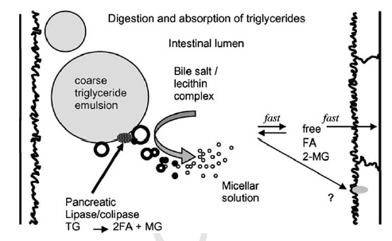
Lipids: In-vivo Fate
Digestive Phase | Absorption Phase | Circulatory Phase
Autocatalytic Process
Physical breakdown of lipids into coarse emulsion
Hydrolysis of TGs into FAs and MGs
Mixed-micelle formation with bile salts and/or vesicle formation of FAs + TGs
Carrier Process
Entry into enterocyte by passive diffusion, facilitated diffusion and active transport
Formation of TG & PL from absorbed FA & MG
Formation of chylomicron and storage in golgi apparatus
Exocytosis into extracellular phase
Size-selective Process
Lipophilic drugs with logP > 5 with TG solubility > 50 mg/ml enters lymphatic delivery
Chylomicrons are big in size and access lymphatic transport
FFA < 12 carbon absorbed by portal and more than that by lymph

Slide 14
Lipids: In-vivo Fate

Slide 15
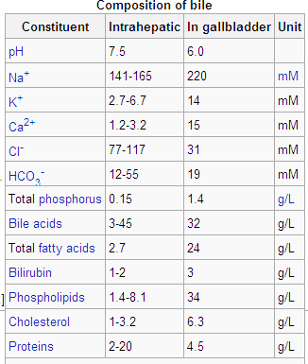
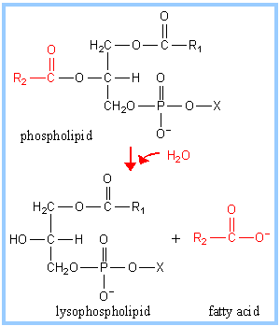
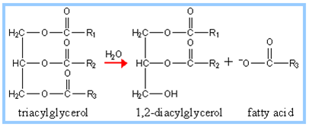
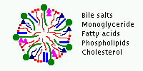
Lipid’s Fate: Digestive Phase
Drains Blood from spleen, pancreas & digestive organs
lipid
HCO3 – neutral environment – max. lipase/colipase activity
More FA stimulates cholecystokinin into portal circ.
This stimulates pancreas to release more TG lipase/co-lipase
Antral contraction shear
Retropropulsion
Gastric emptying
lipid
Key Points to Ponder
SECRETIN
For digesion of lipids: bile acid, phospholipid, enzyme (lipase/co-lipase/phospholipase) , and HCO3- are important
Long chain FA (~2 g) stimulate gall bladder contraction and elevate intestinal biliary lipid accumulation compared to MCTs
In vivo solubilization capacity depends on both lipophilicity and chemical structure of the drug and nature of endo/exogeneous lipids.
Enzymatic action is interfacial process and the lipolysis is enhanced in formulations with good dispersability like SNEDDS/SMEDDS
SNEDDS/SMEDDS maximize rate of drug partitioning into the aqueous intestinal fluids and provide consistent BA.
FA & MG – partially ionized – potent emulsifier – promote binding of co-lipase-lipase complex to emulsion surface
HCO₃
Co-lipase
Lipase
Secretion of bile from gall bladder
Bile Salt, Phospholipid, Cholesterol, HCO₃⁻
_{Pancrease secretes} _{Phospholipase}
Micelle/Mixed micelle/vesicle formation with bile salts and phospholipids
Solubilization of precipitated/released drugs

Slide 16
Lipid’s Fate: Absorptive Phase
Chylomicron Exocytosis
Chylomicron Storage
Chylomicron Formation

Slide 17
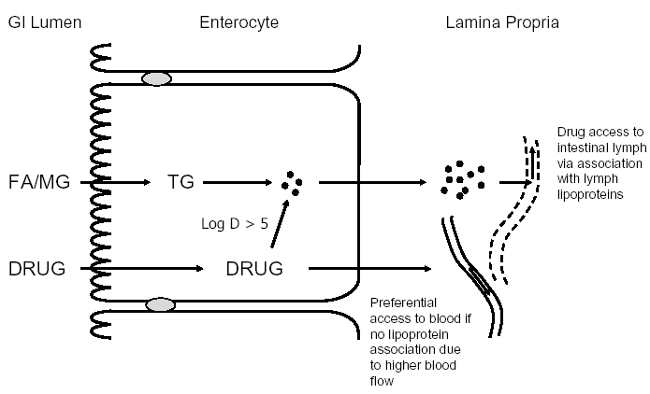
Lipid’s Fate: Circulatory Phase
Points to Ponder
Lymph delivery is size-selective transport
LCT is necessary for stimulation of lipoprotein formation and lymphatic pathway
Free FA chain length & composition and size of the lymph lipid precursor pool in the enterocyte play important role
FFA <12 carbon absorbed by portal and more than that by lymph
High unsaturated chain length produce larger size lipoprotein and enhance lymph delivery
Lymph fluid with fats drains into left subclavian vein through thoracic duct and thus bypass first pass metabolism
Micelles/mixed micelles become monomers in the blood due to large volume dilution, but chylomicrons stay intact for long time and release drug/fat slowly
Critical step
TG Sol. >50 mg /ml
SCT/MCT

Slide 18
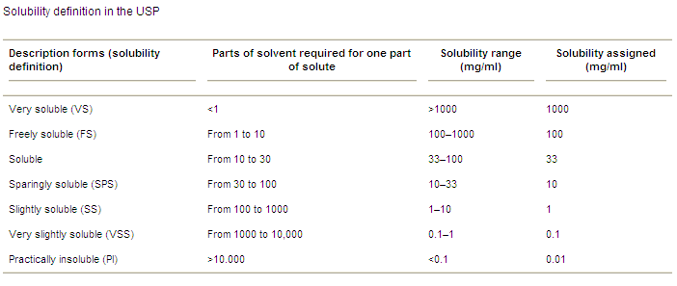
Effect of Food on BA
No Effect
Increases
Decreases
Decreases?

Slide 19
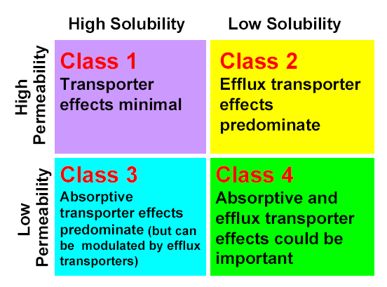
What’s the Rationality???
No Effect: (No action)
Passive diffusion thro’ membrane
Saturate cellular transporter (efllux/absorptive)
Minimal transporter drug interaction
Increased: (Dual action)
Passive diffusion thro’ membrane
Enhanced solubility
Saturation of efflux transporter by enhanced solubility
Decreased: (inhibition)
Inhibition of uptake transporters (these drugs need this transporter for permeability due to poor permeability)
Decreased?: (inhibition)
Inhibition of uptake transporters (these drugs need this transporter for permeability due to poor permeability)

Slide 20
Effect of LBODDS on BA
Minimize gut wall efflux
Reduce enzymatic degradation
No change in BA
Minimize gut wall efflux
Reduce enzymatic degradation
Increase solubilization
Enhance BA
High metabolism
Minimize gut wall efflux
Reduce enzymatic degradation
Enhance BA
Minimize gut wall efflux
Reduce enzymatic degradation
Increase solubilization
Enhance BA

Slide 21
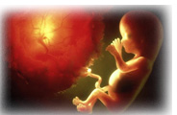
Clinical Pharmacology & Biopharmaceutics Related Journals
Clinical & Experimental Pharmacology
Pharmaceutical Care & Health Systems
Journal of Developing Drugs

Slide 22
For more details on conferences related to Clinical Pharmacology & Biopharmaceutics Journal please visit the link given below
http://www.pharmaceuticalconferences.com/

Slide 23
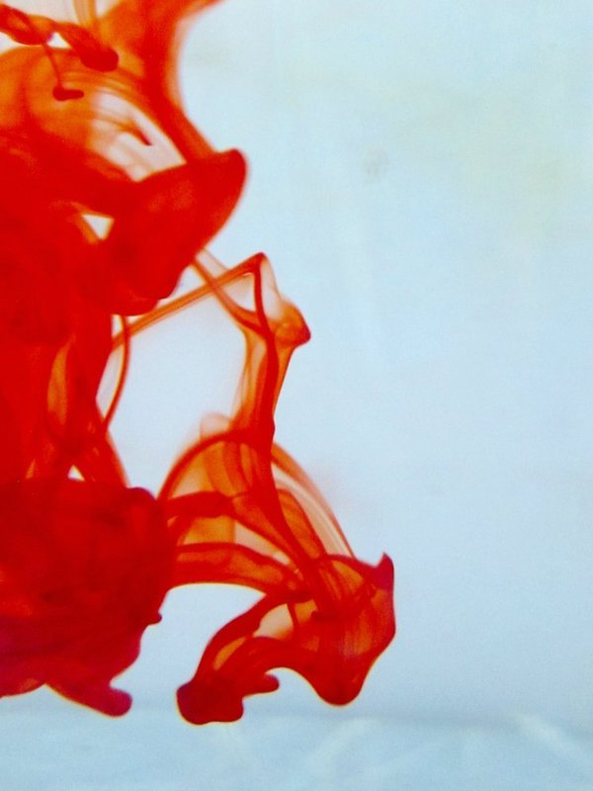
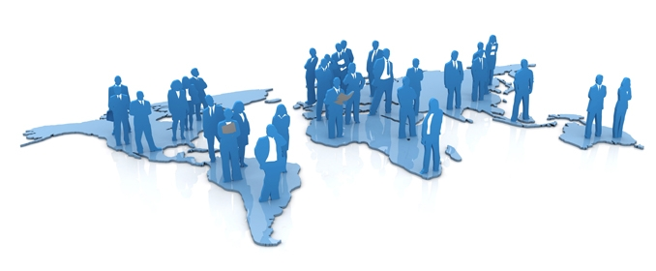
OMICS International Open Access Membership
Open Access Membership with OMICS International enables academic and research institutions, funders and corporations to actively encourage open access in scholarly communication and the dissemination of research published by their authors.
For more details and benefits, click on the link below:
http://omicsonline.org/membership.php

