Slide 1


OMICS INTERNATIONAL
OMICS International through its Open Access Initiative is committed to make genuine and reliable contributions to the scientific community. OMICS Group signed an agreement with more than 1000 International Societies to make healthcare information Open Access.
Contact us at: contact.omics@omicsonline.org

Slide 2
OMICS Journals are welcoming Submissions
OMICS International welcomes submissions that are original and technically so as to serve both the developing world and developed countries in the best possible way.
OMICS Journals are poised in excellence by publishing high quality research. OMICS International follows an Editorial Manager® System peer review process and boasts of a strong and active editorial board.
Editors and reviewers are experts in their field and provide anonymous, unbiased and detailed reviews of all submissions. The journal gives the options of multiple language translations for all the articles and all archived articles are available in HTML, XML, PDF and audio formats. Also, all the published articles are archived in repositories and indexing services like DOAJ, CAS, Google Scholar, Scientific Commons, Index Copernicus, EBSCO, HINARI and GALE.
For more details please visit our website: http://omicsonline.org/Submitmanuscript.p

Slide 3

Structure, Folding, and Interactions of the Fibroblast Growth Factors
T. K. S. Kumar
Department of Chemistry & Biochemistry
University of Arkansas, Fayetteville, AR

Slide 4
Chemistry and biology of FGFs
FGFs are ~17 kDa proteins that bind to heparin.
contain 3 conserved cysteine residues but lack disulfide bonds.
contain a conserved tryptophan residue which can be used as an
optical probe to monitor global structural changes in the protein.
Craniofacial syndromes
(Apert syndrome)
Angiogenesis
(neovascularization)
Role(s) of FGFs
Tumor growth
Cell differentiation
Wound healing

Slide 5
Three-dimensional solution structure of
acidic fibroblast growth factor (FGF-1)
Determination of the 3D solution structure
Of proteins involves two major steps.
Spatial assignment of all atoms in the protein
Establishment of the spatial distance between various atoms.

Slide 6
Spectra
1D
optimized
Magnet
pulse sequence
2D
3D
13_{C}
Computer
3D structure
(Aria, cyana)
Molmol/Insight II
1_{H}
Adapted from http://structbio.vanderbilt.edu/chazin/

Slide 8
1D NMR spectrum of FGF-1
The resolution obtained in a 1D proton spectrum is not sufficient to identify all the protons in the protein.

Slide 9
3D NMR data on FGF-1
Sample – ¹⁵N, ¹³C FGF-1
HNCA-HNCOCA-CBCACONH-HNCACB
G33 G34 Y35 F36 L37 R38
N32
Triple resonance data provide through-bond connectivity between various atoms

Slide 10
Complete resonance assignment of FGF-1
¹H-¹⁵N HSQC of FGF-1
G47
I144
T75
T110 T131
G134 G129
G76
G34
G43
N106
T137
I56
T48 G124
S83
G85
G33
S64
S94
C97
H138
H116
Y35
G66 Y55
S52
E74 D118 S72
S152
A143
15_{N}
K126 V68
D120 M81^{N32} Y1^{Q77}
08
W121
Q57
Q59
E96 G140
K130 ₄₁
Y78 F36 F146
Y88 F99
L79
S153
E95
N128
Q1
L98
Y111
N109
^{L27} Y69 K142
V151 K119
K26
E105
V123 V 65 R136
I125
L100
F139 Q86
D50
S31
E67 _{K44} V115
I39
L145
Y61 F122
V45
K132
L147
F60 L37
I70
L87
A117
L28 W121^{ε}H
F40 _{A62} E63 Y29 _{R51}
E104 R38
K71 A80
R49 D82
L103 D154
D53
L149
L58 C30
K114
D46
E101
R102
L73
1_{H}
¹H-¹⁵N HSQC spectrum represents the finger-print of the backbone
conformation of a protein

Slide 11
NOE data of FGF-1
¹⁵N HSQC-NOESY
G33 G34Y35 F36 L37R38I39 F40 ₂
5
10
¹H-¹⁵N HSQC-NOESY This experiment provides the NOE- based distance constraints useful for calculating the three-dimensional structure of the protein
2D-NOESY, 3D ¹⁵N HSQC-NOESY & ¹³C HSQC-NOESY data provide through-bond and through- space connectivity between various atoms in a protein.

Slide 12
3D solution structure of FGF-1
FGF-1 consists of 12 antiparallel β-strands arranged into a beta-trefoil structure
The β-strands are arranged in three layers enclosing a hydrophobic core.
₁₁11₁₁
₁1₁0₀₀
9₉
₈₈8
₂2₂
1¹1
1₁2₂ 3₃
7⁷7
₅5
₄4
₆6
N-terminal
C-terminal
C-terminal N-terminal
RMSD for structured region - 0.60Å RMSD for the whole protein – 0.97Å
Kumar et al., J. Biol. Chem. (2000) 275, 39444-39450

Slide 13
Role of heparin in the mitogenic
activity of FGF-1

Slide 14
FGF-1 exhibits its cell proliferation activity by binding to its cell surface receptor
Heparin is believed to be the secondary receptor for FGF-1.
Dimerization induced by heparin is considered to be pre-requisite
for FGF-1 action
heparin
FGF
FGF
+
step-1
FGF FGF
D1
D1
D1
D1
D2
D2
D2 D2
FGF FGF
D3 D3
step-2
D3
D3
TM
TM
2 [ATP]
cytoplasm
P
P
TK
cytoplasm
TK TK
TK
FGF receptor
Cell proliferation

Slide 15
Is the heparin-induced oligomerization of
FGF mandatory for its mitogenic activity?
FGF exhibits mitogenic activity even in mutant Chinese Hamster Ovary Cells deficient in heparin (Roghani et al. J. Biol. Chem. (1997) 269, 3976-84)
Mutants of FGF which lack heparin binding affinity exhibit mitogenic activity in NIH3T3 cells (J. Vasc Surg. (1998) 31, 382-90).
These studies suggest that heparin per se is not required for the cell
proliferation activity of FGF

Slide 16
Structures of heparin and sucrose octasulfate (S0S)
SOS has been shown to be good structural and functional mimic of heparin
-O₃SOH₂C O
H
6
CH₂SO₃-
O
4
O
1'
CH₂SO₃-
-O SO
5
H
OH
O
3
2
H
O
H
-O₂C
NH
-O₃SO
3
H
H
OSO -
2'
5'
O
3 1
O
H
-O₃SO
CH₂SO₃-
6'
O
-O₃S
n
-O₃SO
3'
4'
H
Heparin disaccharide
Sucrose Octasulfate (SOS)
Heparin Sucrose octasulfate
Sulfated glucosamine-iduronic acid polymer
Homogeneous heparin samples are difficult to prepare.
Volkin et al (1993) Biochim. Biophys. Acta. 1203, 18.

Slide 17





SOS supports the mitogenic activity of FGF-1 on NIH3T3 cells treated with heparinase
100
80
FGF + heparin
FGF + SOS
60
40
FGF
20
Control
0
Control –deheparinized cells grown in 5% calf serum
Kumar et al, Protein Sci. (2002) 11, 11050-11061

Slide 18

FGF-1 is a monomer in the presence of SOS
Size exclusion data
Sedimentation velocity data
73.17
FGF
FGF+SOS FGF + heparin
FGF + Heparin
90.64
Absorbance @ 280 nm
Absorbance
Absorbance
Absorbance
FGF + SOS
94.16
Radius Radius Radius
Estimations from Sedfit: FGF(15±2 kDa); FGF+SOS (17±1 kDa); FGF + heparin (39±2 kDa, 70 kDa, and 92±2 kDa)
FGF (Free)
Retention Time (in minutes)
NMR relaxation data
Overall correlation time (τ_{m}) = T₁/T₂
τ_{m}= 9.35±0.1 ns (FGF)
τ_{m} = 10.55±0.2 ns (FGF + SOS)
τ_{m} = 24.13±0.4 ns (FGF + heparin)
Oligomerization of FGF-1 induced heparin is not mandatory for its cell proliferation activity

Slide 19
Both heparin and SOS stabilize FGF-1
Free FGF
FGF+heparin
FGF+SOS
Kumar et al, Protein Sci. (2002) 11, 11050-11061
SOS and heparin appear to support the mitogenic activity of FGF-1 by protecting it against proteolytic enzymes active at the cell surface

Slide 20
SOS binding sites in FGF-1
SOS binding sites are spread between residues, 126-142.
140
120
100
Weighted Average Chem.l Shift Change
H138
G134
S135
80
S135
60
40
G33
126
142
N32
20
0
31 43 55 67 79
91 103 115
127 139
Residue Number
Cyan –FGF Red – FGF +SOS
Residues located at the c-terminal are involved in binding to SOS
Kumar et al, Protein Sci. (2002) 11, 11050-11061

Slide 21

SOS binds to FGF-1 at the heparin binding site
Intermolecular NOEs from 3D ¹H-¹³C isotope filtered NOESY
Structure of the FGF-SOS complex
W2 = 28.53
W1
1.0
1.0
K130 Hδ/H1
K130 Hδ/H1
1.5
W3
5.8
5.6
5.4
5.2
5.0
4.8
W2 = 29.14
W1
K127 Hδδ/H1’a
1.5
K127 Hδδ/H3’
2.5
W3
5.1 4.9 4.7 4.5 4.3 4.1
W2 = 43.97
W1
3.0
R136 Hδδ/H3’
R136 Hδδ/H1’b
3.5
W3
5.1 4.9 4.7 4.5 4.3 4.1
Lys126 C H-H`; Lys130 C H-H3`; Lys130C H-H2,
FGF exists as a monomer upon binding to SOS
and Lys142C H-H3`
3D ¹H-¹³C isotope filtered NOESY provides NOE information between ¹³C-¹H (in FGF)
and ¹²C-₁H atoms (in SOS). Kumar et al., J. Biol. Chem. (2006) 277, 47507-46516

Slide 22
Backbone dynamics of FGF-1
Protein molecules experience ‘breathing” motions
Backbone dynamics of proteins can be studied based on R1, R2
and NOE relaxation measurements
FGF FGF+ SOS
R₁ (S⁻¹)
R₁ (S⁻¹)
R₂ (S⁻¹)
Av R₂ = 9.8 ± 0.2 s⁻¹
R₂ (S⁻¹)
Av R = 13.4 ± 0.2 s⁻¹
2
NOE
NOE
Residue Number
Residue Number
The average conformational flexibility of FGF appears to decrease in the presence of SOS.
Kumar et al., J Biol Chem. (2003)278, 17701-9

Slide 23
SOS stabilizes the structure of FGF-1
The order parameter S² defines the degree of flexibility of residues in the protein
FGF
Average S² = 0.73± 0.1
FGF + SOS
Average S² = 0.81± 0.1
SOS decreases the overall flexibility of the FGF molecule
J Biol Chem. (2010)285, 34220-34230

Slide 24
Conclusions
SOS is both a structural as well as a functional mimic of heparin.
FGF exists as a monomer in the presence of FGF.
Heparin-induced oligomerization of FGF is not a pre-requisite for its
cell proliferation activity.
Both SOS and heparin appear to support the cell proliferation activity by stabilizing FGF.
SOS binds to the putative heparin binding site in FGF.

Slide 25
Structure of the FGF receptor
FGF exhibits its cell proliferation activity by binding to its cell surface receptor.
D2, D3 modules of the extracellular domain of FGFR are sufficient for the FGF signaling
process.
heparin
FGF
FGF
+
D1
D1
D1
D1
D2
D2
D2 D2
FGF FGF
D3 D3
D3
D3
TM
TM
2 [ATP]
cytoplasm
P
P
TK
cytoplasm
TK TK
TK
Cell proliferation

Slide 26
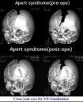
Mutations in FGFR are linked to craniofacial syndromes and urinary bladder cancers
Mutations in FGFR lead to gain of FGF function
www.id.yamagata-u.ac.jp/
(A, P)
R251E (P, C)
D281A (P)
S252W, P253R (A)
S351C
Y375C (BS)
L164F
 | D1 |  | D2
D2
D3
TM
K1
D3
TM
K1
TM
AA D2 D3 K1
61
109
149 253 278 342
Functional domains of FGFR
Cranial defects in Apert syndrome
A – Apert syndrome; C.S – Cronzon syndrome; P-Pfeiffer syndrome;
BS Beare-Stevenson syndrome

Slide 27
Structure of the D2 domain
D2 domain consists of 103 amino acids (residues,149 to 253) Resonance assignments were accomplished using a variety of triple resonance NMR experiments
HSQC of D2
Kumar et al., J. Biomol. NMR. (2004) 30, 99-100

Slide 28
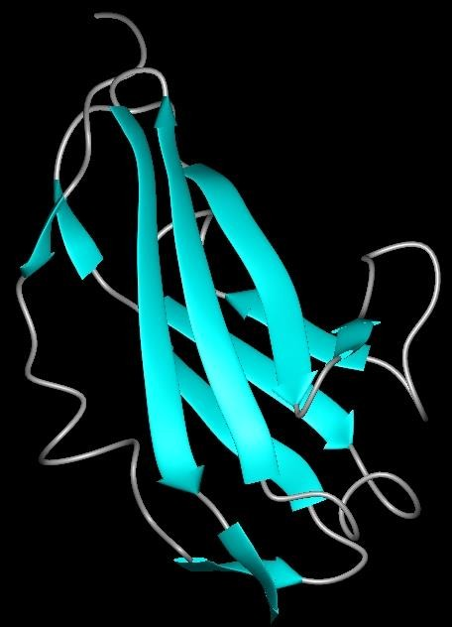
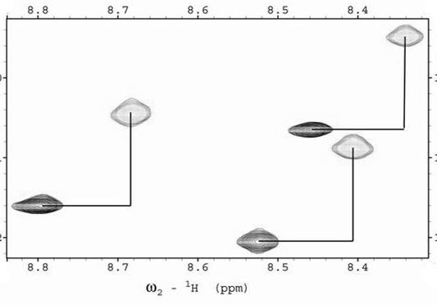
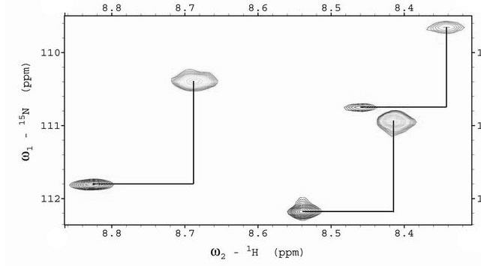
3D solution structure of the D2 domain of FGFR
Backbone RMSD based on NOE constraints ~ 0.54 Å Backbone RMSD based on NOE + RDC constraints ~ 0.45 Å
RDC
Isotropic medium
G82
T43
-94.7 Hz
G109
-93.1 Hz
5
-94.7 Hz
1
4
10
15_{N}
7
6
aligned medium
T43
G82
9
8
-88.9 Hz
G109
3
-115.4 Hz
-99.9 Hz
11
12
1_{H}
Kumar et al., Biochemistry (2005) 44, 15787-98

Slide 29
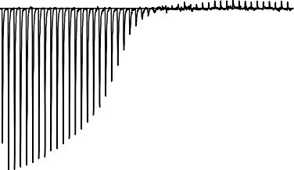
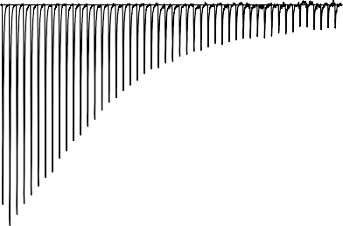
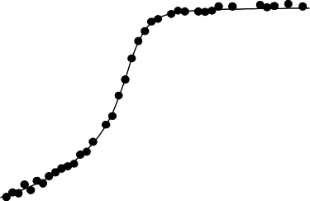
Isolated D2 domain is functional
D2 domain vs SOS
Time (min)
0 25 50 75 100 125 150 175 200
D2 domain vs FGF
Time (min)
0 33 67 100 133 167
A
0.
2
0.1
0.0
200
0.0
-0.1
-0.2
-0.3
-0.4
-0.5
-0.6
-0.7
-0.08
µcal/sec
-0.2
µcal/sec
-0.4
-0.6
-0.8
K_{D} ~ 27 μM
K_{D} ~ 65 nM
kcal/mole of injectant
0
-2
kcal/mole of injectant
-2
-4
-4
-6
0.0 0.25 0.5 0.75 1.0
Molar Ratio
1.25
1.5 1.75
-8
0.0
0.5 1.0 1.5
Molar Ratio of SOS/D2
Kathir & Kumar, unpublished results
D2 domain binds to both SOS (heparin) and FGF. The growth factor does not
per se require heparin for binding to its cell surface receptor

Slide 30
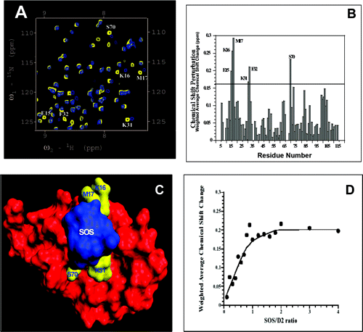
Mapping the SOS (heparin) binding sites in D2
domain
Glu15
D2 domain binds to SOS in a 1:1 stoichiometry.
Kumar et al., Biochemistry (2010) 44, 15787-98
The residues in D2 domain that possibly bind to SOS include E15, K16, M17, K31, F32 and S70

Slide 31

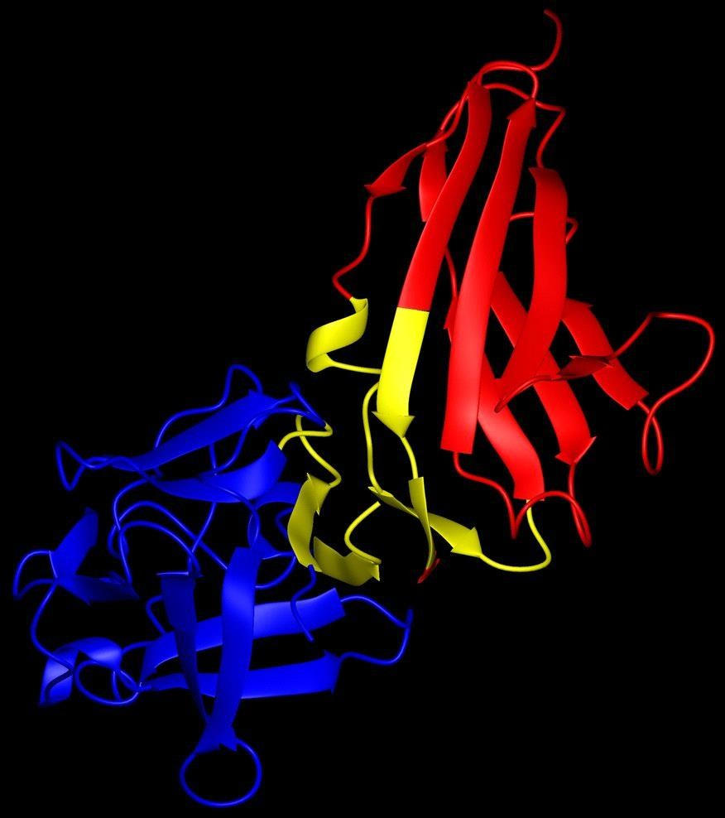
FGF-D2 domain binding interface
¹⁵N D2 vs unlabeled FGF
L21
V106
R108
Structure of the D2-FGF complex
% crosspeak intensity
100
80
K16
K19
V76
60
E56
G109
_{E15} T98
G20
F132 ^{N28}
L14 V103
S138
40
20
0
S138W (Apert)
K16
20 40 60 80 100
T98
Residue number
¹⁵N FGF vs unlabeled D2
100
L14
C15
H93
L21
V106 R108
% crosspeak intensity
A103
80
S17
S138
L46
S47
Y55
F132
N28
60
F132
L14
A103
40
S138
R108E
20
(Cronzon, Pfeiffer)
0
10
30
50 70 90 110
Residue Number
130
Kathir & Kumar, unpublished results

Slide 32
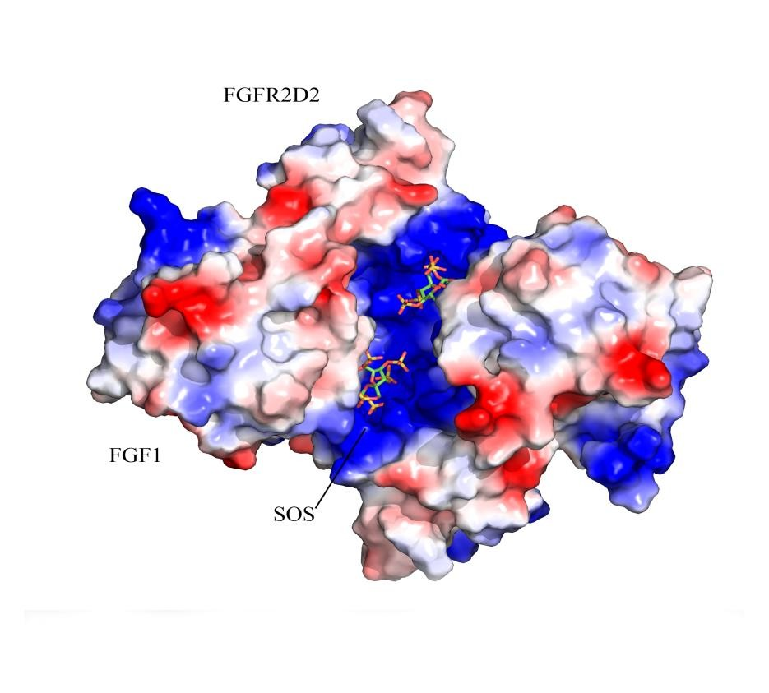
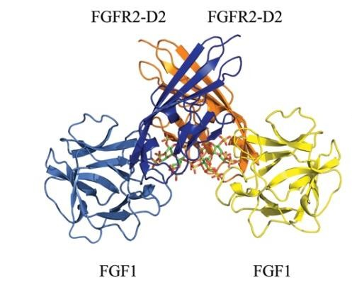
3D crystal structure of the FGF-receptor-SOS ternary complex
D2 domain
FGF
Kumar & Sakon, unpublished results

Slide 33
Conclusions
➢The 3D solution structure of the D2 domain of the FGFR has been solved at high resolution.
➢The SOS (heparin) binding sites on D2 have been mapped
➢The structure of the FGF- D2 domain binding interface has been characterized

Slide 34
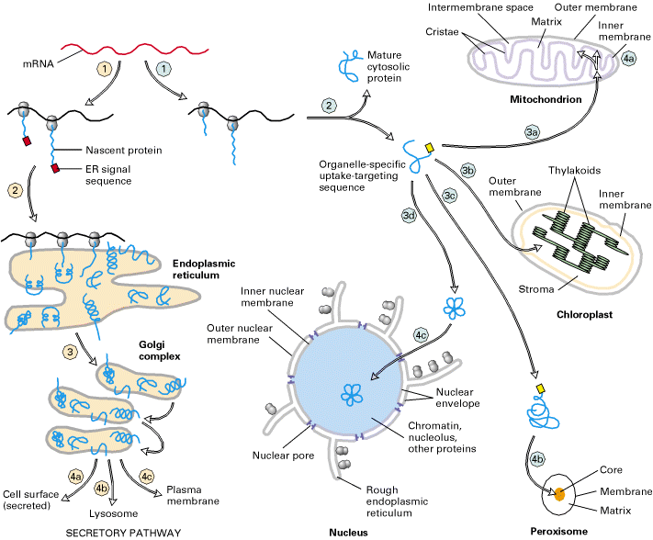


Overview of sorting of nuclear-encoded proteins in eukaryotic cells
Proteins secreted by the classical ER-Golgi apparatus secretion pathway typically contain N-terminal signal peptides. FGF-1 lacks N-terminal signal peptide.
www.ncbi.nlm.nih.gov
SP
FGF
FGFR
FGFR

Slide 35
List of signal peptide-less proteins
Secretory transglutaminase
Thioredoxin
p40 synaptotagmin Interleukins
Fibroblast growth factors Spingosine kinase Annexins
TAT-HIV integrase; Engrailed-2
Herpes VP 22 protein HM GB1
Galectins
Foamy virus bet protein
Leishmania HASPB protein.
Prudovsky & Kumar et al.(2003) J. Cell Sci., 116, 4871-81; Kumar et al (2013) Int. J. Mol. Sci., 14,
3734-72 .

Slide 36
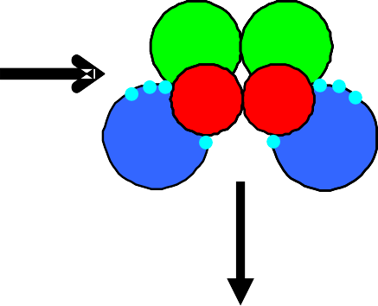
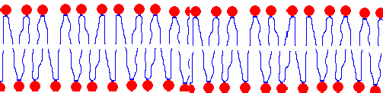
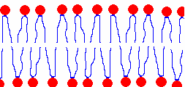

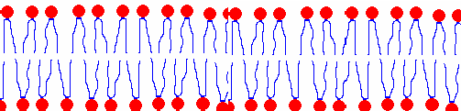
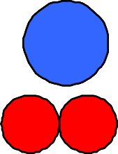
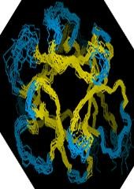
Proposed mechanism for the non-classical release of FGF-1
3D structures of FGF and the C2A domain of syt1 are available
Multi-protein Complex
C2A
Prudovsky and Kumar.,
_{Cu}2+
FGFGF-F1 FGFGF-F1
J. Cell Sci. (2003)
FGF
S100A13
116,4871. & Int. J. Mol.
Sci., (2013) 14, 3734-
72
S1S0100A01A313
C2A
C2A
Under Heat Shock
FGFGF-F1 FGFGF-F1
C2A
GSH
D2
S100A13
FGF-1
FGF-1
D3
Membrane
Cytoplasm Domain
Autophosphorylation
Cell proliferation

Slide 37
Open Questions
1a. What is the structure of the FGF multiprotein complex?
b. What are the sequence of structural events leading to the formation of the FGF release complex?
2a. What is the exact role of Cu²⁺ in the organization of the multiprotein complex?
b. Which of the protein components in the release complex
bind to Cu²⁺?
3. How is the FGF release complex transported across the cell membrane?

Slide 38

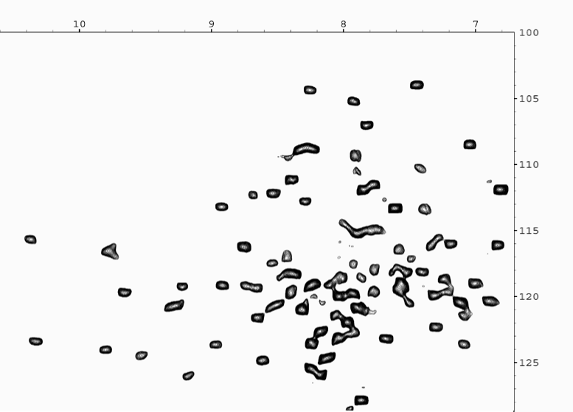
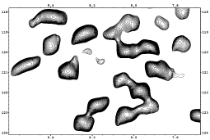
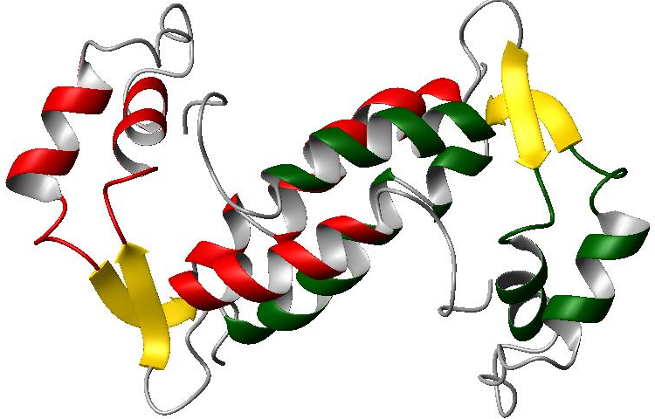
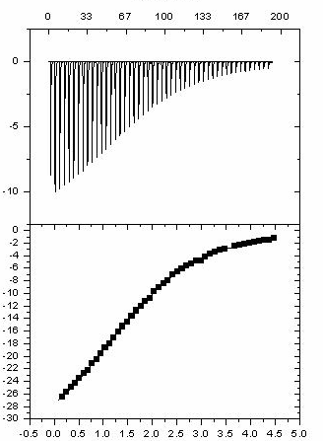
3D solution structure of S100A13
S100A13 is a ~25 kDa homodimer consisting of two calcium binding EF hands. Each monomer of S100A13 consists of four helices
D68 K39 E10 A
_{A24 D57 I13} L83
D52
_{E4 V17} ^{E58} G31 G25
^{A42} E14^{M60} E40 ^{G81} _{A92} K59 Y76
E37 M1 _{K89} G94
^{L41} V-1 S32
A3 A12 ^{T43}
V65 V87
K97 _{R29 L6}
_{G28} T62
T7
_{S74} Q45
G54
S55 _{N66}
_{S69} Q67 _{F21}
S18 ^{I35} _{T5} E70
_{E27} Q44 _{I80 K85} K61
T19 ^{L49} L50
H48 ^{R88} L93 _{R78}
F20
_{E8} ^{F38 T15} L9 D64 F23
V54 E90 L79
_{A11} T22 I95 ^{K51}
^{W77} L63 ^{E86}_{N36}
^{A84} L46 ^{R26}
L71 _{R72} E82 _{E75} N34 _{F73}
A2 R96
^{L33} V16 L-2
L0
K98
D68 K39 E10 A
_{A24 D57 I13} L83
D52
_{E4 V17} ^{E58} G31 G25
^{A42} E14^{M60} E40 ^{G81} _{A92} K59 Y76
E37 M1 _{K89} G94
^{L41} V-1 S32
A3 A12 ^{T43}
V65 V87
K97 _{R29 L6}
_{G28} T62
T7
_{S74} Q45
G54
S55 _{N66}
_{S69} Q67 _{F21}
S18 ^{I35} _{T5} E70
_{E27} Q44 _{I80 K85} K61
T19 ^{L49} L50
H48 ^{R88} L93 _{R78}
F20
_{E8} ^{F38 T15} L9 D64 F23
V54 E90 L79
_{A11} T22 I95 ^{K51}
^{W77} L63 ^{E86}_{N36}
^{A84} L46 ^{R26}
L71 _{R72} E82 _{E75} N34 _{F73}
A2 R96
^{L33} V16 L-2
L0
K98
A
D68
K39
E10
HSQC
_{A24 D57 I13} L83
D52
V17
E58
G31
G25
A42
E4
M60
E14
_{A92} K59
E40 Y76
K89 V-1
A12 V87
G81
E37 M1
L41
G94
S32
3D structure of Ca²⁺⁻bound S100A13
A3 K97
V65 R29 ^{L6}
T43
B
T62
B
N-Terminal
H2
H3
H1'
H4
^{H1} H2'
H4'
H3'
C-Terminal
S74
T7
G28 Q45
B
N-Terminal
H2
H3
H1'
H4
^{H1} H2'
H4'
H3'
C-Terminal
S69
G54
S55 _{N66}
Q67
F21
_{I80 K85} K61
E27
S18
I35
T19
Q44
_{T5} E70
H48 E8
F38
T15
T22 A84
L9
^{L49} L50
R88
L93
R78 F20
D64 F23 V54
E90
K51
N36
L79
N-Terminal
W77
A11
I95
L63 ^{E86}
L46
R26
H2
L71
N34 _{F73}
R72
E82
E75
H3
L33
A2
V16 L-2
L0
R96
K98
H1'
Time (min)
A
A
H4
H1
μμcal/sec
H2'
H4'
H3'
Kcal/mole of injectant
C-Terminal
K_{d} ~ 8μM
Molar ratio
Molar ratio
Molar ratio
Molar ratio
Titration of S100A13 with Ca ²⁺
Kumar et al.,J. Biomol. NMR (2005) 32, 257-8; Biophys. J (2006) 91, 1832-43

Slide 39
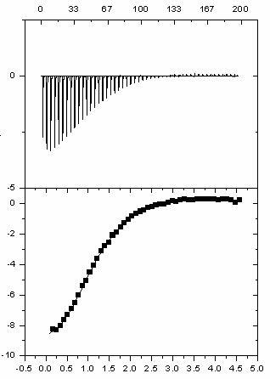
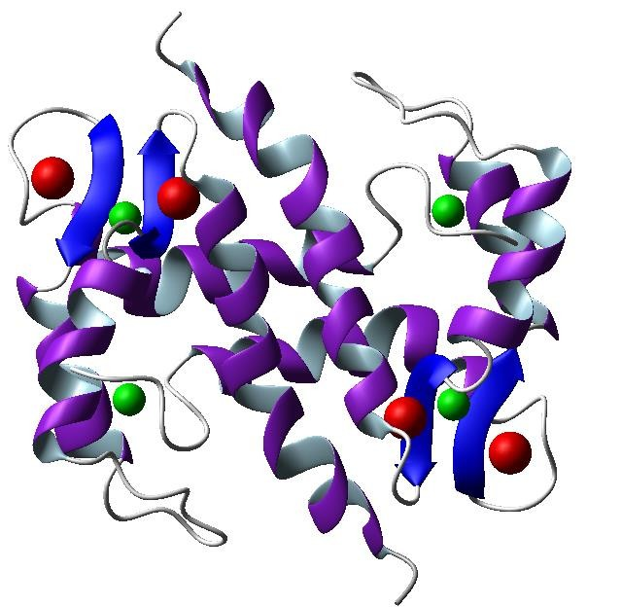
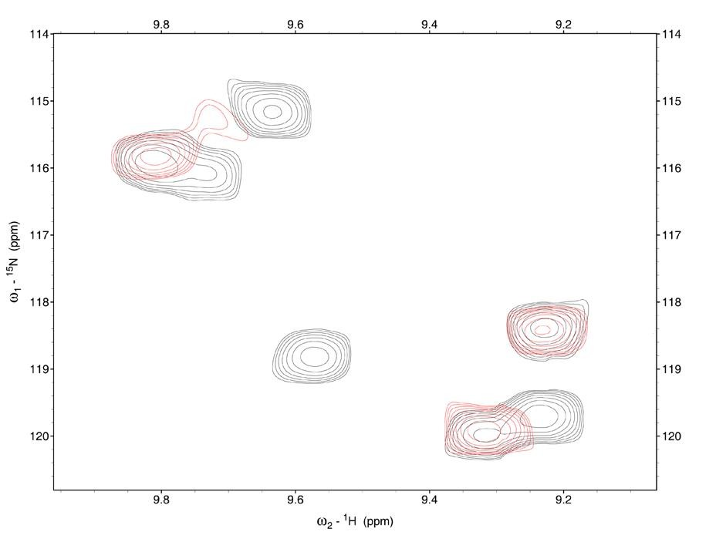
S100A13 binds to Cu2+
Cu²⁺ -S10013 titration
Cu ²⁺ binding sites are distinct from the Ca ²⁺
binding sites in S100A13.
μcal/sec
Kcal/mol of the injectant
BB
K_{d} ~ 120 μM
Molar ratio
red-S100A13 + Cu²⁺
grey – S100A13
E27
H48
E8
A11
Sivaraja and Kumar, Biophys. J. (2006)
91(5):1832-43

Slide 40
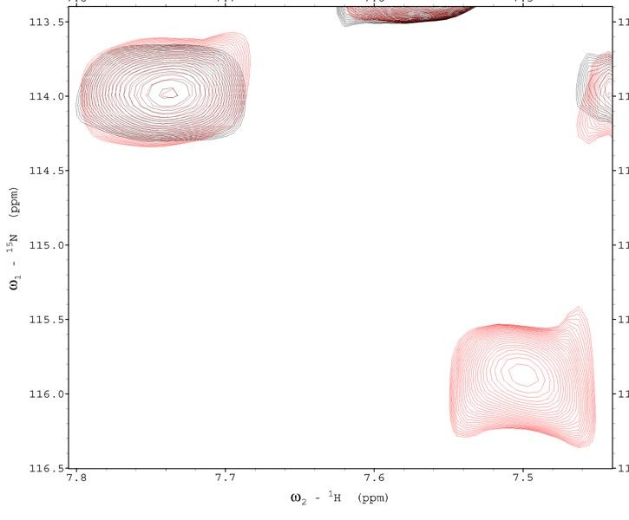
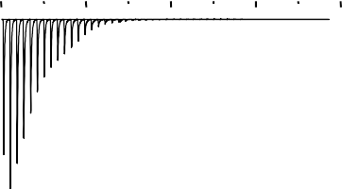
ITC data
0
-5
-10
-15
µcal/sec
K_{d} ~ 25 nM
-20
-25
kcal/mole of
injectant
0
H254
-25
Red-C2A + Cu²⁺
Grey –C2A
-50
0 2 4 6 8 10 12
Molar Ratio
Peak intensity ( arbitrary units)
1.4
B
¹⁵N-crosspeak intensity changes
1.2
1
0.8
0.6
0.4
0.2
0
G253 & H254
K182
D230 F231
F234
D172 G174
D178
K200
D238
V183
A227
D232
145
157
169
181
193
205 217 229 241 253
Raja
Residue number
lingam & Kumar, Biochemistry (2009) 44, 15472-9

Slide 41
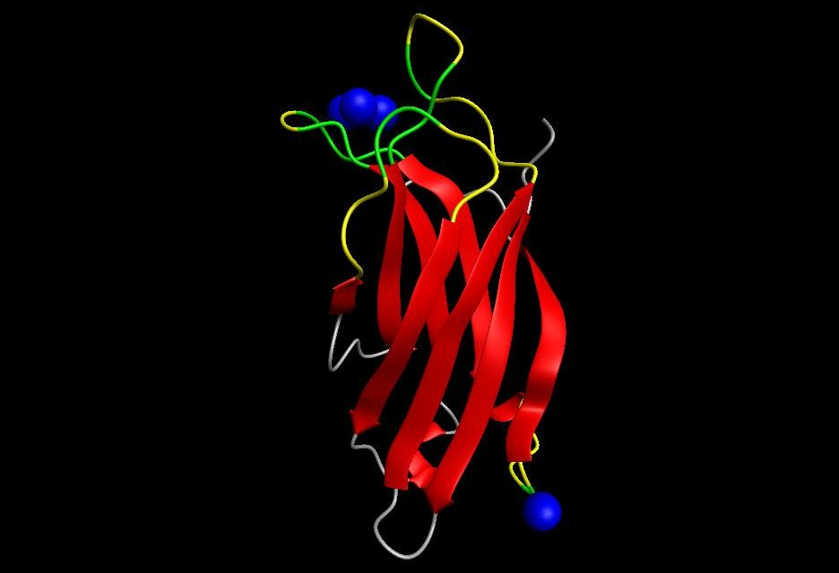

C2A domain binds to 4 Cu2+ ions
Loop1
G174
F234 D232 F231
D238 D230
D172
Loop 3
N-terminal
7
3
4
5
6
8
2
1
Unique Cu ²⁺
binding site
H254
G253
Rajalingam and Kumar
Biochemistry (2009) 44, 15472-9

Slide 42
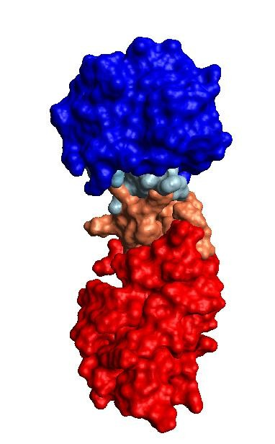
FGF-C2A binding interface
FGF-C2A Titration
Time (min)
100
0
50
150
200
FGF
2.0
1.5
1.0
0.5
µcal/sec
C30
N32
H35
Y139
0.0
20
18
16
14
12
10
8
6
4
L28 D230 F231
D172
K200
kcal/mole of injectant
D238
K
d(app)
~1.2 µM
C2A
0.0
0.5
Molar Ratio
1.0
Rajalingam and Kumar, unpublished results

Slide 43
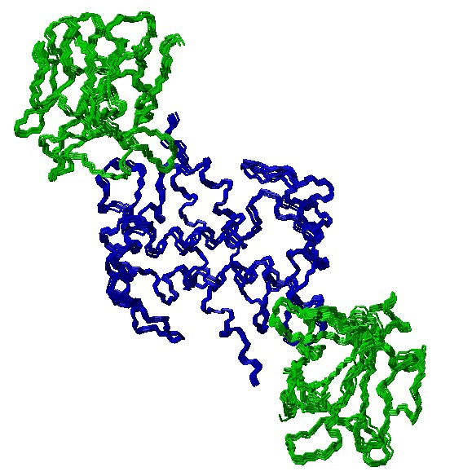
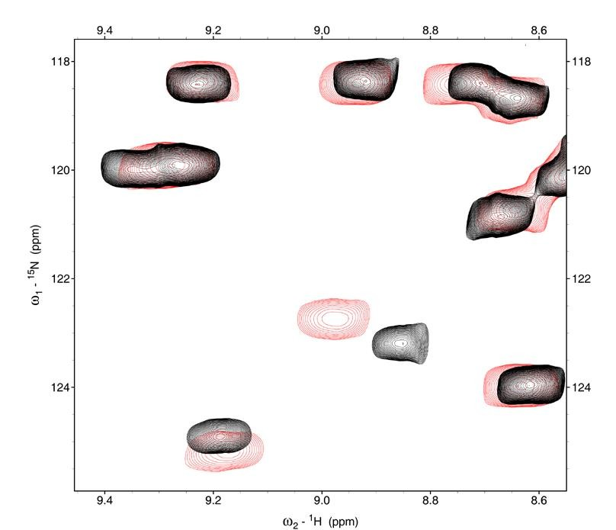
Structure of the S100A13-FGF binary complex
K_{d} ~ 100 μM estimated from ITC experiments
0.3
AA
¹⁵N FGF + unlabeled S100A13
0.25
0.2
0.15
0.1
Chemical shift perturbation ( ppm )
0.05
FGF-S100A13 complex
0
2 8 14 20 26 32 38 44 50 56 62 68 74 80 86 92
Residue Number
T22
W77
R72
L33
Kathir and Kumar (2009) J. Mol. Biol., 381, 49-60
Black – ¹⁵N-S100A13 Red – ¹⁵N S100A13 + unlabeled FGF

Slide 44
Conclusions
A high resolution 3D solution structure of S100A13 has been
determined.
The Cu²⁺-binding sites in S100A13 and the C2A domain of Syt1
have been mapped.
FGF binds to both S100A13 and the C2A domain of Syt1. The FGF- S10013 and FGF-C2A binding interfaces have been characterized.

Slide 45
FGF - Inhibitor interactions

Slide 46
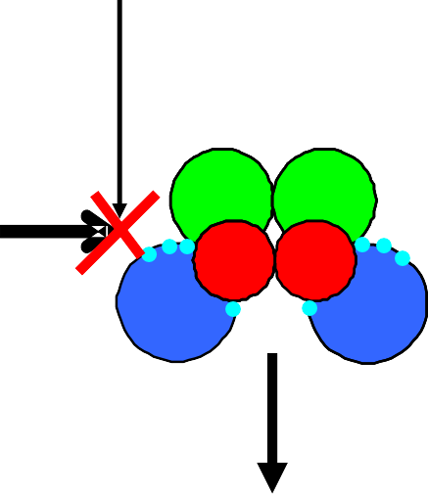

Mitogenic activity of FGF can be inhibited by either preventing the formation of theFGF multiprotein complex or by blocking the receptor interaction.
Amlexanox
Multi-protein Complex
C2A
_{Cu}2+
FGFGF-F1 FGFGF-F1
FGF
S1S0100A01A313
C2A
S100A13
C2A
Under Heat Shock
Suramin
FGFGF-F1 FGFGF-F1
C2A
GSH
D2
S100A13
FGF-1
FGF-
D3
Membrane
CytoplasmDicomain
Autophosphorylation
Cell proliferation

Slide 47
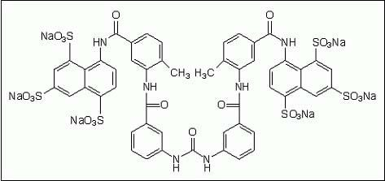
FGF-suramin interactions
Suramin is a well known mitogenic agent. Suramin has been shown
to inhibit the mitogenic activity of FGF. However, the exact
mode of action of suramin was previously not known
Structure of suramin

Slide 48
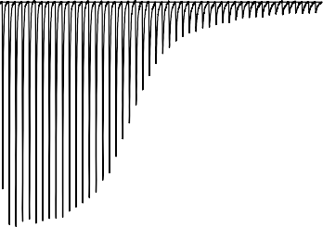
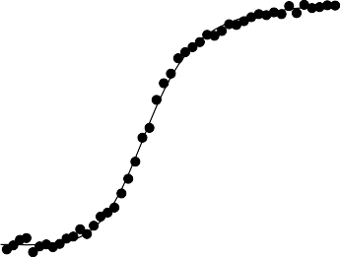
Suramin binds to FGF
FGF:suramin
ITC
Time (min)
AAA
M
75.63
Size exclusion chromatography
0.1
0.0
-0.1
-0.2
-0.3
-0.4
-0.5
-0.6
-0.7
-0.8
2
0
-2
-4
-6
-8
-10
-12
-14
-16
-18
-20
-22
-24
0 25 50 75 100 125 150 175 200
1:0
BBB
T
75.65
µcal/sec
Absorbance @ 280 nm
47.05
Std.MW plot
5
4.84.8
4.6
BSA (65 kDa)
E
1:1
Ovalbumin (44 kDa)
Chymotrypsin (25 kDa)
K_{d (app)}~ 54 nM
log (Mol. Wt)
4.4
CCC
4.2
nFGF (15.146 kDa)
RNAse (13.7 kDa)
47.09
4
Chromo1 (5.049 kDa)
kcal/mole of injectant
3.8
3.6
50
60
70
Retion Time (min)
80
90
75.69
1:1.5
FGF oligomerizes to a tetramer upon binding to suramin
DDD
47.09
0.0
0.5
1.0 1.5
Molar Ratio
2.0
2.5
1:2
Two molecules bind per molecule of FGF
0
50 100 150
Elution Time (min)
Kathir & Kumar, Biochemistry (2006) 45, 899-906

Slide 49
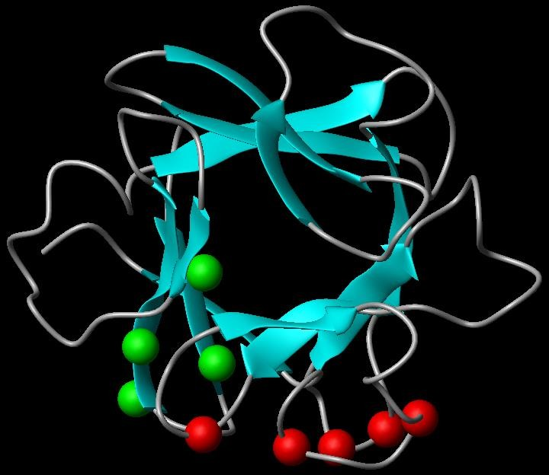

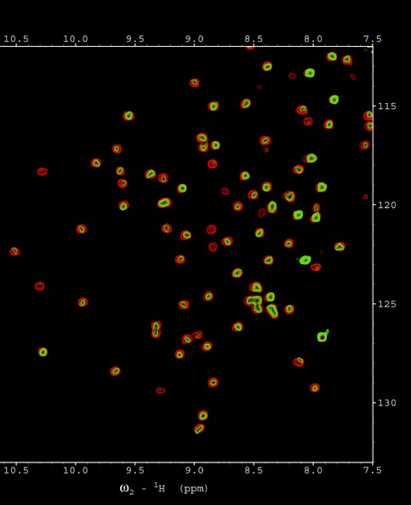
Suramin binding sites on FGF
B N106
E105
Y111
K127
Y139
L28
C30
B N106
E105
Y111
K127
Y139
L28
C30
N106
E105
Y111
K127
Y139
L28
L28
C30
H35
G34
C30
E105
N106 K142
Y139
Heparin binding residues
K127
Receptor binding residues
Suramin binds to both heparin and receptor binding residues

Slide 50










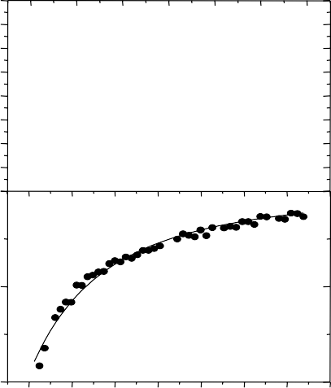

Modes of action of suramin
2
4
Inhibition by oligomerization
+
FGF
suramin
Time (min)
67 100
Time (min)
0.02
0
33
133
167
200
0
25
50 75
100 125 150
0.00
0.10
-0.02
0.05
µcal/sec
-0.04
µcal/sec
0.00
-0.06
-0.08
-0.05
suramin also binds to the D2 domain of the receptor
-0.10
D2+suramin
-0.10 {
D2+FGF}+ suramin
-0.12
-0.140
-0.15
0.4
0.2
0.0
-0.2
-0.4
-0.6
-0.8
-1.0
-1.2
-1.4
-1.6
-1.8
-2.0
-2.2
-2.4
-2.6
kcal/mole of injectant
kcal/mole of injectant
-2
K_{d} ~ 1.06 µM
1.0 1.5 2.0 2.5 3.0
Molar Ratio
-4
0.0
0.5
3.5
0.0
0.5 1.0
Molar Ratio
1.5
2.0
Kathir & Kumar, Biochemistry (2013) in press
Suramin inhibits the mitogenic activity of FGF by also binding at the FGF-receptor interface

Slide 51
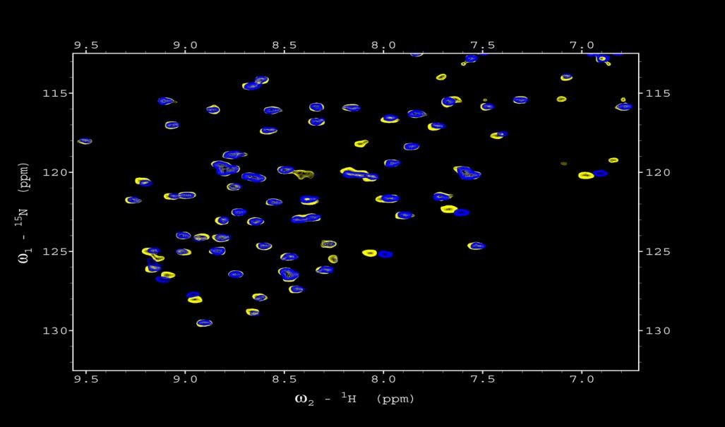
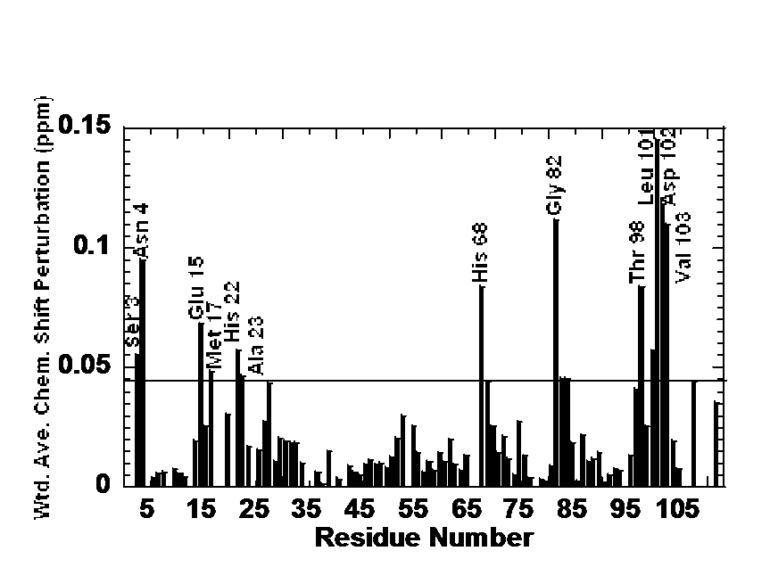
Suramin binding sites on the D2 domain
K16 _{M17}
H100 ^{N28 T98}
V103
E15
_{Y99} H68
R20
H22 D102
L101
A23
K16
M17
Residues that bind to suramin are those
that are located at the FGF-receptor interface
H100
N28
T98
V103
E15
Y99 H22
H68 R20
D102
L101
A23
Kathir & Kumar, unpublished results

Slide 52
Conclusions on FGF-suramin interaction
➢Suramin binds to both FGF and the D2 domain of the receptor
➢Suramin induces oligomerization (tetramer) of FGF.
➢Suramin binds at the FGF-D2 binding interface.
➢Suramin inhibits the mitogenic activity of FGF by inducing oligomerization of FGF and also by blocking FGF-receptor interaction

Slide 53



Acknowledgements
Present members of the Kumar group Post-doctoral Associates
Srinivas Jayanthi Lab Technician Mercede Furr
Graduate Students
Jacqueline Morris Beatrice Kachel Musaab Al-Ameer
Rory Henderson Mercede Furr Gage Coltrain
Undergraduate Students
Emily Crossfield, Jake Usery, Alex Jones, Arshan Dehbozorgi, Ashley Miller, Julie Tran, Daniel Bingham, Rachael Pellegrino, Karina Sanders, Austin Cole, Sushanth Kumar, Kathryn Ramey, Chase Wingfield, Taylor Greghmani, Shelby Nolte, Dilawer Singh, Ross Burnett
Collaborators
Late Tom Maciag & Igor Prudovsky
Maine Medical Center, ME
Funding
Arkansas Bioscience Institute
SURF-SILO grant
Honors College, UARK HHMI - studio

Slide 54





Journal of Analytical & Bioanalytical Techniques Related Journals
Journal of Chromatography &
Seperation Techniques
Journal of Bioanalysis & Biomedicine

Slide 55





Journal of Analytical & Bioanalytical Techniques
Related Conferences
International Conference and Exhibition on Analytical &
Bioanalytical Techniques
International Summit on Current Trends in Mass Spectrometry

Slide 56
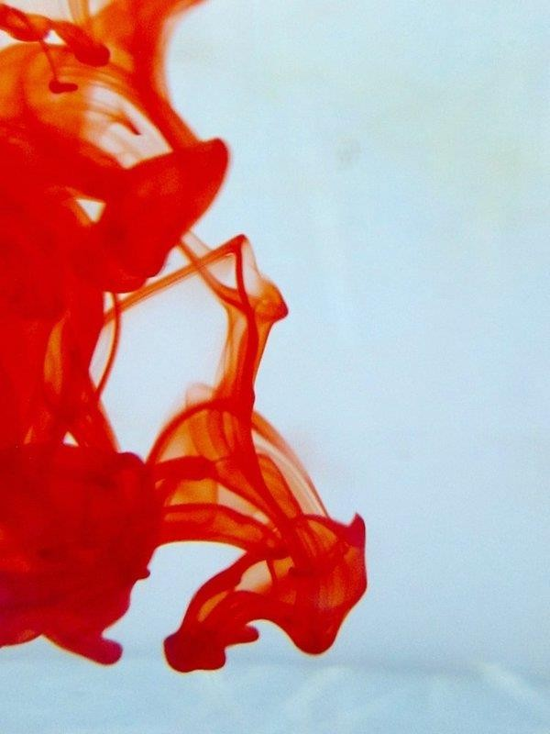


OMICS International Open Access Membership
OMICS International’s Open Access Membership enables academic and research institutions, funders and corporations to actively encourage open access in scholarly communication and the dissemination of research published by their authors.
For more details and benefits, click on the link below: http://omicsonline.org/membership.php

